Slide 1
Anyframe Log Analyzer
ID
Password
Copyright ⓒ Anyframe Log Analyzer All rights reserved.

Slide 2
Log Analyzer
Alex, logout
Log Analysis
Log Application Management
Account Management
Log Analysis
v
Advanced Options
v
Matched Log Only
App. Name
/anyframe-log-analyzer
Appender
mongodb
Client IP
User ID
Duration
09
:
40
~
10
:
40
Log Level
DEBUG
●
This Level Only
Including Sub Level
Including High Level
Program Info.
Class Name
Method Name
Message Text
(“blank” to be more complex search)
Clear
Export
Search
[DEBUG] [2011-11-18 17:26:25, 080] [127.0.0.1] [88888] [LoggingAspect. beforeLogging()] [line 73] [http-8080-1] before executing update(Movie arg1) method
-------------------------------------------------------------------------------
.arg1 : [actors=Johnny Depp, director=Tim Burton, movieId=MV-00001, nowPlaying=Y,
posterFile=, releaseDate=Fri Mar 04 00:00:00 KST 2011, runtime=110, ticketPrice=8000.0,
title=Alice in Wonderland, genreId=GR-02]
-------------------------------------------------------------------------------
[DEBUG] [2011-11-18 17:26:26, 518] [127.0.0.1] [88888] [LoggingAspect. beforeLogging()] [line 73] [http-8080-1] before executing getList() method
-------------------------------------------------------------------------------
No arguments
------------------------------------------------------------------------------
[DEBUG] [2011-11-18 17:26:26, 526] [127.0.0.1] [88888] [LoggingAspect. beforeLogging()] [line 73] [http-8080-1] before executing get(String arg1) method
-------------------------------------------------------------------------------
.arg1 : MV-00003
-------------------------------------------------------------------------------
[DEBUG] [2011-11-22 13:44:32, 166] [127.0.0.1] [Test] [org.anyframe.loganalyzer.web.SampleMongoLoggingController. log()] [line 45] [http-8080-2] sdjfdsksld
[DEBUG] [2011-11-22 13:44:43, 346] [127.0.0.1] [Test] [org.anyframe.loganalyzer.web.SampleMongoLoggingController. log()] [line 45] [http-8080-2] 하하하하
Copyright ⓒ Anyframe Log Analyzer All rights reserved.

Slide 3
Log Analyzer
Alex, logout
Log Analysis
Log Application Management
Account Management
Log Analysis
v
Advanced Options
v
Matched Log Only
App. Name
/anyframe-log-analyzer
Appender
mongodb
Client IP
User ID
Duration
09
:
40
~
10
:
40
Log Level
DEBUG
●
This Level Only
Including Sub Level
Including High Level
Program Info.
Class Name
Export Form Select
Method Name
Message Text
(“blank” to be more complex search)
Clear
Export
Excel(*.xls)
Text(*.txt)
Search
[DEBUG] [2011-11-18 17:26:25, 080] [127.0.0.1] [88888] [LoggingAspect. beforeLogging()] [line 73] [http-8080-1] before executing update(Movie arg1) method
-------------------------------------------------------------------------------
.arg1 : [actors=Johnny Depp, director=Tim Burton, movieId=MV-00001, nowPlaying=Y,
posterFile=, releaseDate=Fri Mar 04 00:00:00 KST 2011, runtime=110, ticketPrice=8000.0,
title=Alice in Wonderland, genreId=GR-02]
-------------------------------------------------------------------------------
[DEBUG] [2011-11-18 17:26:26, 518] [127.0.0.1] [88888] [LoggingAspect. beforeLogging()] [line 73] [http-8080-1] before executing getList() method
-------------------------------------------------------------------------------
No arguments
------------------------------------------------------------------------------
[DEBUG] [2011-11-18 17:26:26, 526] [127.0.0.1] [88888] [LoggingAspect. beforeLogging()] [line 73] [http-8080-1] before executing get(String arg1) method
-------------------------------------------------------------------------------
.arg1 : MV-00003
-------------------------------------------------------------------------------
[DEBUG] [2011-11-22 13:44:32, 166] [127.0.0.1] [Test] [org.anyframe.loganalyzer.web.SampleMongoLoggingController. log()] [line 45] [http-8080-2] sdjfdsksld
[DEBUG] [2011-11-22 13:44:43, 346] [127.0.0.1] [Test] [org.anyframe.loganalyzer.web.SampleMongoLoggingController. log()] [line 45] [http-8080-2] 하하하하
Copyright ⓒ Anyframe Log Analyzer All rights reserved.

Slide 4
[112 rows]
[DEBUG][2011-11-17 15:21:02, 421][127.0.0.1][admin][LoggingAspect.beforeLogging()][line 73][http-8080-6]before executing getPagingList(Movie arg1, Integer arg2) method
-------------------------------------------------------------------------------
.arg1 : [actors=null, director=null, movieId=null, nowPlaying=Y,
posterFile=null, releaseDate=null, runtime=null, ticketPrice=null,
title=, genreId=]
.arg2 : 1
-------------------------------------------------------------------------------
[DEBUG][2011-11-17 15:21:15, 394][127.0.0.1][admin][LoggingAspect.beforeLogging()][line 73][http-8080-6]before executing getList() method
-------------------------------------------------------------------------------
No arguments
-------------------------------------------------------------------------------
[DEBUG][2011-11-17 15:21:15, 419][127.0.0.1][admin][LoggingAspect.beforeLogging()][line 73][http-8080-6]before executing get(String arg1) method
-------------------------------------------------------------------------------
.arg1 : MV-00001
-------------------------------------------------------------------------------
[DEBUG][2011-11-17 15:30:01, 250][127.0.0.1][tttttt][LoggingAspect.beforeLogging()][line 73][http-8080-6]before executing getPagingList(Movie arg1, Integer arg2) method
-------------------------------------------------------------------------------
.arg1 : [actors=null, director=null, movieId=null, nowPlaying=Y,
posterFile=null, releaseDate=null, runtime=null, ticketPrice=null,
title=, genreId=]
.arg2 : 1
-------------------------------------------------------------------------------
[DEBUG][2011-11-17 15:30:02, 228][127.0.0.1][tttttt][LoggingAspect.beforeLogging()][line 73][http-8080-6]before executing getList() method
-------------------------------------------------------------------------------
No arguments
-------------------------------------------------------------------------------
[DEBUG][2011-11-17 15:30:02, 235][127.0.0.1][tttttt][LoggingAspect.beforeLogging()][line 73][http-8080-6]before executing get(String arg1) method
-------------------------------------------------------------------------------
.arg1 : MV-00001
-------------------------------------------------------------------------------
[ERROR][2011-11-21 15:20:44, 656][127.0.0.1][Test][SampleMongoLoggingController.log()][line 51][http-8080-7]sdfds3.
sdf
dsfsd
sd
dfsd
f
ds
fsd
[WARN][2011-11-21 15:20:57, 586][127.0.0.1][Test][SampleMongoLoggingController.log()][line 49][http-8080-7]하
하핳
하한아ㅏㄴㅇ
하하
[INFO][2011-11-21 15:21:04, 860][127.0.0.1][Test][SampleMongoLoggingController.log()][line 47][http-8080-7]ㄴㄹㄴㅇㄹㄴㅇㄹㄴ
ㄴㅇㄹ
ㅇㄴㄹ
ㄴㅇ
ㄹㄴㅇ
ㄹㄴㅇㄹㄴㅇ
[DEBUG][2011-11-22 11:29:17, 365][127.0.0.1][Test][org.anyframe.loganalyzer.web.SampleMongoLoggingController.log()][line 45][http-8080-7]fdfsfdsfdsfsdf
[DEBUG][2011-11-22 13:44:32, 166][127.0.0.1][Test][org.anyframe.loganalyzer.web.SampleMongoLoggingController.log()][line 45][http-8080-2]sdjfdsksld
[DEBUG][2011-11-22 13:44:43, 346][127.0.0.1][Test][org.anyframe.loganalyzer.web.SampleMongoLoggingController.log()][line 45][http-8080-2]하하하하

Slide 5
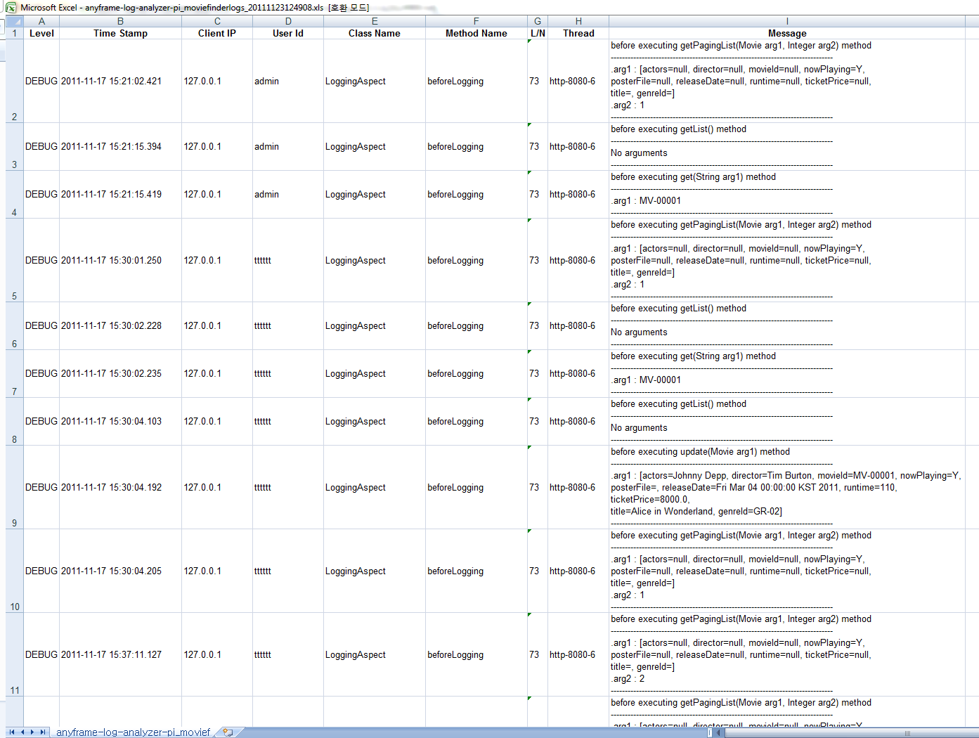

Slide 6
Log Analyzer
Alex, logout
Log Analysis
Log Application Management
Account Management
Log Application Management
App Name | log4j.xml | Status
/anyframe-log-analyzer | D:/Temp/log4j.xml | ACTIVE
/anyframe-log-analyzer1 | D:/Temp2/log4j.xml | INACTIVE
/anyframe-log-analyzer2 | D:/Temp3/log4j.xml | FAILED
/anyframe-log-analyzer3 | D:/Temp4/log4j.xml | ACTIVE
/anyframe-log-analyzer4 | D:/Temp5/log4j.xml | ACTIVE
Inactive
Delete
Inactive
Delete
Inactive
Delete
Inactive
Delete
Inactive
Delete
Copyright ⓒ Anyframe Log Analyzer All rights reserved.

Slide 7
Log Analyzer
Alex, logout
Log Application Edit Form
Log Analysis
Log Application Management
Account Management
Log Application Management
App Name | log4j.xml | Status
/anyframe-log-analyzer | D:/Temp/log4j.xml | ACTIVE
/anyframe-log-analyzer1 | D:/Temp2/log4j.xml | INACTIVE
/anyframe-log-analyzer2 | D:/Temp3/log4j.xml | FAILED
/anyframe-log-analyzer3 | D:/Temp4/log4j.xml | ACTIVE
/anyframe-log-analyzer4 | D:/Temp5/log4j.xml | ACTIVE
App. Name
log4j.xml path
Load
Inactive
Delete
Logger Management
Inactive
Delete
root
ERROR
Inactive
Delete
jdbc.sqlonly
INFO
Inactive
Delete
jdbc
DEBUG
Inactive
Delete
org.anyframe.loganalyzer
WARN
org.anyframe.cxf
DEBUG
Appender Management
mongodb
Admin Only
mongodb2
Developer Visible
Save
Copyright ⓒ Anyframe Log Analyzer All rights reserved.

Slide 8
Log Analyzer
Alex, logout
Log Analysis
Log Application Management
Account Management
Account Management
Copyright ⓒ Anyframe Log Analyzer All rights reserved.

Slide 9
Log Analyzer
Alex, logout
Log Analysis
Log Application Management
Account Management
Account Management
Copyright ⓒ Anyframe Log Analyzer All rights reserved.

