Slide 1
Determining the Camera Response Function Short Presentation
2010-05-12
Dominik Neumann
Chair of Pattern Recognition (Computer Science 5)
Friedrich-Alexander-University Erlangen-Nuremberg

Slide 2
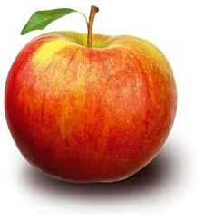

The Camera Response
Sensor
- White Balancing
- Gamma Correction
- "Beautification"
➔ Camera
Response
Function
Camera
Processor
Scene
Radiance
Image
Irradiance
(RAW image)
Image
Intensity
(pixel values)
Notes:
In practice: mapping of irradiance to intensity (CRF) is a collective effect of various camera internal operations and noise.

Slide 3
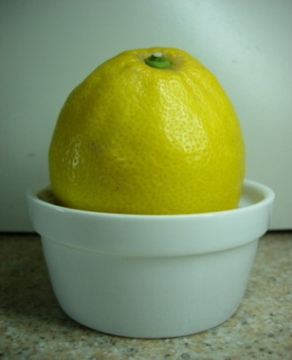
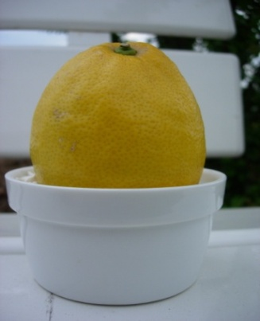
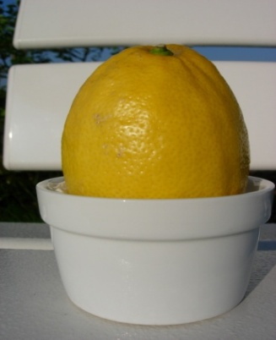
Motivation
Various Computer Vision Algorithms require Image Irradiance
Color Constancy
Shape from Shading
Inverse Rendering
Creating accurate
HDR-Images
But: Output of a usual camera is not linear
My task: Examination of methods for CRF Estimation
“Using Geometry Invariants for Camera Response Function Estimation” (Ng et al.)
“Radiometric Calibration from a Single Image” (Lin et al.)
Color Constancy: Images by Eva Eibenberger
Notes:
When running algorithms on arbitrary|natural|real-world images (flickr, …) …
Accept additional error OR find methods for estimating CRF so that you can „remove“ the changes of the CR

Slide 4
Camera Response Functions
Kodak Ektachrome-100plus Green
1
Kodak Ektachrome-64 Green
0.9
Agfachrome CTPrecisa100 Green
Agfachrome RSX2 050 Blue
0.8
Agfacolor Futura 100 Green
0.7
Agfacolor HDC 100 plus Green
0.6
Agfacolor Ultra 050 plus Green
Intensity
Agfapan APX 025
0.5
Agfa Scala 200x
0.4
Fuji F400 Green
0.3
Fuji F125 Green
0.2
Kodak Max Zoom 800 Green
0.1
Kodak KAI0372 CCD
0
0.1
0.2
0.3
0.4
0.5
0.6
0.7
0.8
0.9
1
0
Irradiance
Sample CRFs from DoRF (Database of Response Functions)
(compiled by Grossberg and Nayar)
Notes:
CRF are usually non-linear, monotonically increasing

Slide 5
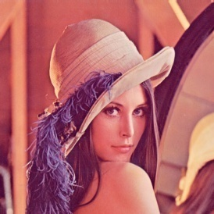
CRF Estimation: Geometry Invariants
Physics-based approch
→ Separation of camera nonlinearities from reflectance-induced nonlinearities
Strategy
Find set of "Locally Planar Irradiance Points" (LPIP)
→ no more reflectance-induced nonlinearities
Estimate CRF from this data
Main Steps of the Algorithm:
Compute Image
Derivatives
CRF
Detect
LPIPs
Estimate
CRF
Notes:
The idea is based on the observation that image gradient contains information about the camera response function. Geometry invariants are independent on the geometry of the locally planar regions in image irradiance. These planar regions in image irradiance is detected using the constraint equation.

Slide 6
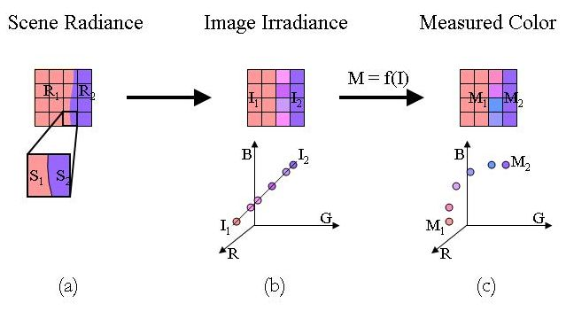
CRF Estimation: Radiometric Calibration
Image © Lin et al.
➔ Method is edge-based and chooses the best fitting one of the previously learned CRFs from DoRF

Slide 7


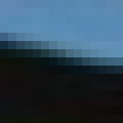

CRF Estimation
What have I done so far?
Radiometric Calibration almost done
Next steps
Completing the code on "Radiometric Calibration"
Start implementing the "Geometry Invariants" paper
Evaluation
sample patches detected by the algorithm (Radiometric Calibration)

Slide 8
Evaluation Methods
Synthetically generated Images
Take direct output of camera sensor (supposed to be linear)
Manually apply a particular CRF and check if this CRF is found afterwards
Ground Truth Evaluation
Use a camera with a well known CRF (extract from DoRF)
Check how far our computed CRFs are from the ground truth
Stability Test
Obtain series of images taken by the same camera (with fixed camera settings)
Analyze how much the individual results vary

Slide 9
Determining the Camera Response Function
Thank you
for your attention!

