Slide 1
Determining the Camera Response Function Final Presentation
2010-07-21
Dominik Neumann
Chair of Pattern Recognition (Computer Science 5)
Friedrich-Alexander-University Erlangen-Nuremberg

Slide 2
Overview
Introduction
The Camera Response
Motivation
Description of the methods
“Radiometric Calibration from a Single Image”
“Using Geometry Invariants for Camera Response Function Estimation”
Challenges
Evaluation
Outlook

Slide 3
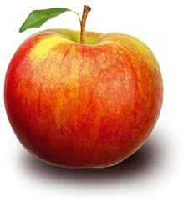

The Camera Response
Sensor
- White Balancing
- Gamma Correction
- "Beautification"
➔ Camera
Response
Function
Camera
Processor
Scene
Radiance
Image
Irradiance
(RAW image)
Image
Intensity
Notes:
In practice: mapping of irradiance to intensity (CRF) is a collective effect of various camera internal operations and noise.

Slide 4
Camera Response Functions
1
0.9
0.8
0.7
0.6
Intensity
0.5
0.4
0.3
0.2
0.1
0
0.1
0.2
0.3
0.4
0.5
0.6
0.7
0.8
0.9
1
0
Irradiance
Sample CRFs from DoRF (Database of Response Functions)
(compiled by Grossberg and Nayar)
Notes:
CRF are usually non-linear, monotonically increasing

Slide 5
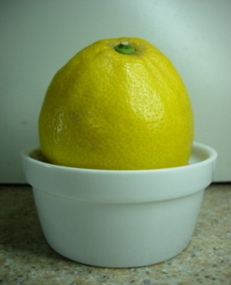
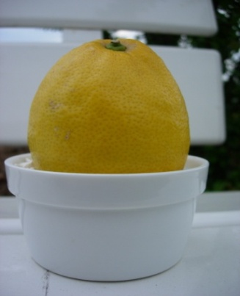
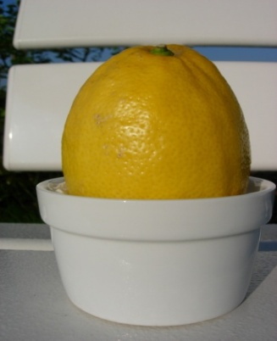
Motivation
Various Computer Vision Algorithms require Image Irradiance
Color Constancy
Shape from Shading
Inverse Rendering
Creating accurate
HDR-Images
But: Output of a usual camera is non-linear
My task: Examination of methods for CRF Estimation
GeoInv: “Using Geometry Invariants for Camera Response Function Estimation” (Ng et al.)
RadCal: “Radiometric Calibration from a Single Image” (Lin et al.)
Color Constancy: Images by Eva Eibenberger
Notes:
When running algorithms on arbitrary|natural|real-world images (flickr, …) …
Accept additional error OR find methods for estimating CRF so that you can „remove“ the changes of the CR

Slide 6




CRF Estimation: RadCal
Scene Radiance
Scene Radiance
with CCD grid
Image Irradiance
Image Intensity
gamma = 0.4
Mapping of Irradiance to Intensity is non-linear
Edge color distributions supply information about the desired CRF
Normalized RGB cube

Slide 7
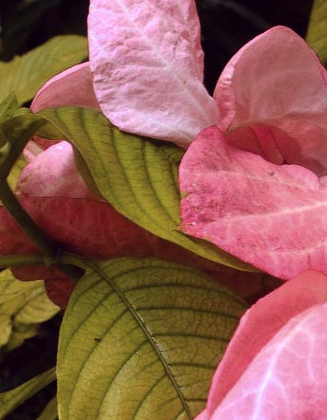
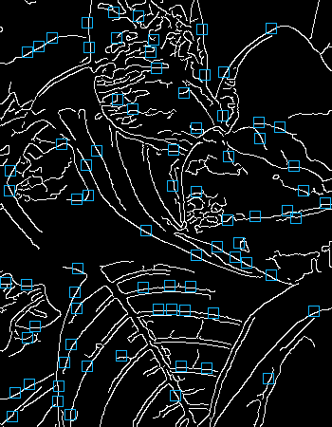

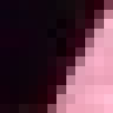


CRF Estimation: RadCal
Original Image
Edge image
with detected patches
Sample patches

Slide 8
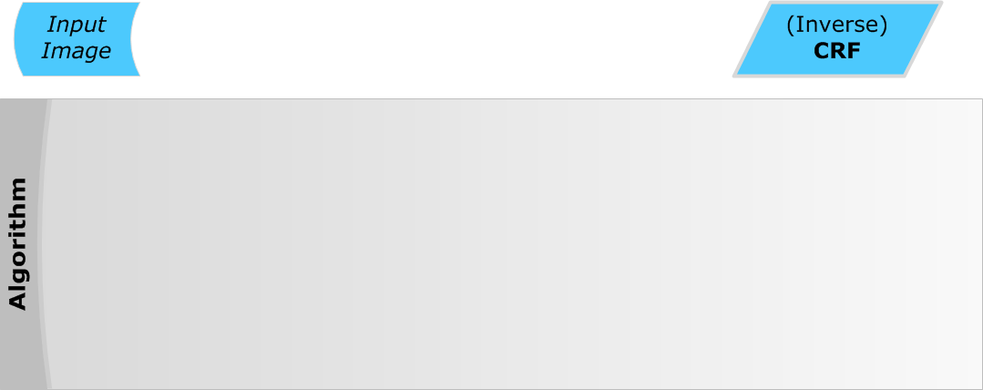
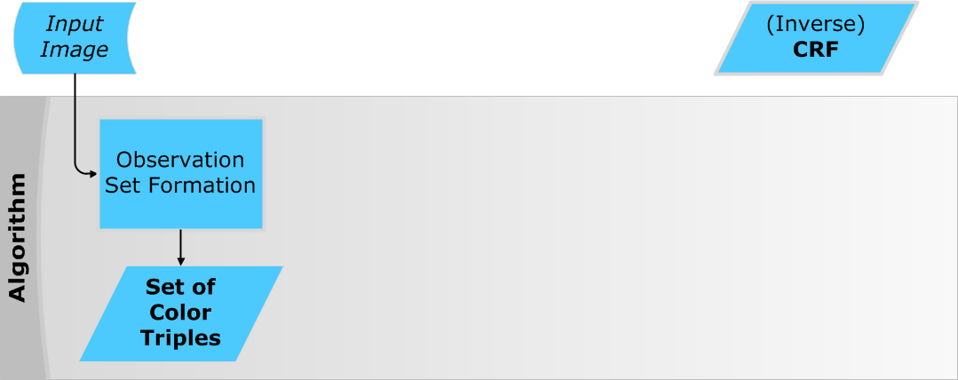
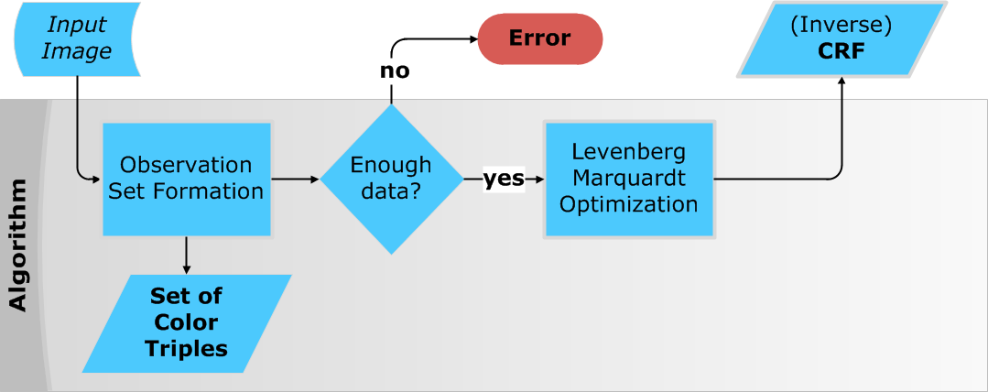
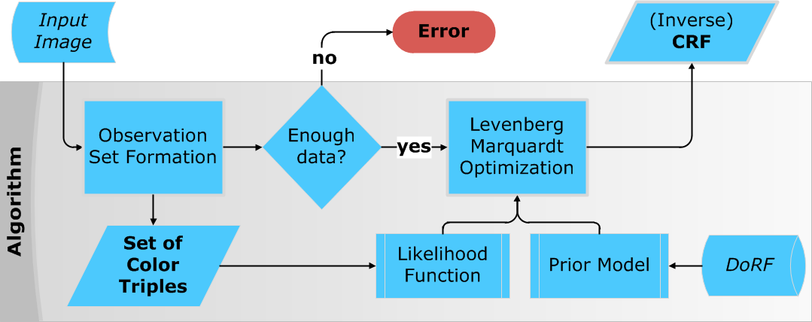
CRF Estimation: RadCal
Likelihood Function: Image specific information
Prior Model: Prior knowledge extracted from DoRF

Slide 9
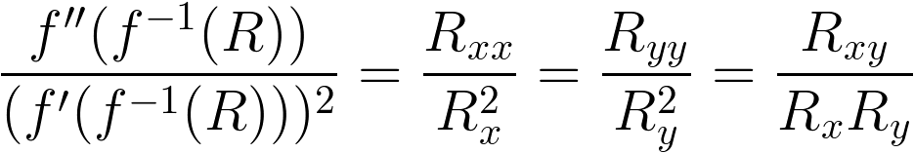




CRF Estimation: GeoInv
Physics-based approch
Separation of camera nonlinearities from reflectance-induced nonlinearities
For Locally Planar Irradiance Points (LPIP) some quotients composed of partial derivatives result in a constant
→ The following Derivative Equality Constraints (DEC) hold
: Camera Response Function
: Image Intensity
: 1st order partial derivative in x-direction
: 2nd order partial derivative in x-direction
...
Notes:
DEC invariant to scene geometry, ONLY CRF-dependence (left)… geometry wegsubstituiert

Slide 10
CRF Estimation: GeoInv
But DEC detects not only the desired LPIPs
Bayesian Inference
Using 6 different features
Training with a set of real or synthetic images with well-known CRF
Space of all image points
normalized feature histograms
LPIP
non-LPIP
ratio
Detected points
Desired points (LPIPs)
LPIP
non-LPIP
ratio
feature value

Slide 11
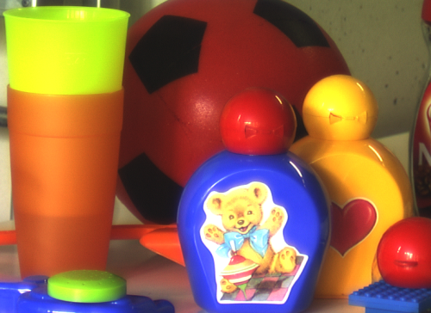
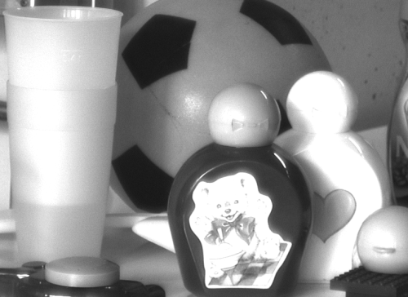
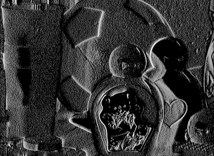
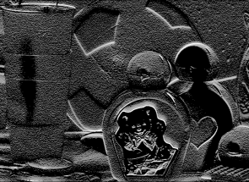
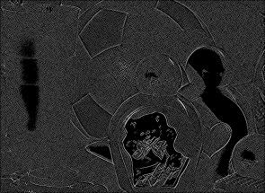
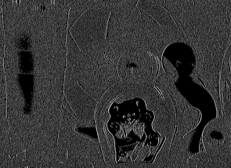
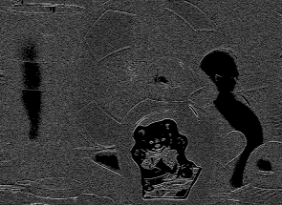
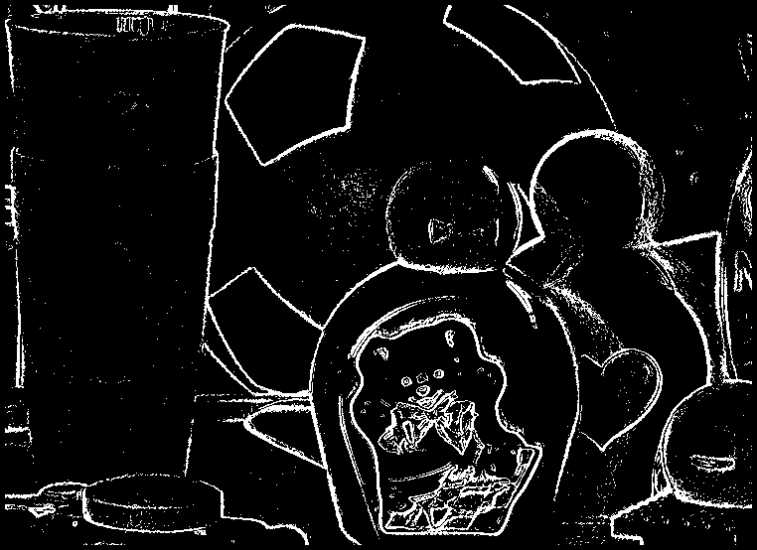
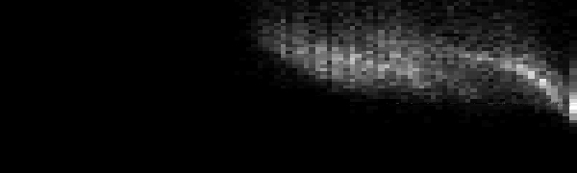
CRF Estimation: GeoInv
Original image
Extracted channel
Partial derivatives
Optimization
Generalized Gamma Curve Model
Considering training → weights
binary map (DEC)
CRF
„value“
2D Histogram
intensity

Slide 12
GeoInv: Challenges
Implementation is currently not working
Some implementation detail missing?
Accuracy for computing the derivatives too low?
Assumption
Classification might not work properly
→ Too much „noisy“ points seen as LPIPs?
But our feature histograms look quite similar to those in the original paper
Notes:
We asked the author for support
→ Only got encrypted code from a subsequent project

Slide 13
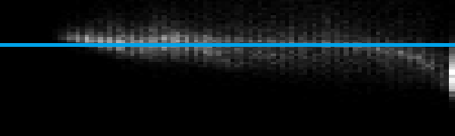
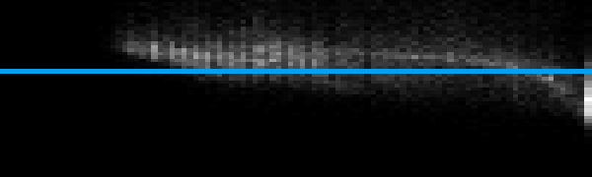



GeoInv: Challenges
gamma = 1.0
gamma = 0.8
gamma = 0.6
gamma = 0.4
Expected vertical shift is missing
gamma = 0.2

Slide 14




Evaluation: RadCal Data Acquisition
Goal: Empirical determination of good settings for Observation Set Formation
Two crucial parameters
: minimum distance between region colors
: maximum color distance within a region
Brute Force method
Several test images
> 30² runs per image
Reasonable parameter space
Color Coverage
Notes:
Color coverage erklären

Slide 15

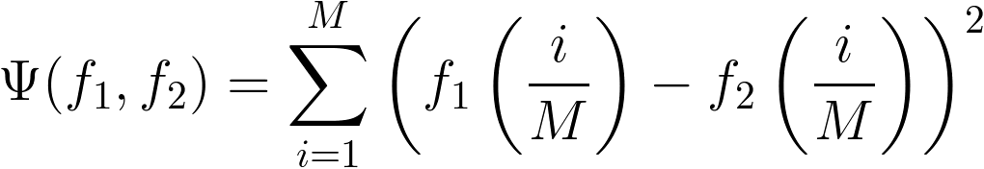





Evaluation: Error Measurement
Quantification of error between two inverse CRFs
Number of samples:
Compared functions:
Annotation
→ Normalization
1
Illustration with
Irradiance
0
0
Intensity
1

Slide 16
Evaluation: Stability Tests
Goal: Assessing the robustness of the method
Compiled sets of images for 8 different cameras
Freely available amateur photographs, e.g. from Picasa / flickr
An average of >50 images per camera
Evaluation method
Determine the mean curve of all estimated curves per image set
Compute for each estimated curve to the mean curve
Minimum & Maximum error
Mean error µ
Standard Deviation σ
… seperately for the 3 channels (RGB) and altogether
Notes:
Amateur photographs -> hight probability not being post processed

Slide 17
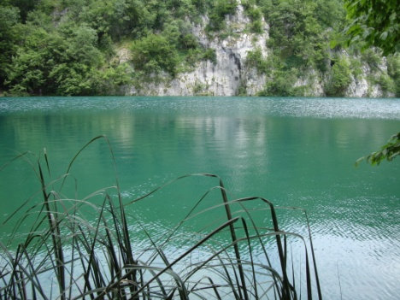
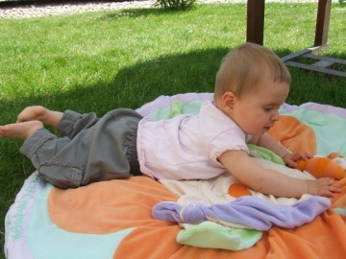
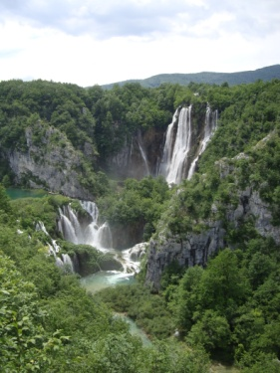
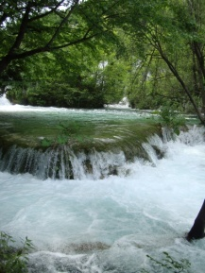
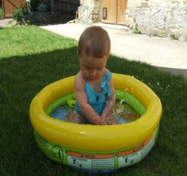
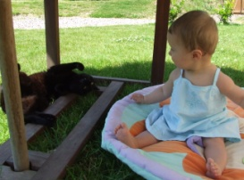
Evaluation: Stability Tests
Camera | Sony DSC-w300 |  |  |  | Fujifilm Finepix s5600
 | R | G | B | ∑ | R | G | B | ∑
min | 0.133 | 0.168 | 0.400 |  | 1.53 | 0.552 | 0.193
max | 7.97 | 12.8 | 13.0 |  | 11.5 | 10.8 | 10.2
µ | 2.39 | 2.78 | 3.86 | 3.01 | 5.01 | 3.67 | 2.61 | 3.76
σ | 1.31 | 1.75 | 2.18 | 1.74 | 2.40 | 1.89 | 2.51 | 2.26
Sony DSC w-300 mean curves
1
Fujifilm s5600 mean curves
1
Irradiance
Irradiance
Intensity
0
Intensity
0
0
1
0
1
Notes:
Images with color coverage < 5% were omitted

Slide 18
Outlook
Further evaluation approaches (RadCal)
Extension of the stability tests by using a higher variety of configurations
Examination of a parameter controlling the balance between prior knowledge and image specific information
Efforts in finding images with known CRFs (→ ground truth)
Conclusion
Determination of CRF is an important but tough task
Highly dependent on acquiring reasonable amounts of data
New camera generations may require new CRF estimation methods
Notes:
Für single image methods noch schlimmer

Slide 19
Determining the Camera Response Function
Thank you
for your attention!

