Slide 1
Attention Mechanisms
Ahn Yongjoo

Slide 2
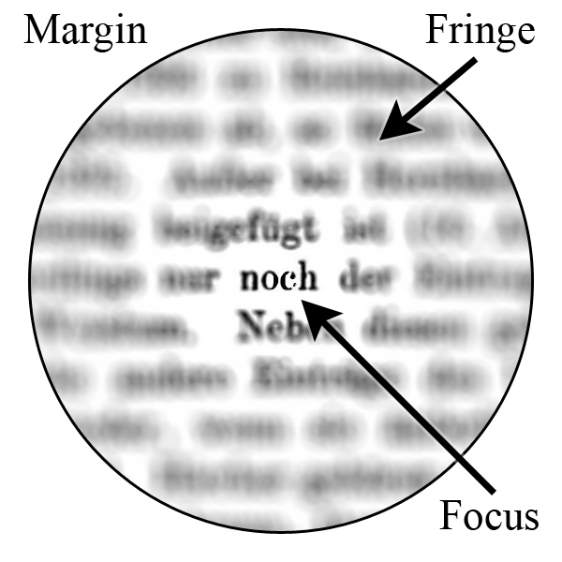
Introduction
Attention mechanisms are (very) loosely based on the visual attention found in humans.
Focus on a certain region with “high resolution” while the surroundings with “low resolution”

Slide 3
Attention in Neural Networks
The idea of adding attention to neural networks has been around for a long time, but has only found widespread use in the last three years.
Systems that input and output have rich structure and the input and output structures are somehow related.
Tasks like: Machine Translation, Image Captioning, Speech Recognition, Neural Turing Machines …

Slide 4
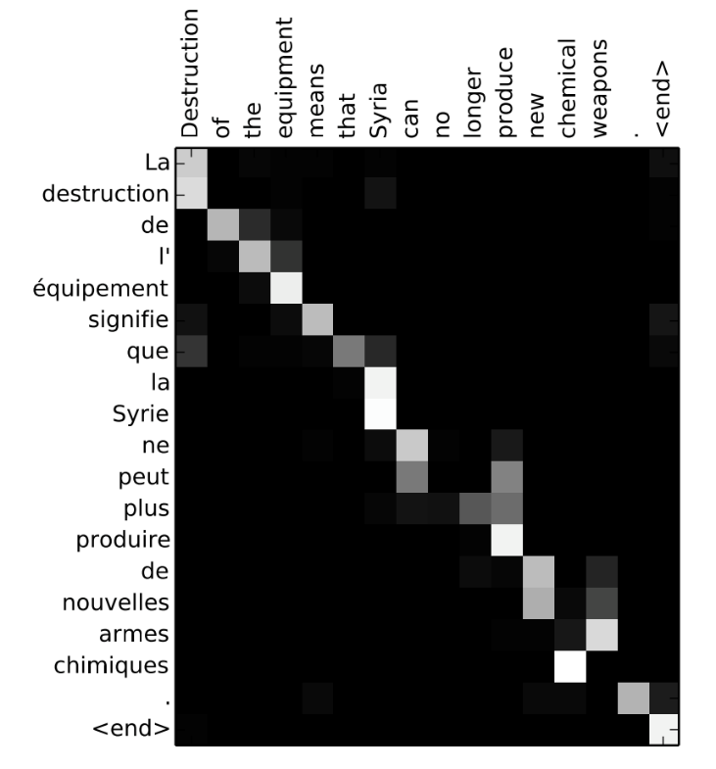
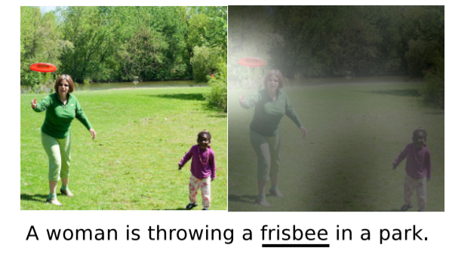
Examples
Translation
Image caption generation

Slide 5
Encoder-Decoder Network
An encoder-decoder framework is a general frame work that aims at handling the mapping between highly structured input and output
The input and output could be text, speech, image and video as well as text in another language.

Slide 6

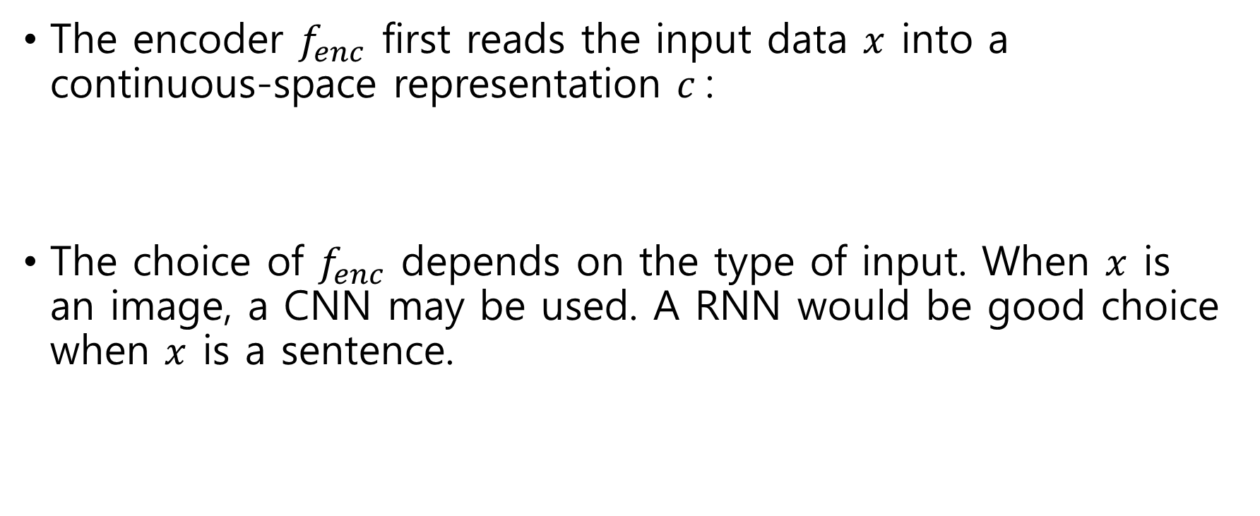
Encoder-Decoder Network (contd.)
The encoder $f_{enc}$ first reads the input data $x$ into a continuous-space representation $c$:
The choice of $f_{enc}$ depends on the type of input. When $x$ is an image, a CNN may be used. A RNN would be good choice when $x$ is a sentence.
${c = f}_{enc}\left(x\right)$,

Slide 7

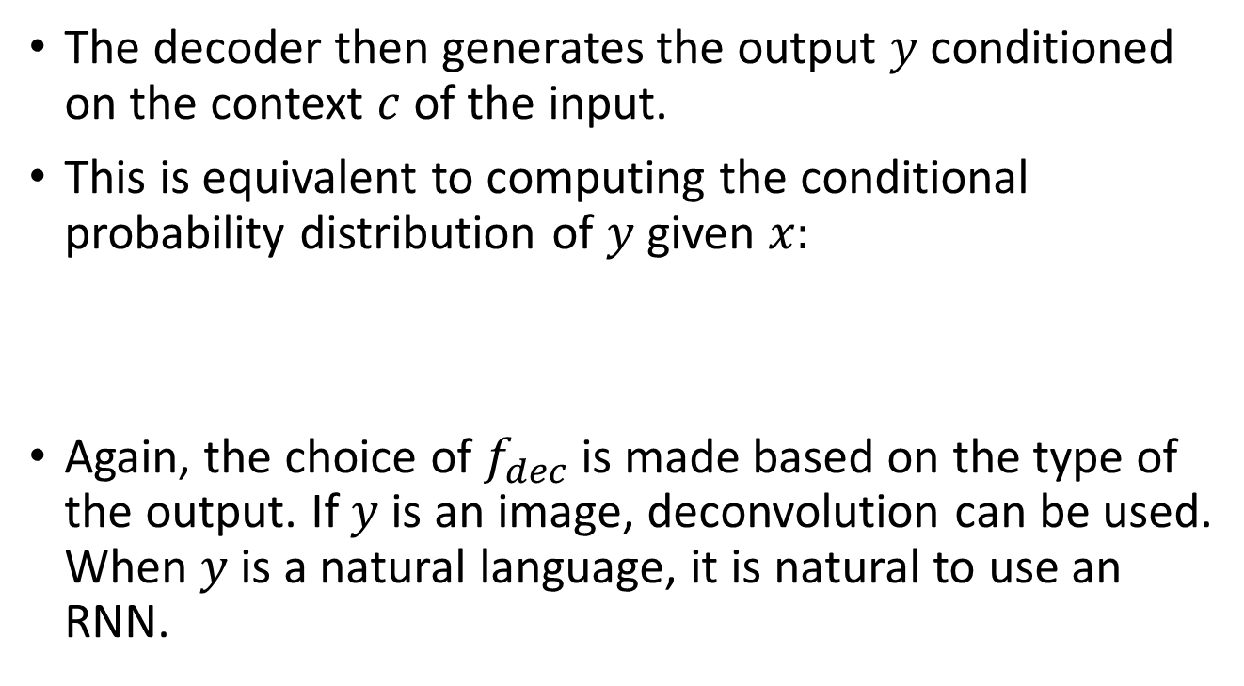
Encoder-Decoder Network (contd.)
The decoder then generates the output $y$ conditioned on the context $c$ of the input.
This is equivalent to computing the conditional probability distribution of $y$ given $x:$
Again, the choice of $f_{dec}$ is made based on the type of the output. If $y$ is an image, deconvolution can be used. When $y$ is a natural language, it is natural to use an RNN.
$p\left(Y | x\right)=f_{dec}(c)$.

Slide 8
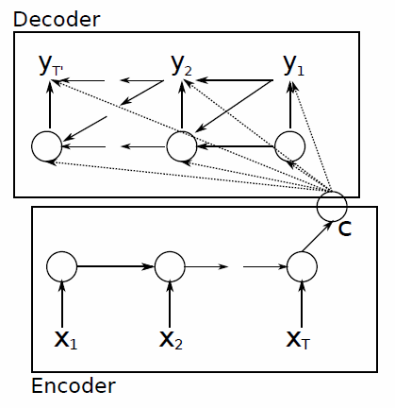
Graphical illustration of simple form encoder-decoder model for machine translation.

Slide 9
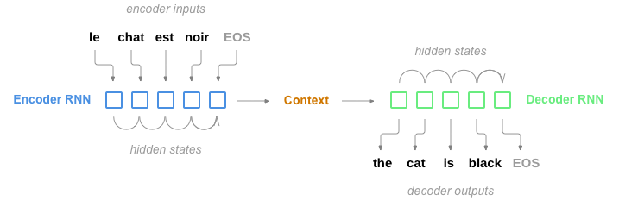
An Example: NMT (Neural Machine Translation)
The Sequence to Sequence model (or seq2seq)
The encoder reads an input sequence one item at a time, and outputs a fixed length vector at each step.
The final output of the encoder is the ‘context vector’ of input.
The decoder uses this context vector to produce a sequence of outputs one step at a time.

Slide 10
Motivation for Attention
The fixed-length context vector carries the burden of encoding the entire “meaning” of the input sequence, no matter how long that will be.
“Long-term (long-range) dependencies” problem.
Researchers tackle with feeding an input sequence twice, or feeding input sequence in reverse …
And the Attention Mechanism

Slide 11
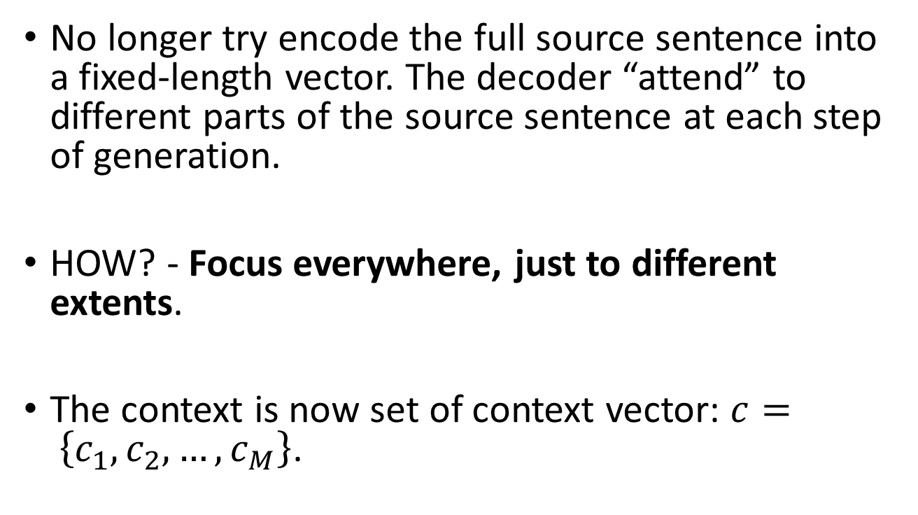
Attention in Neural Networks
No longer try encode the full source sentence into a fixed-length vector. The decoder “attend” to different parts of the source sentence at each step of generation.
HOW? - Focus everywhere, just to different extents.
The context is now set of context vector: $c= \left\{c_{1},c_{2},…,c_{M}\right\}$.

Slide 12
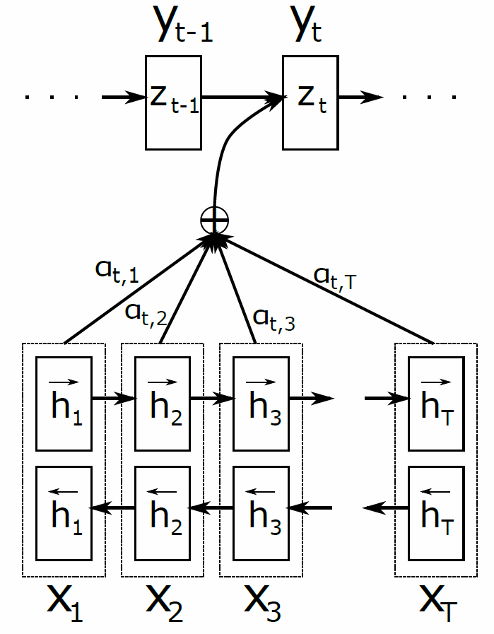
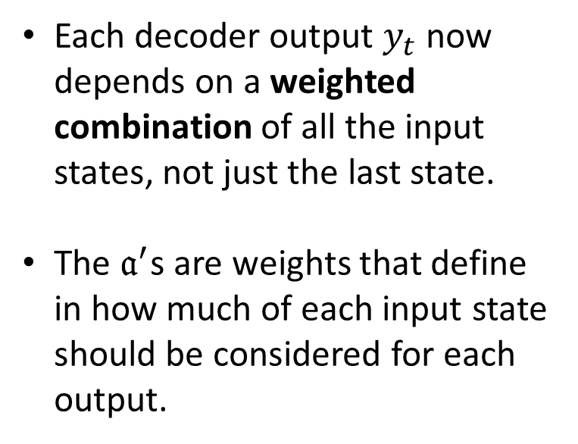
Each decoder output $y_{t}$ now depends on a weighted combination of all the input states, not just the last state.
The $𝔞^{′}$s are weights that define in how much of each input state should be considered for each output.

Slide 13
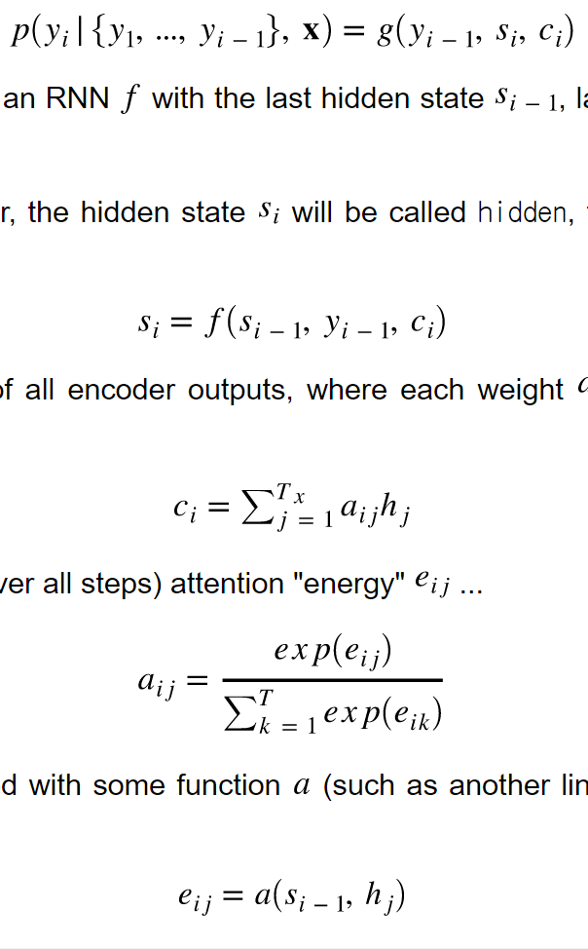
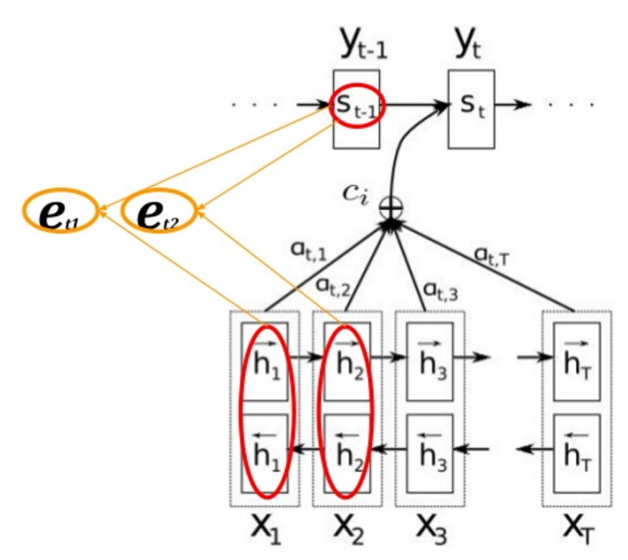
Attention in NMT (1)

Slide 14
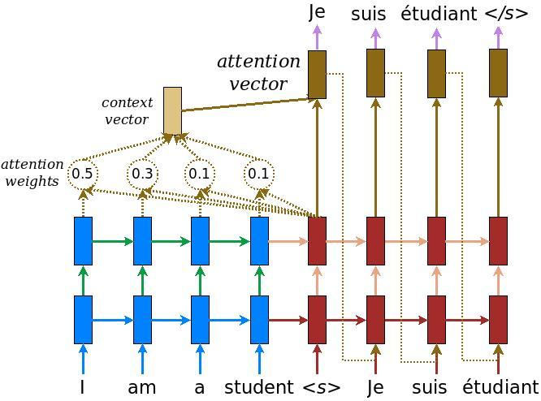
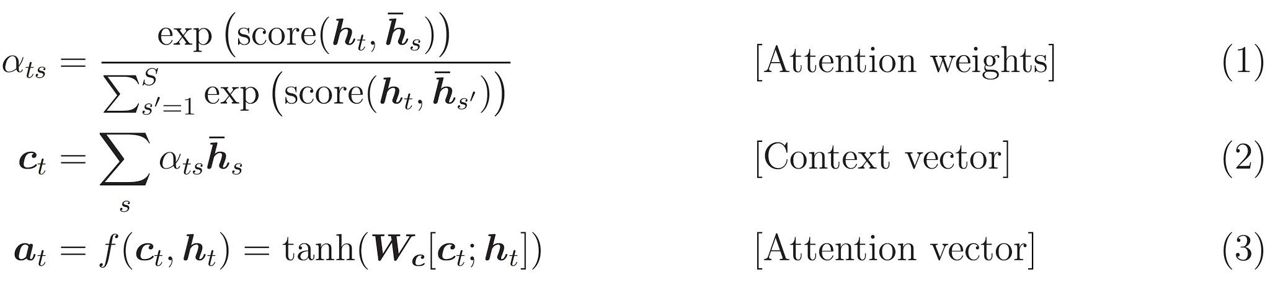
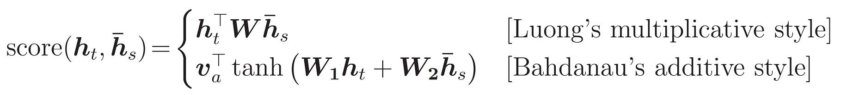
Attention in NMT (2)

Slide 15
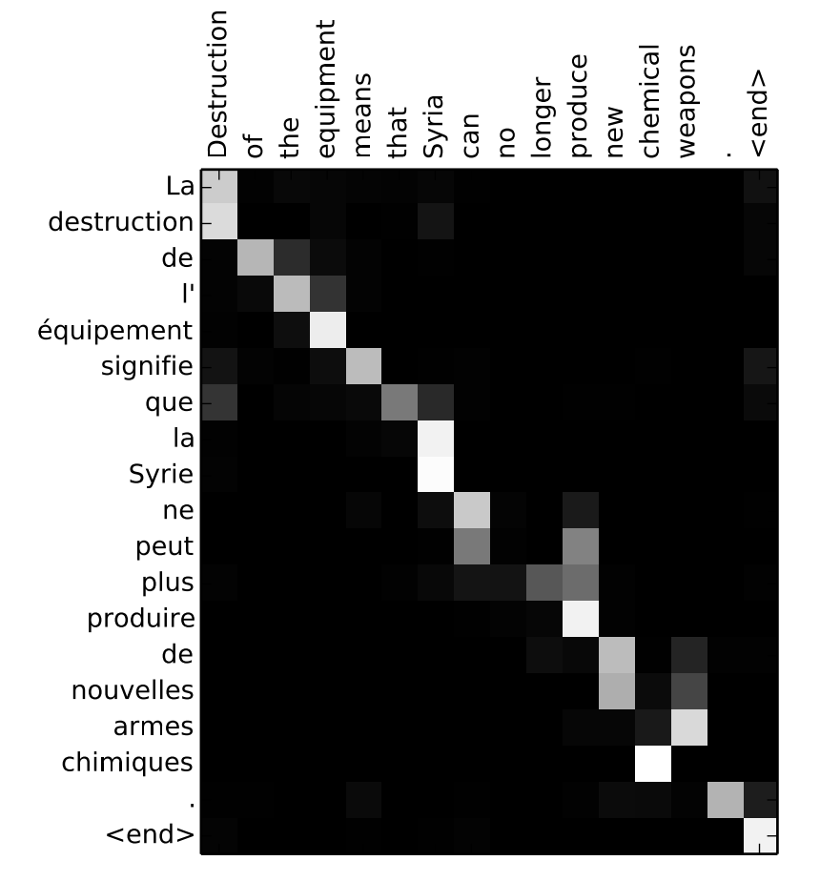

Slide 16
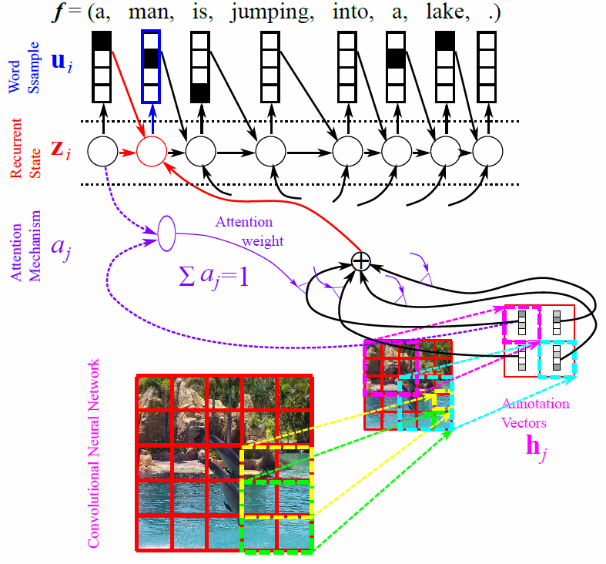

Slide 17
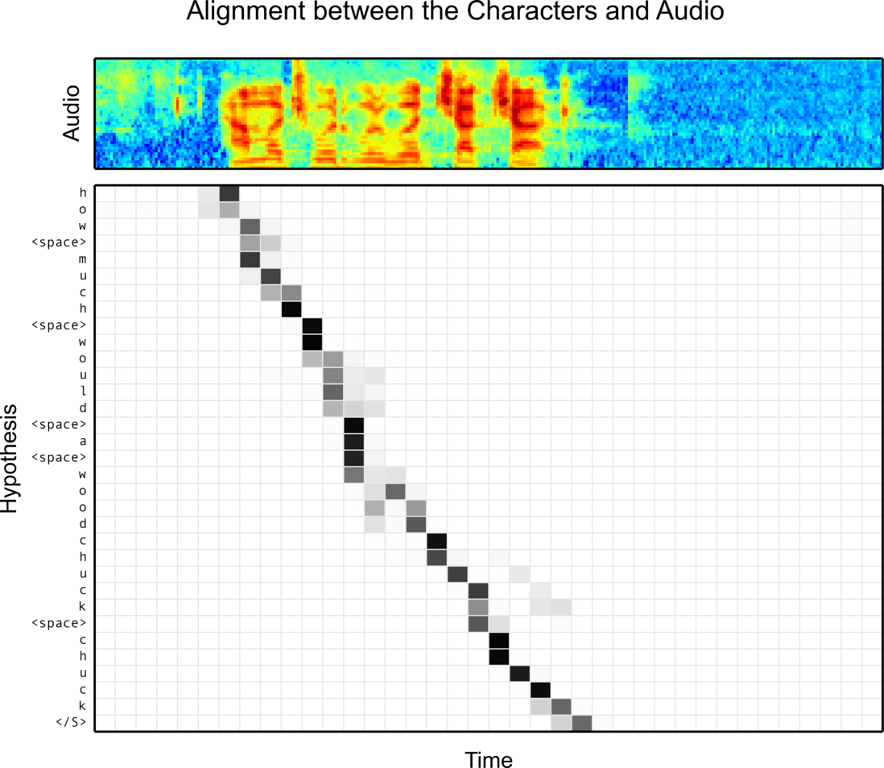

Slide 18
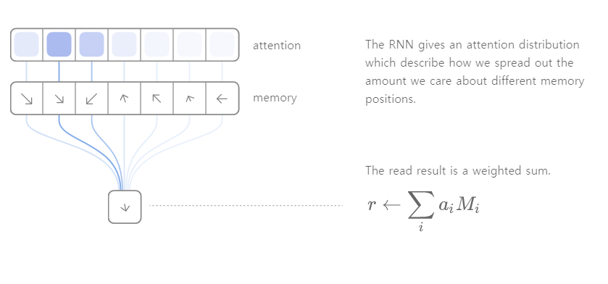

Slide 19
Cost of Attention
Attention comes at a cost. We need to calculate an attention value for each combination of input and output word.
Actually, that’s quite counterintuitive. Human attention is something that’s supposed to save computational resources.

Slide 20
Attention Is All You Need
Google Brain team achieved SOTA on the machine translation, based solely on attention mechanisms without any CNN or RNN.
It use self-attention: an attention mechanism relating different positions of a single sequence in order to compute a representation of the sequence
[A. Vaswani et al. Attention Is All You Need. arXiv preprint arXiv:1706.03762. 2017]

Slide 21
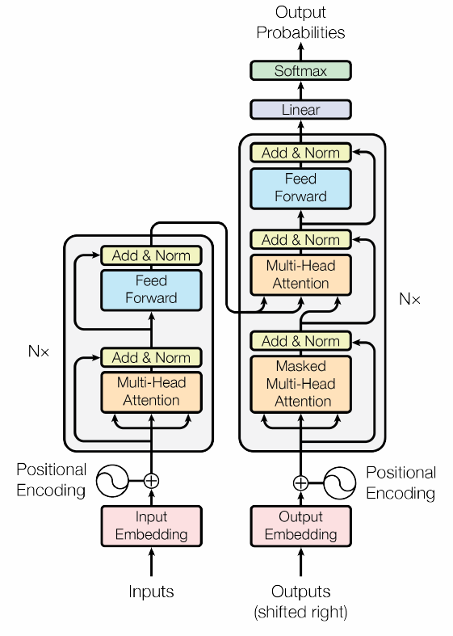
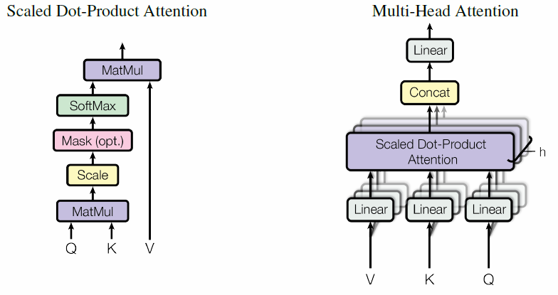

Slide 22
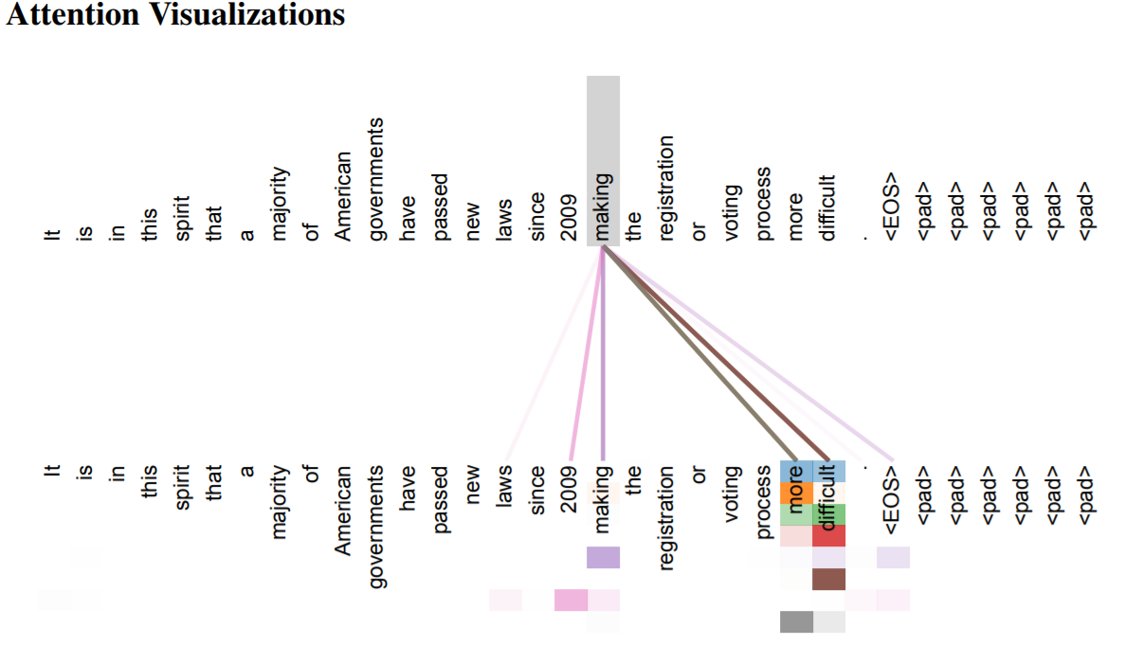

Slide 23
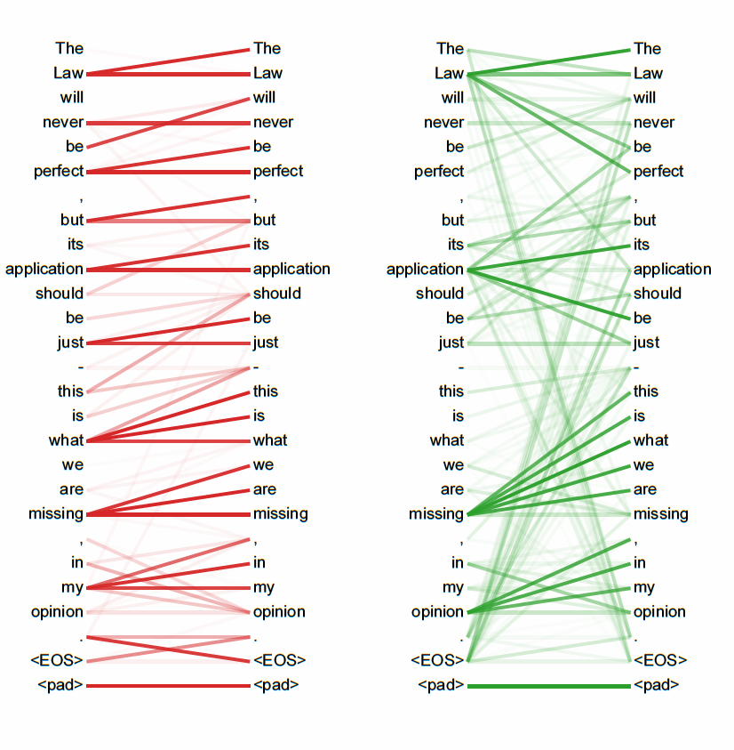

Slide 24
Conclusions
Neural nets always have implicit attention, but they can be greatly improved by adding explicit attention mechanisms.
Differentiable (backpropable) attention has made this easy.

