Slide 1
EDUC 263: Managing and Manipulating Data Using R Lecture 8: Tidy data
NOV 15

Slide 2
1. Overview
Creating analysis datasets often require changing the organizational structure of data
Reshape your data –tidying
Rows ←→ Columns
Untidy → Tidy
Why tidy? 2 main advantages
one consistent way of storing data; underlying uniformity.
R’s vectorised nature; tidyverse (dplyr, ggplot2,etc)

Slide 3
2. Data “structure” vs. data “concepts”
Data “structure” physical layout | Data “concepts” what should be
rows | observations
columns | variables
cell | value
= if tidy (Wickham)

Slide 4
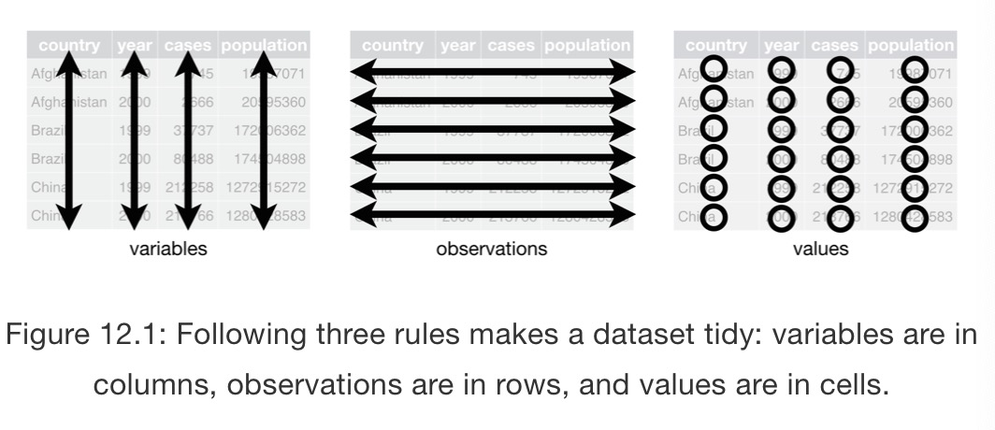
3 Tidy vs. Untidy data
Rules of tidy data
Each variable must have its own column
Each observation must have its own row
Each value must have its own cell

Slide 5
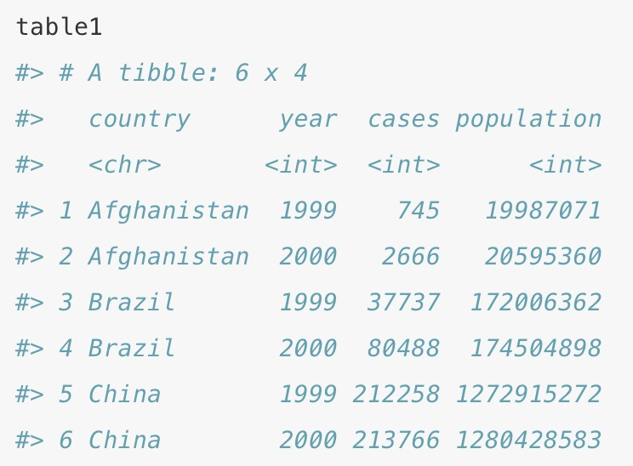
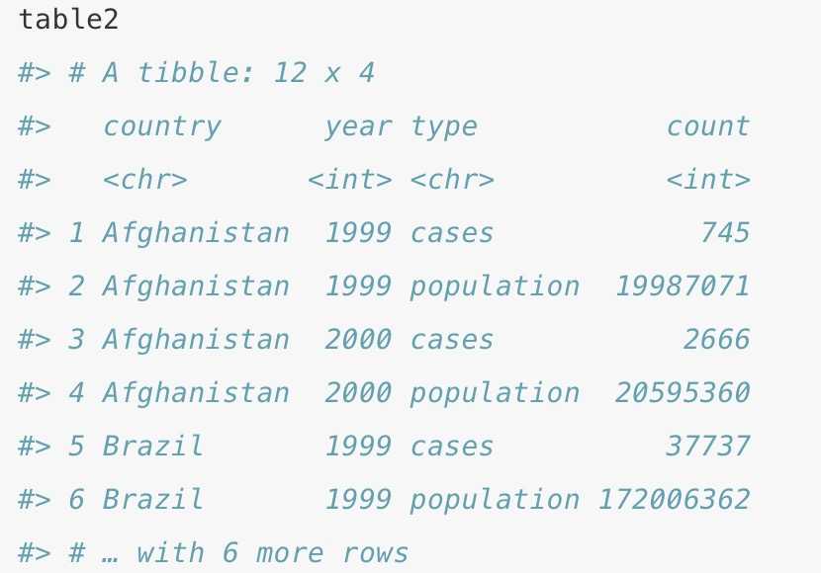
3 Tidy vs. Untidy data Example
table1 is tidy.
It’s the only representation where each column is a variable.
Question:
How to reshape untidy data to tidy data?
More untidy examples:
Digest of Education Statistics https://nces.ed.gov/programs/digest/current_tables.asp

Slide 6
4 Tidying data: Wide ←→ Long
Function {tidyr} | Description | Main Arguments
pivot_longer | wide → long (gathering) # rows ↑; # columns ↓ | Names_to | Values_to
pivot_wider | Long → wide (spreading) # rows ↓; # columns ↑ | Names_from | Values_from
Long
Wide
pivot_longer()
pivot_wider()
table1 %>% pivot_longer(cols = c('cases','population'),
names_to = 'type',
values_to = 'count')
table2 %>% pivot_wider(names_from = type,
values_from = count)

Slide 7
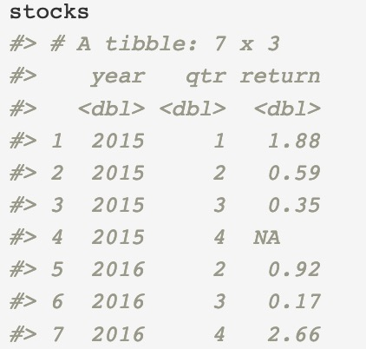
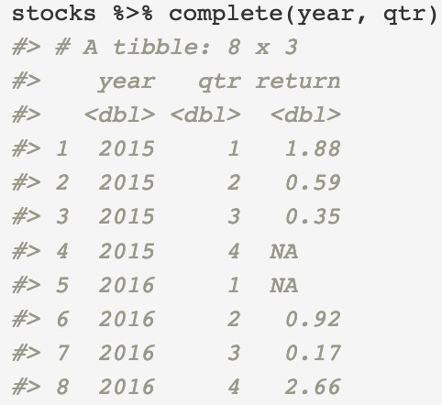
5 Missing values
Two types of missing values:
Explicit missing values: variable has the value NA for a particular row
Implicit missing values: the row is simply not present in the data
Complete() {tidyr}
turns implicit missing values into explicit missing values
1 explicit missing value
1 implicit missing value

