Slide 1
Chapter 1 Fundamental Concepts
§1-1 Introduction
§1-2 Discrete-Time Signals
§1-3 Discrete-time Systems
§1-4 Basic Properties of Discrete-time Systems
Problems

Slide 2
Problems
1.1 Sketch the discrete-time signal x[n] (0≤n≤10) obtained by sampling the continuous-time signal x(t)=e^{–2t} with sampling interval T=0.1.
1.2 Sketch the following discrete-time signals
(a) x[n]= u[n]–2u[n–1]+ u[n–4]
(b) x[n]=(n+2)u[n+2]–2u[n] –nu[n–4]
(c) x[n]=δ[n+1]–δ[n]+u[n+1] – u[n–2]
1.3 Let x[n] be a signal with x[n]=0 for n < – 2 and n > 4. for each signal given below, determine the values of n for which it is guaranteed to be zero.
(a) x[n–3] (b) x[n+4] (c) x[–n] (d) x[–n+2] (e) x[–n–2]
Answer: (a)n<1 and N>7; (b)n<-6 and n>0; (c)n<-4 and n>2; (d)n<-2 and n>4; (e)n<-6 and n>0

Slide 3
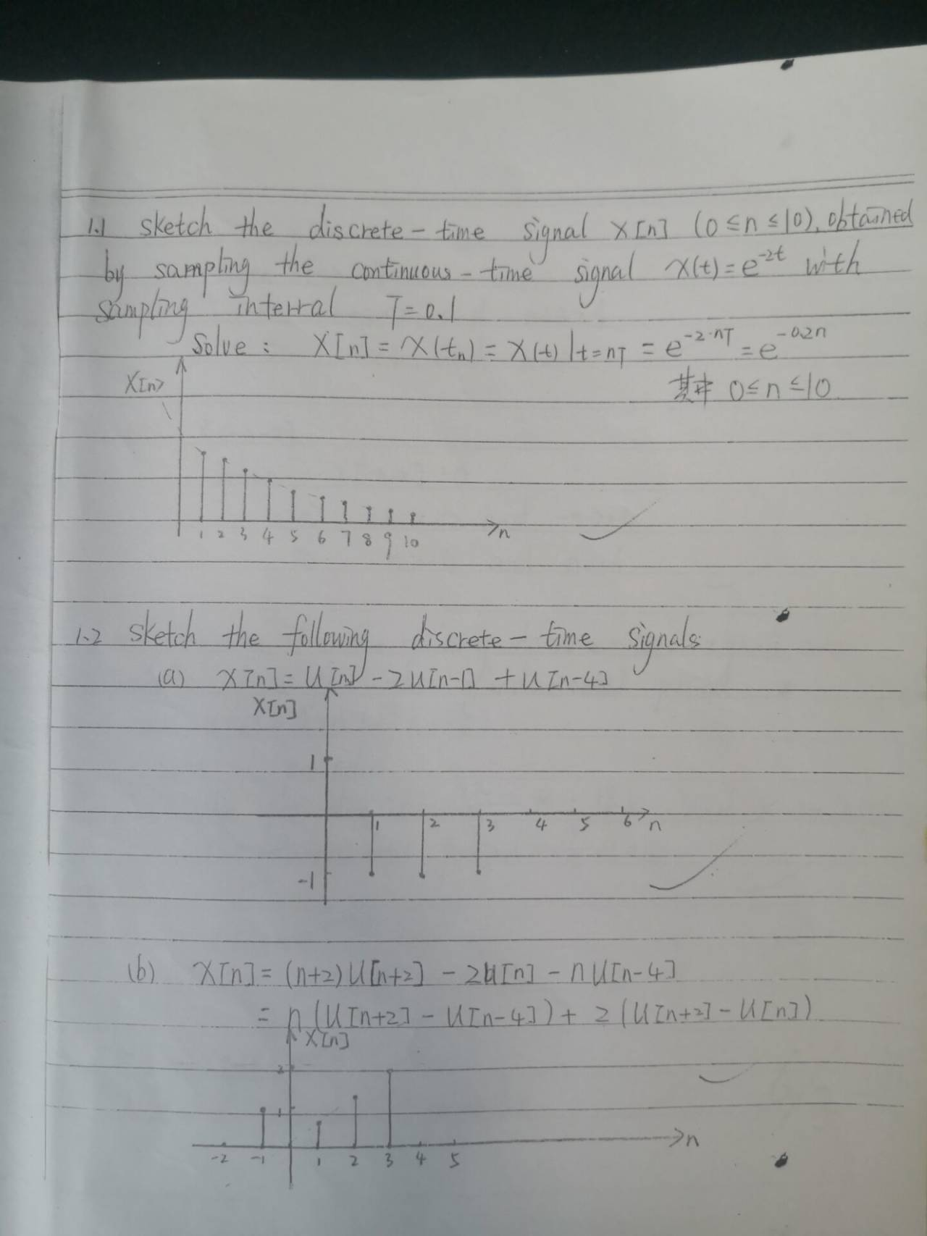
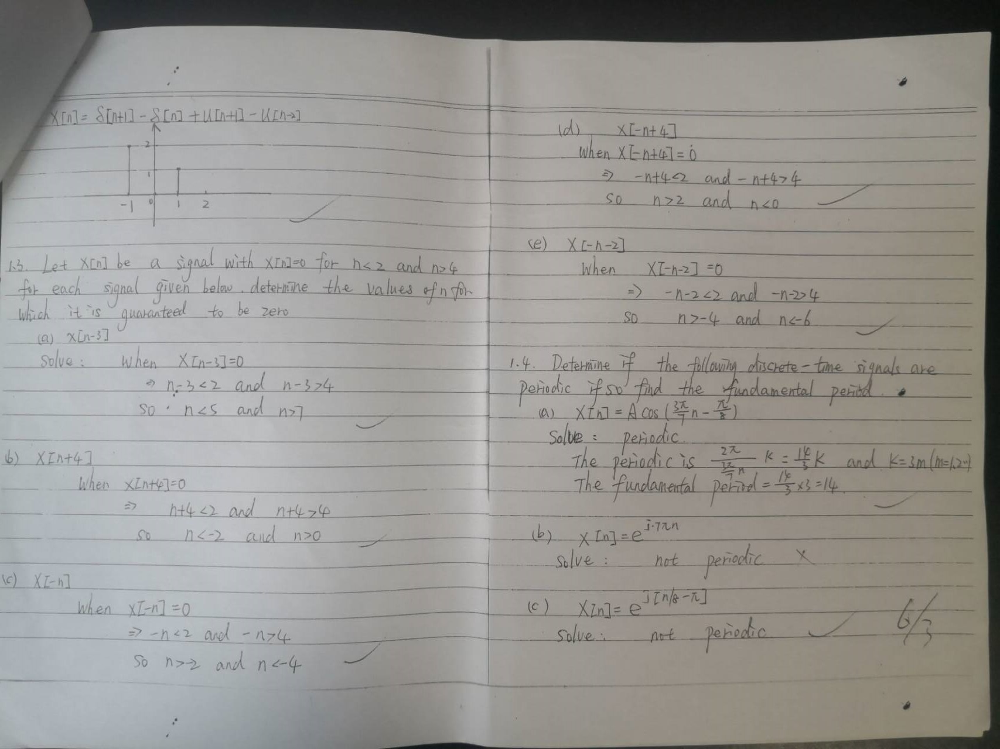

Slide 4
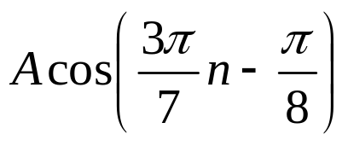
1.4 Determine if the following discrete-time signals are periodic. If so, find the fundamental period.
(a) x[n]= (b) x[n]=e^{j7πn} (c) x[n]= e^{j(n/8–π)}
r=2πq/Ω=14q/3 r=2πq/Ω=2q/7 r=2πq/Ω=16πq
1.5 Consider a discrete-time system with input x[n] and output y[n]. The input-output relationship for this system is
y[n]= x[n] x[n – 2]
(a) Is the system memoryless?
(b) Determine the output of the system when the input is
Aδ[n], where A is any real or complex number.
Answer: N=14
Answer: N=2
Answer: not periodic
Answer: No
Answer: 0

Slide 5
1.5 Consider a discrete-time system with input x[n] and output y[n]. The input-output relationship for this system is
y[n]= x[n] x[n – 2]
(a) Is the system memoryless?
Solution: By the definition of a system with or without memory, the system is not memoryless. For example, y[0]= x[0] x[ – 2], the output y[n] at the given time n=0 is related to the value of the input x[n] at the time n=−2.
(b) Determine the output of the system when the input is
Aδ[n], where A is any real or complex number.
Solution: y[n]= Aδ[n]⋅Aδ[n – 2]=0

Slide 6
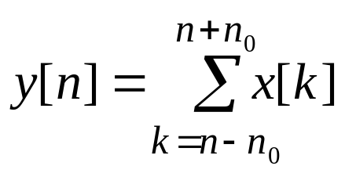
1.6 Consider a discrete-time system with input x[n] and output y[n] related by
where n₀ is a finite positive integer.
(a) Is the system linear?
(b) Is the system time-invariant?
1.7 For each of the following input-output relationships, determine whether the corresponding system is linear, time invariant or both.
(a) y[n]= x[n–2]²
(b) y[n]= x[n+1]+x[n–1]
Answer: Yes
Answer: Yes
Answer: Not linear; Time invariant
Answer: Linear; Time invariant

Slide 7
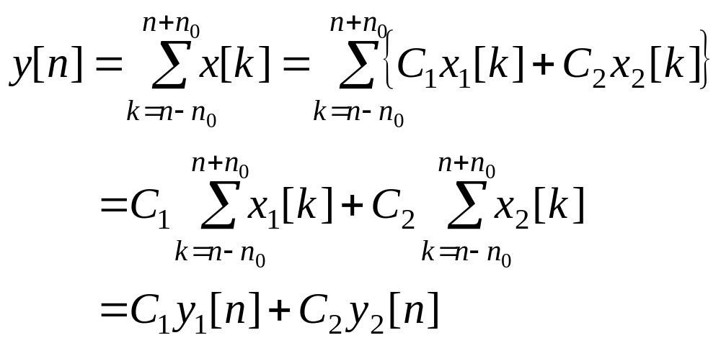
1.6 (a) Solution:
Consider two inputs x₁[n] and x₂[n], y₁[n] and y₂[n] are the outputs of the system with the two inputs, respectively. Suppose that C₁ and C₂ are any complex constants and let the input x[n] =C₁x₁[n]+C₂ x₂[n], the corresponding output of the system is:
By the definition of a linear system, this system is linear.

Slide 8
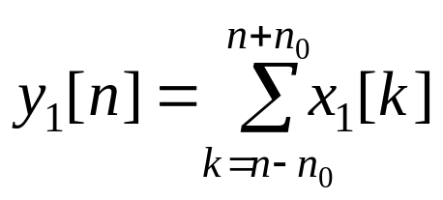
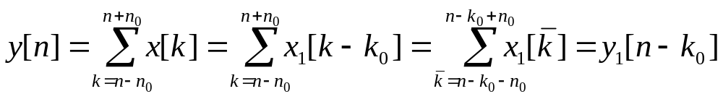
1.6 (b) Solution:
Suppose that k₀ is a time shift, y₁[n] is the output of the system with the input x₁[n], i.e.,
Let the input x[n]=x₁[n−k₀], the corresponding output of the system is:
By the definition of a time-invariant system, this system is time-invariant.

Slide 9
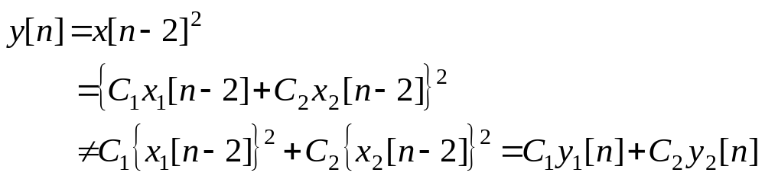
1.7 (a) Solution:
(1) Consider two inputs x₁[n] and x₂[n], y₁[n] and y₂[n] are the outputs of the system with the two inputs, respectively. Suppose that C₁ and C₂ are any complex constants and let the input x[n] =C₁x₁[n]+C₂ x₂[n], the corresponding output of the system is:
By the definition of a linear system, this system is not linear.

Slide 10
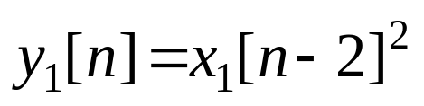
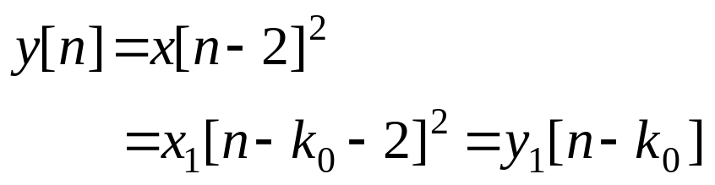
1.7 (a) Solution:
(2) Suppose that k₀ is a time shift, y₁[n] is the output of the system with the input x₁[n], i.e.,
Let the input x[n]=x₁[n−k₀], the corresponding output of the system is:
By the definition of a time-invariant system, this system is time-invariant.

Slide 11
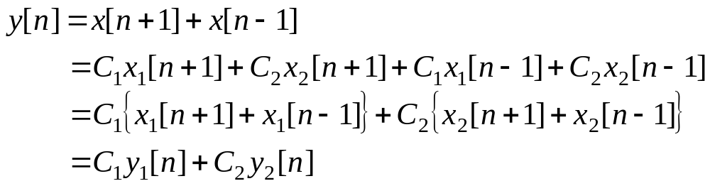
1.7 (b) Solution:
(1) Consider two inputs x₁[n] and x₂[n], y₁[n] and y₂[n] are the outputs of the system with the two inputs, respectively. Suppose that C₁ and C₂ are any complex constants and let the input x[n] =C₁x₁[n]+C₂ x₂[n], the corresponding output of the system is:
By the definition of a linear system, this system is linear.

Slide 12
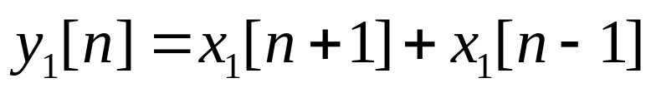
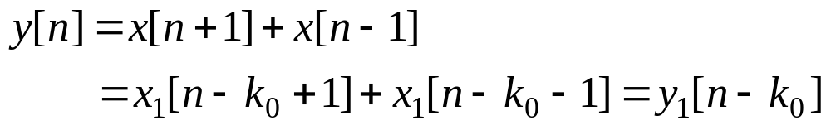
1.7 (b) Solution:
(2) Suppose that k₀ is a time shift, y₁[n] is the output of the system with the input x₁[n], i.e.,
Let the input x[n]=x₁[n−k₀], the corresponding output of the system is:
By the definition of a time-invariant system, this system is time-invariant.

