Slide 1


Discrete-Time System Analysis
Liang Tao (Ph.D & Prof.)
School of Computer Science & Technology
Anhui University

Slide 2
Grading Policy
Attendance 10% Final Grade
Homework 20% Final Grade
Tests 20% Final Grade
Final exam 50% Final Grade
• Final exam will be an open-book test.
• Homework should be submitted by every Friday.

Slide 3
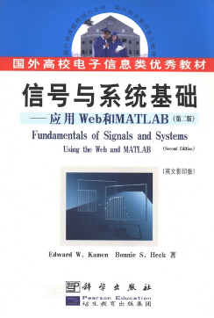
Course Text
• E. W. Kamen and B. S. Heck, Fundamentals of Signals and Systems Using the Web and MATLAB (2nd ed.), Science Press and Pearson Education North Asia Limited, 2002.
Pages:
1
17-25
66-80
101-114
555-611

Slide 4
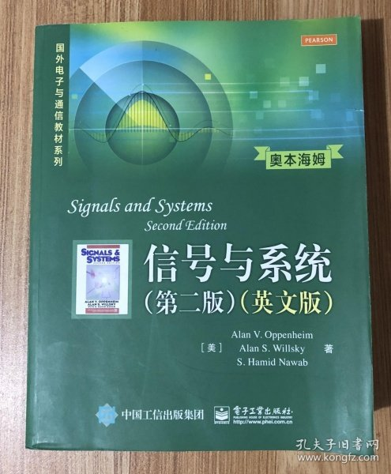
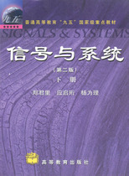
References
A. V. Oppenheim, A. S. Willsky and S. H. Nawab, Signals and Systems (2nd ed.), Publishing House of Electronics Industry, and Pearson Education North Asia Limited, 2002.
Pages: 38-41, 44-56
M. J. Roberts, Signals and Systems, McGraw Hill, 2003.
• 郑君里等, 信号与系统（下册）, 第二版，北京：高等教育出版社, 2002.

Slide 5
Chapter 1 Fundamental Concepts
Chapter 2 Discrete-Time System Analysis in the Time Domain
Chapter 3 Convolution Representation
Chapter 4 The Z Transform
Chapter 5 Discrete-Time System Analysis in the Z-Domain

