Slide 1
Chapter 5 Discrete-Time System Analysis in the z-Domain
§5-1 Transfer Function Representation
§5-2 Transform of the Input/output Convolution Sum
§5-3 Stability of Discrete-time Systems
§5-4 Frequency Response of Discrete-Time Systems
Problems

Slide 2
§5-1 Transfer Function Representation
In this section the transfer function representation is generated for the class of causal linear time-invariant discrete-time systems. The development begins with discrete-time systems defined by an input/output difference equation. Systems given by a first-order input/output difference equation are considered first.

Slide 3
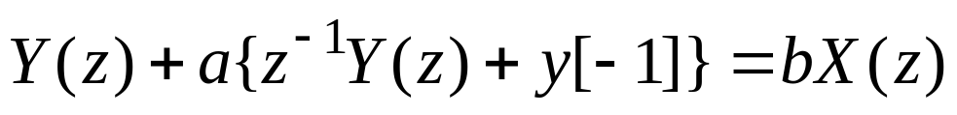
First-order Case
Consider the linear time-invariant discrete-time system given by the first-order input/output difference equation
y[n]+ay[n–1] = bx[n] (5.1)
where a and b are real numbers, y[n] is the output, and x[n] is the input. Taking the z-transform of both sides of (5.1) and using the right-shift property gives
(5.2)
where Y(z) is the z-transform of the output response y[n] and X(z) is the z-transform of the input x[n]. Solving (5.2) for Y(z) yields

Slide 4
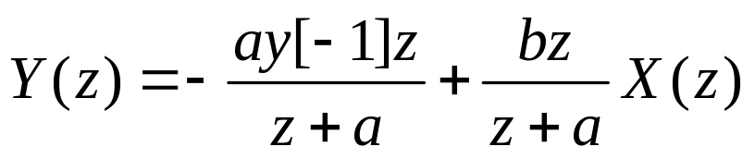
(5.3)
Equation (5.3) is the z-domain representation of the discrete-time system defined by the input/output difference equation (5.1). The first term on the right-hand side of (5.3) is the z-transform of the part of the output response resulting from the initial condition y[–1], and the second term on the right-hand side of (5.3) is the z-transform of the part of the output response resulting from the input x[n] applied for n=0, 1, 2, ….
The system given by (5.1) has no initial energy at time n=0 if y[–1] =0, in which case (5.3) reduces to

Slide 5
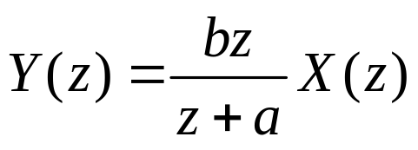
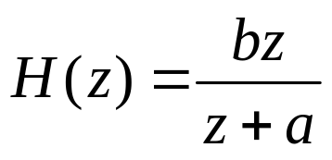

(5.4)
Defining
(5.4) becomes
(5.5)
The function H(z) is called the transfer function of the system since it specifies the transfer from the input to output in the z-domain assuming no initial energy (y[–1] =0). Equation (5.5) is the transfer function representation of the system.

Slide 6
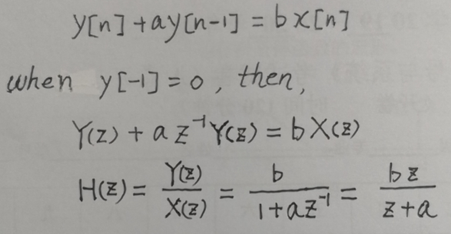

Slide 7
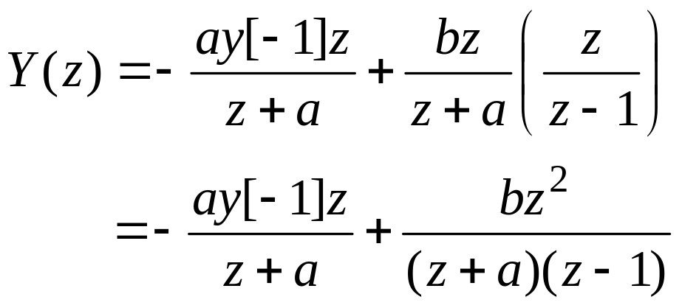
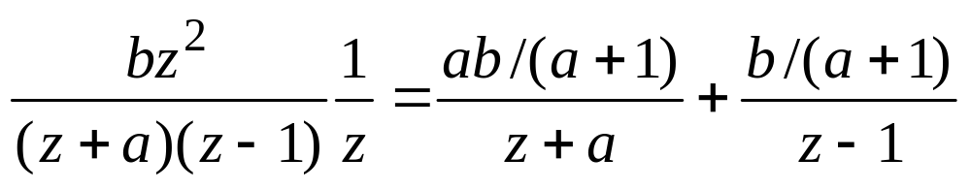
Example 5.1 Step response
For the system given by (5.1), suppose that a≠0 and x[n] is equal to the unit-step function u[n]. Then X(z)=z/(z–1), and from (5.3) the z-transform of the output response is
n
(5.6)
Expanding
(5.7)
and taking the inverse z-transform of both sides of (5.6) gives

Slide 8
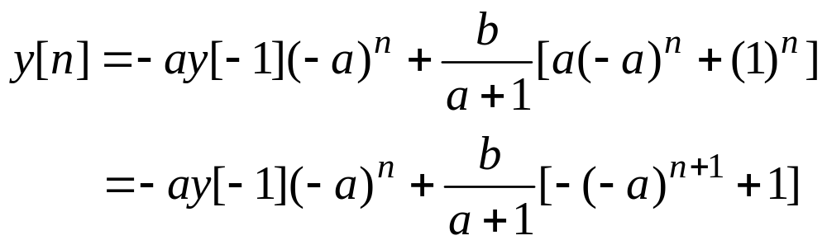
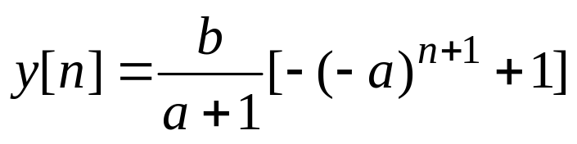
(5.8)
n=0, 1, 2, …
If the initial condition y[–1] is zero, (5.8) reduces to
(5.9)
The output y[n] given by (5.9) is called the step response since it is the output response when the input x[n] is the unit step u[n] with no initial energy prior to the application of u[n].

Slide 9
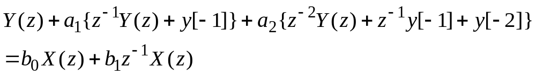
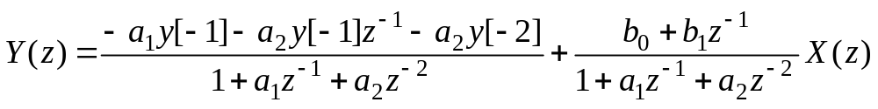
Second-order Case
Now consider the discrete-time system given by the second-order input/output difference equation
y[n]+a₁y[n–1]+a₂y[n–2]= b₀x[n]+ b₁x[n –1] (5.10)
Taking the z-transform of both sides of (5.10) and using the right-shift property gives (assuming that x[–1]=0)
Solving for Y(z) gives

Slide 10
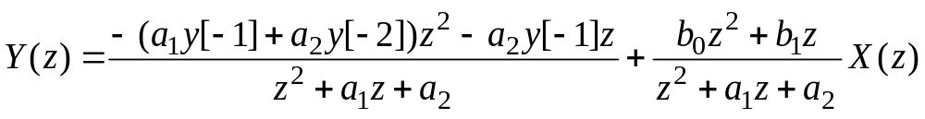
The above equation can be rewritten as follows
(5.11)
Equation (5.11) is the z-domain representation of the discrete-time system given by the second-order input/output difference equation (5.10). The first term on the right-hand side of (5.11) is the z-transform of the part of the output response resulting from the initial condition y[–1] and y[–2], and the second term on the right-hand side of (5.11) is the z-transform of the part of the output response resulting from the input x[n] applied for n=0, 1, 2, ….

Slide 11
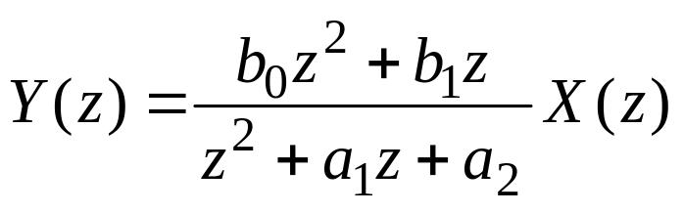
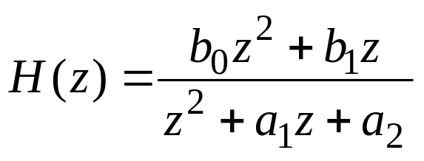
There is no initial energy in the system at time n=0 if y[–1] = y[–2] =0, in which case (5.11) reduces to the transfer function representation
(5.12)
From (5.12) it is seen that the transfer function H(z) of the system is
(5.13)
Note that H(z) is a second-order rational function of z.

Slide 12
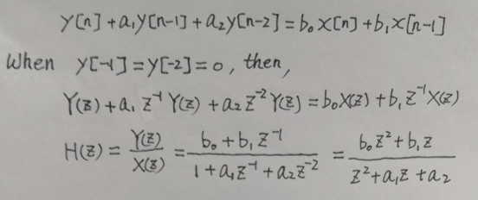

Slide 13
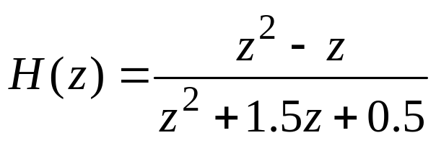
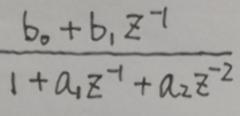
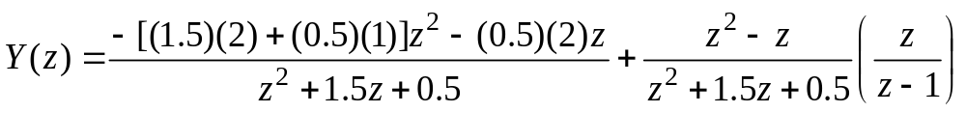
Example 5.2 Second-order System
Consider the discrete-time system given by the input/output difference equation
y[n] + 1.5y[n – 1] + 0.5y[n –2] = x[n] – x[n –1]
By (5.13), the transfer function H(z) of the system is
Suppose that the goal is to compute the output response y[n] when y[–1]=2, y[–2]=1, and the input x[n] is the unit step u[n]. Then by (5.11), the z-transform of the response is

Slide 14
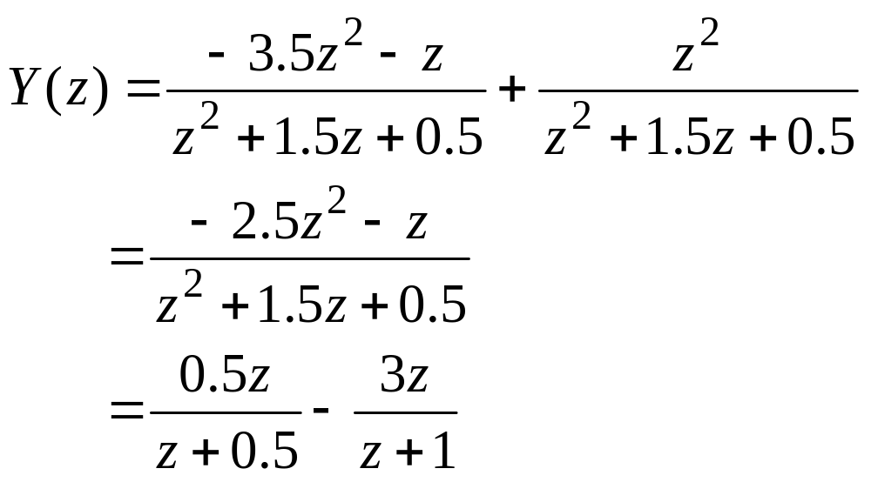
Then taking the inverse z-transform gives
y[n]=0.5(–0.5)^{n}–3(–1)^{n} , n = 0, 1, 2, …

Slide 15
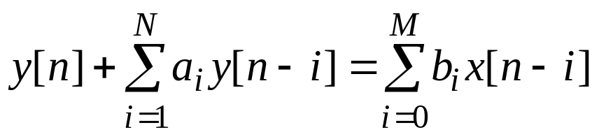
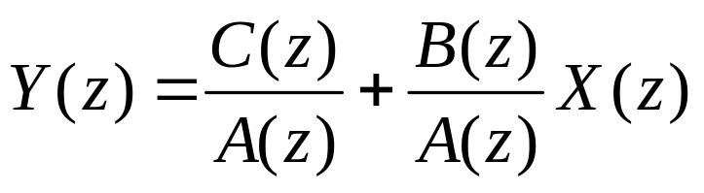
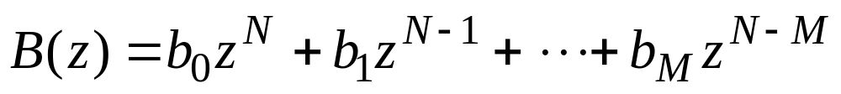
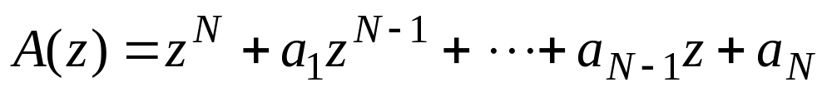
Nth-order Case
Now consider the discrete-time system under study is specified by the Nth-order input/output difference equation
(5.14)
Taking the z-transform of both sides of (5.14) and resulting in the z-domain representation of the system:
(5.15)
where
and

Slide 16
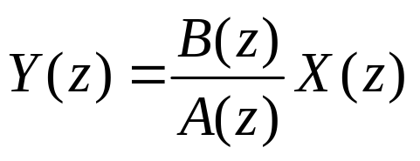
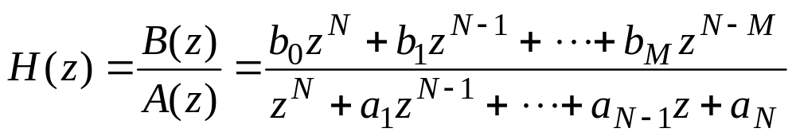
and where C(z) is a polynomial in z whose coefficients are determined by the initial conditions y[–1], y[–2], …, y[–N] (assuming that x[n]=0 for n= –1, –2, …, –M). The system defined by (5.14) has no initial energy at time n=0 if C(z) =0, in which case (5.15) reduces to the transfer function representation
(5.16)
From (5.16), it is seen that the transfer function H(z) of the system is
(5.17)

Slide 17
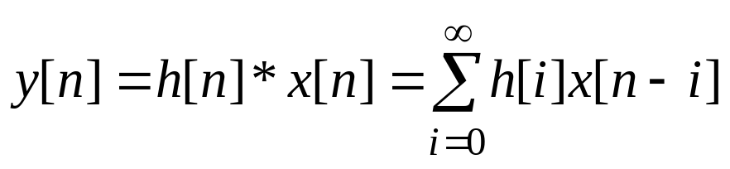
§5-2 Transform of the Input/output Convolution Sum
Suppose that the discrete-time system is given by input/output convolution relationship
(5.18)
n=0, 1, 2, …
where h[n] is the unit-pulse response of the system. Recall that y[n] given by (5.18) is the output response resulting from input x[n] with no initial energy in the system prior to the application of x[n].
If the input x[n] is zero for n= –1, –2, …, the z-transform can be applied to both sides of (5.18), which results in the transfer function representation

Slide 18

(5.19)
In (5.19), H(z) is the transfer function of the system, which is equal to the z-transform of the unit-pulse response h[n]. Note that if x[n] is the unit pulse δ[n], then X(z) =1 and (5.19) reduces to Y(z)=H(z). The relationship between the unit-pulse response h[n] and the transfer function H(z) can be expressed in terms of the transform pair notation
(5.20)

Slide 19
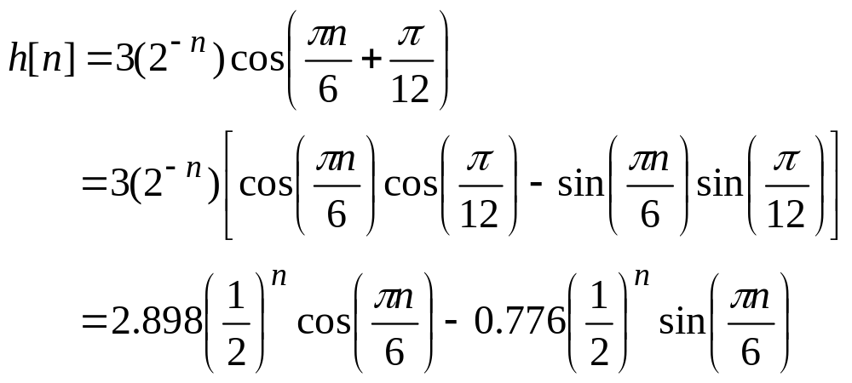
Example 5.3 Computation of Transfer Function
A linear time-invariant discrete-time system has unit-pulse response
n= 0, 1, 2, …
where the argument of the cosine is in radians. Taking the z-transform of h[n] yields:

Slide 20
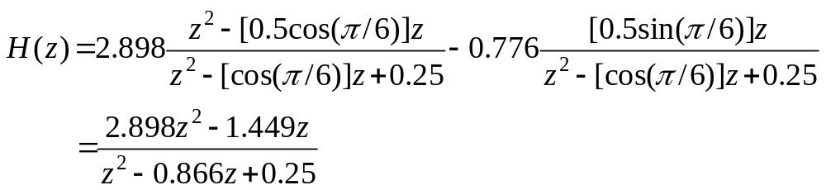
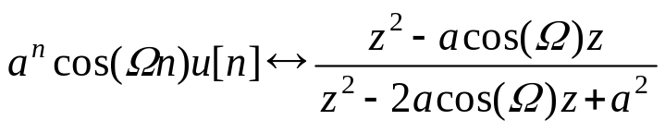
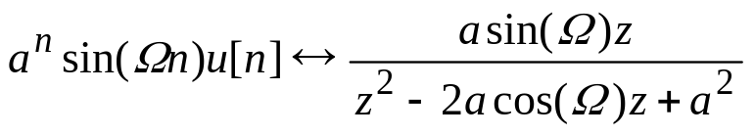
(see Table 11.3 in Page 572)

Slide 21
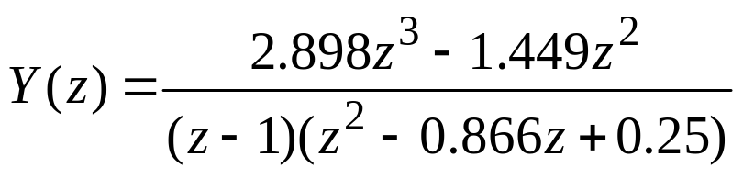
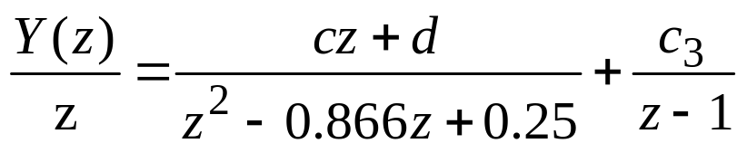
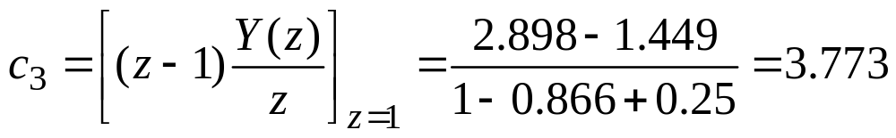
Example 5.4 Computation of Step Response
Suppose that the objective is to compute the step response of the system in Example 5.3. Then inserting X(z)=z/(z −1) and H(z) into Y(z)=H(z)X(z) gives
Since the zeros of z² −0.866z+0.25 are complex, to avoid complex arithmetic, Y(z)/z can be expanded into the form:
where

Slide 22
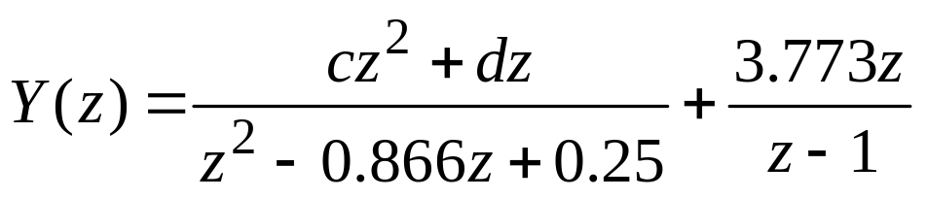

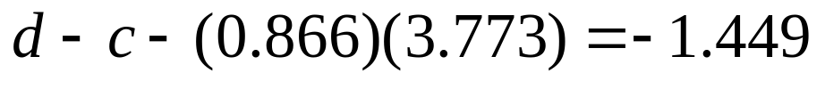
Hence
Putting the right-hand side of the above expression over a common denominator and equating coefficients gives:
Solving for c and d yields:
c= −0.875
d=0.943

Slide 23
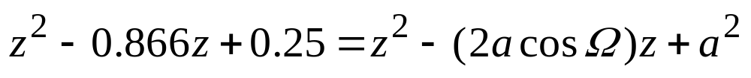
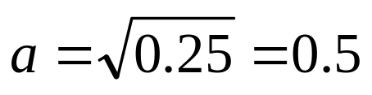
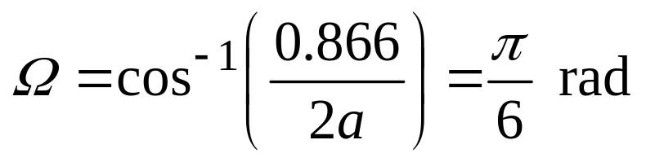
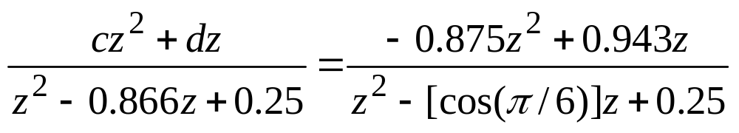
Now to determine the inverse z-transform of the first term on the right-hand side of the expression of Y(z), set
Then
and thus
Expressing the right-hand side of the above expression in the form

Slide 24
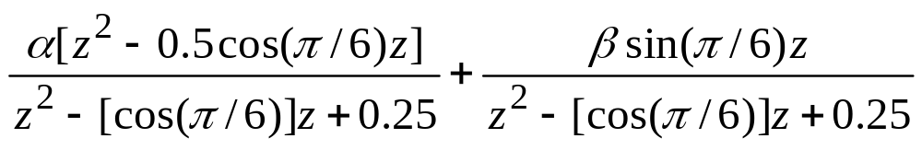

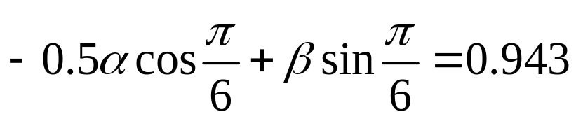
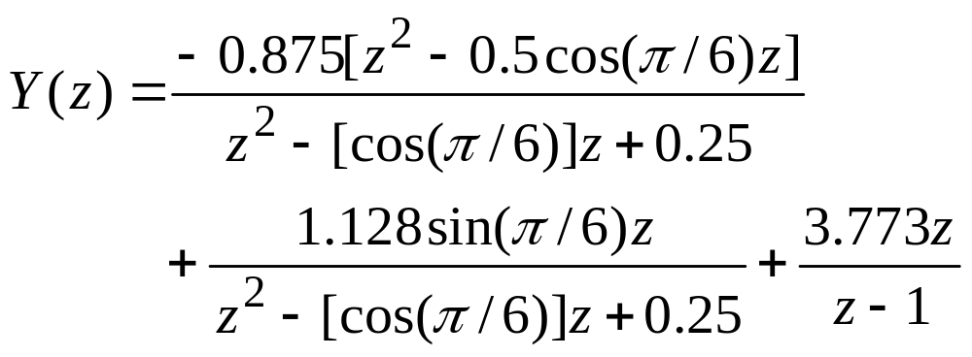
results in and
Solving the expression for β yields β =1.128. Thus

Slide 25
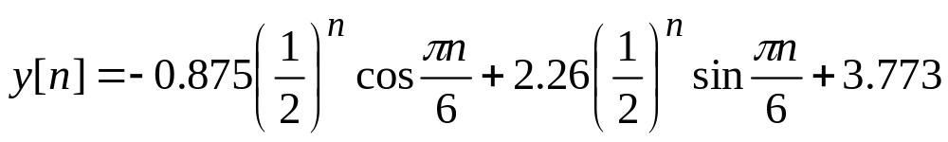
Finally, using Table 11.3 (see Page 572) gives
n= 0, 1, 2, …

Slide 26
Transfer Function of Interconnections
The transfer function of a linear time-invariant discrete-time system can be computed directly from a signal-flow diagram of the system. This approach is pursued here for systems given by an interconnection of unit-delay elements and an interconnection of blocks.
Interconnections of unit-delay elements
The unit-delay element is a system whose input/output relationship is given by
y[n]=x[n−1] (5.21)
The system given by (5.21) is referred to as the unit-delay element since the output y[n] is equal to a one-step time delay of the input x[n].

Slide 27
x[n]
y[n]=x[n−1]
D
Figure 5.4 Unit-delay element
As shown in Figure 5.4, the unit-delay element is represented by a box with a D that stands for “delay”.
Taking the z-transform of both sides of y[n]=x[n−1] with x[−1]=0 yields the transfer function of the unit-delay element:
Y(z)=z ⁻¹X(z)
From the expression it is seen that the transfer function of the unit-delay element is equal to 1/z.

Slide 28
x[n]
y[n]=x[n−1]
D
X(z)
Y(z)=z⁻¹X(z)
1/z
y[n]=x[n−1]
→
x[n]=y[n+1]
y[n+1]
y[n]
D
zY(z)
Y(z)
1/z
Y(z)=z⁻¹X(z)
→
X(z) = zY(z)

Slide 29
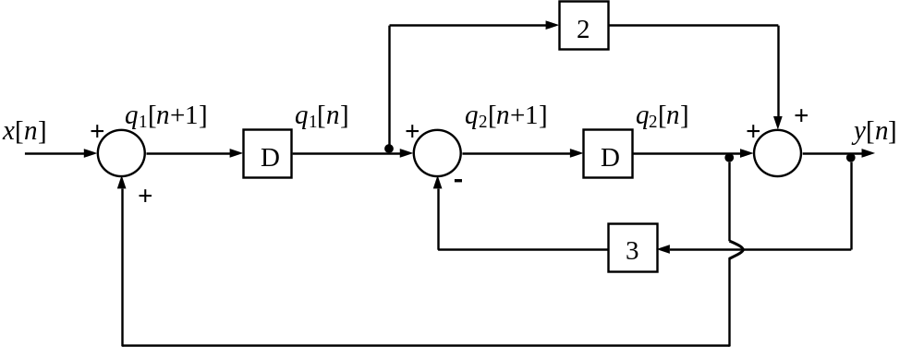
Example 5.5 Computation of Transfer Function
H(z)=Y(z)/X(z)
Consider the discrete-time system given by the interconnection in Figure 5.5. Note that the outputs of the two unit-delay elements in Figure 5.5 are denoted by q₁[n] and q₂[n].
Figure 5.5 System in Example 5.5

Slide 30
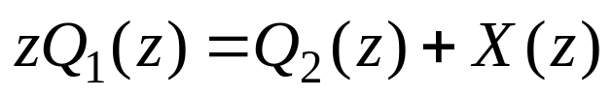
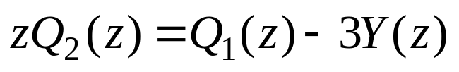
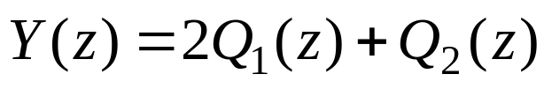
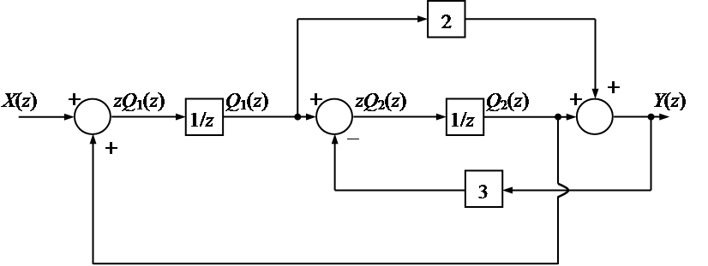
The z-domain representation of the system with all initial conditions equal to zero is shown in Figure 5.6. From the figure it is clear that
(5.22)
(5.23)
(5.24)
Figure 5.6 Representation of system in the z-domain

Slide 31
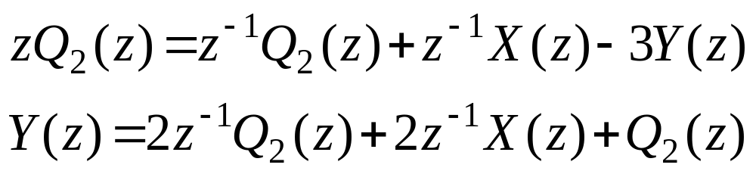
(5.22)
(5.23)
(5.24)
Solving (5.22) for Q₁(z) and inserting the result into (5.23) and (5.24) yields
(5.25)
(5.26)

Slide 32

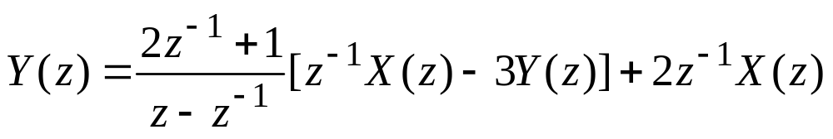


(5.25)
(5.26)
Solving (5.25) for Q₂(z) and inserting the result into (5.26) gives
Thus
so the transfer function is

Slide 33

Transfer function of basic interconnections
The transfer function of series, parallel, and feedback connections have exactly the same form as in the continuous-time case. The results are displayed in Figure 5.7
X(z)
Y(z)
X(z)
Y(z)
H₁(z)
H₂(z)
≡
H₁(z) H₂(z)
(a)
H₁(z)
Y(z)
X(z)
Y(z)
X(z)
+
≡
H₁(z)+H₂(z)
(b)
H₂(z)
+
X(z)
+
Y(z)
H₁(z)
X(z)
Y(z)
≡
(c)
−
H₂(z)
Figure 5.7 transfer function of basic interconnections: (a) series connection; (b) parallel connection; (c) feedback connection.

Slide 34


Slide 35


§5-3 Stability of Discrete-time Systems
Consider the linear time-invariant discrete-time system given by the transfer function
(5.27)
The system is assumed to be causal, and thus M≤N. It is also assumed that the polynomials B(z) and A(z) do not have any common factors. If there are common factors, they should be canceled.
It follows from the relationship between the form of h[n] and the poles of H(z) that h[n] converges to zero as n→∞ if and only if
for i= 1, 2, …, N
(5.28)

Slide 36
where p₁, p₂, …, p_{N} are the poles of H(z). The condition (5.28) is equivalent to requiring that all the poles be located in the open unit disk of the complex plane. The open unit disk is that part of the complex plane consisting of all complex numbers whose magnitude is strictly less than 1. The open unit disk is the hatched region shown in Figure 5.8
Im
1
Hatched region not including boundary where |z|<1
Re
–1
0
1
–1
Fig. 5.8 Open unit disk

Slide 37
A discrete-time system with transfer function H(z) given by (5.27) is said to be stable if its unit-pulse response h[n] converges to zero as n→∞. Thus stability is equivalent to requiring that all the poles of the system lie in the open unit disk of the complex plane.
The system is marginally stable if the unit-pulse response h[n] is bounded; that is,
|h[n]| < c for all n
where c is a finite positive constant. It also follows from the relationship between the form of h[n] and the poles of H(z) that a system is marginally stable if and only if |p_{i}|≤1 for all non-repeated poles of H(z), and |p_{i}|<1 for all repeated poles. This is equivalent to requiring that all poles lie in the open unit disk, except that non-repeated poles can be located on the unit circle.

Slide 38

Example 5.6 Stability of the discrete-time System
Consider the discrete-time system given by the input/output difference equation
y[n] + 0.2y[n – 1] – 0.24y[n –2] = x[n] + x[n –1]
By (5.13), the transfer function H(z) of the system is
Now the poles of H(z) are p₁=0.4, p₂= – 0.6, and thus all the poles of the system lie in the open unit disk of the complex plane, the system is stable.

Slide 39


The partial fraction expansion of H(z) has the form
The unit-pulse response h[n] of the system is the inverse z-transform of H(z); that is,
It can be seen that the unit-pulse response h[n] converges to zero as n→∞.

Slide 40




Example 5.7 Stability of the Discrete-time System
Consider the discrete-time system given by the transfer function
where
Compute the poles of H(z).
For what range of r is the system stable, marginally stable or unstable.
Solution:
(a)

Slide 41






Let
, so the poles of H(z) is
(b) For p₁ and p₂ lie in the open unit disk of the complex plane, so the system is stable.
For since p₁ and p₂ are non-repeated poles and are located on the unit circle of the complex plane, thus the system is marginally stable.
For p₁ and p₂ lie in the outside of the unit disk of the complex plane, so the system is unstable.

Slide 42


§5-4 Frequency Response of Discrete-Time Systems
Again consider the linear time-invariant finite-dimensional discrete-time system with the transfer function
(5.27)
Throughout this section it is assumed that the system is stable, and thus all the poles of H(z) are located in the open unit disk of the complex plane.
Now since the system is stable, the unit-pulse response h[n] is absolutely summable, and thus the DTFT of h[n] is equal to the transfer function H(z) evaluated at that is,
(5.29)

Slide 43

Computation of the Frequency Response Curves
The MATLAB command freqz can be used to compute the frequency response function H(Ω) for any desired set of values of the frequency variable Ω. Once H(Ω) is determined, the magnitude and phase plots can be computed and plotted. To use the command freqz, the transfer function H(z) must be have M≤N and be defined in terms of polynomials in z⁻¹. Given a transfer function H(z) in the form (5.27), H(z) can be put into the proper form by multiplying H(z) by z^{−N}/z^{−N}. This yields
(5.30)

Slide 44

(5.30)
(5.27)
Note that if M=N, the coefficients d_{i} in the numerator of H(z) are equal to the b_{i} in (5.27). Otherwise, if M<N, then d_{i}= b_{i} for i=0, 1, 2, …, M and d_{i} =0 for i>M. Now the MATLAB commands that will generate the frequency response curves are given as follows:
num=[d_{N} d_{N−1} … d₀];
den=[a_{N} a_{N−1} … a₀];
OMEGA= –pi:pi/150:pi;
H=freqz(num,den,OMEGA);
mag=abs(H);
phase=180/pi*angle(H);
numerator
denominator

Slide 45


Example 5.7 frequency Response Curves
Consider the discrete-time system with transfer function
To use MATLAB for computation of the frequency response curves, first rewrite H(z) as
Then the MATLAB commands to obtain the frequency response are
num=[0 1];
den=[1 -0.5];
OMEGA= - pi:pi/150:pi;
H=freqz(num,den,OMEGA);
subplot(211),plot(OMEGA,abs(H));
subplot(212),plot(OMEGA, angle(H))

Slide 46

angle(H), degree |H|
Ω
Ω
Figure 5.9 Magnitude (a) and phase (b) plots for the system in Example 5.7

Slide 47
Problems
5.1 A system is described by the difference equation
y[n]+0.7y[n−1]=x[n]; y[−1]=1
where the input of the system x[n] =u[n], and y[−1]=1.
(a) Find an analytical expression for y[n].
(b) Determine the transfer function H(z) of the system
5.2 A system is described by the difference equation
y[n] −0.2y[n−1] −0.8y[n−2]=x[n]
where the input of the system x[n] =0 for all n, and y[−1]=1, y[−2]=1.
(a) Find an analytical expression for y[n].
(b) Determine the transfer function H(z) of the system.

Slide 48

5.3 A linear time-invariant discrete-time system is given by the input/output difference equation
y[n]+y[n−1] −2y[n−2]=2x[n] −x[n−1]
Find an input x[n] with x[n]=0 for n<0 that gives the output response y[n]= 2(u[n] −u[n−3]) with initial conditions y[−2]=2, y[−1]=0.
5.4 A linear time-invariant discrete-time system has transfer function
(a) Compute the unit-pulse response h[n] for all n≥0.
(b) Compute the step response y[n] for all n≥0.
(c) Determine if the system is stable, marginally stable, or unstable.

Slide 49

5.5 A linear time-invanriant discrete-time system has transfer function
(a) Determine if the system is stable, marginally stable, or unstable.
(b) Use MATLAB to plot the frequency response curves of the system.

Slide 50





Answers:
5.1 (a)
5.1 (b)
5.2 (a)
y[n]=u[n]
5.2 (b)
5.3
5.4 (a)
5.4 (b)
5.4 (c) unstable

Slide 51

5.5 (a) stable
(b)
num=[0 0 0 1 0];
den=[1 -1 0.5 -0.25 0.0625];
OMEGA= - pi:pi/150:pi;
H=freqz(num,den,OMEGA);
subplot(211),plot(OMEGA,abs(H));
subplot(212),plot(OMEGA, angle(H))

