Slide 1
Chapter 4 The Z Transform
§4-1 z-Transform of A Discrete-Time Signal
§4-2 Properties of the z-Transform
§4-3 Computation of the Inverse z-Transform
Problems

Slide 2
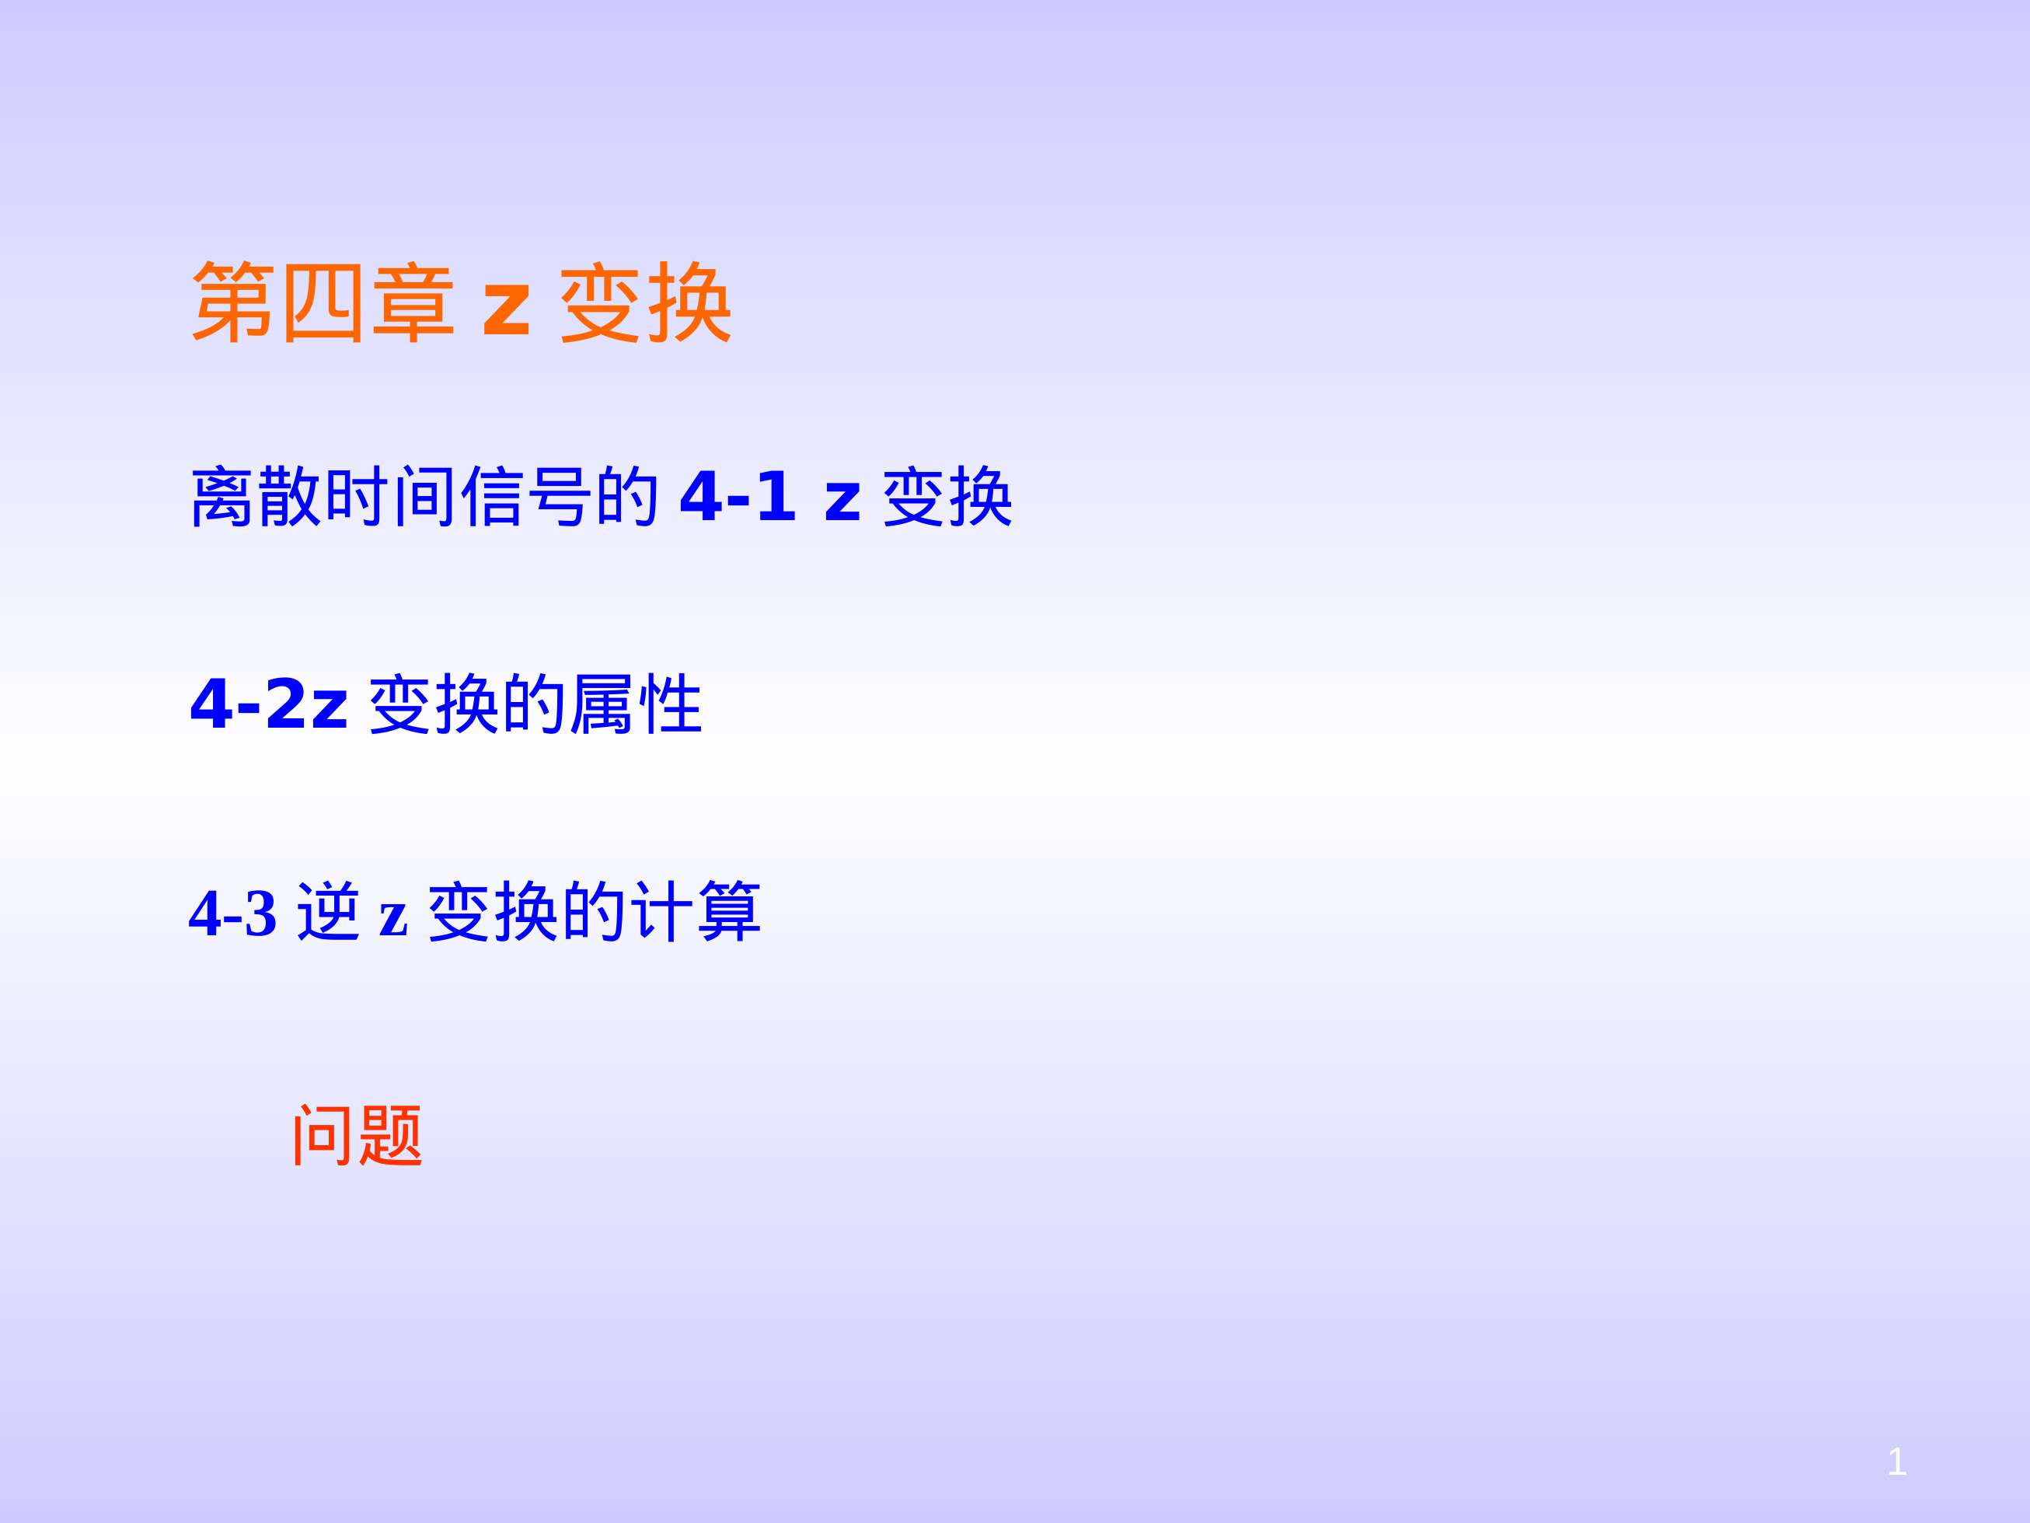

Slide 3
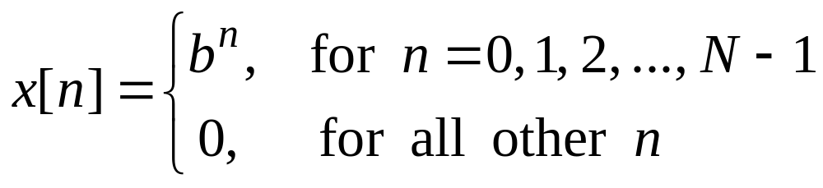
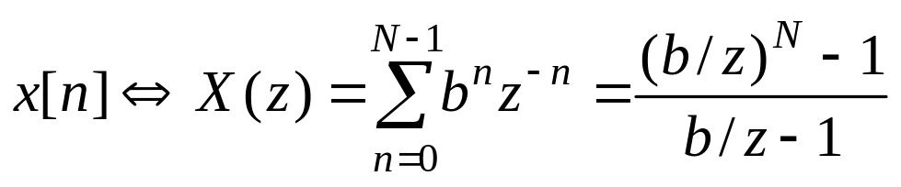
Problems and Solutions
4.1 Consider the discrete-time signal x[n], where
Here b is an arbitrary real number and N is a positive integer.
(a) For what real values of b does x[n] possess a z-transform?
(b) For the values of b determined in part (a), find the z-transform of x[n], Express your answer as a ratio of polynomials.
Solution:
4.1(a) For any real values of b, x[n] possesses a z-transform because

Slide 4
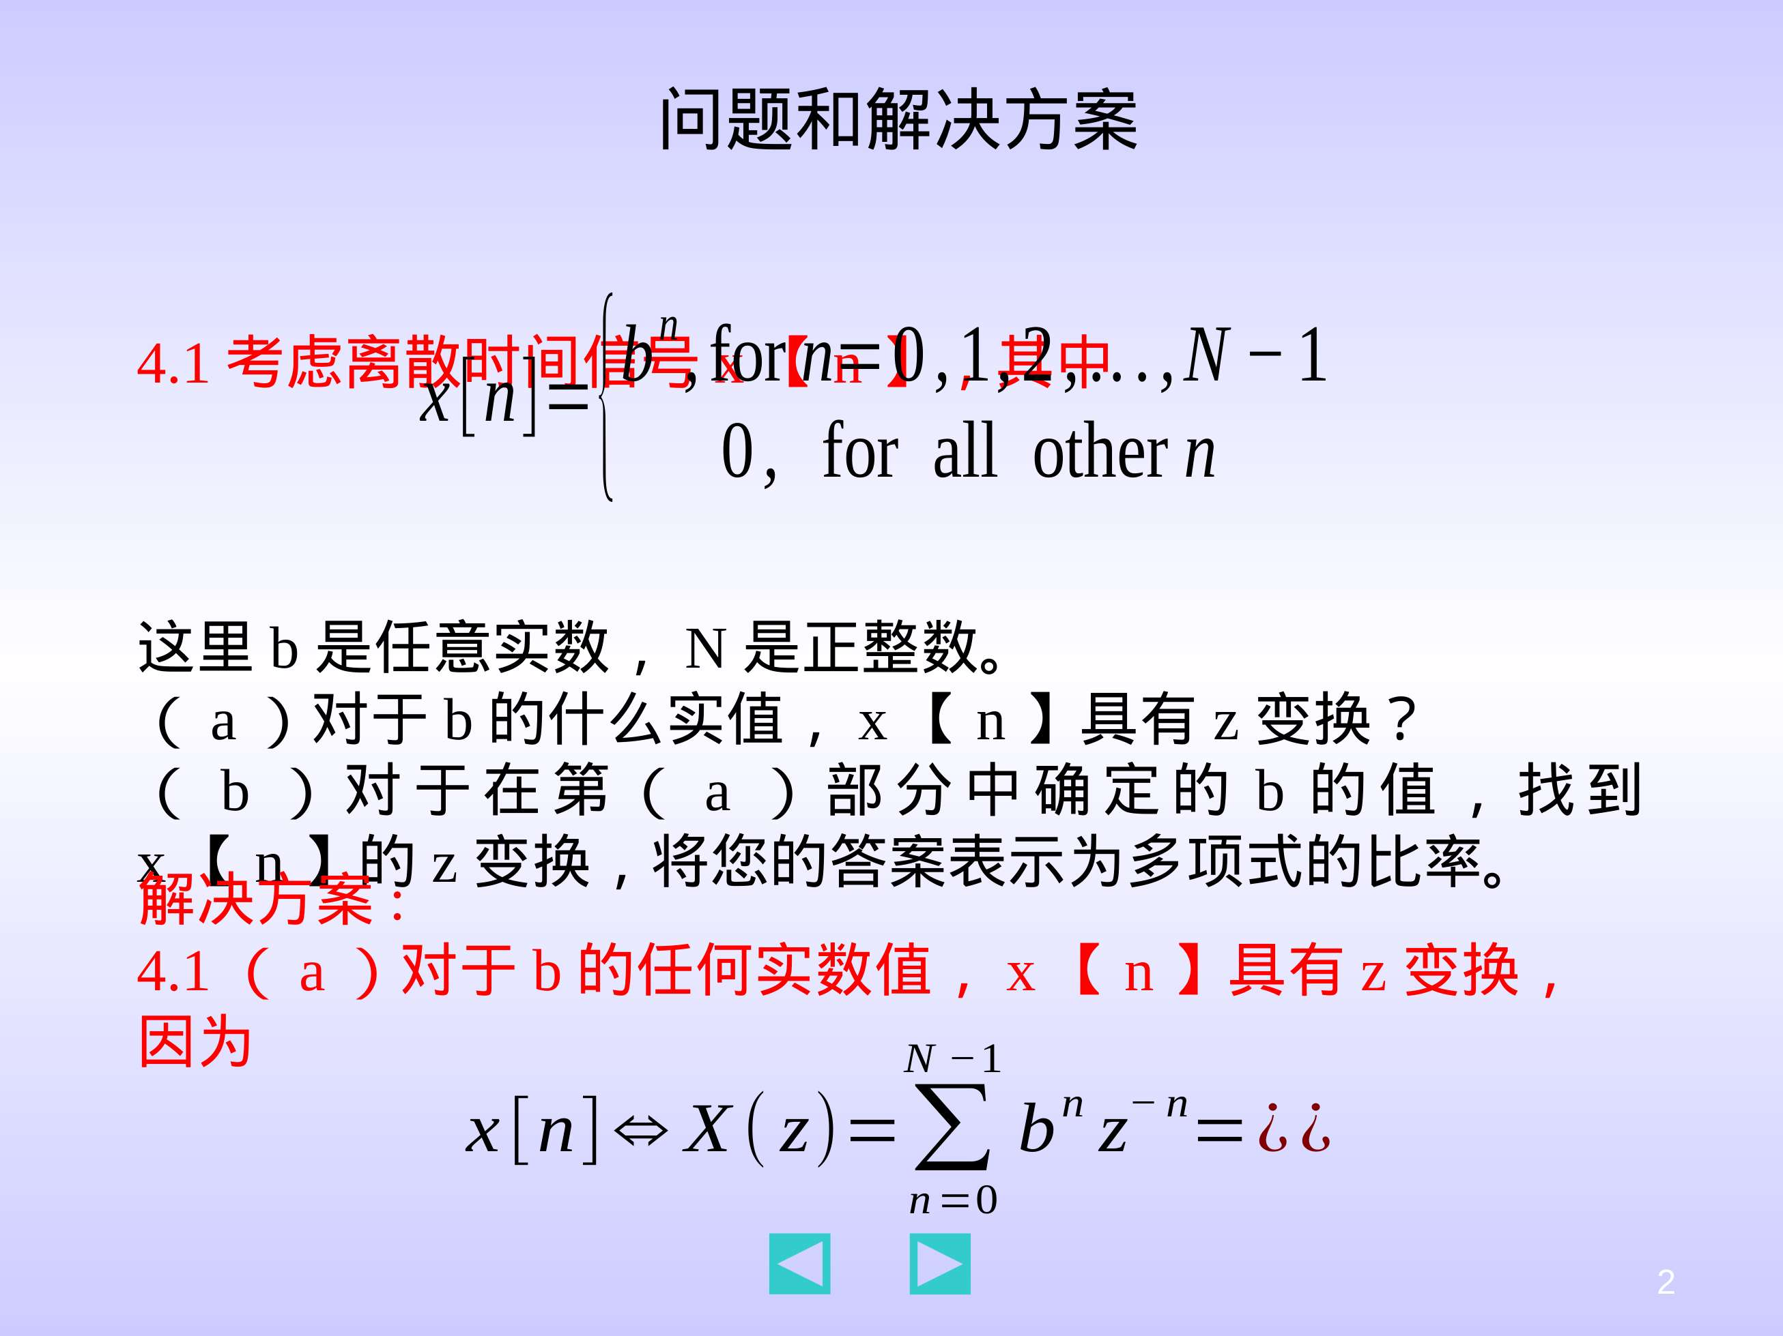
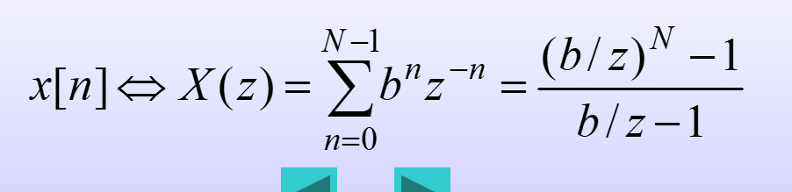

Slide 5
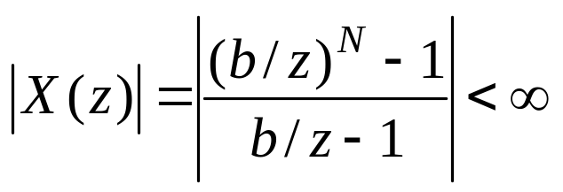
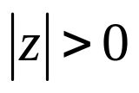
and
for any real values of b and .
4.1(b)

Slide 6
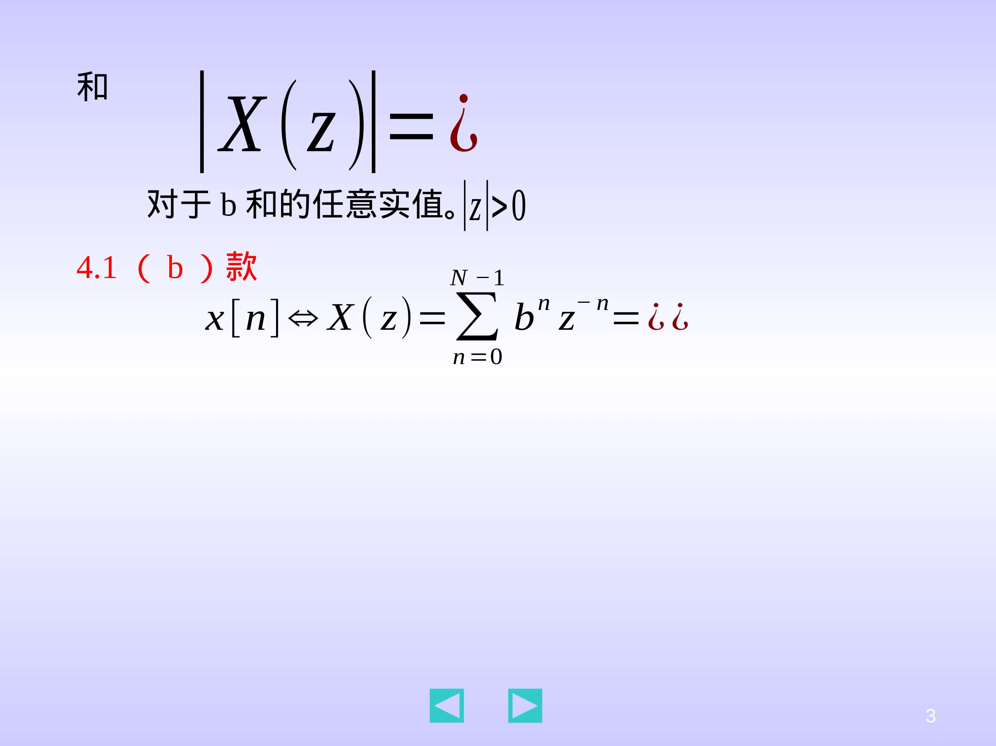
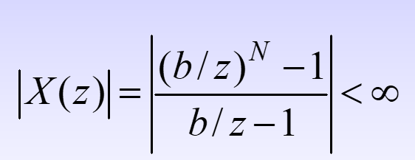
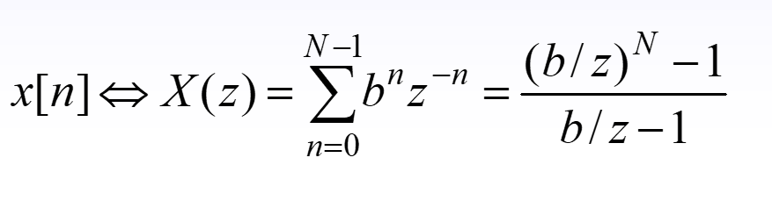

Slide 7
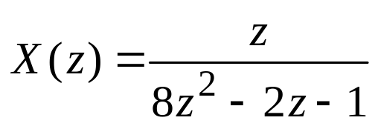
4.2 A discrete-time signal x[n] has z-transform
Determine the z-transform V(z) of the following signals.
(a) v[n]= x[n–4]u[n –4]
(b) v[n]= x[n+2]u[n +2]
(c) v[n]= cos(2n)x[n]
(d) v[n]= e^{3n}x[n]
(e) v[n]= n²x₁[n], where x₁(n)=δ(n−1)
(f) v[n]= x[n]*x[n]
(g) v[n]= x[0]+x[1] +x[2]+ · · · +x[n]
Solution:
4.2(a) By the right shift property of x[n]u[n]

Slide 8
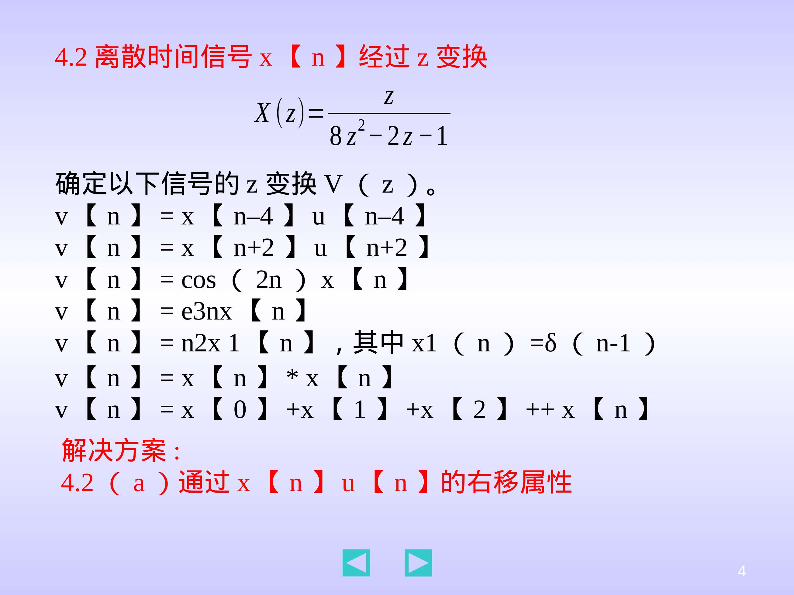

Slide 9
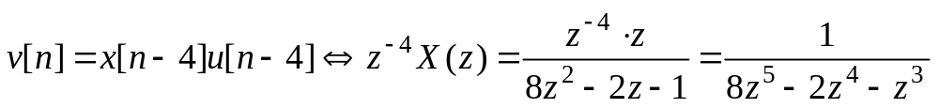
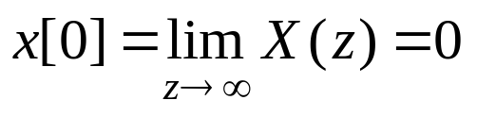
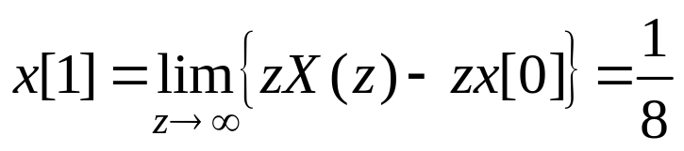
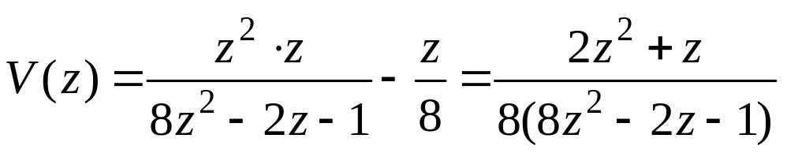
4.2(b) By the left shift property of x[n]
By the initial-value theorem,
thus,

Slide 10
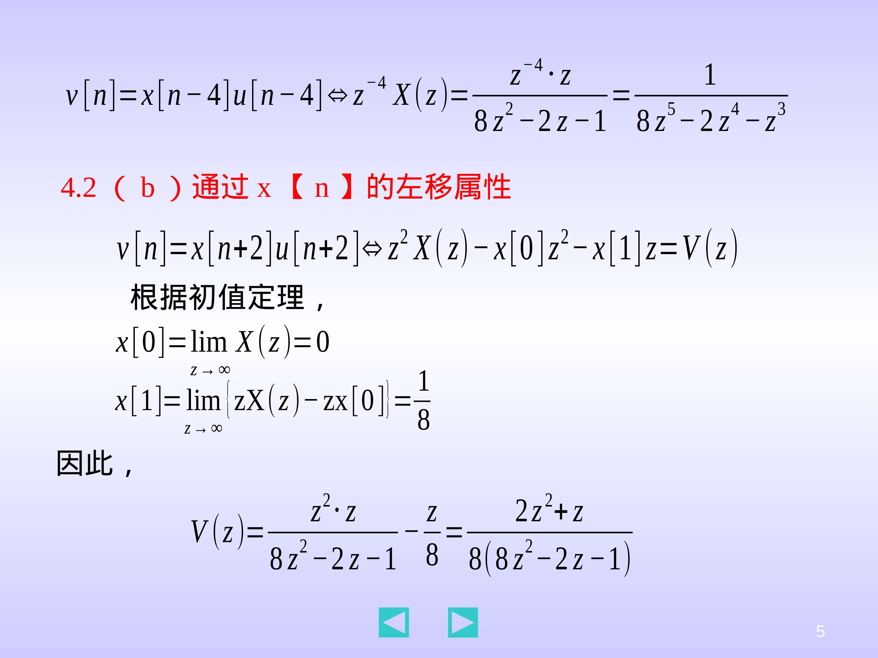

Slide 11
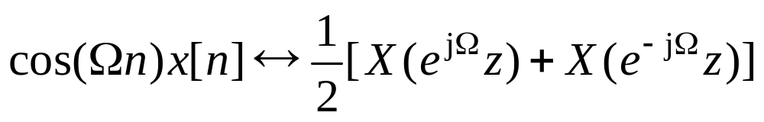
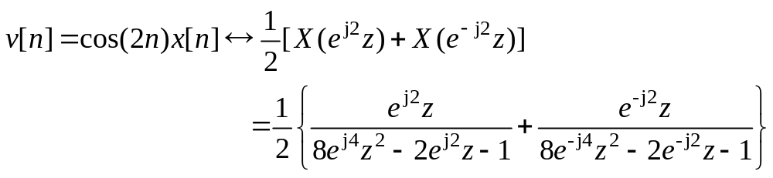
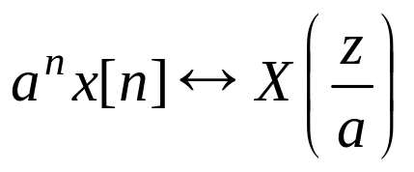
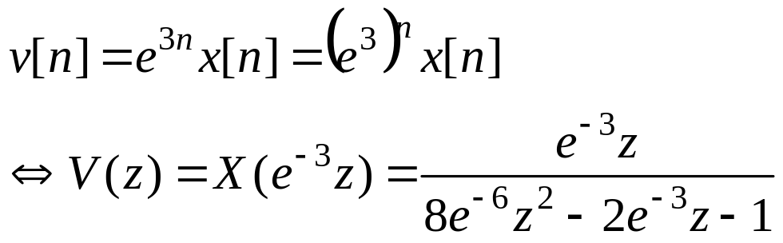
4.2(c) By the property of multiplication by cos(Ωn)
thus,
4.2(d) By the property of multiplication by a^{n}
thus,

Slide 12
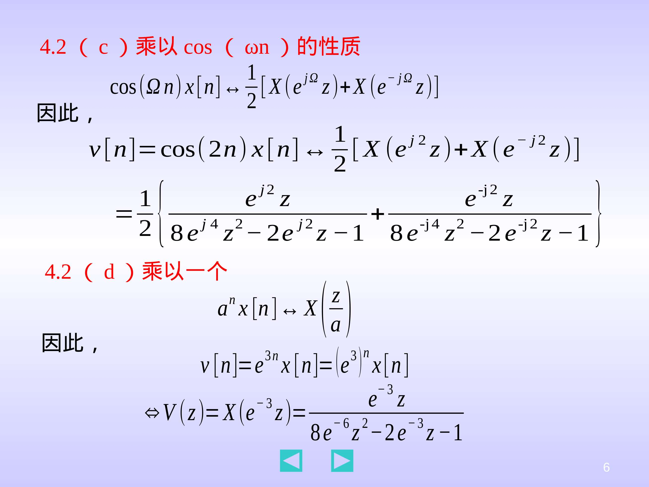

Slide 13
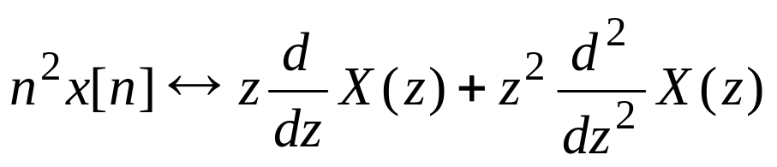
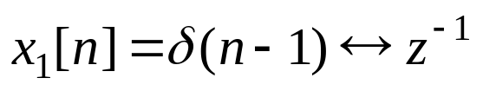
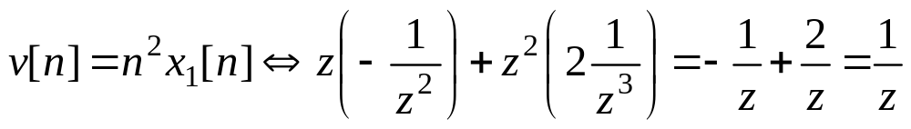
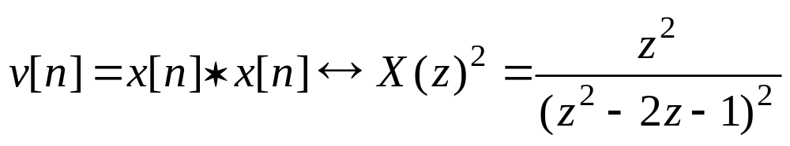
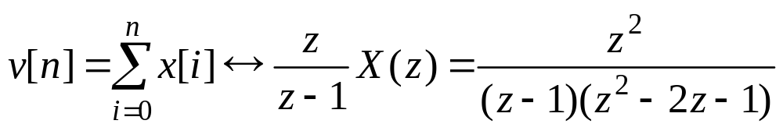
4.2(e) Based on the property of multiplication by n²
and , we have,
4.2(f) Based on the convolution property
4.2(g) Based on the summation property

Slide 14
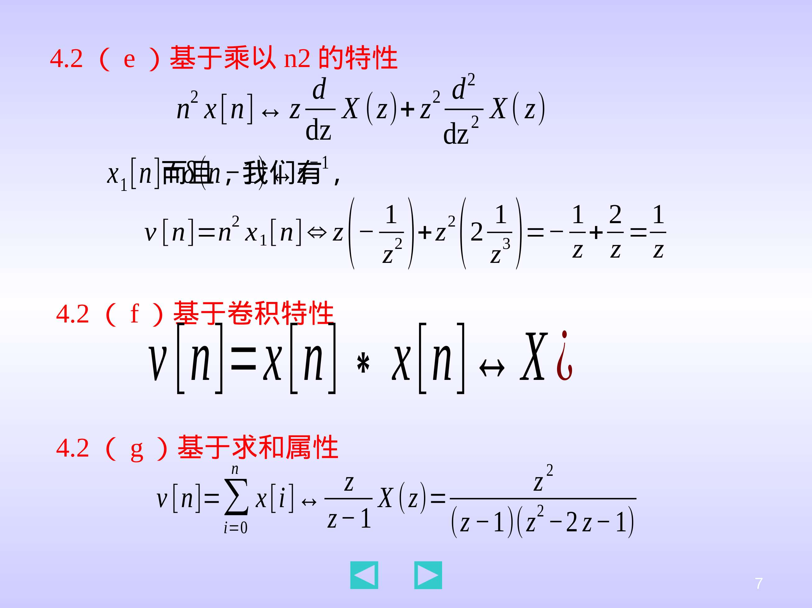
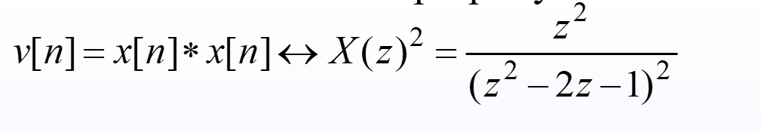

Slide 15

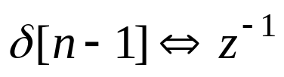
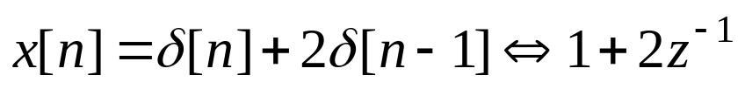
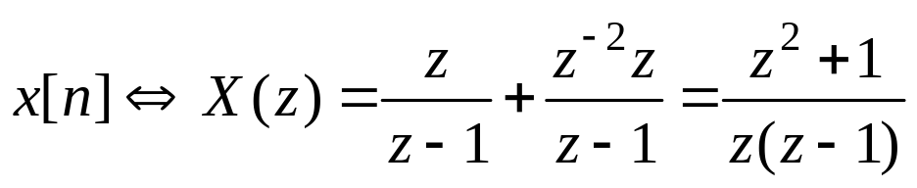
4.3 Compute the z-transform of the following discrete-time signals. Express your answer as a ratio of polynomials in z whenever possible.
(a) x[n]= δ[n]+2δ[n –1]
(b) x[n]=1 for n=0, 1 and x[n]=2 for all n≥2
x[n]= e^{0.5n}u[n]+ u[n –1]
(d) x[n]= sin(πn/2)u[n –2]
Solution:
4.3(a) Because and
4.3(b)

Slide 16
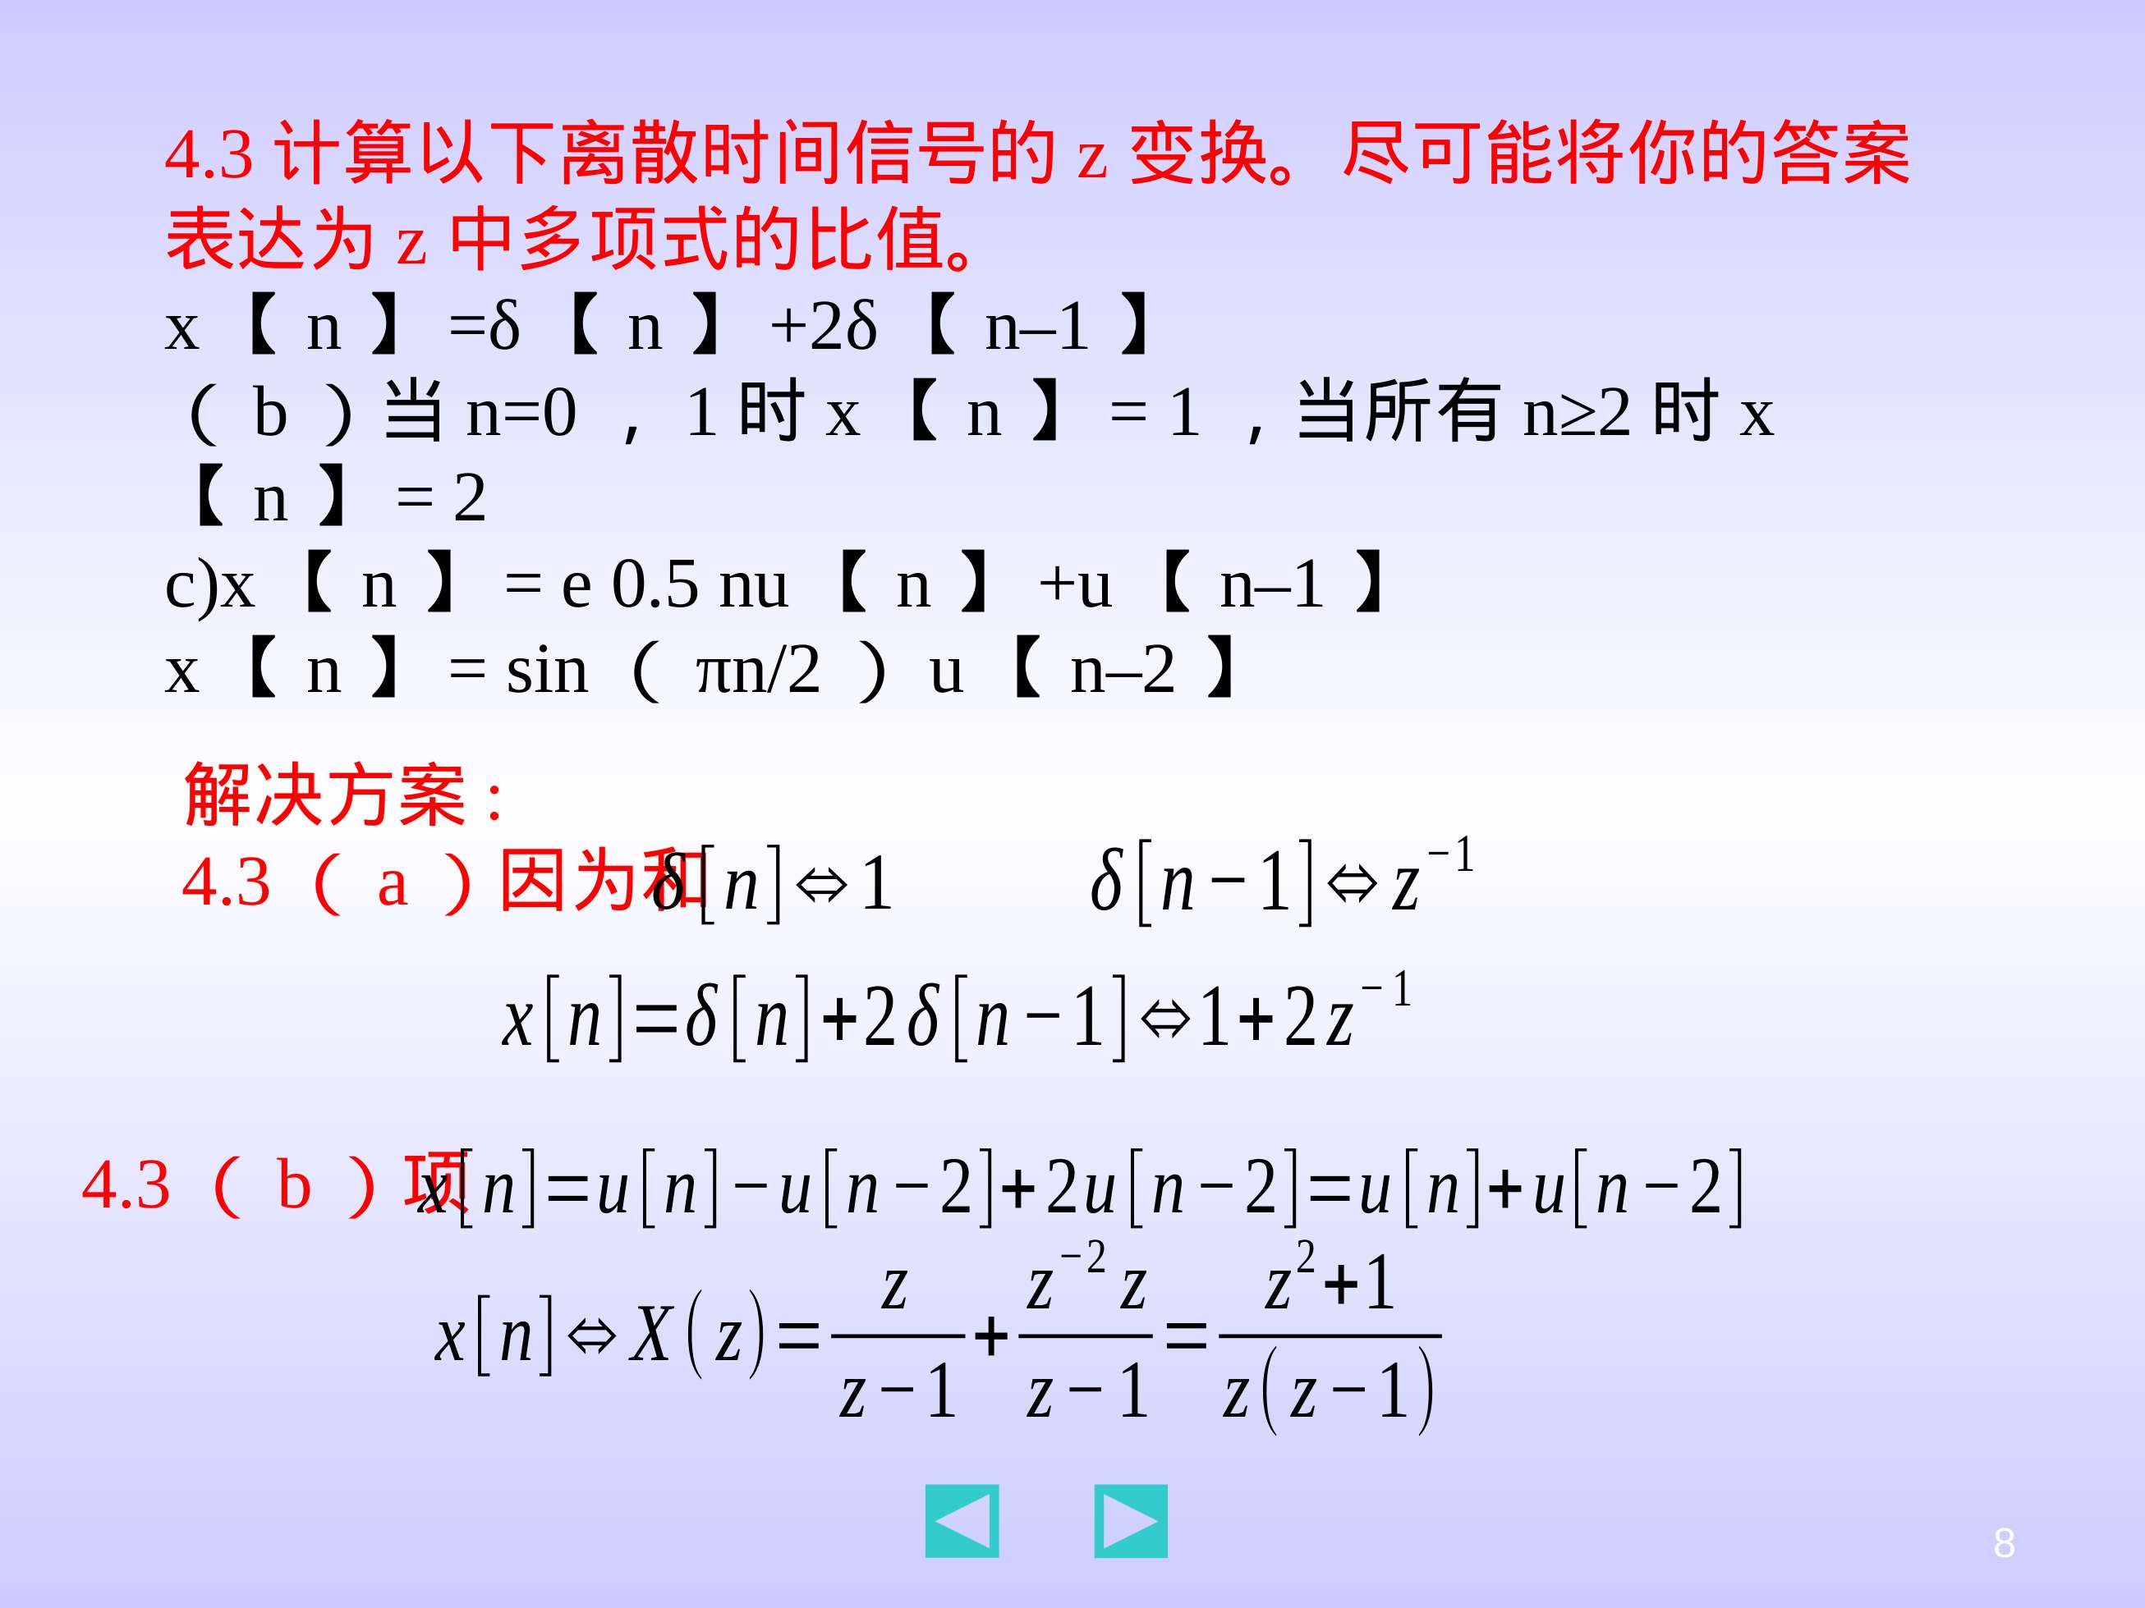

Slide 17
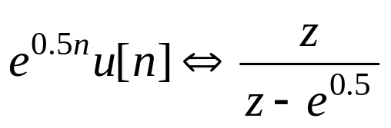
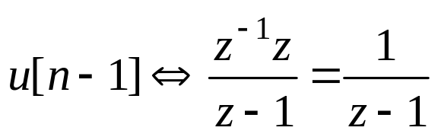
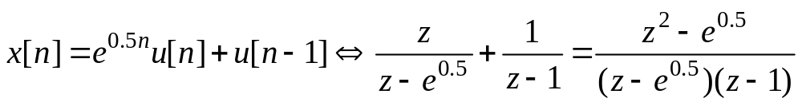
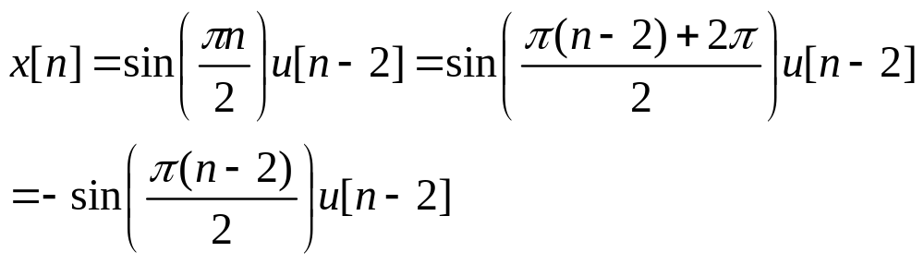
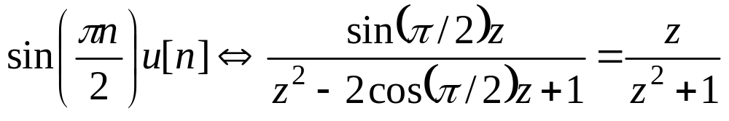
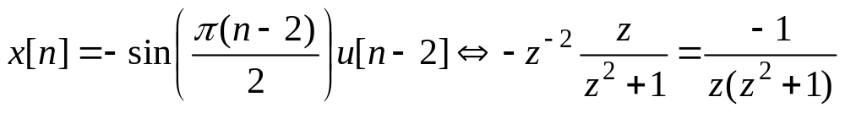
4.3(c) Because and
4.3(d)
Because
and using the right shift property of x[n]u[n]

Slide 18
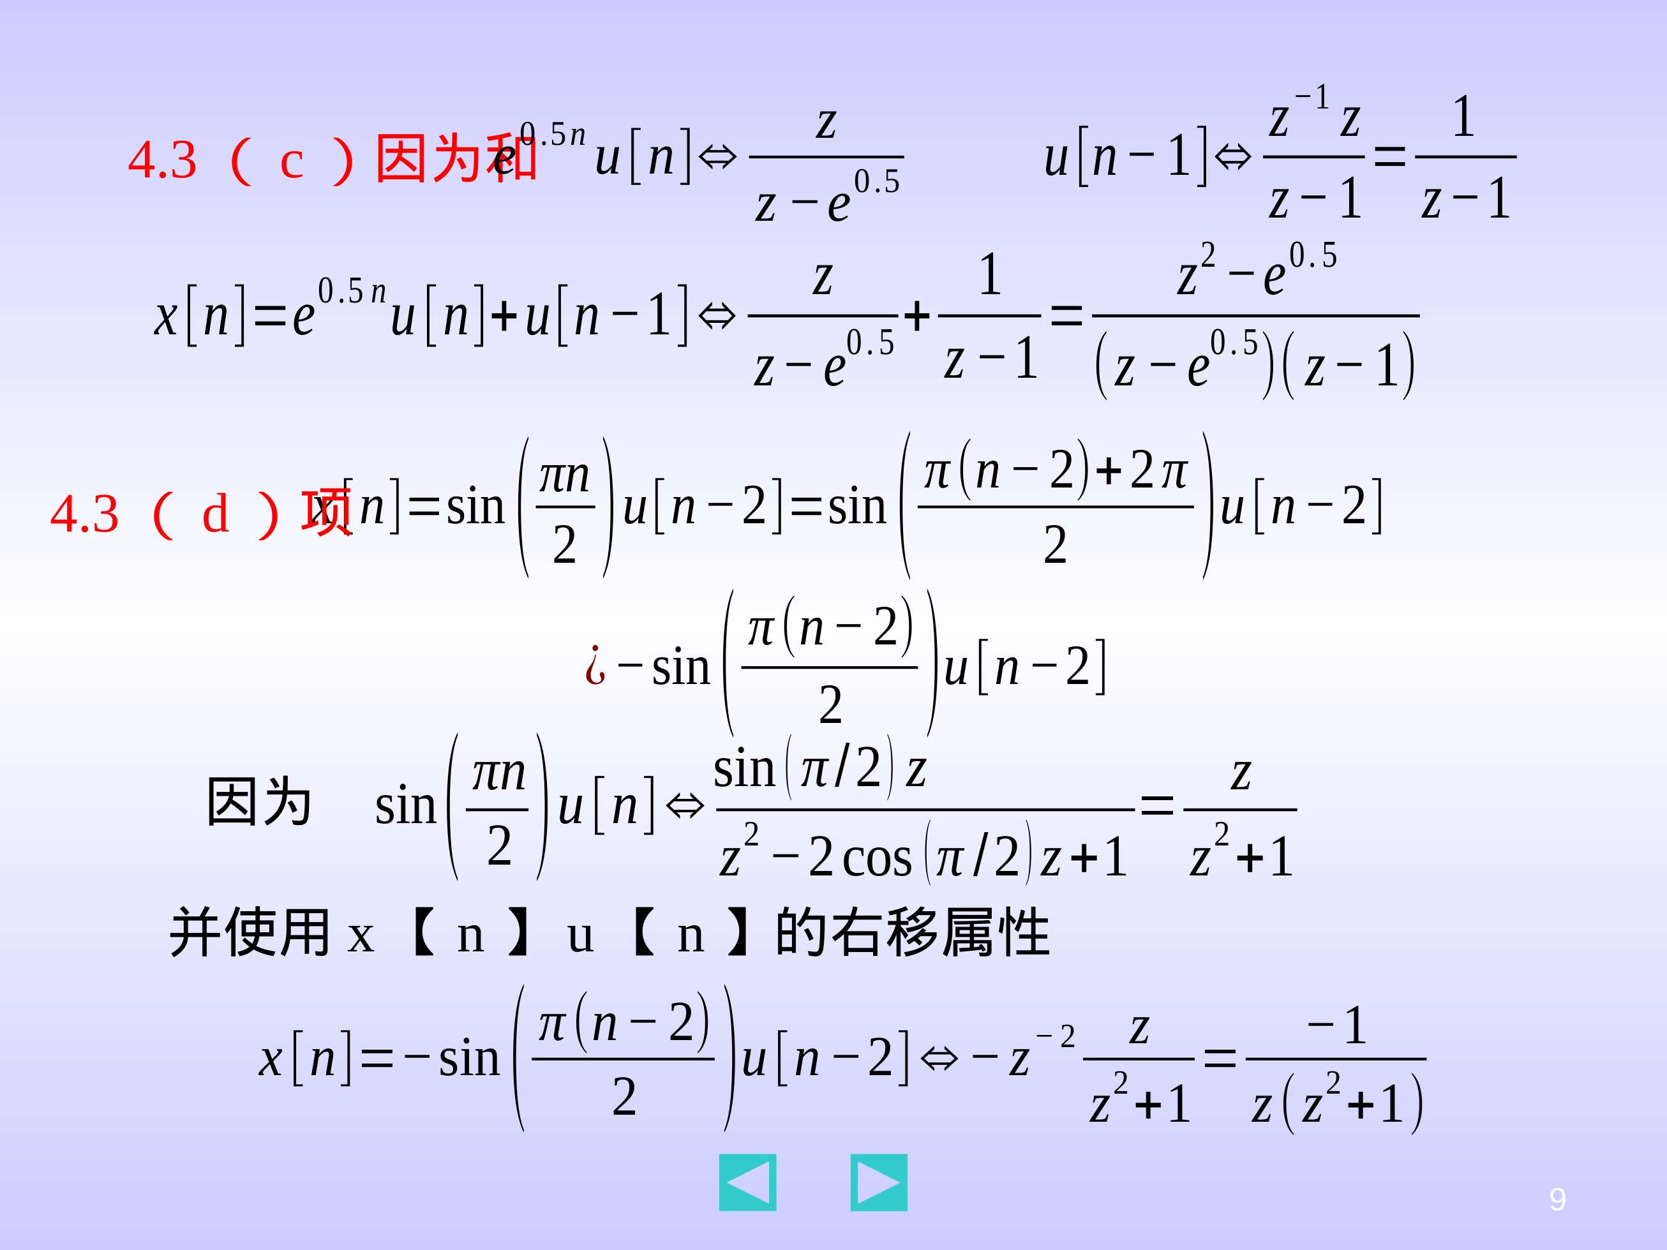

Slide 19
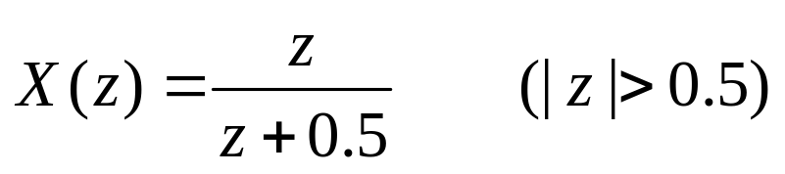
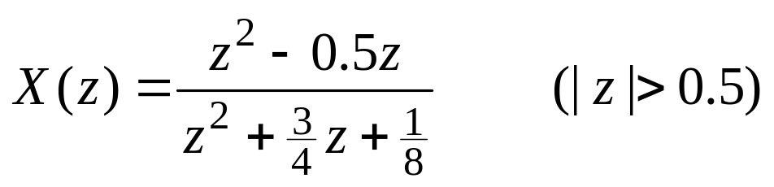
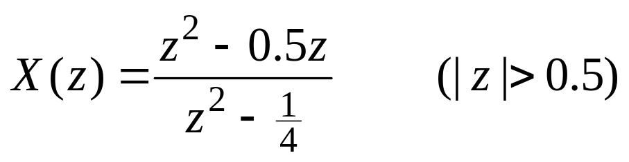
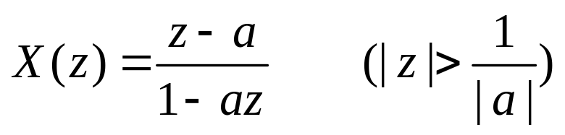
4.4 Compute the inverse z-transform x[n] of the following transforms. Determine x[n] for all integers n≥0.
(1)
(2)
(3)
(4)

Slide 20
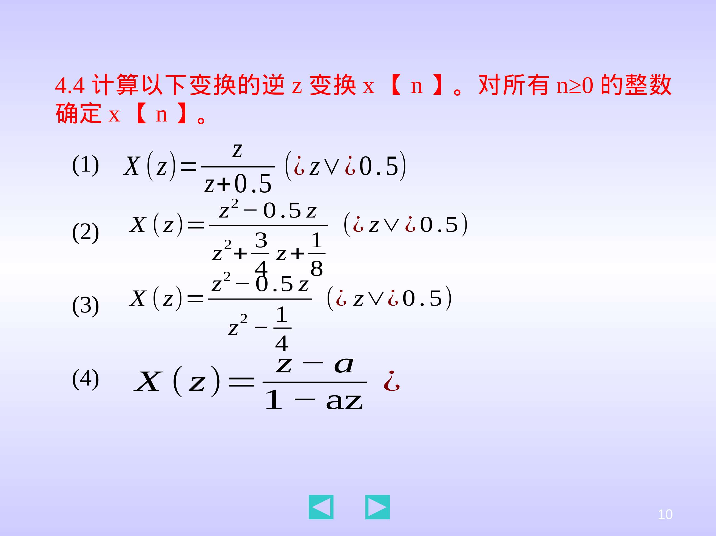

Slide 21
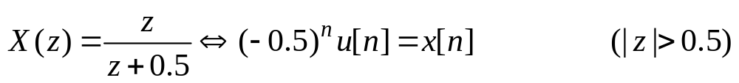
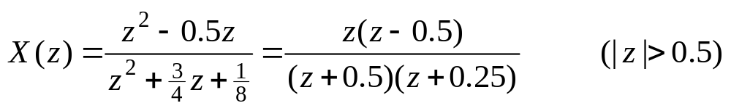
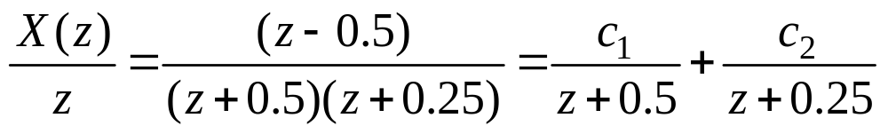
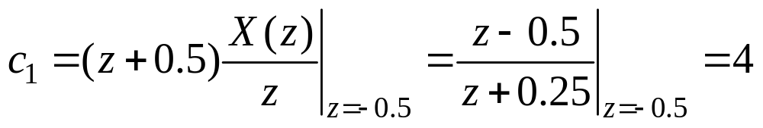
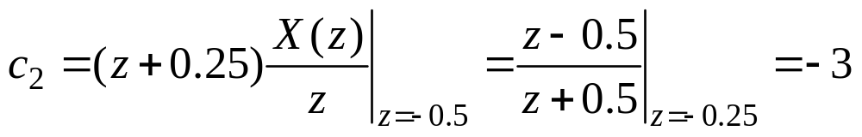
Solution:
4.4(1)
4.4(2)
where,
thus,

Slide 22


Slide 23




4.4(3)
4.4(4)
thus,

Slide 24





Slide 25





4.5 Compute the inverse z-transform x[n] of the following transforms. Determine x[n] for all integers n≥0.
(1)
(2)
Solution:
4.5(1) Because
thus, (4.73)

Slide 26






Slide 27






4.5(2) Because
or,
thus,
Another method:

Slide 28




