Slide 1
Introduction to Container &
Docker

Slide 2
Container
Containers are a lightweight and portable store for an application and its dependencies.

Slide 3




Software Development
Eclipse
JDK8
Tomcat
MySQL
Marven
…
JDK8
JBoss
MYSQL
JDK7
WebSphere
Oracle Client (DB is sunning in another machine)
Other Apps
Other Apps
Other Apps
…

Slide 4
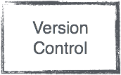


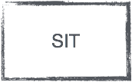

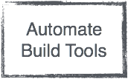

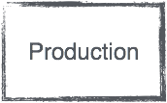

Automate CI / CD Environment
Check In / Push
Trigged
Pull
Automate Deploy
One-Click Publish
Automate Build, Unit Test, Coverage, Integration Test

Slide 5
Virtualization
Install Everything, from OS to application libraries
My app not requires graphic drivers, printer drivers, Windows Services, COM+, etc… I just want to run my app.
Prepare by operation. Most developer has no permission to do it.
Solve issues by emails, screen captures, … Lack of communication.
On production server. Capacity is always full, but runtime usage only fews.

Slide 6
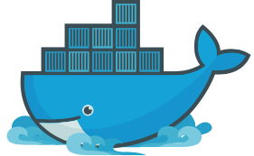
Docker
Docker is the original author and primary sponsor of the Docker open source project.
Together with the community of maintainers and contributors, Docker aims to deliver open tools to help developers build applications with open APIs to help sysadmins better manage these applications.
Services :- Docker Cloud, Docker Datacenter

Slide 7
Container
The docker project offers higher-level tools which work together, built on top of some Linux kernel features.
Docker achieves this by creating safe, LXC (i.e. Linux Containers) based environments for applications called “docker containers”.
Encapsulation of an application with its dependencies.
At first glance, its appear to be just a lightweight form of VM. However, containers have several advantages.
Container holds an isolated instance of an OS, which we can use to run applications.
Containers are fundamentally changing the way we develop, distribute, and run software.

Slide 8
Container Benefits
Share resources with host OS. That makes its an order more effective.
Start and Stop in a second, incur little to no overhead compare to application running natively on the host OS.
Containers has the potential to eliminate bugs cause by changed in the runtime environment. “But it works on my machine” stuff should be gone.
Developers and operation can run dozens of containers at the same time. Making it possible to emulate a production-ready distributed system.
Developers and operation can avoid differences in user environments and the availabilities of dependencies.
Finally, you don’t need to run container all the time to execute your tasks. Start-execute-stop in seconds, with large scale of worker nodes scenario, is possible.

Slide 9










Virtual Machine

Slide 10

Container

Slide 11

Container

Slide 12







Docker Components
Docker Engine :- Create Docker images and run Docker containers. Including Swarm mode from 1.12.0-rc1
Docker Compose :- Defines applications built using multiple containers.
Docker Hub :- A hosted registry service for managing and building images.
Docker Cloud :- A hosted service for building, testing, and deploying Docker images to your hosts.
Docker Trusted Registry :- (DTR) stores and signs your images.
Docker Universal Control Panel :- (UCP) Manage a cluster of on-premises Docker hosts as if they were a single machines.
Docker Machine :- Automate container provisioning on your network or in the cloud. Available for Windows, Mac OS X, or Linux
References :- https://docs.docker.com

Slide 13
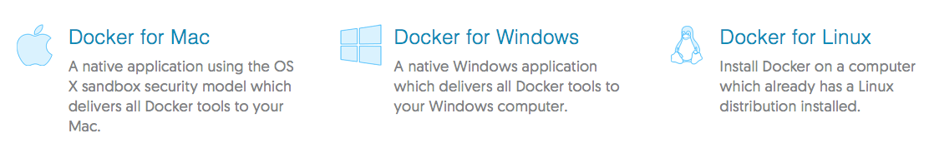
Platforms Supported
OS X 10.10.3 Yosemite or newer
Mac 2010 or newer
Intel’s hardware support for MMU virtualization
At lease 4GB Memory
VirtualBox prior to version 4.3.30 must NOT be installed
64bit Windows 10 Pro, Enterprise or Education (Build 10586 or later)
Support Microsoft Hypervisor
VirtualBox will no longer work
Arch Linux, CentOS, CRUX, Debian, Fedora, FrugalWare, Gentoo, Oracle Linux, RHEL, openSUSE / SUSE Ent., Ubuntu
64bit
Kernel version 3.10 or later

Slide 14
Lab Resources
3 Laptops per team. 4GB Memory, 8GB recommend. 2.5GB - 4GB free memory remains after boot. 16GB free storage space.
VMWare Workstation or VMWare Player. https://goo.gl/rZTnVn
Visual Studio Code with Dockerfile plugins https://code.visualstudio.com/download Atom or Sublime should be ok.
Ubuntu 16.04.1 LTS VMWare Guest Image (1.13GB) download: http://download.somewhere.com/img.zip
Handouts download: http://download.somewhere.com/handouts

Slide 15
References
Docker Official Website :- https://www.docker.com
Documents :- https://docs.docker.com Overview :- https://goo.gl/vnVJGT Getting Start :- https://goo.gl/pbfSjq Learn by Example :- https://goo.gl/F5ZTQS
Github :- https://github.com/docker/docker https://github.com/docker
Some Interesting Books :- Using Docker :- http://amzn.to/2aYflh5 Docker Up & Running :- http://amzn.to/2aYeBIC

