Slide 1
Data Preprocessing - NLP Sessions I
Yuhang
July 2017

Slide 2
Python environment
Install Anaconda
Install virtual environment
conda create –name tensorflow
Install Python modules
tensorflow, keras, ipython, sk-learn, etc.

Slide 3
Corpora & Vector Spaces
From strings to corpora
documents =
["Human machine interface for lab abc computer applications",
"A survey of user opinion of computer system response time",
"The EPS user interface management system”]
Build dictionary
{'minors': 11, 'graph': 10, 'system': 5, 'trees': 9, 'eps': 8, 'computer': 0, 'survey': 4, 'user': 7, 'human': 1, 'time': 6, 'interface': 2, 'response': 3}
Build reverse_dictionary
{0: 'computer', 1: 'human', 2: 'interface', 3: 'response', 4: 'survey', 5: 'system', 6: 'time', 7: 'user', 8: 'eps', 9: 'trees', 10: 'graph', 11: 'minors'}
Build sequence
[“Human computer system”] => [1, 0, 5]

Slide 4
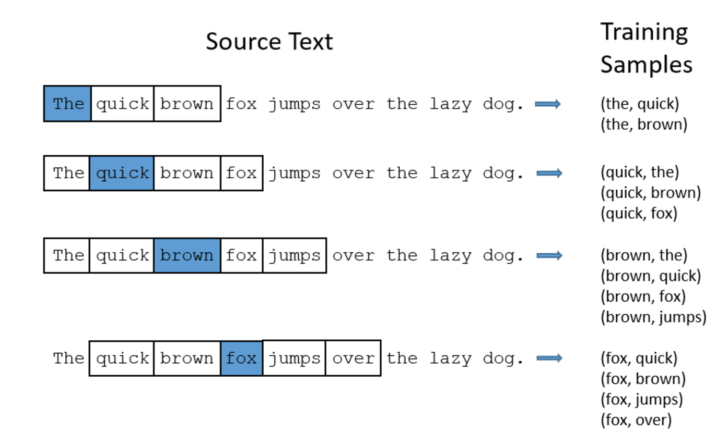
Word2Vec
Paper: https://arxiv.org/abs/1301.3781
tutorial: http://mccormickml.com/2016/04/19/word2vec-tutorial-the-skip-gram-model/
Code: https://github.com/chrisjmccormick/word2vec_commented

Slide 5
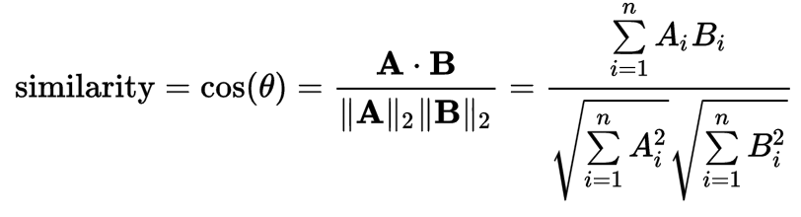
Cosine Similarity
Once word2vec word embedding is learned, words (or documents) similarity can be calculated this way.
similarity = np.matmul(em_word, np.transpose(em_word))

Slide 6
Numpy Arrays
a = np.array([[1,2,3],
[4,5,6],
[7,8,9],
[10, 11, 12]])
# Create an array of indices
b = np.array([0, 2, 0, 1])
# Select one element from each row of a using the indices in b
print(a[np.arange(4), b])
# Prints "[ 1 6 7 11]"
http://cs231n.github.io/python-numpy-tutorial/

