Slide 1
Distributed Systems
Pavlos Sofroniou
Alexandros N. Zafeirakopoulos
Technical University of Crete, June 2nd 2021

Slide 2
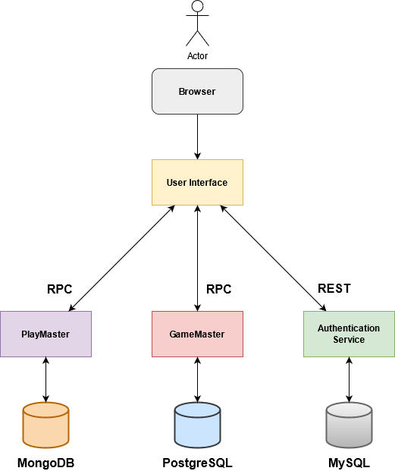
Architecture Diagram

Slide 3
Tools, Frameworks and Libraries
Server-side scripting done with NodeJS and Express
Axios and AJAX
gRPC for interservice communications
SQL with Sequelize ORM
MongoDB with Mongoose ODM
Docker for container deployment
EJS for HTML templating
CSS with Bootstrap
JavaScript for game logic(chess, tic-tac-toe)
Postman
Github, Git, Github desktop, GitKraken
phpMyAdmin, pgAdmin
mongo-express

Slide 4
Authentication Service
Player, Admin and Official
POST: /api/user/register
Validate user details and insert into SQL DB.
POST: /api/user/login
Authenticate user and issue a JWT.
GET: /api/user/tokenValidation
Check if token is valid.
Admin
GET: /api/user
Fetch all users except admins.
DELETE: /api/user/:username
Delete a specified user.
PUT: /api/user/:username
Update user email and role.

Slide 5
GameMaster Service
Practice play
connectUser()
- Check if the user already exists in matchmaking
joinGame()
- Try to join an already existing play or create one
deleteGame()
- Delete game after the timeout for matchmaking has been reached
gameHistory()
- After the end of a play, move the game from the GameList table into the
GameHistory table
History
getPracticeHistory()
- Return the practice history of the plays for a given user
getTournamentHistory()
- Return the tournament history of all the plays
Leaderboards
leaderboards()
- Return the scores (practice or tournament) for all players

Slide 6
GameMaster Service
Tournament creation and deletion (Official)
createTournament()
- Create a tournament with the given options
deleteTournament()
- Delete a specific tournament from the available ones
Joining and leaving a Tournament (Player)
joinTournament()
- join a tournament and wait for all players to join
leaveTournament()
- leave a tournament
Tournament execution
joinGameTournament()
- Matchmake all tournament players for a round (normal, semifinal, final)
continueTournament()
- If won, wait for all the plays to finish before continuing to the next round
removePlayerTournament()
- If lost, remove from the tournament and update relevant score
checkTournamentEnd()
- check if tournament has ended and move it to history

Slide 7
PlayMaster Service
Individual play management
initializeGame()
- Initialize the game with default values in the database
pushMove()
- save last move made by a player
checkTurn()
- check if the player's turn has come
receiveMove()
- retrieve the move made by the opponent and check if the game has ended
gameEnd()
- update the status and winner of the game when it ends

Slide 8
Problems, Missing Features and Future Work
Problems and possible solutions
Not fault tolerant
- disconnections
- user must be consistent(inputs, refreshes, redirections)
- concurrency in matchmaking
- non critical bugs
Missing features
- Spectator functionality
- Kubernetes implementation and Okeanos deployment
- PlayMaster replication (if a node fails)

Slide 9
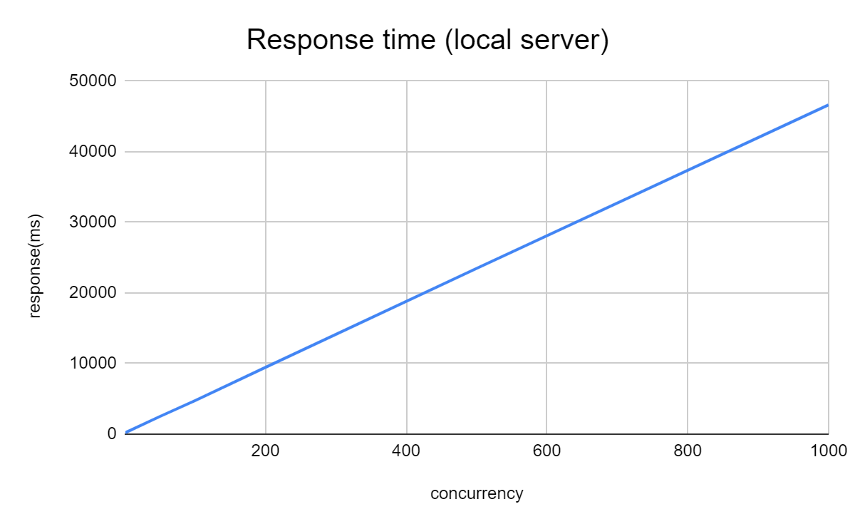
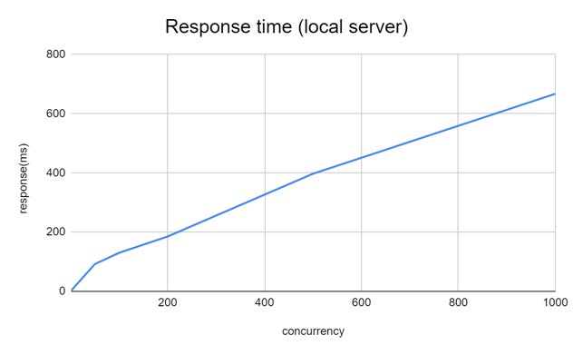
Apache Bench – System Performance
POST: http://127.0.0.1:3000/login/auth
GET: http://127.0.0.1:3000/login
concurrency | response(ms)
1 | 203
50 | 2484
100 | 4741
200 | 9446
500 | 23476
1000 | 46638
concurrency | response(ms)
1 | 3
50 | 92
100 | 130
200 | 185
500 | 397
1000 | 667

Slide 10
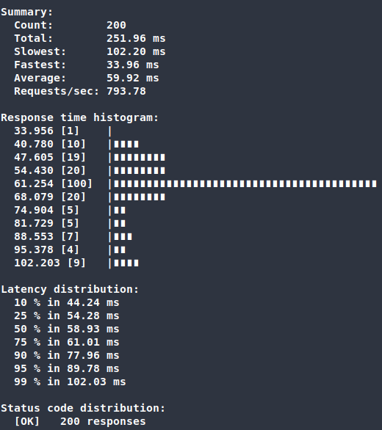
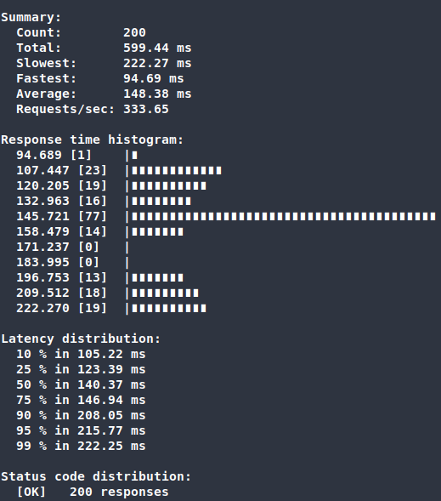
gRPC (ghz) – System Performance
GameMaster.createTournament()
GameMaster.getTournamentList()

Slide 11
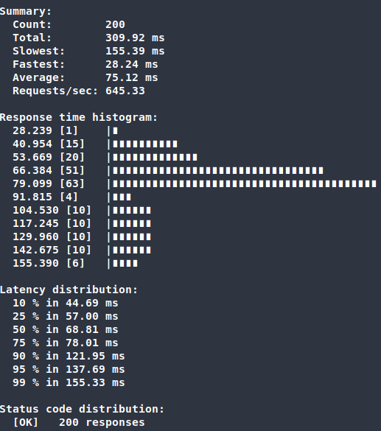
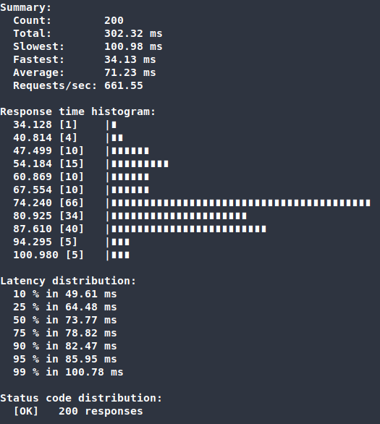
gRPC (ghz) – System Performance
PlayMaster.initializeGame()
PlayMaster.receiveMove()

Slide 12
Thank you for your time! Now we will proceed to the demo.

