Slide 1
Body Language

Slide 2
Body language cues over the last two weeks

Slide 3
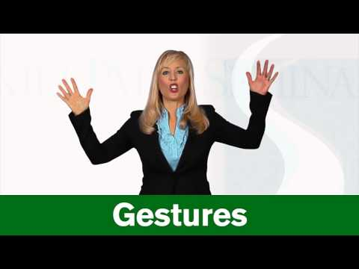

Slide 4
Activity

Slide 5
Reflection

Slide 6
The End

