Slide 1
LLM Prompting
Strategy Comparison
Zero-shot vs Good Few-shot vs Poor Few-shot
Customer complaint classification using Qwen2.5:3B + Ollama
Group : 07
Presenter(s): Anzar Eqbal(MT/AI/10002/26), Md Sartaj Hussain(MT/AI/10018/26)
Institute: BIT Mesra | Program: M.Tech(AI&ML)
Notes:
Suggested time: 1 minute. Introduce the project as a comparison of three prompting strategies for a local language model. Replace the team and presenter placeholders before presenting. This is prompting-based evaluation, not model fine-tuning.

Slide 2
1. Real-World Problem
02
Customer-support teams receive large volumes of messages every day.
Customer
complaint
→
LLM
classifier
→
Support
category
• Manual sorting can be slow and inconsistent.
• Incorrect routing delays refunds, technical support, deliveries, or account recovery.
• Automatic classification can help route messages to the right team.
• Model decisions may depend on how instructions and examples are written.
Motivation: test whether prompt examples improve or harm category decisions.
Notes:
Suggested time: 2 minutes. Explain how automatic routing may save support teams time, but errors have a cost. This is a prototype experiment, not a deployed support system.

Slide 3
2. Research Question & Hypothesis
03
Research question
How do zero-shot, good few-shot, and deliberately poor few-shot prompts affect complaint-classification performance?
Hypotheses
• H1: Correctly labeled examples may guide the model and improve consistency.
• H2: Incorrectly labeled examples may confuse the model and reduce performance.
• H3: Clear category definitions may let zero-shot perform similarly to good few-shot.
These are hypotheses to test—not results to assume in advance.
Notes:
Suggested time: 2 minutes. Explain that hypotheses predict possible outcomes but are not guaranteed. Scientific evaluation tests them rather than forcing results to match expectations.

Slide 4
3. Dataset Description
04
1,000
4
750 / 250
250 each
generated complaints
categories
train / test
per category
Labels and examples
Data generation
• Billing — charges, invoices, payments, refunds
• Technical — software bugs, crashes, website errors
• Delivery — shipping, tracking, parcel problems
• Account — login, password, profile, access
• 25 base descriptions per category
• 10 sentence patterns per description
• Saved to data/complaints.csv
• Stratified split preserves class proportions
Limitation: rows are template-generated, not 1,000 independently written real complaints.
Notes:
Suggested time: 2.5 minutes. The dataset has four balanced categories, 250 examples each. A 75/25 split yields 750 train and 250 test examples. It is generated from 25 base descriptions per category and ten sentence patterns. Similar wording can occur in train and test, potentially making evaluation optimistic.

Slide 5
4. Methodology
05
A
Zero-shot
Category definitions + test complaint; no labeled demonstrations.
B
Good few-shot
Same instructions plus correctly labeled training examples.
C
Poor few-shot
Same instructions, but demonstration labels are deliberately mismatched.
Fair comparison: keep model, test set, definitions, output format, and evaluation fixed; change only the examples.
Notes:
Suggested time: 2 minutes. Explain each condition. Few-shot prompting does not update model weights; examples are placed in the prompt context. The poor condition is an artificial stress test, not a recommended technique.

Slide 6
5. Experimental Setup
06
• Model: qwen2.5:3b, run locally
• Runtime: Ollama; no OpenAI API key required
• Output format: JSON with one category label
• Temperature: 0 to reduce sampling variation
• Stratified 75/25 split; random_state = 42
• Metrics: Accuracy, macro Precision, macro Recall, Macro-F1
• Outputs: metrics.csv, predictions.csv, chart, confusion matrices
All three strategies use the same test set, enabling a direct comparison.
Notes:
Suggested time: 2 minutes. Temperature zero reduces sampling variation but cannot guarantee identical outputs in every environment. Stratification preserves class proportions. Predictions are compared against known labels. Multiple random seeds would make the study stronger.

Slide 7
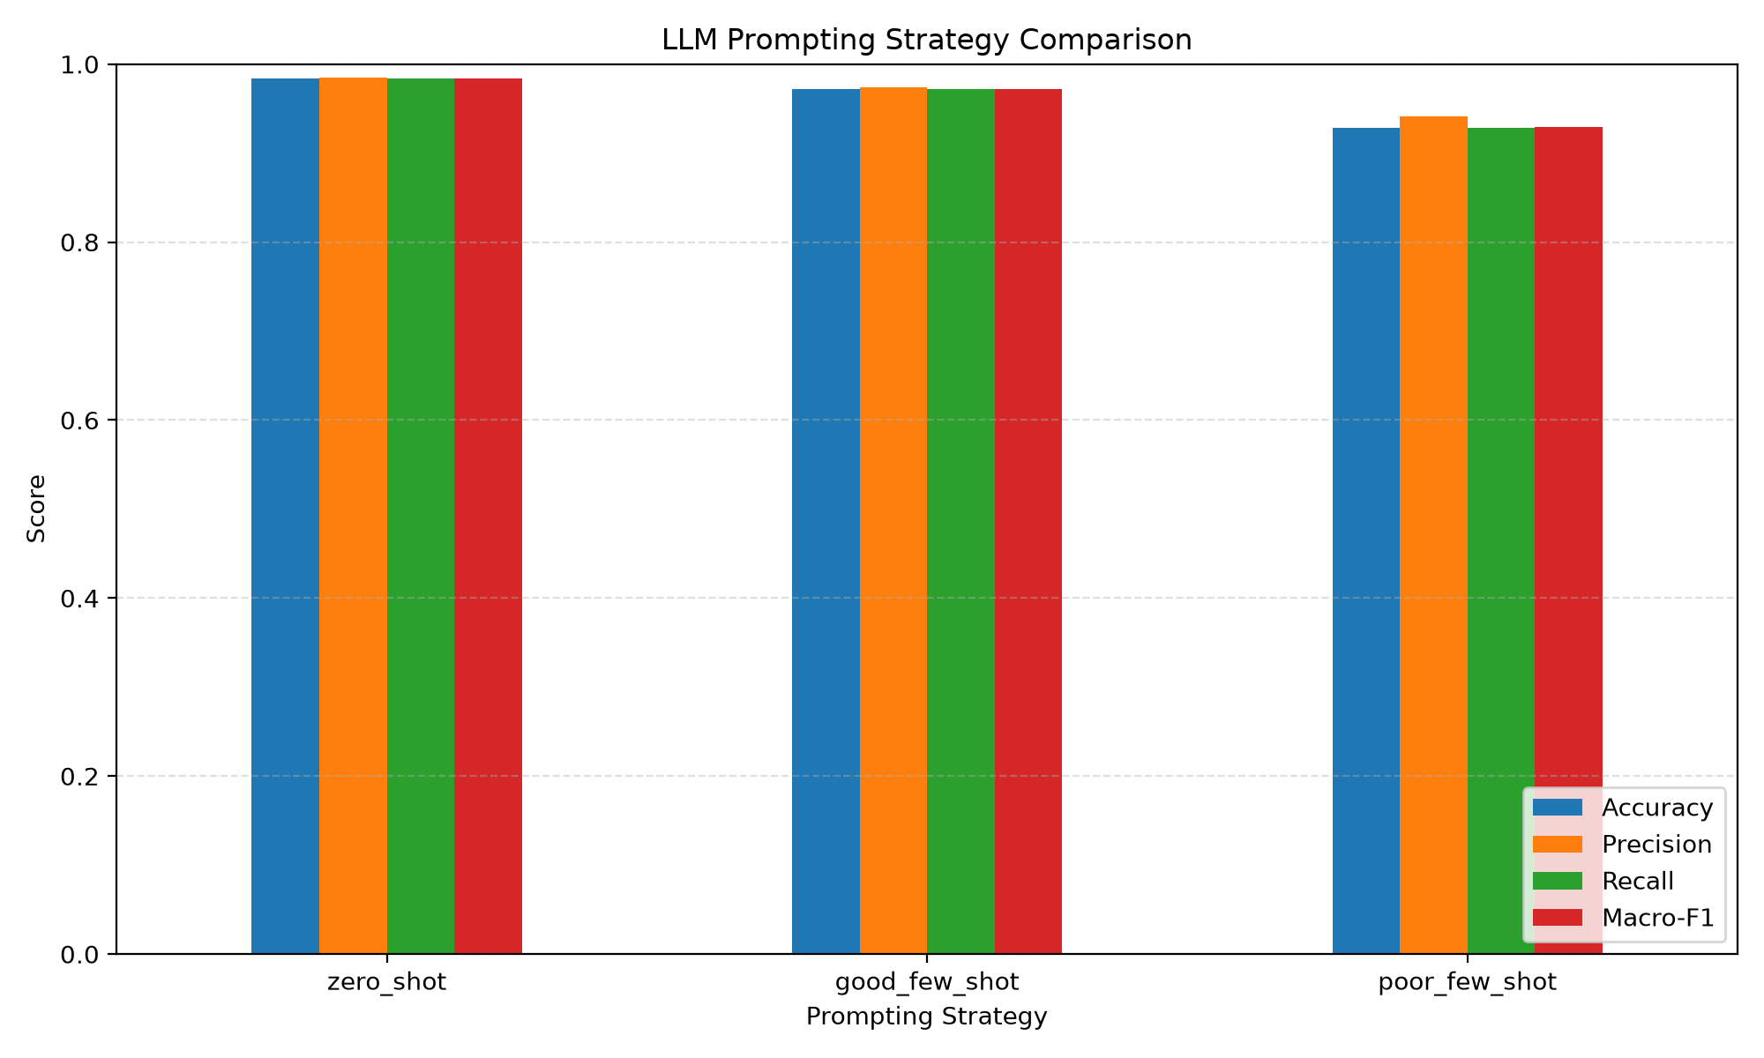
6. Results: Strategy Comparison
07
Zero-shot
Accuracy 98.4% | Macro-F1 0.984
Good few-shot
Accuracy 97.2% | Macro-F1 0.972
Poor few-shot
Accuracy 92.8% | Macro-F1 0.929
Best observed: zero-shot. Lowest: poor few-shot.
Notes:
Suggested time: 2.5 minutes.
From the supplied confusion matrices: zero-shot 246/250 = 98.4%; good few-shot 243/250 = 97.2%; poor few-shot 232/250 = 92.8%. Macro-F1: 0.984, 0.972, and 0.929. This is a result for this setup, not a universal rule that zero-shot is always better.

Slide 8
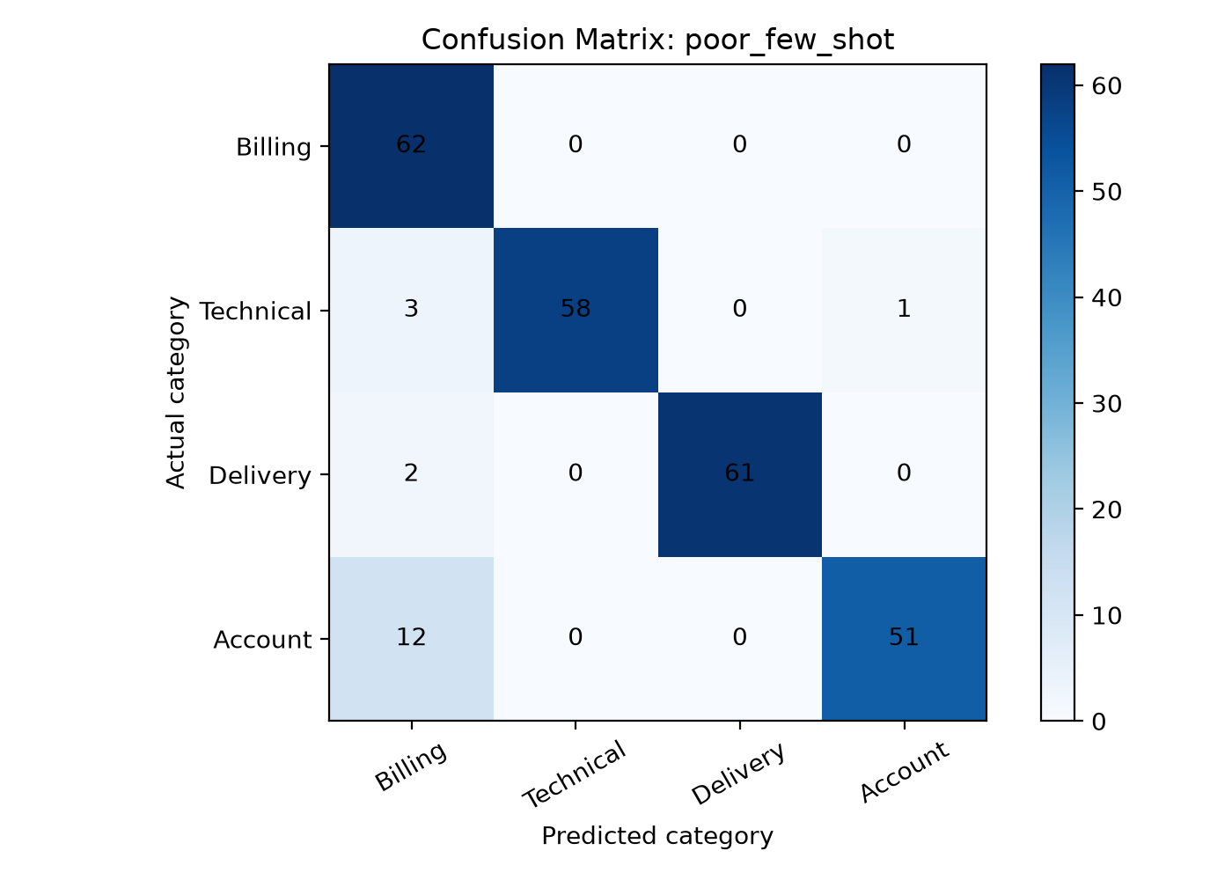
7. Interesting / Failure Cases
08
What stands out?
• Poor few-shot: 12 actual Account complaints predicted as Billing.
• Technical complaints were occasionally confused with Billing or Account.
• Zero-shot made fewer total errors than either few-shot condition.
• Incorrect demonstrations may bias the model toward wrong labels.
Rows = actual class; columns = predicted class; diagonal = correct predictions.
Notes:
Suggested time: 2.5 minutes. In the poor few-shot matrix, 12 Account complaints were classified as Billing. Off-diagonal cells show mistakes. This pattern is consistent with misleading examples affecting decisions, although the matrix alone does not prove causation. Individual examples can be inspected in predictions.csv.

Slide 9
8. Conclusion, Limitations & Future Work
09
Conclusion
• Prompt strategy affected performance in this experiment.
• Zero-shot was strongest; deliberately poor examples produced the most errors.
• Good examples did not outperform clear category instructions in this run.
Limitations
Future work
• Synthetic, templated data can cause near-duplicate train/test examples.
• Only one model and one split are represented.
• Results may not transfer to ambiguous real complaints.
• Use real or independently written complaints.
• Split by base complaint before paraphrasing.
• Test multiple seeds and models; report mean ± standard deviation.
• Review per-class metrics and individual errors.
Takeaway: prompt examples can help or hurt; test them on a realistic evaluation set.
Notes:
Suggested time: 2 minutes. Acknowledge that synthetic repeated templates may inflate performance. Future experiments should use independent examples, prevent related wording from leaking across splits, run multiple seeds, and compare more models.

Slide 10
Thank You!
Notes:
Suggested time: 2 minutes. Acknowledge that synthetic repeated templates may inflate performance. Future experiments should use independent examples, prevent related wording from leaking across splits, run multiple seeds, and compare more models.

