Slide 1

Team Paradox 2.0

Slide 2

Why
The hospital industry in India is forecast to increase to Rs. 8.6 trillion (US$ 132.84 billion) by FY22 from Rs. 4 trillion (US$ 61.79 billion) in FY17 at a CAGR of 16–17%. The Government of India is planning to increase public health spending to 2.5% of the country's GDP by 2025.
The Indian electronic medical record market is projected to witness a compound annual growth rate of 6.67% to grow to US$314.720 million by 2026, from US$200.240 million in 2019. The Indian electronic medical record market is expected to grow owing to the rapid digitalization happening in the medical sector in India.
Electronic Health Records ( EHR ) is the digitized collection of patients or populations' medical or health information. The vital health records of people are entered electronically by the healthcare providers throughout his/her lifetime. EHRs aim towards making the patient-centered records securely and instantly available to authorized users on demand.
Although EMR has tangible positive outcomes, the adoption rate has been low. The market comprises handful of hospitals using EMR. The usage of EMR is limited to corporate hospitals in the various metro cities of India. The known hospital chain Fortis and Apollo have been using EMR in a few of their hospitals.
Biggest challenge for EHR in India is the lack of capital needed for implementation in hospitals of non-metro cities or unawareness of benefits of EHR.
There is a need of platform which would be mobile and easy to use by both Physician/Doctor and User/Patient to keep track of medical data.

Slide 3
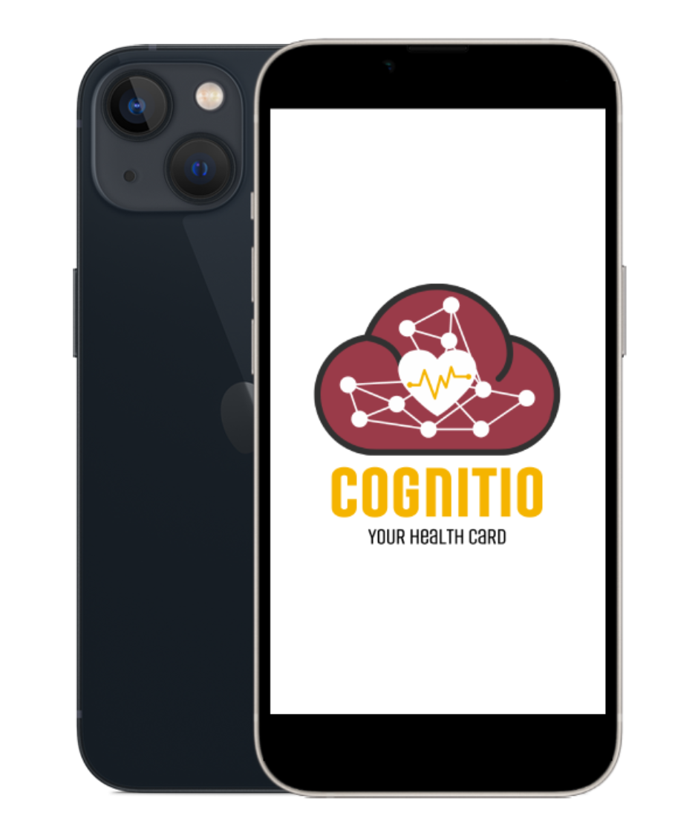
COGNITIO
Your Health Record
A decentralised affordable medical history database

Slide 4
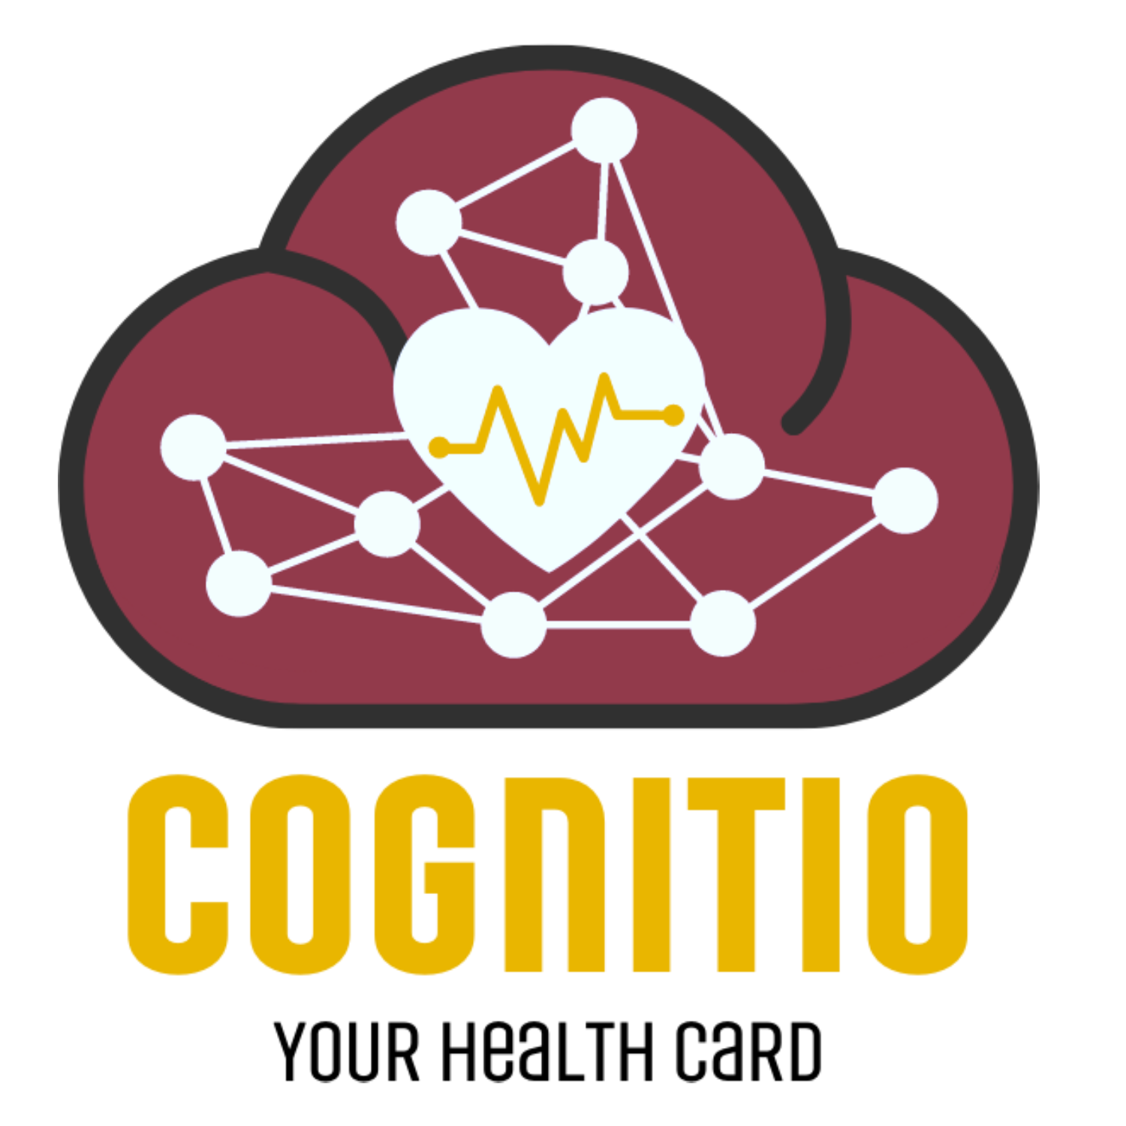
Right now, big hospitals have their own EMR system , major problem with that system is;
Cost of Implementation
Data is centralised and only available to that hospital , due to this reason there is no integration of data from different hospital organization
The digitized data is often not shared with the patients
Our platform provide feature to store past medical records and data and access them at one place.
The purpose of collecting medical records, as much as possible, are manifold – better and evidence-based care, increasingly accurate and faster diagnosis that translates into better treatment at lower costs of care, avoid repeating unnecessary investigations .
The benefits are COGNITIO can reduce application and treatment time while improving customer experience.

Slide 5

IPFS
The Interplanetary File System (IPFS) is a file system protocol based on a peer-to-peer network for storing and sharing data in a distributed file system. IPFS uses content-addressing to uniquely identify each file in a global namespace connecting all computing devices.
In our platform the major part of data is stored on IPFS and can only be viewed through the hash generated by IPFS.
The data stored is linked to a hash which can then later be used to query the data stored on the file system.
In our platform, the whole IPFS query model is separated into a node application, which we refer to as an IPFS engine. It consists of three API endpoints:
One that stores text data to the filesystem.
Second is responsible for storing the binary data to the system.
And the final one is responsible that fetch the saved data by using the hashes that we got by the response of the two endpoints we discussed earlier.
Because of IFPS there is high availability of data.
Since data is on distributed file system, because the whole system is paired with some asymmetric cryptographical algo it tends to have more security than traditional file system.
This hash generated is based on sha-256, which has a reputation of not getting broken unlike some popular hashing algorithms.

Slide 6
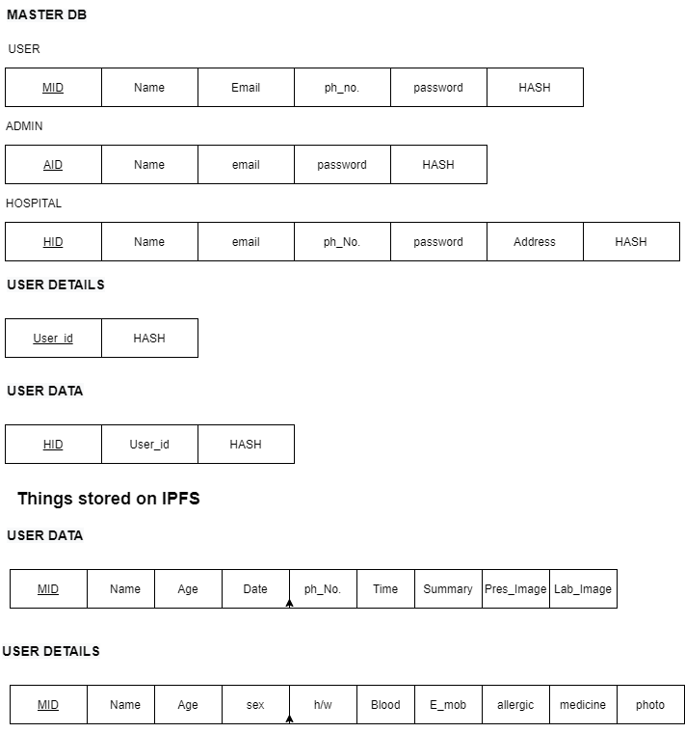
SCHEMA

Slide 7
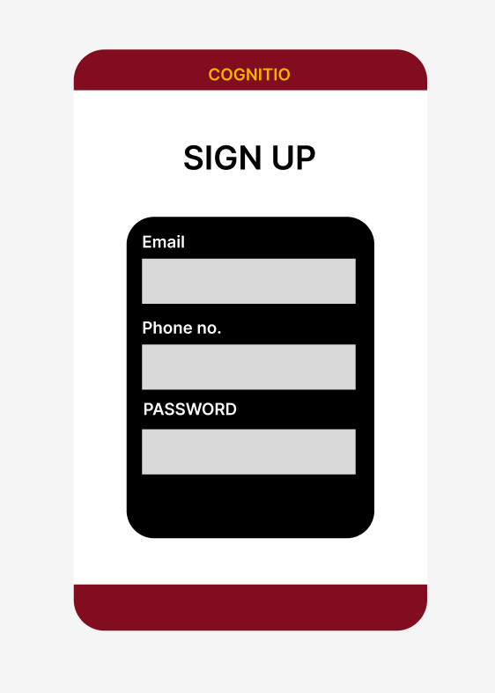
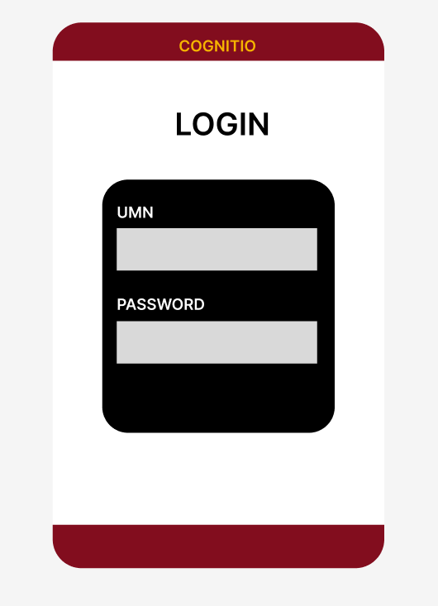
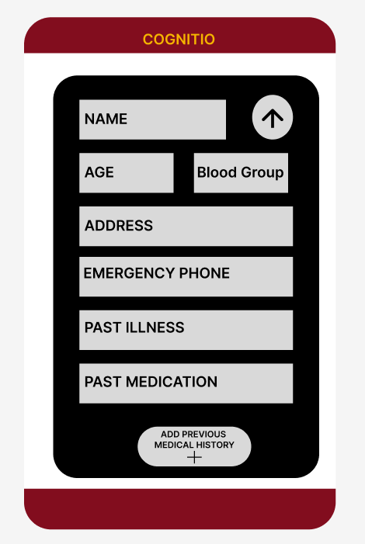
User App : User can register and one unique medical id will be generated. User can fill out basic info and upload older medical info. User can view past medical history
Sign up / Login
Fill out basic info

Slide 8
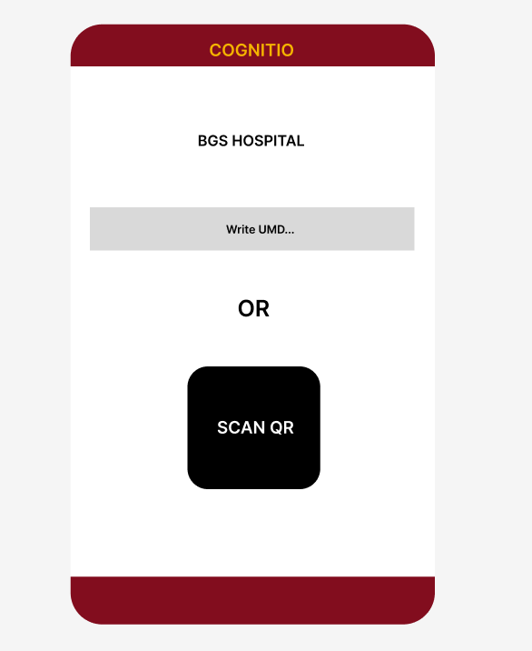
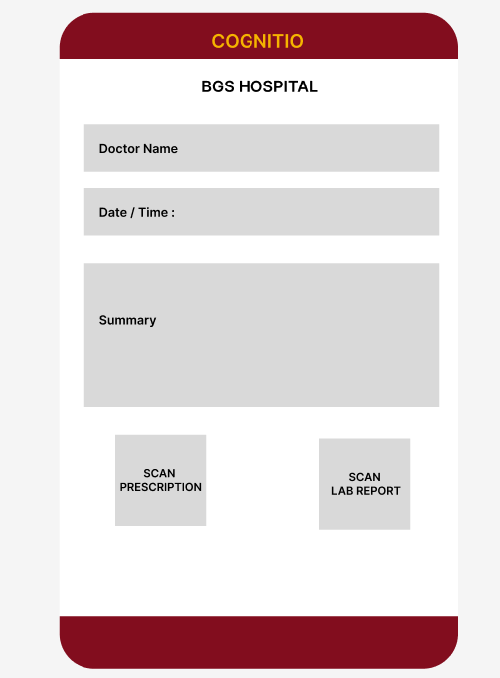
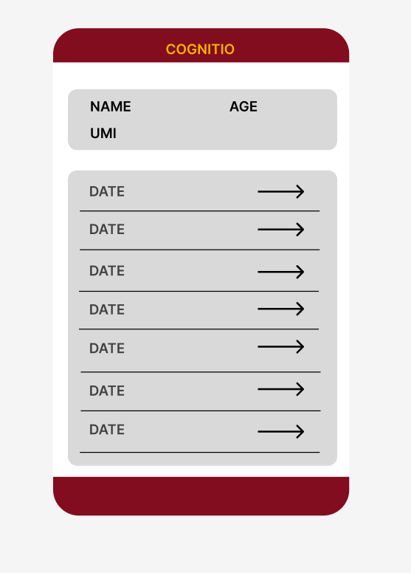
Hospital/Physician (PHP based Web App) : Physician can ask for permission to update medical history using patient unique id (Authorization done with Otp check) Physician can upload Prescription, Lab reports , Diagnose summary etc. The image data will be compressed before saving on database. There will be two portals out there , admin portal and hospital portal.
Access the data
Upload the data
Check previous medical history

Slide 9
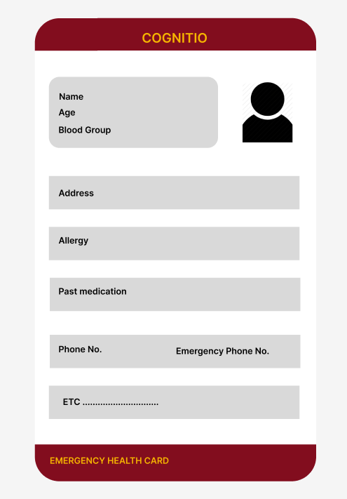

Interface Concept : Emergency Web App
Emergency Info :
This service will be optional , user can turn it off whenever they want
The user app will generate a QR code
No authorization needed to view the data.
By scanning this QR code, basic info about user will be shown on web app( Identification , past medication, allergies)
In future planning to detect accident by collect high-frequency sensor data from instruments in the phone and automatically show QR code on screen.
QR code
Emergency Health Card

Slide 10

Business Model
Subscription based model can be used to generate revenue in which a small fess will be taken from user to avail storage feature . (Small subscription fees like Rs. 100-200 per family).
We can also collaborate with the Indian Government to help reach the out to unreachable sections of India and cover much wider population. (PMGDISHA)
There will be a different subscription model, exclusive to hospital management to provide service related to store and manage electronic health record for them.

Slide 11
Future Plan
To have a feature to manage health data of family members.
Integrate and partner with insurance company to provide them with EHR data , by this data insurance companies can provide score to categorise future customers or validate insurance claim more accurately.
The data in masked format can be used in analytics including predictive analytics to support personalized care, improved health policy decisions based on better understanding of the underlying issues, etc., all translating into improved personal and public health.
We can use the analytics to provide the user with health tips and issue warning when we deduce possibility of emerging disease.

Slide 12

Thank You

