Slide 1

Team Paradox

Slide 2
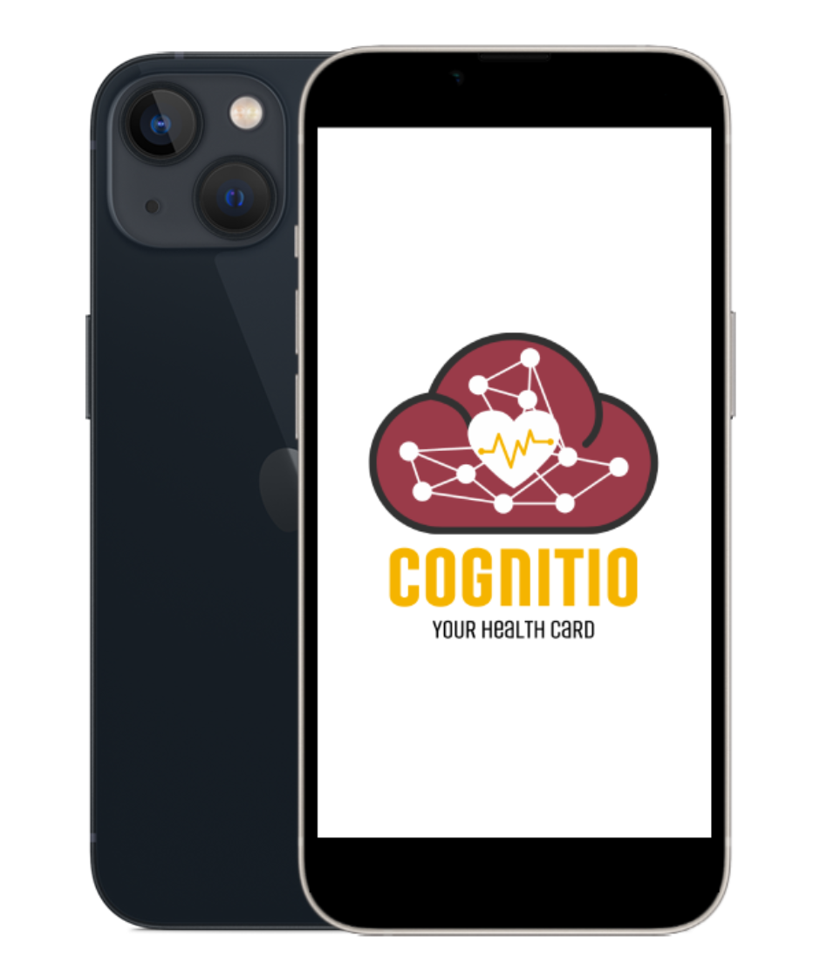
COGNITIO
Your Health Record
A decentralised affordable medical history database

Slide 3
Why
The Indian electronic medical record market is projected to witness a compound annual growth rate of 6.67% to grow to US$314.720 million by 2026, from US$200.240 million in 2019. The Indian electronic medical record market is expected to grow owing to the rapid digitalization happening in the medical sector in India.
Although EMR has tangible positive outcomes, the adoption rate has been low. The market comprises handful of hospitals using EMR. The usage of EMR is limited to corporate hospitals in the various metro cities of India. The known hospital chain Fortis and Apollo have been using EMR in a few of their hospitals.
Electronic Health Records ( EHR ) is the digitized collection of patients or populations' medical or health information. The vital health records of people are entered electronically by the healthcare providers throughout his/her lifetime. EHRs aim towards making the patient-centered records securely and instantly available to authorized users on demand.
Biggest challenge for EHR in India is the lack of capital needed for implementation in hospitals of non-metro cities or unawareness of benefits of EHR.
There is a need of platform which would be mobile and easy to use by both Physician/Doctor and User/Patient to keep track of medical data.
Also the platform should have capability to integrate medical data from different medical organisaton.

Slide 4
Challenges With Existing Platform
Cost of Implementation

Slide 5
Decentralized File System
The InterPlanetary File System (IPFS) is a protocol and peer-to-peer network for storing and sharing data in a distributed file system. IPFS uses content-addressing to uniquely identify each file in a global namespace connecting all computing devices
In our platform the major part of data is stored on IPFS , and can only be viewed through the hash generated by IPFS.
This hash generated is based on sha-256 .

Slide 6
Our App:
User : (Flutter based App)
User can register and one unique medical id will be generated
User can fill out basic info and upload older medical info
Hospital/Physician (PHP based Web App) :
Physician can ask for permission to update medical history using patient unique id (Authorization done with Otp check)
Physician can upload Prescription, Lab reports , Diagnose summary etc.
The image data will be compressed before saving on database.
There will be two portals out there , admin portal and hospital portal.
Emergency Info :
This service will be optional , user can turn it off whenever they want
The user app will generate a QR code
No authorization needed to view the data.
By scanning this QR code, basic info about user will be shown on web app( Identification , past medication, allergies)
In future planning to detect accident by collect high-frequency sensor data from instruments in the phone and automatically show QR code on screen.

Slide 7
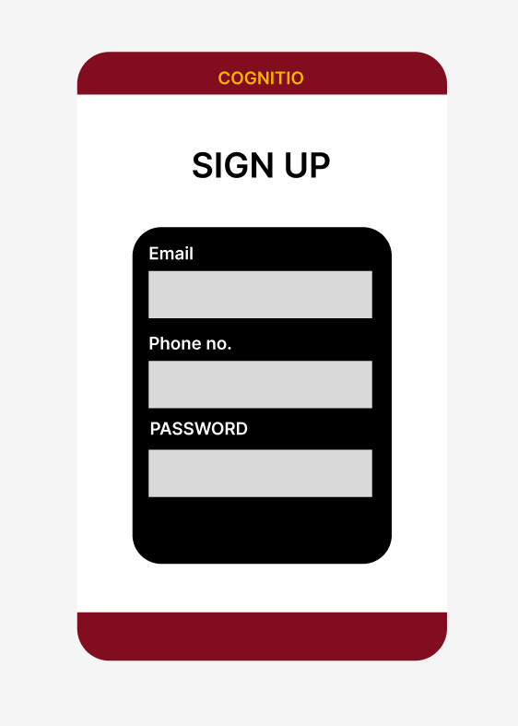
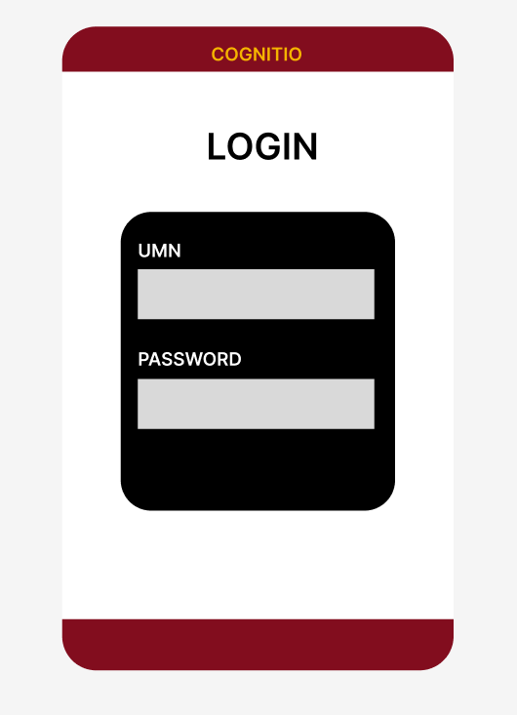
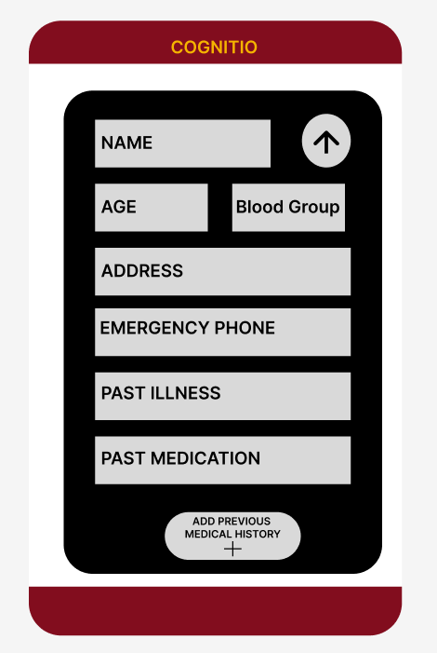
Interface Concept : User Side

Slide 8
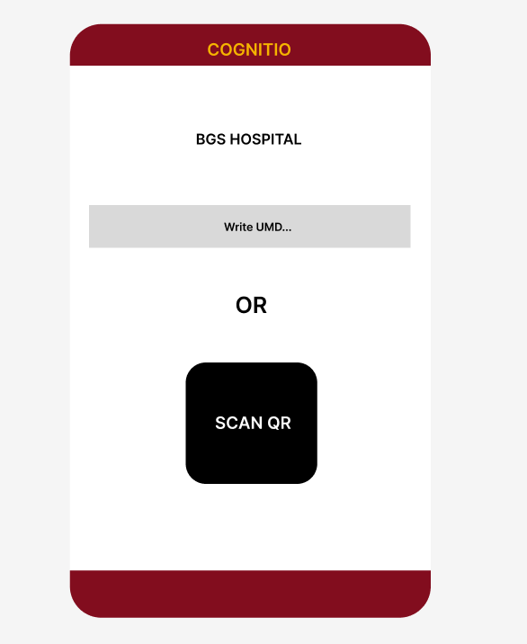
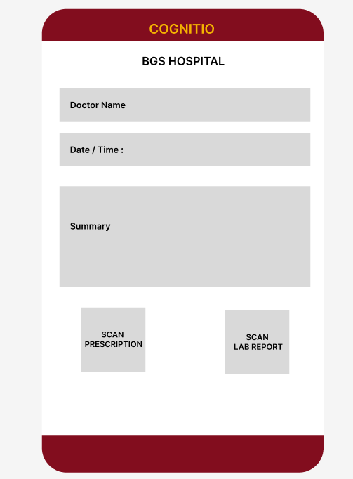
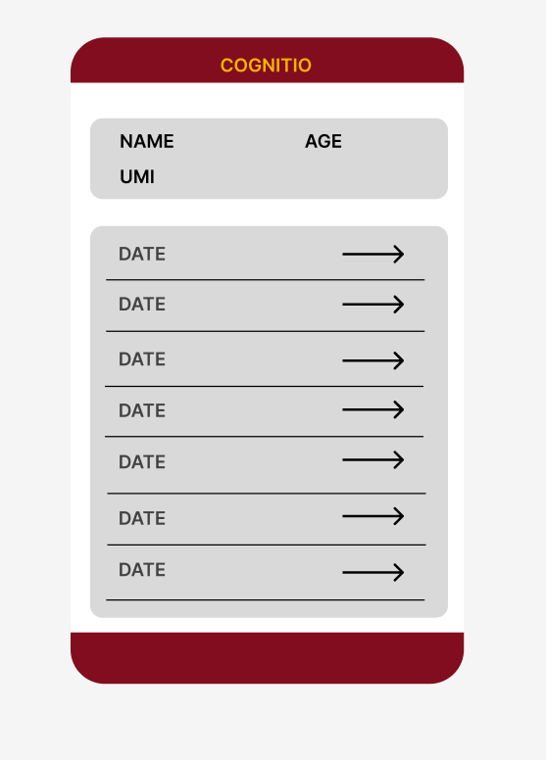
Interface Concept : Hospital/Physician

Slide 9
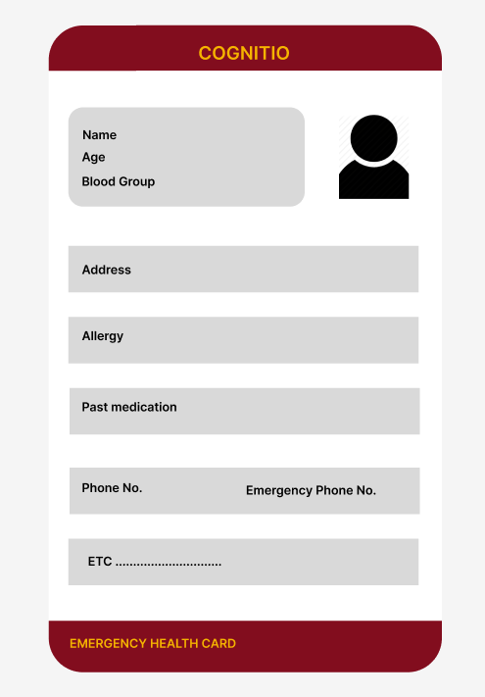

Interface Concept : Emergency Web App
QR code
Emergency Health Card

Slide 10
Bussinese Model

