Slide 1
Reservoir Sampling
Anže Pečar, Miha Zidar

Slide 2
What is reservoir sampling
Continuous data
Random sample
data mining
AUC maximization
frequent itemsets
online learning
J.~S. Vitter, Random Sampling with a Reservoir

Slide 3
Algorithm R
for simmilar data over time
Simple implementation
Lots of room for improvement

Slide 4
Algorithm Z
Simmilar to Algorithm R
Improved perfomance
Rejection technique
Does not detect trends

Slide 5
Online learning
Focus on recent data
Constant feedback
Good for endless streams
Algorithms:
  Logistic regression
  Online AUC maximization
N. Littlestone, Learning Quickly When Irrelevant Attributes
Abound: A New Linear-threshold Algorithm

Slide 6
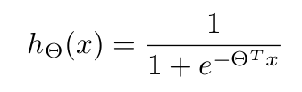
Logistic regression
Popular and widely used
Classification algorithm
Give a forecast of costs
Fitting parameters

Slide 7
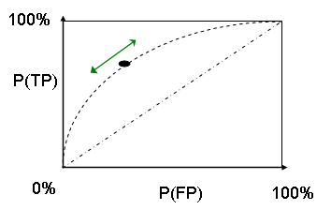
Online AUC maximization
AUC - Area Under ROC Curve
Optimize pairwise loss
Use of Algorithms R and Z for sampling
Needs more memorry
ROC - Receiver operating characteristic
https://en.wikipedia.org/wiki/Receiver_operating_characteristic

Slide 8
Frequent itemsets
Automated data collection
Vast amounts of data
Algorithms:
  Sequential algorithms
  Parallel algorithms
R. Kessl, Parallel algorithms for mining of frequent itemsets

Slide 9
Sequential algorithms
Apriori
Eclat
FP-Growth
  Depth first search
  Frequent pattern tree
  Simple estimates

Slide 10
Parallel algorithms
Parallel Frequent Itemset MIning
Parallel-FIMI-SEQ
Parallel-FIMI-PAR
Parallel-FIMI-RESERVOIR

