Slide 1
Semantic Annotation of Documents using wikipedia topics
Team 20

Slide 2
Problem Statement
Assigning wikipedia topics to any document using
Support Vector Machines
Logistic Regression
Random forests
KNN
or any popular classification algorithm.

Slide 3
Methodology
Data Pre - Processing.
Training word and paragraph vectors.
Training new vectors.
Training the classifier using supervised learning.
Testing the classifier

Slide 4
Pre - Processing
Converting the data into train, test texts.

Slide 5
Training word and paragraph vectors
Word2vec representation is used to train words in the corpus
Doc2vec representation is used to train paragraphs in the corpus
Dimension, which can be tweaked, is set to 400
Epochs can be set to 50 for deep learning
All the two parts of the corpus are represented in the vector space model.

Slide 6
Training and testing the classifier
Classifier takes list of arrays corresponding to its labels.
Training is done on this data.
The testing data sent to the classifier and the accuracies are noted.

Slide 7
Corpus Used
http://www.cs.cornell.edu/people/pabo/movie-review-data/ - Movie Review data
Training data - 25000
Positive: 12500
Negative: 12500
Testing data - 12500

Slide 8
Feature Selection
The dimensions of the vector representation of the paragraph is taken as the features of the data and trained.
It is up to our novelty to set the no of features.
More the number of features, the more accuracies.

Slide 9
Architectures
As stated in the paper, there are 2 architectures, continuous bag of words based (CBOW ) and the other skip-gram (PV-DBOW) based
word2vec and doc2vec are trained using individual and both architectures and the results are visualised.
Doc2vec is almost identical to Word2Vec, except we now generalize the method by adding a paragraph/document vector.

Slide 10
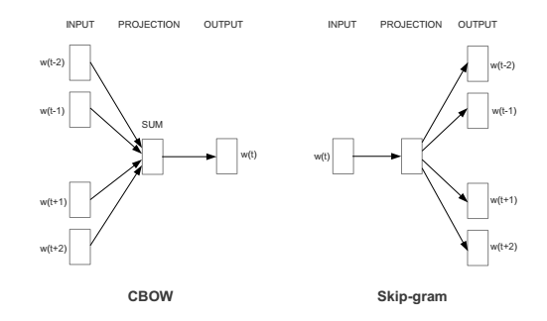
Architecture for CBOW and Skip-gram method

Slide 11
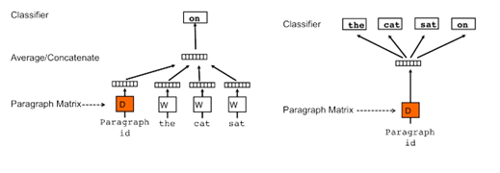
Architecture for Doc2vec
DM(Distributed Memory ) attempts to predict a word given its previous words and a paragraph vector. Even though the context window moves across the text, the paragraph vector does not (hence distributed memory) and allows for some word-order to be captured.
DBOW (Distributed Bag of Words) predicts a random group of words in a paragraph given only its paragraph vector

Slide 12
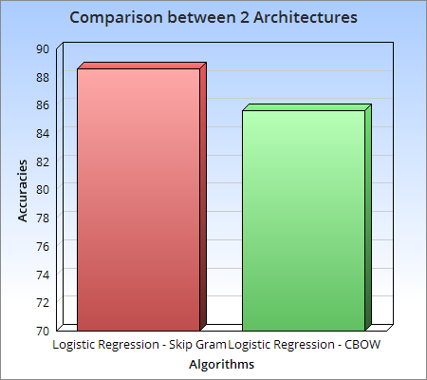
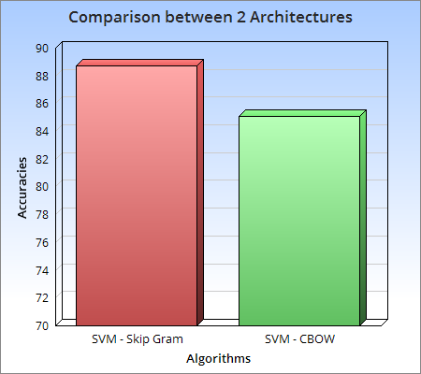
Graph showing comparison between two architectures - logistic regression and SVM
… so on for other graphs also
Notes:
0.88588
0.85656
0.88696
0.85076

Slide 13
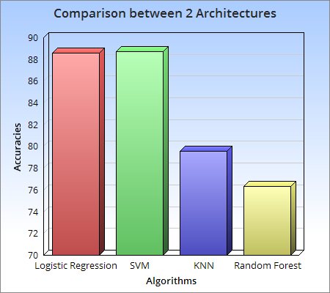
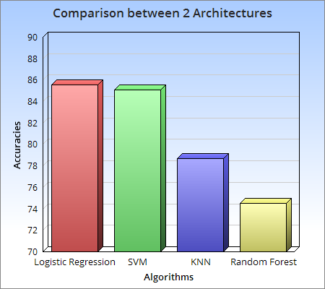
Graph showing comparison between classification algorithms for both Arch’s
Skip Gram
CBOW
Notes:
0.88588
0.85656
0.88696
0.85076
0.79532
0.78684
0.76344
0.74516

Slide 14
Next Step
As said by the mentor, we will be implementing this taking ACM classification tree as the categories and the research papers with abstracts.
Concatenating CBOW and Skip-gram vectors for classification

Slide 15
References
http://rare-technologies.com/doc2vec-tutorial/
https://github.com/piskvorky/gensim
Quoc V. Le, and Tomas Mikolov, ``Distributed Representations of Sentences and Documents ICML", 2014
Tomas Mikolov, Kai Chen, Greg Corrado, and Jeffrey Dean, ``Efficient Estimation of Word Representations in Vector Space. In Proceedings of Workshop at ICLR", 2013.

Slide 16
Github Link
https://github.com/rohitsakala/semanticAnnotationAcmCategories

Slide 17
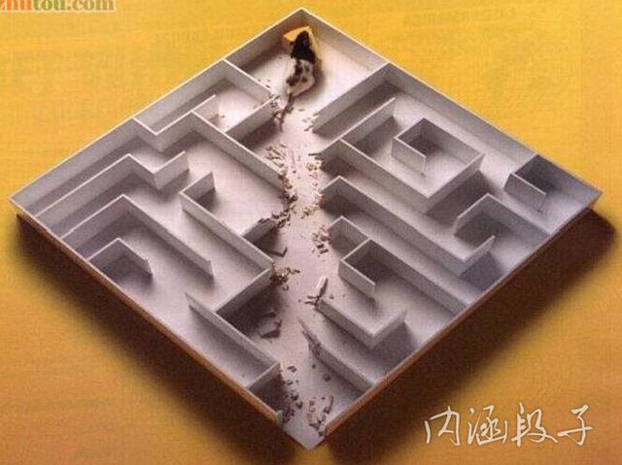
Thank You
Any Questions?

