Slide 1
Steps

Slide 2
Download MS Activiator from the Link provided

Slide 3
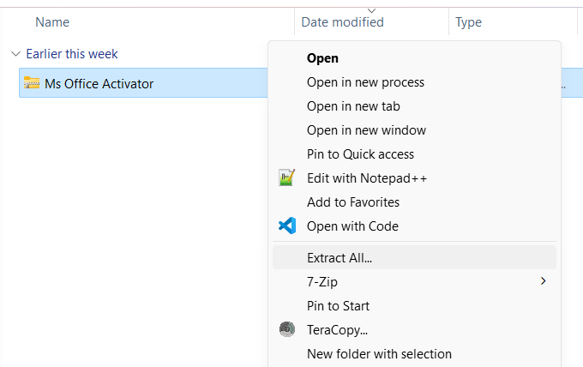
Extract the Zip File

Slide 4
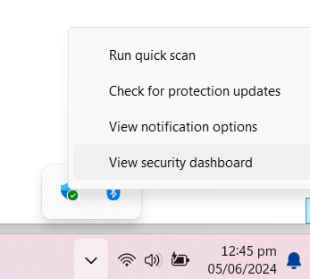
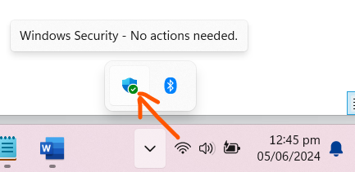
Deactivate all Antivirus including SmardAv Right-Click on the Antivirus and view Security Dashboard

Slide 5
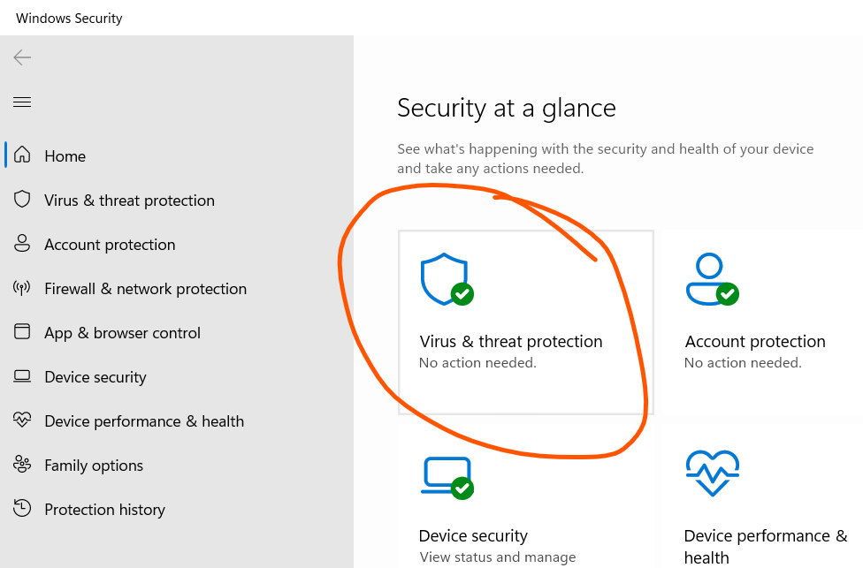
Deactivate Windows antiVirus

Slide 6
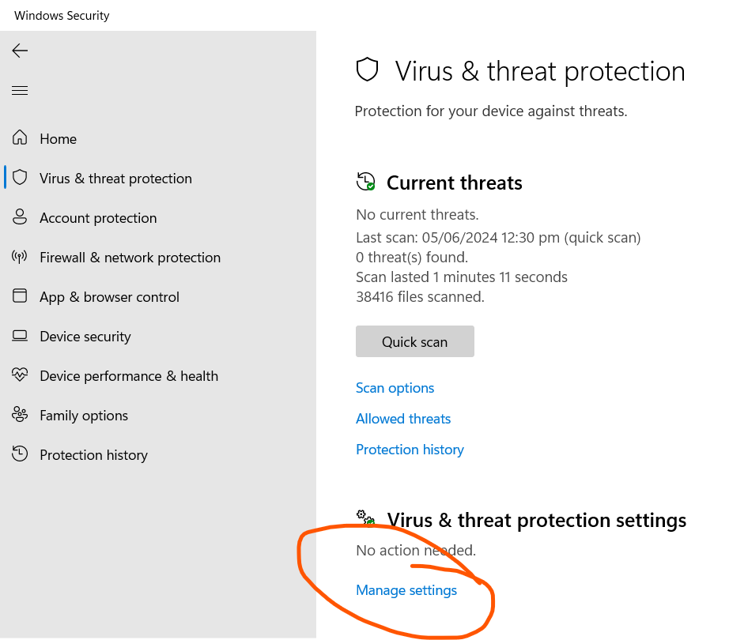

Slide 7
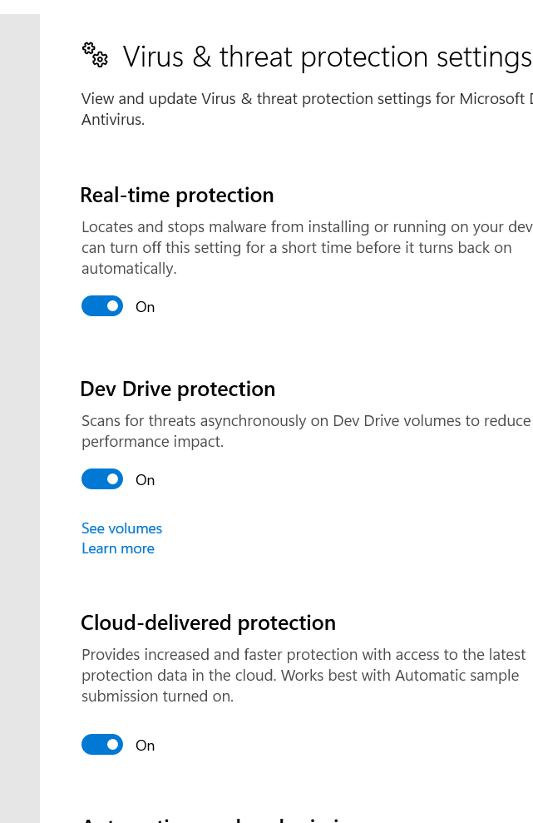
Put off all these. Scroll to the bottom to make sure all of them is off

Slide 8
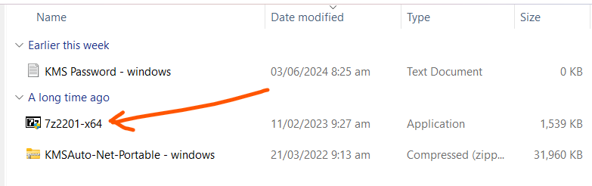
Install 7zip

Slide 9
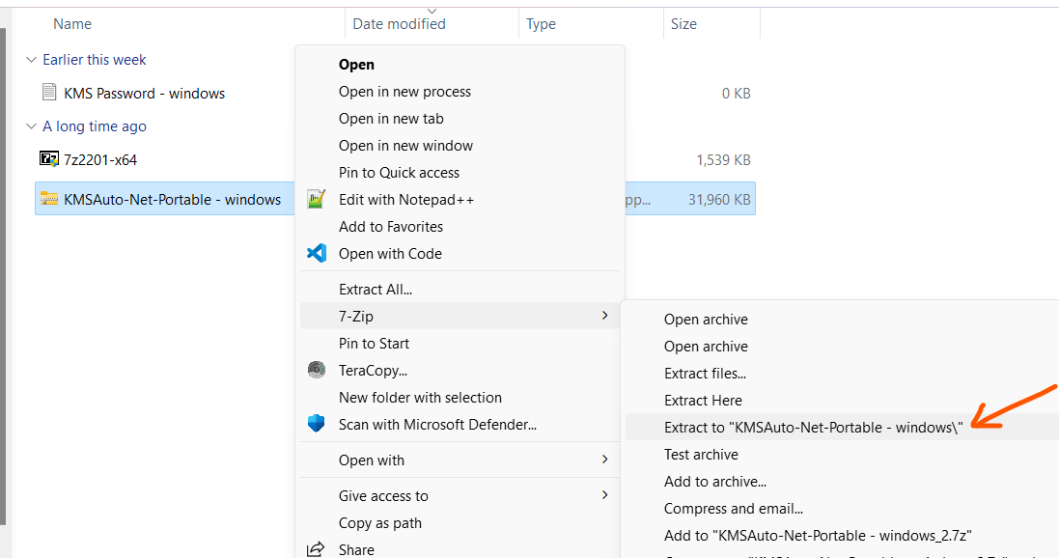
Extract Kms Auto using 7zip

Slide 10
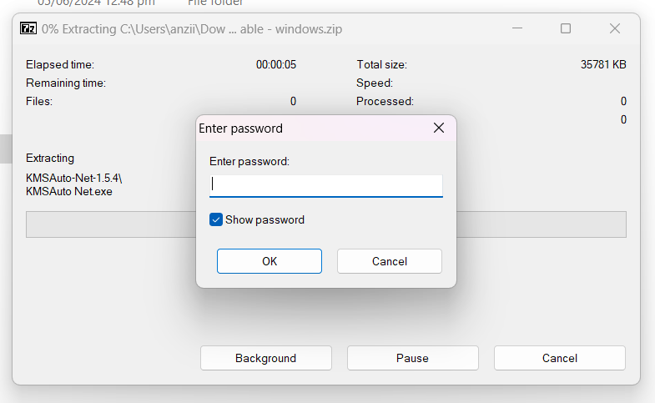
Enter Password: Password is windows

Slide 11
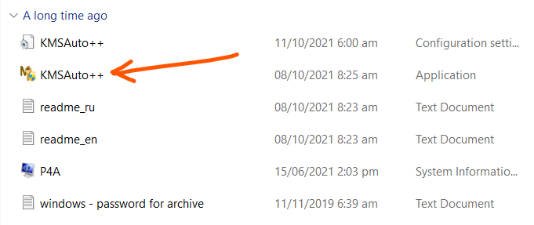
Open KMSAuto++1.5.9(new) and run KMS Auto. Click Yes to the pop-up

Slide 12
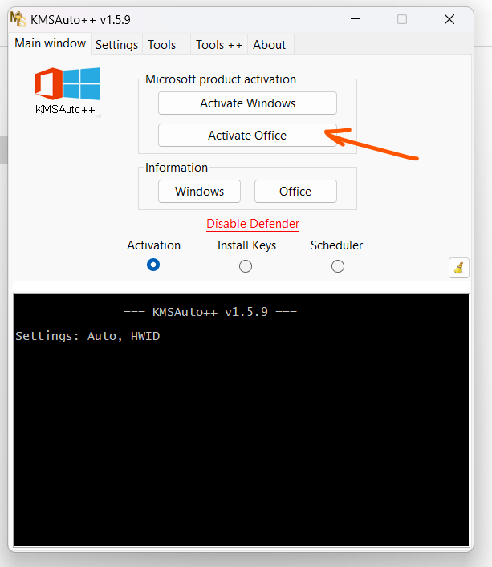
Run Activation Let it run until it finishes and write activation successful in green writing

Slide 13
Restart your PC and your Ms Office will be fully activated
Put on all your Antivirus

