Slide 1



Shop
0

Ideal hearing care kit.
Made to last.
Just arrived
Made to help.
Shop

Slide 2
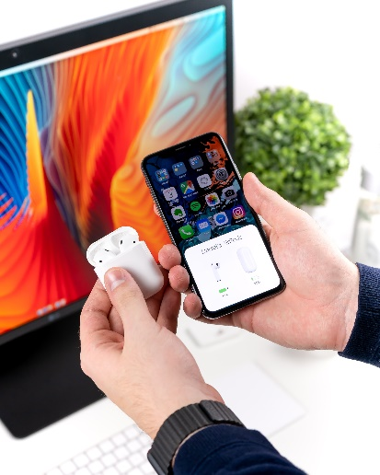
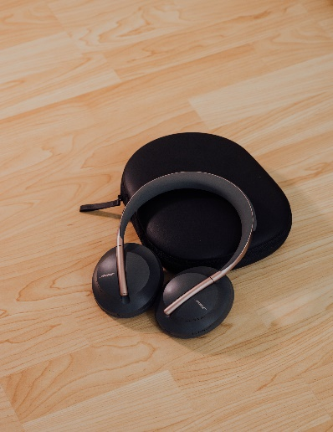
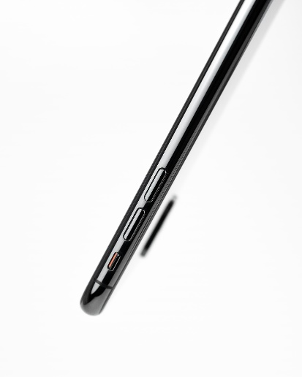

Hearx-shop collections
Joy Set
HEar piece
Stylus
Ref Screen
R 21,000.00
R 7,250.00
R 5,100.00
R 18,145.90
Add To Cart
Add To Cart
Add To Cart
Add To Cart

Slide 3


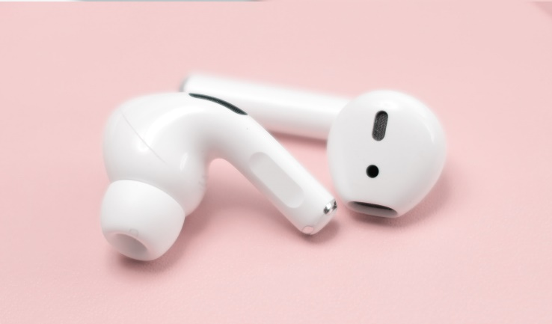




Coming This Year
Two months left
Wanna get it immediately ?
Fill the form below
Screens
Kiosky
preordemail@mail.com
Pre-order
Earpieces
© Copyright 2020 HearX.
Privacy
Terms
Faqs

