Slide 1
The battle of neighborhoods – finding a better place in Scarborough toronto
ANZIL ASHRAF

Slide 2
INTRODUCTION
We know that people migrate to different cities in search of jobs, education or due to some business requirements. While shifting many people are concerned about the neighbourhood around the particular location. They always aware of how easily can access hospital, groceries, and schools for children, medical shops, shopping mall, and theatre and also about the crime rates and housing prices. The need of this project is to explore the facilities around the neighbourhood for people who are moving out. This project focussed on the neighbourhood dataset of Scarborough and its features. Scarborough is one of the popular destination for new immigrants in Canada to reside.

Slide 3
Objective
The major objective of this project is to suggest a better neighborhood for people who are moving in to new city.
Here I mainly focused :
a) To sort list of house in terms of housing price
b) To sort list of schools in terms of ratings, reviews and fees

Slide 4
METHODOLOGY
Four Square API:
This project make use of Four Square API for data gathering. It has a collection of millions of places and its API which helps to perform location search, location sharing and business details. Due to some constraints http request for number of places per neighbourhood parameter be set to 100 and radius set to 500.
Clustering
To compare similarities of two cities we need to explore its neighbourhood, segment and finally group them to clusters. From this clusters we can find the feature of neighbourhoods. Unsupervised machine learning K-means clustering technique is used to cluster the data.

Slide 5
Libraries used:
Pandas: For creating and manipulating dataframes.
Folium: Python visualization library would be used to visualize the neighbourhoods cluster distribution of using interactive leaflet map.
Scikit Learn: For importing k-means clustering.
JSON: Library to handle JSON files.
XML: To separate data from presentation and XML stores data in plain text format.
Geocoder: To retrieve Location Data.
Beautiful Soup and Requests: To scrap and library to handle http requests.
Matplotlib: Python Plotting Module.

Slide 6
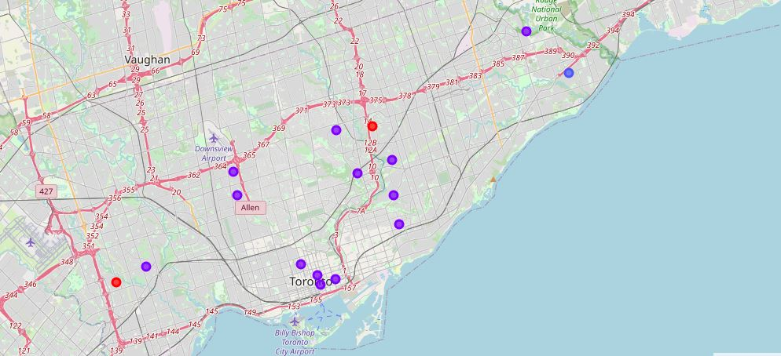
RESULTS
Maps of clusters in Scarborough

Slide 7
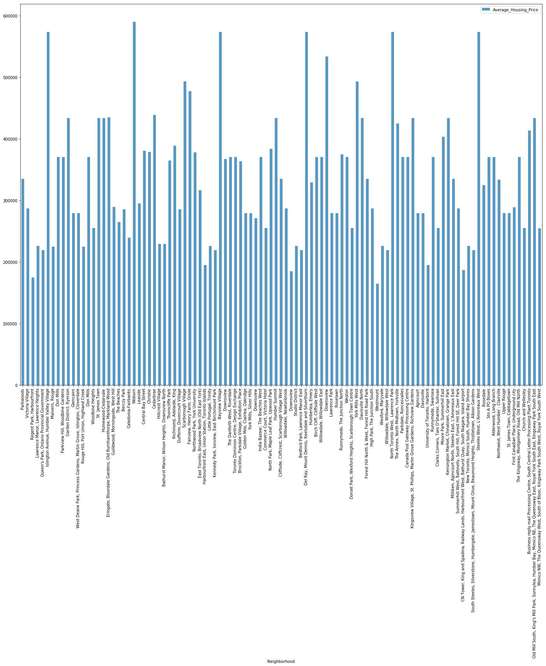
Average Housing Price by Clusters in Scarborough

Slide 8
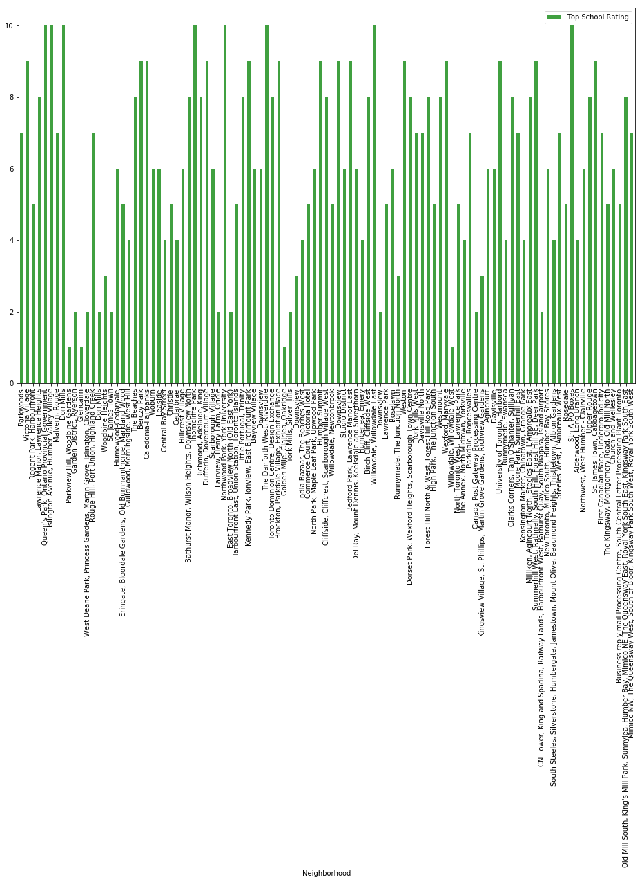
School Ratings by Clusters in Scarborough

Slide 9
CONCLUSION & Future work
In this project, using k-means cluster algorithm I separated the neighbourhood into 10(Ten) different clusters and for 103 different latitude and longitude from dataset, which have very-similar neighbourhoods around them. Using the charts above results presented to a particular neighbourhood based on average house prices and school rating have been made.
This project has shown me a practical application to resolve a real situation that has impacting personal and financial impact using Data Science tools. The mapping with Folium is a very powerful technique to consolidate information and make the analysis and decision better with confidence.
This project can be continued for making it more precise in terms to find best house in Scarborough. Best means on the basis of all required things (daily needs or things we need to live a better life) around and also in terms of cost effective.

