Slide 1

Dynamic systems
Maarten Hoogerland
University of Auckland

Slide 2
Today Outline
Delta kicked rotors
Classical rotors
Atom optics implementation
Quantum resonances

Slide 3
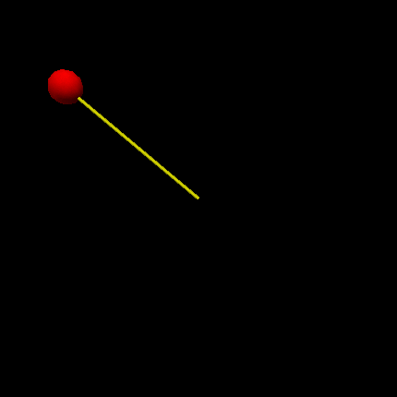
Delta kicked rotor
Ball with mass m at the end of a massless stick
Potential switched
Non-linear dynamics
θ

Slide 4
Theorist units

Slide 5
Standard map
Each kick the momentum ρ changes by κ sin θ
Between kicks the angle changes by ρ
Define the Energy as ‹ρ²/2›

Slide 6
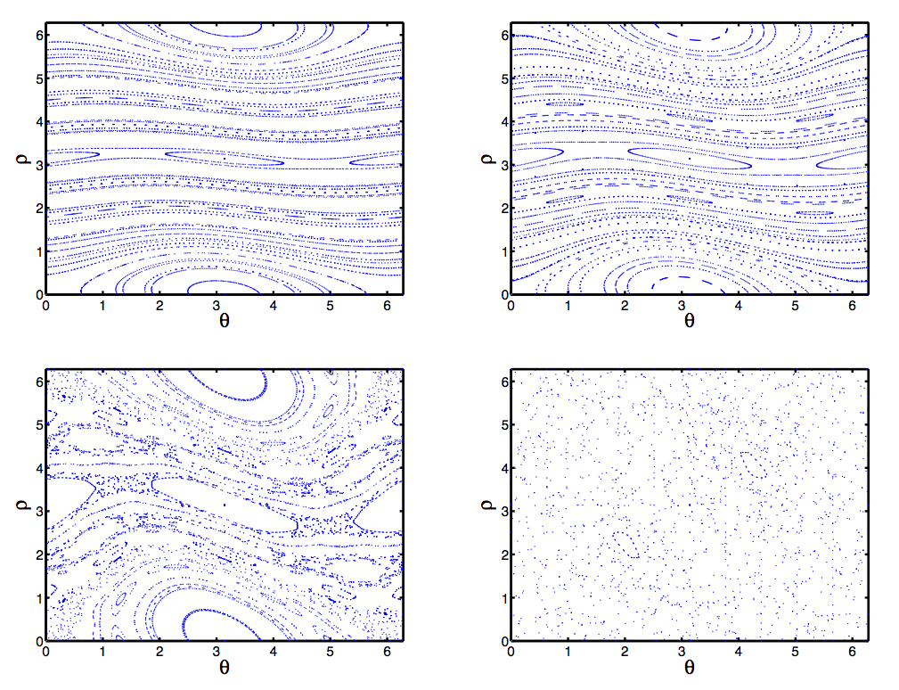
Phase space

Slide 7
Classical kicked rotor
80
2 kicks
350
Five kicks
70
3 kicks
Two kicks
5 kicks
300
60
250
50
Energy
200
40
Energy (a.u.)
30
150
20
100
10
50
0
0
1
2
3
4
5
6
7
8
9
10
0
0
1
2
3
4
5
6
7
8
9
10
Kick period (a.u.)
Kick strength (a.u.)
700
Oscillations as
function of kick period
Oscillations as function
of kick strength
600
500
400
Energy
300
200
100
0
0
5
10
15
20
25
30
35
40
45
50
Number of kicks

Slide 8
Quantum kicked rotor
Replace observables by operators
Commutation relations are
with

Slide 9
Atom optics kicked rotor
Atoms in standing wave
  Potential varies as cos 2kx
MOT:
  Hot, integrate over initial momentum states
  Large, integrate over initial positions
BEC:
  Cold
  Position spread due to uncertainty
f(t)

Slide 10
Quantum Kicked Rotor
In position space:
  Kick introduces phase shift =Ωsin 2kx
In momentum space:
  Delta kick transforms delta function into comb
  Free evolution accumulates linear phase shift =ct
  Talbot effect:
    After free propagation =2n
    Wave function the same
    Constructive interference


Duffy et al, Physical Review E 70, 056206 (2004)

Slide 11
Kicked rotor setup
AOM
laser
cell

Slide 12
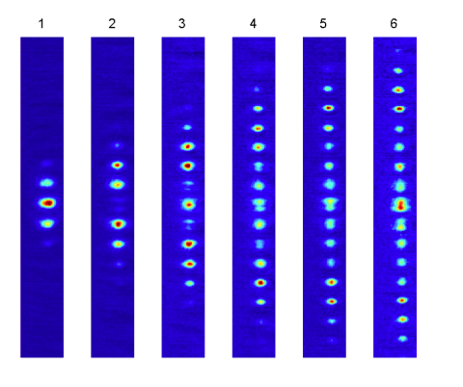
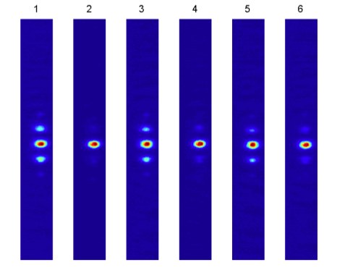
Talbot effect

Slide 13
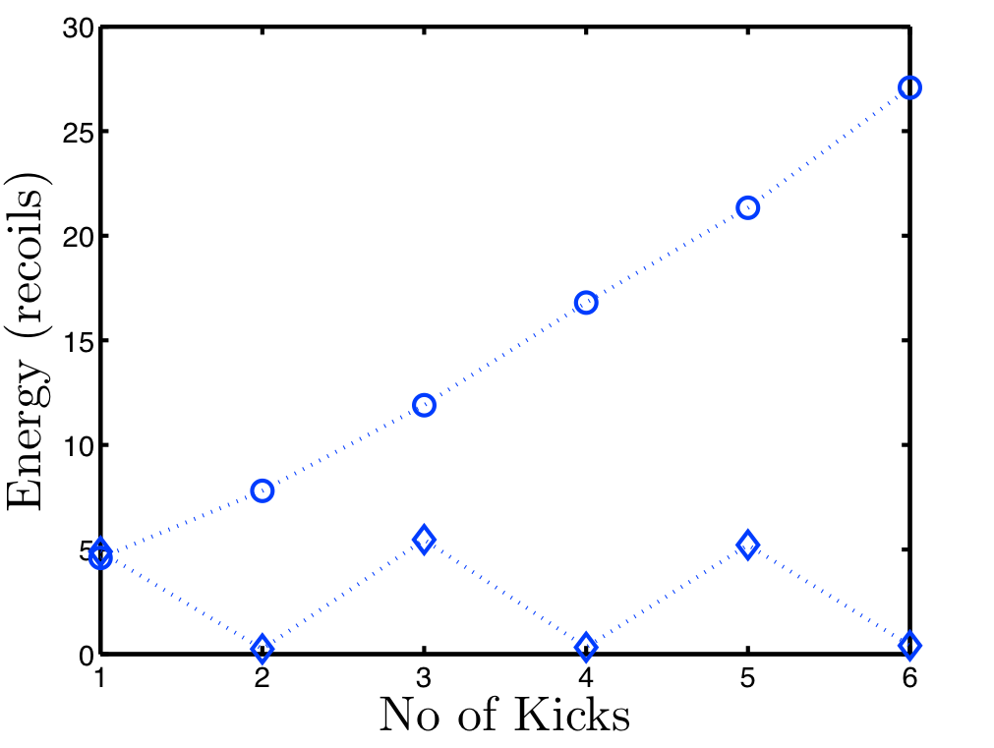
Talbot effect

Slide 14
Simulations
Start with wave packet
Time evolution
Integrate ka over momentum distribution BEC

Slide 15
Simulations
Start with wave packet
Time evolution
Integrate ka over momentum distribution BEC

Slide 16
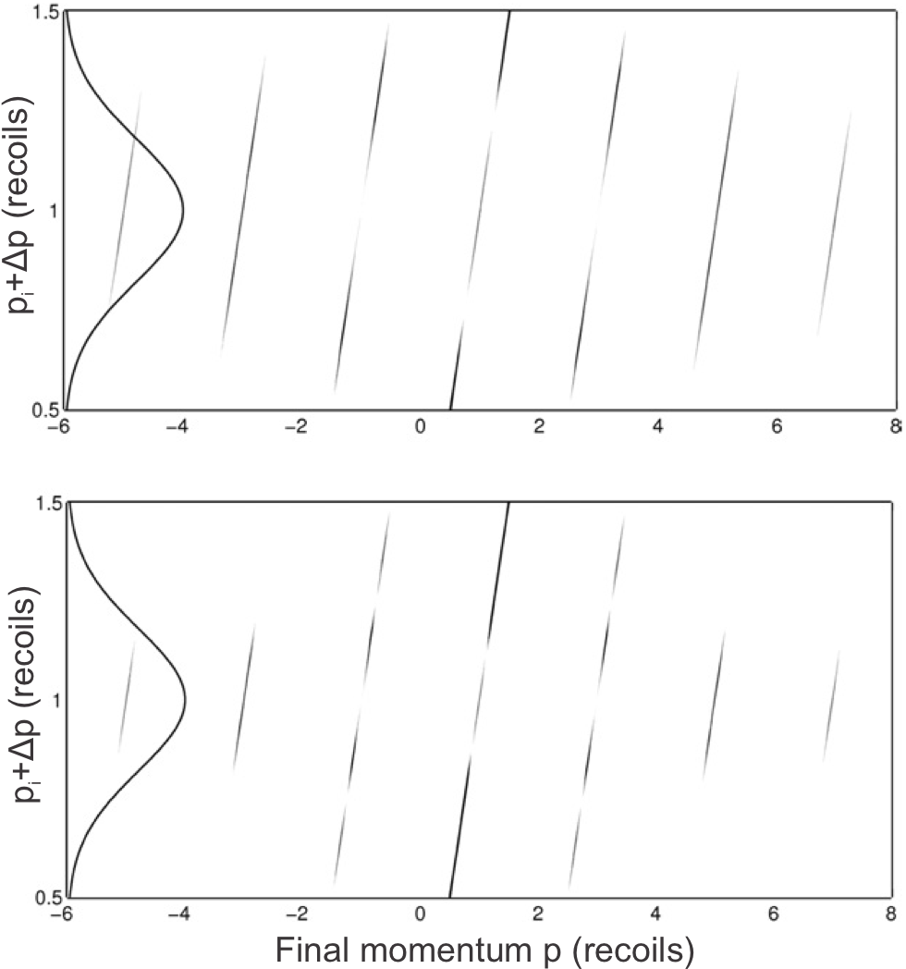
Simulations
Start with wave packet
Time evolution
Integrate ka over momentum distribution BEC

Slide 17
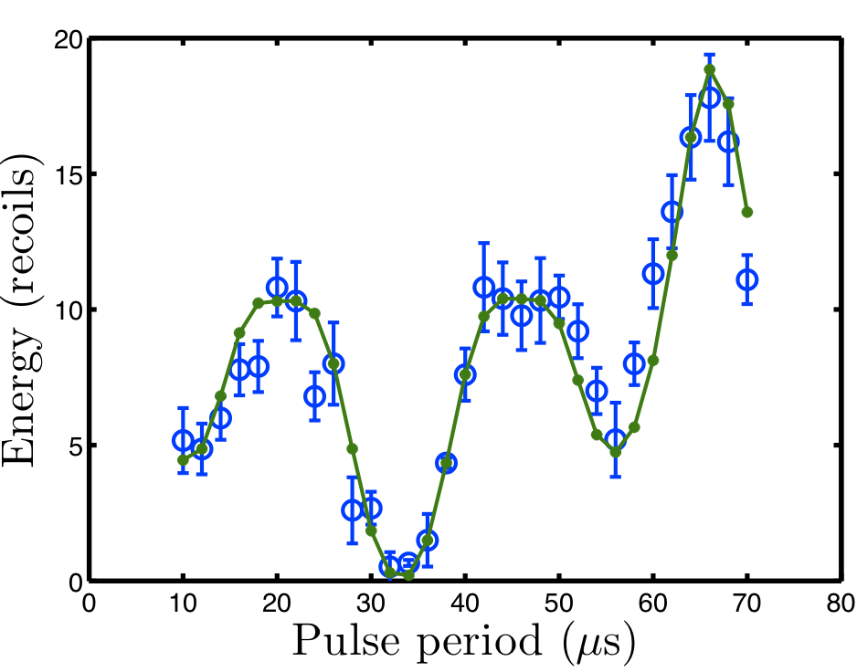
Varying period

Slide 18
Talbot effect conclusion
Addition or
cancellation on
resonance
In between
not so clear

