Slide 1
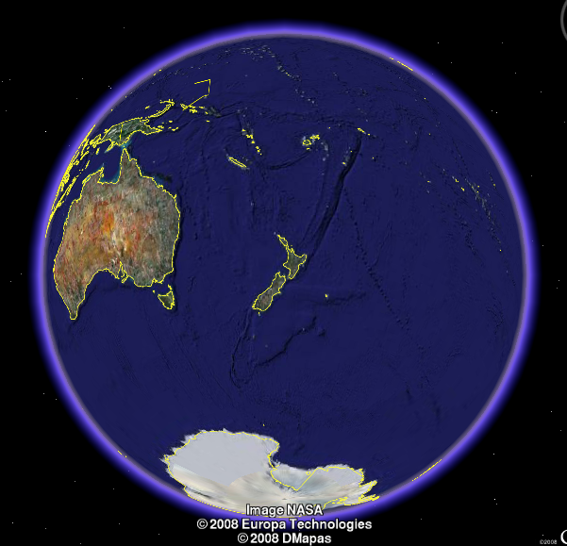
Dynamic systems
Maarten Hoogerland
University of Auckland

Slide 2
Outline today
Fractional resonances
Velocity dependence
Chaos

Slide 3
Atom optics kicked rotor
Atoms in standing wave
  Potential varies as cos 2kx
MOT:
  Hot, integrate over initial momentum states
  Large, integrate over initial positions
BEC:
  Cold
  Position spread due to uncertainty
f(t)

Slide 4
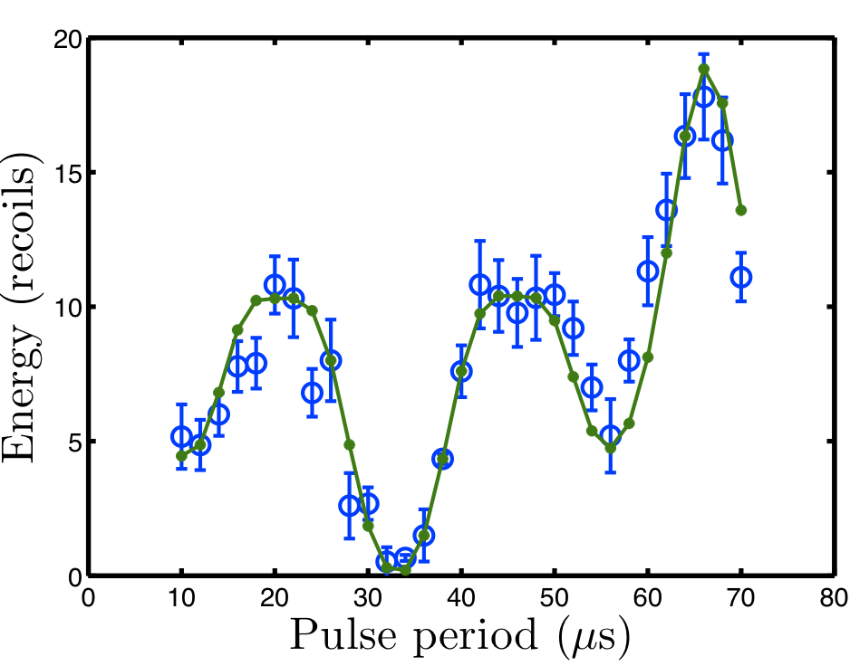
Varying period

Slide 5
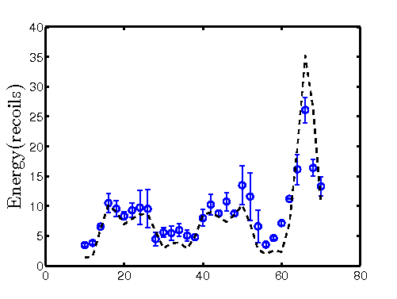
Varying period

Slide 6
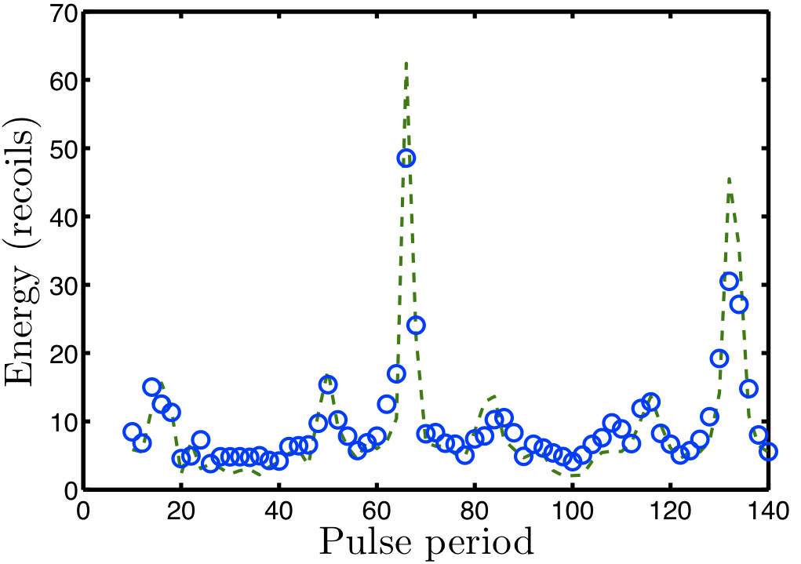
Varying period (5 kicks)

Slide 7
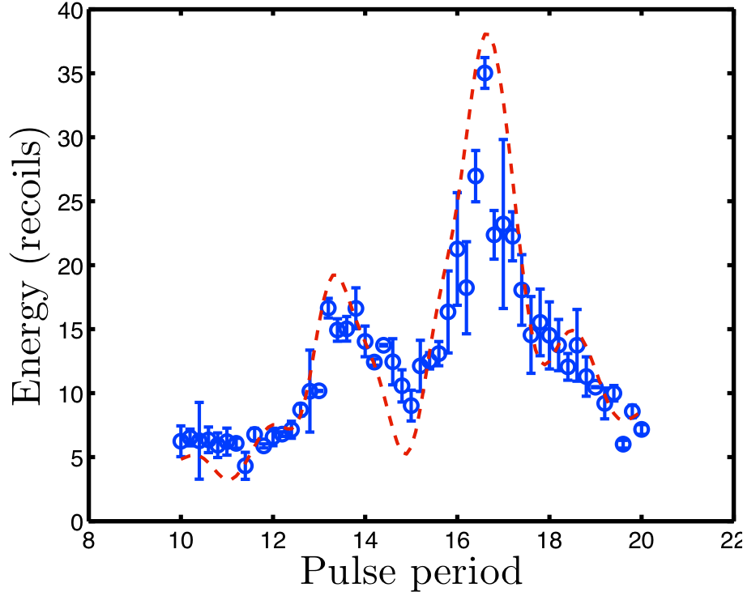
T_{T}/4 resonance

Slide 8
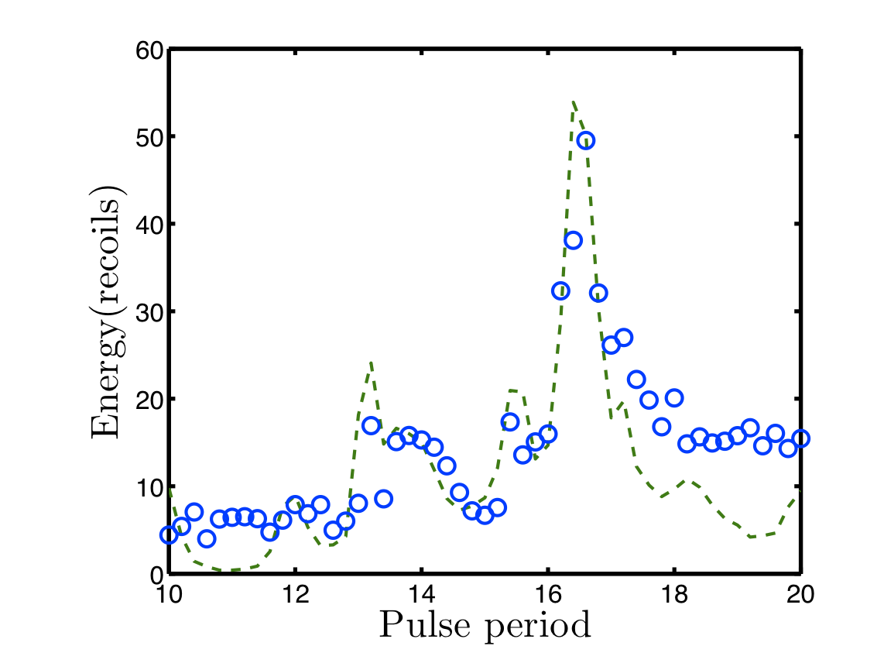
T_{T}/4 resonance

Slide 9
Initial momentum

Slide 10
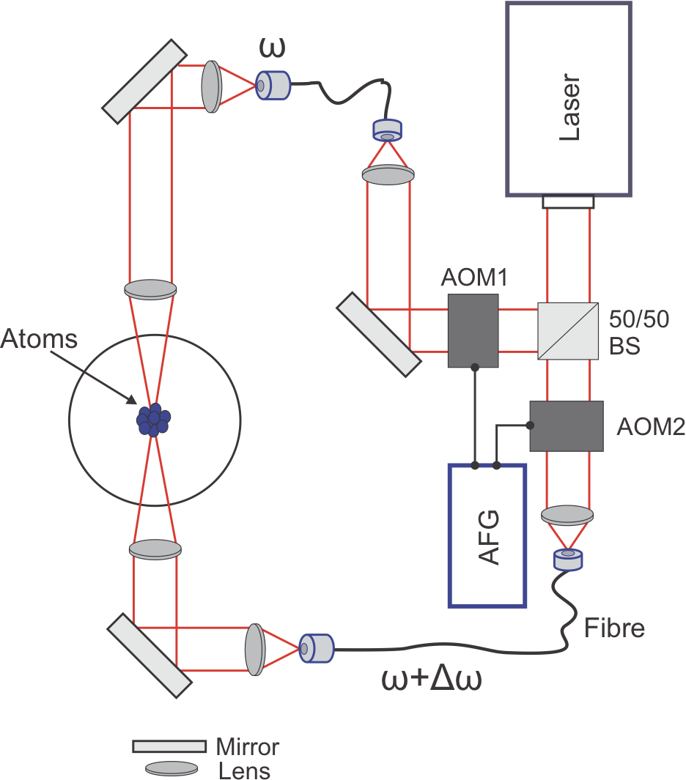
Initial momentum

Slide 11
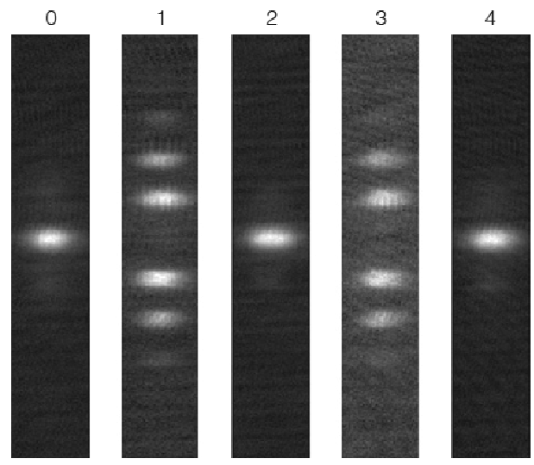
Initial momentum

Slide 12
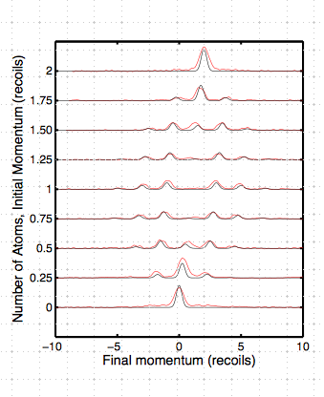
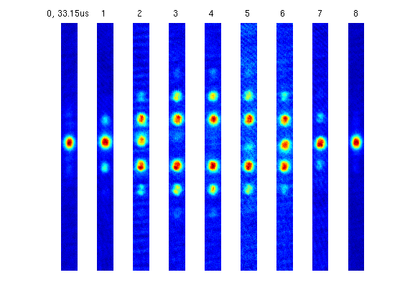
Two kicks
k=2π

Slide 13
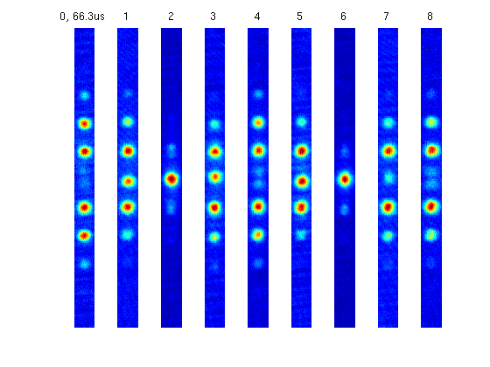
Two kicks
k=4π

Slide 14
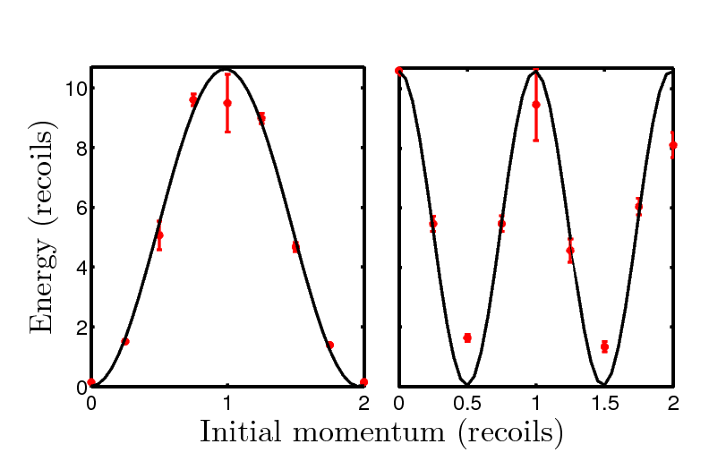
Initial momentum

Slide 15
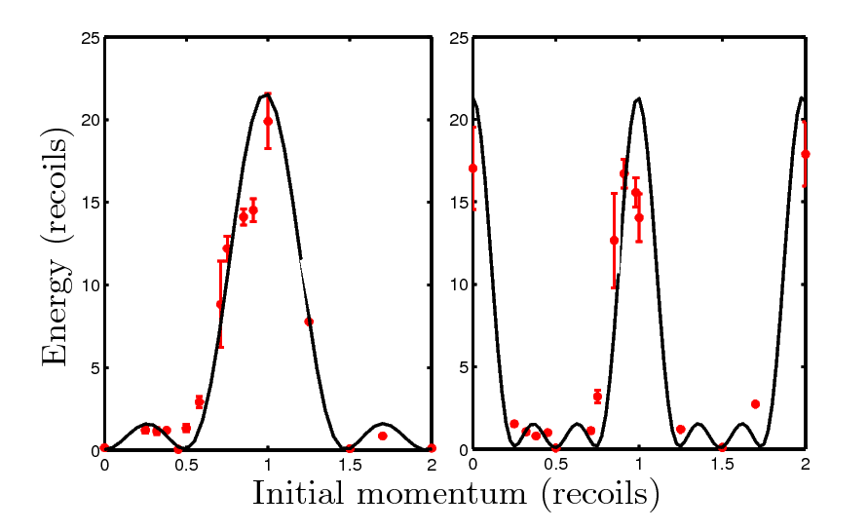
Initial momentum

Slide 16
Warmer atoms

Slide 17
Analytical expressions
200
180
160
140
where
Energy (recoils)
120
100
80
60
40
20
0
0
2
4
6
k
8
10
12
14
Kick period
J_{n}(x) is nth Bessel function

Slide 18
Dynamical Localisation
Classical
Energy
Quantum w/noise
Quantum
Kick number
Break time

Slide 19
5 kicks
250
450
200
400
350
150
Energy (recoils)
Energy (recoils)
300
250
100
200
50
150
100
0
5
10
15
20
25
30
35
0
0.5
1
1.5
2
2.5

Pulse Period (s)
k/

Slide 20
Periodic kicked rotor energy
Energy vs. Kicking Period
180
160
140
120
Energy/E_{R}
100
Energy (au)
80
60
40
20
0
2
4
6
8
10
12
14
16
18
20
k/π
Quantum resonances

Slide 21
Time reversal in a chaotic system

Slide 22
Time reversal
System is classically chaotic
Quantum motion
Should be reversible!
Apply number of kicks, 8ω_{R}T=4π+ε
Wait for sign change
Reverse evolution by applying more kicks with
8ω_{R}T=4π-ε

Slide 23
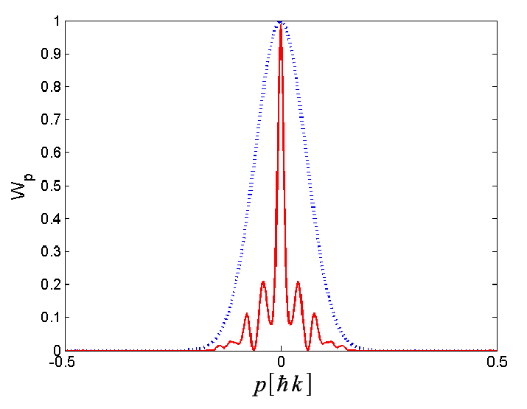
Time reversal
System is classically chaotic
Quantum motion
Should be reversible!
Apply number of kicks, 8ω_{R}T=4π+ε
Wait for sign change
Reverse evolution by applying more kicks with
8ω_{R}T=4π-ε

Slide 24
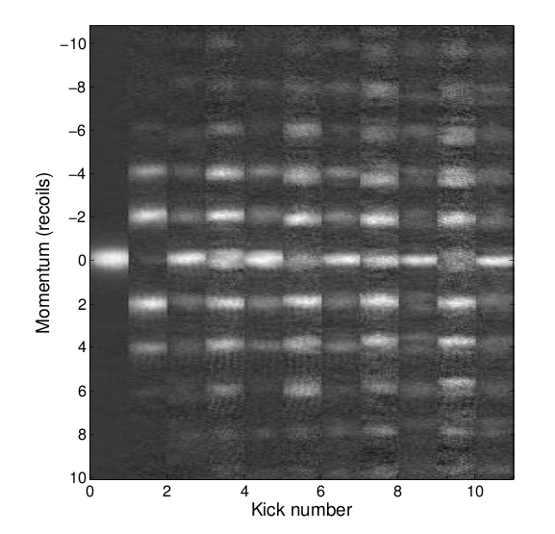
Time reversal
Central peak should reach same height after pulse sequence
Central peak more narrow after pulse sequence

Slide 25
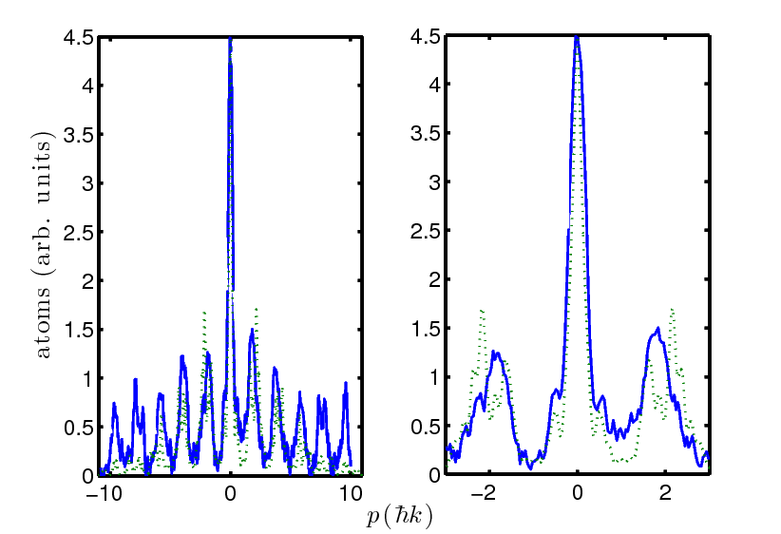
Momentum distribution

Slide 26
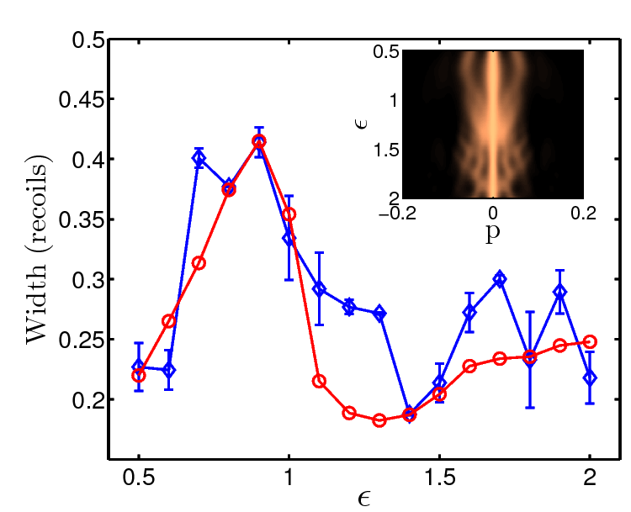
Changing ε

Slide 27
Conclusions today
Higher order resonances
Initial momentum
Time reversal
Tomorrow: more fancy experiments

