Slide 1
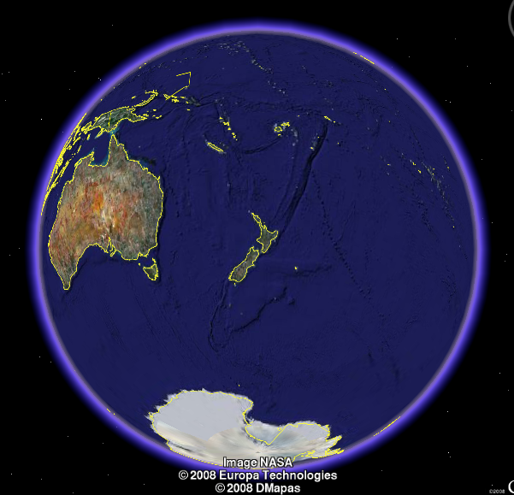
Dynamic systems
Maarten Hoogerland
University of Auckland

Slide 2
Today
Anderson localisation
Optical lattices

Slide 3
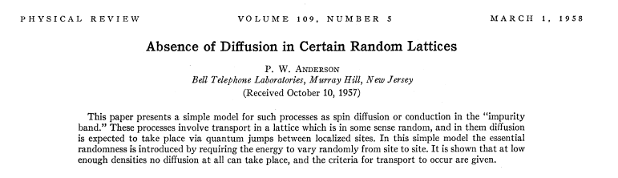
Anderson localisation
“If the density is low enough, no diffusion takes place”

Slide 4
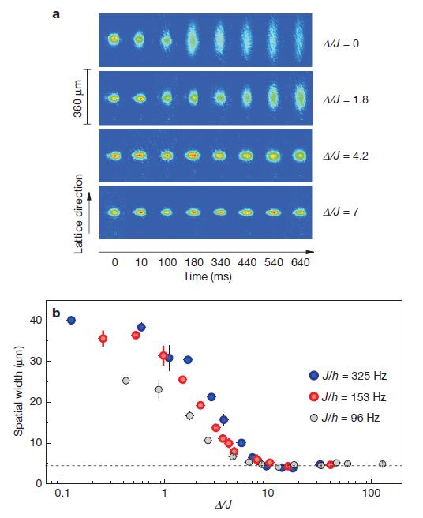
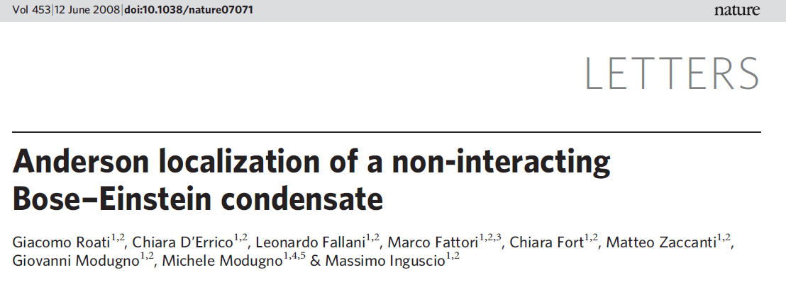
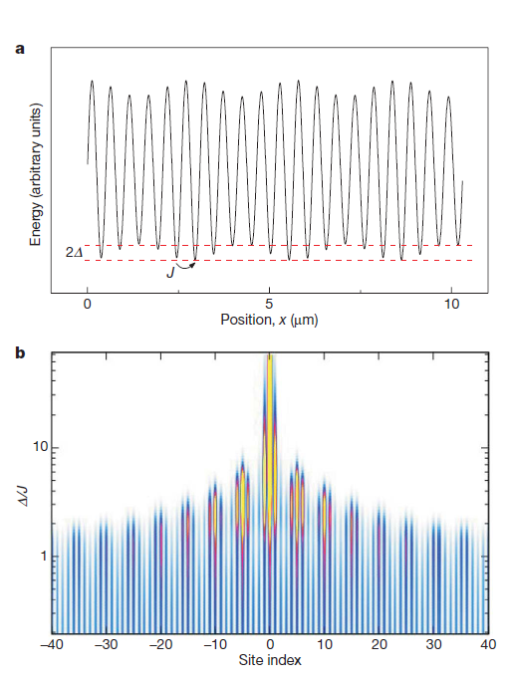
Inguscio experiment

Slide 5
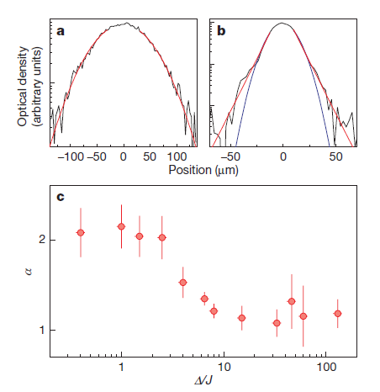
Inguscio experiment

Slide 6
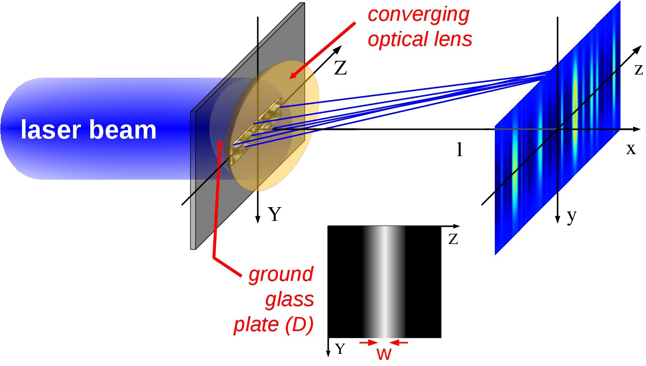
Disordered potentials

Slide 7
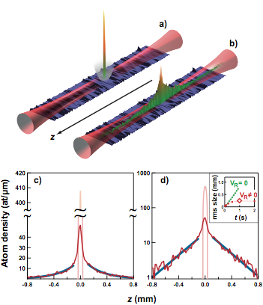
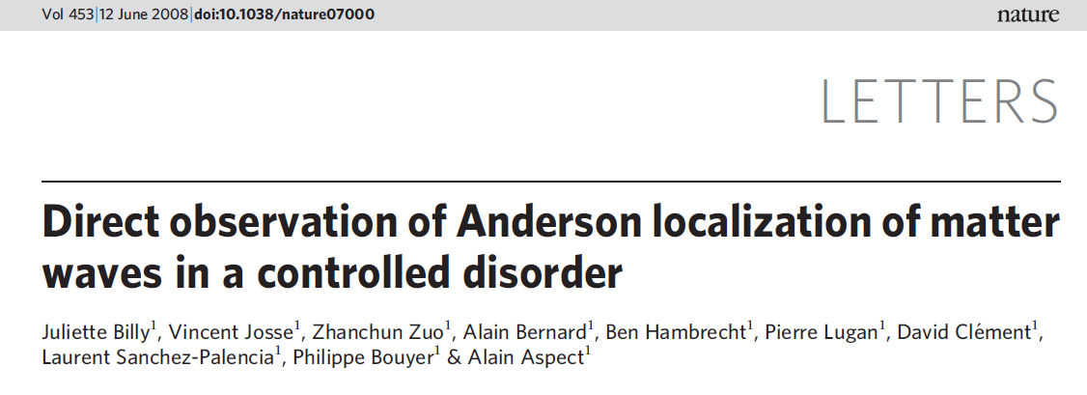
Aspect experiment (1)
BEC in 1-D guide
Random potential from frosted glass
Strongly reduced transport

Slide 8
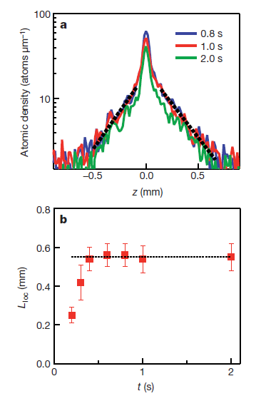
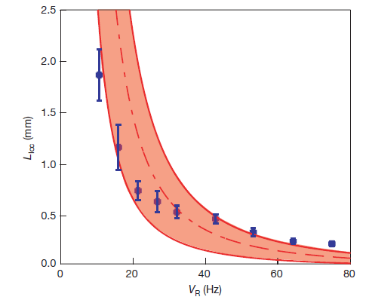
Results
Localisation length vs potential depth
Localisation length vs time

Slide 9
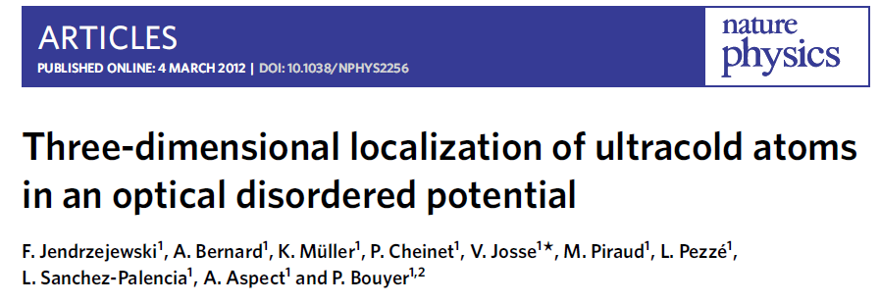
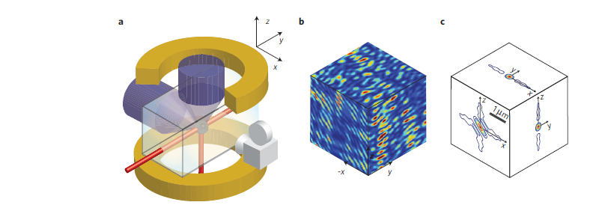
Aspect experiment (2)

Slide 10
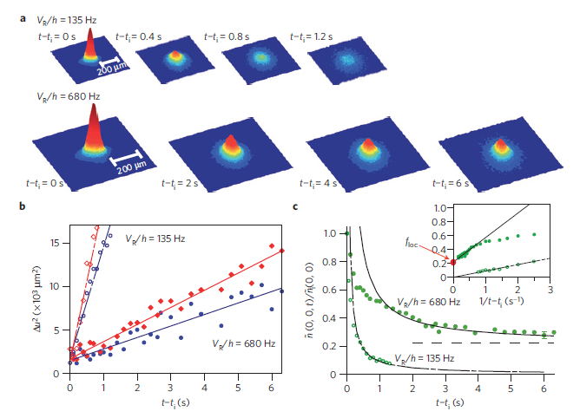
3D results

Slide 11
Optical lattices

Slide 12
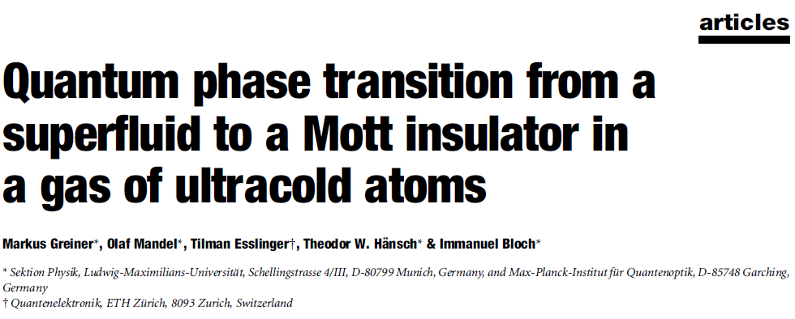
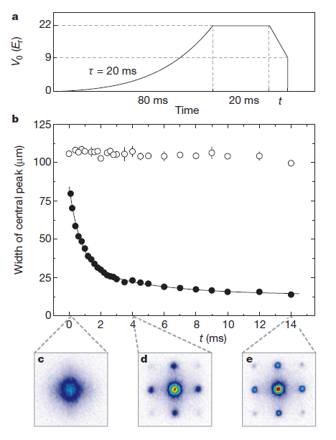
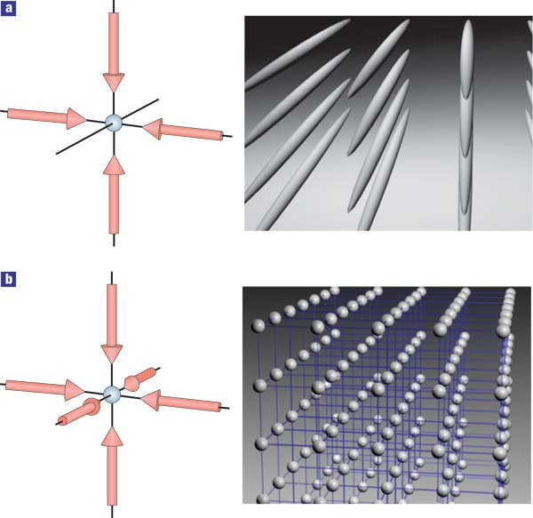
Optical lattices

Slide 13
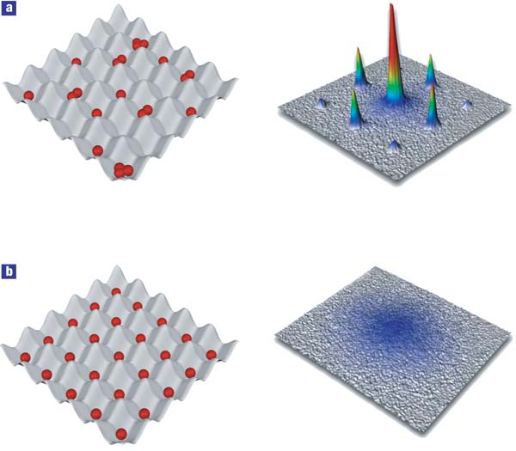
The central result
+

Slide 14
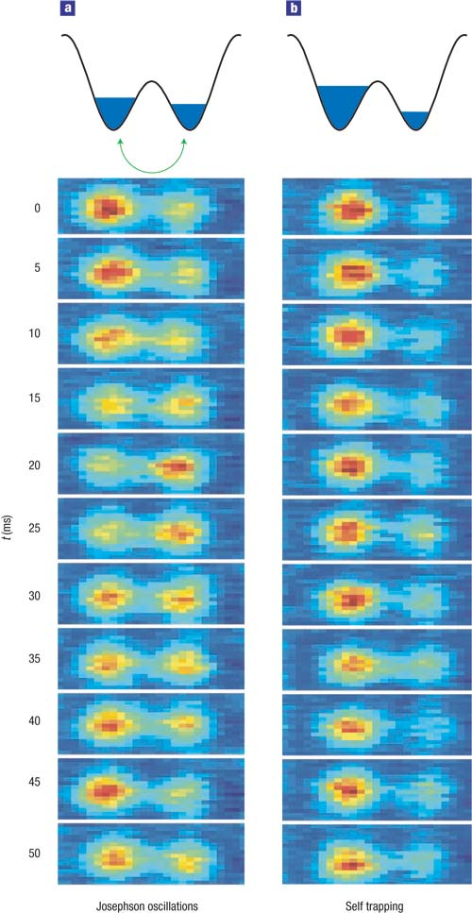
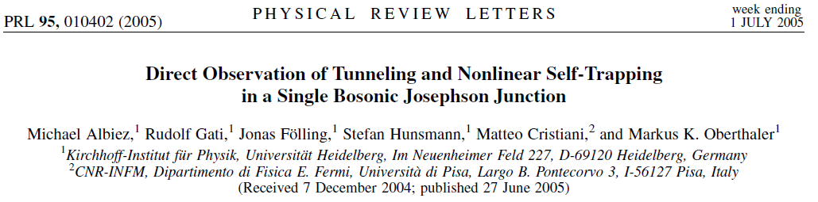
Double well potential
Josephson junction
For almost equal populations, oscillations
For large population difference, self-trapping

Slide 15
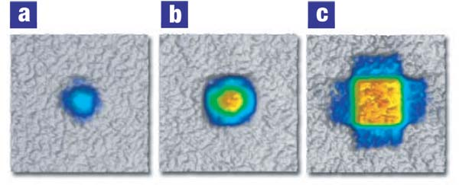
Fermions
Vary fill factor, leading to varying Fermi energy
Adiabatically lower lattice
Map crystal momentum to free momentum
Köhl, M., Moritz, H., Stöferle, T., Günter, K. & Esslinger, T. Fermionic atoms in a 3D optical lattice: Observing Fermi-surfaces, dynamics and interactions. Phys. Rev. Lett. 94, 080403 (2004).

Slide 16
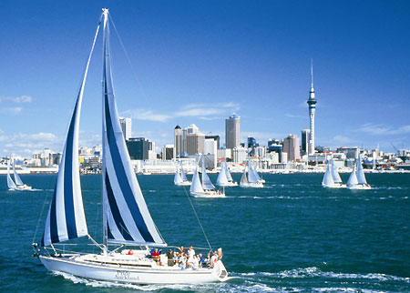
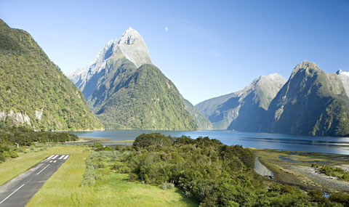
Physics in Auckland
Exciting physics in an exciting place!
Contact m.hoogerland@auckland.ac.nz

