Slide 1
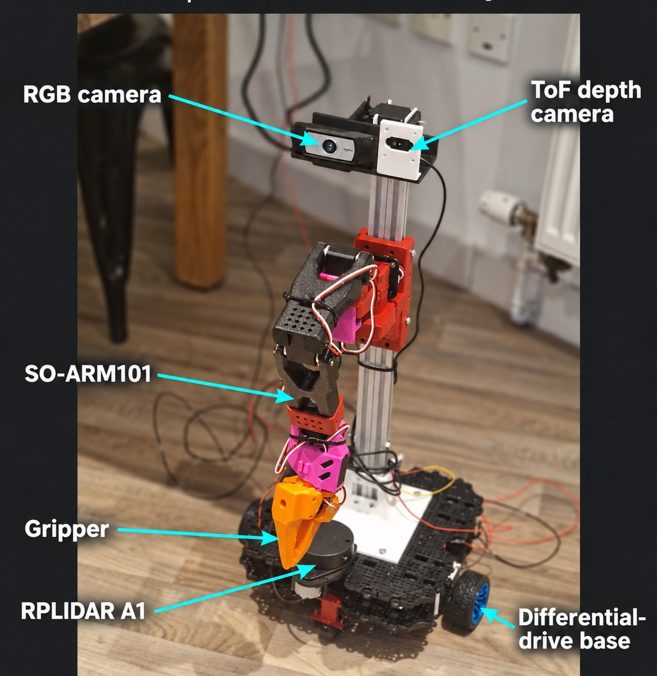
YOUR NAME / AFFILIATION
01 / PLATFORM
Homer: a low-cost ROS 2 mobile manipulator
THE GOAL
Find objects.
Approach them.
Grasp them.
DIFFERENTIAL DRIVE + SO-ARM101
Raspberry Pi · ESP32 · RGB · ToF · LiDAR
ROS 2 • Mobile manipulation
01
Notes:
0:00–0:20. Introduce yourself, then Homer: a low-cost ROS 2 mobile manipulator combining a Raspberry Pi, ESP32 base, SO-ARM 101, cameras and LiDAR. The goal is to find an object, approach it and grasp it. This is the project goal; autonomous approach and grasping are not yet demonstrated.

Slide 2
ROSCON UK 2026 / LIGHTNING TALK
02 / THE ROS GRAPH
How Homer fits together
ACT is a future arm-policy node; its ROS observation and command paths still need design.
Gamepad / teleop
Pi serial bridge
ESP32 + drive base
MOBILE BASE
/teleop/cmd_vel
serial transport
/odom · status · monitoring
Robot teleop
SO-ARM bridge
SO-ARM101
MANIPULATOR
/soarm/command_delta_ticks
USB transport
joint / gripper actuation
RGB + ToF
LiDAR + odom
SLAM + transforms
PERCEPTION
object observations
mapping inputs
IN PROGRESS
ROS 2 • Mobile manipulation
02
Notes:
0:20–0:50. Trace the gamepad-to-base path through the Pi serial bridge and ESP32. Point out the separate arm bridge, LiDAR/mapping and RGB/ToF sensing. ACT is a possible future arm-policy node; its ROS interfaces still need design.

Slide 3
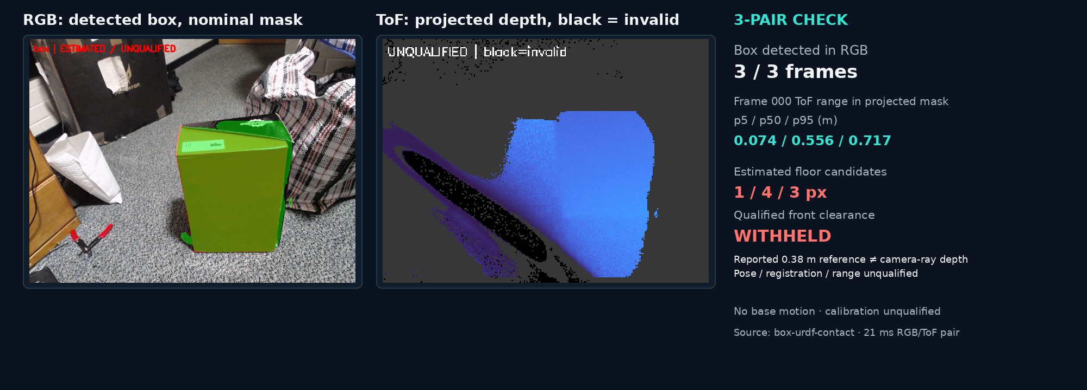
ROSCON UK 2026 / LIGHTNING TALK
03 / LESSON LEARNED
The box is visible; clearance isn’t.
Three paired RGB/ToF frames show why object detection alone cannot prove distance.
ROS 2 • Mobile manipulation
03
Notes:
0:50–1:40. Show the actual paired RGB/ToF snapshot from box-urdf-contact. The box was detected in all three frames. The nominal floor-contact probe produced 1, 4 and 3 candidate pixels; camera calibration and pose remained unqualified, and front clearance stayed null. Frame 000 projected box-mask ToF p5/p50/p95: 0.074/0.556/0.717 m. The reported 0.38 m front-edge reference is a different quantity from camera-ray range, so these values are not a proven distance error. Lesson: object detection alone does not establish usable clearance.

Slide 4

ROSCON UK 2026 / LIGHTNING TALK
04 / FIND OUT MORE
Find Homer and the build notes
01
github.com/ao2-yekeen/homer#bill-of-materials-bom
Scan the code for the repo: ROS graph, hardware notes and the software.
02
A live graph, still earning its robot driving licence.
Homer project · ROS 2 · Raspberry Pi · ESP32 · SO-ARM 101
ROS 2 • Mobile manipulation
04
Notes:
1:40–2:00. Point to the repository URL and QR code for the code, architecture and build notes. Close: Homer has the ROS graph; it is still earning its robot driving licence.

