Slide 1
Instructions for Visualization and Analysis Demos
You have 3 minutes to present – be ready to share your screen, practice first. We can only offer you one opportunity to present. Present your slides in “Slide Show” mode. Presentations will take place during the module Tutorial slots (see Announcements for links to join the Tutorials via Teams).
The next few slides give you all the alternatives for how to present your Visualizations. You will select only one as fits your RQ. Before presenting DELETE all text (and instructions) that you do not use (including this slide). You can then enlarge your selection, so it is clearly visible on the slide.
Appointment slots will appear on Canvas soon (calendar-7com1079-24). Sign up early. When space runs out, we cannot issue any further slots for this week. If you do not turn up for your slot you will not be given another opportunity. Ideally, all the group members should attend but select one person to present. DO NOT SIGN UP unless once of your group can attend and present. You will not be graded on this.
We look forward to giving you feedback. If your group is not presenting, still attend the tutorial as the feedback will help you too.
At this point we assume you are using your allocated datasets (see RQ coursework spec). Any changes to the Kaggle.Data.world csv/xlxs file you make such as merges, grouping, or size reduction must be done via an R script, not manually, not in excel.

Slide 2

Visualization and Analysis – Tutorial Presentation for Feedback Date:
Group Id: A233 Name of Student Presenting: Najib Jama

Slide 3
If you have not defined your Research Question (RQ) yet, please do not attempt to present Visualisations and/or analyses of your data. Go to Canvas, announcements on RQ presentations, and use the PowerPoint template provided for you to present your RQ. You can use the time slot to present your RQ instead of the Visualisation.
Part 1: VISUALISATION

Slide 4
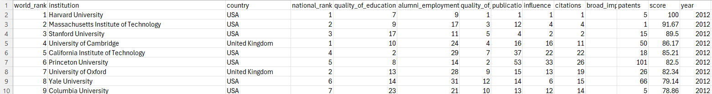
We are using the dataset (DS035 cwur.csv)
“Is there a difference in the mean of world university rankings between universities from different countries?"
The dataset has 2201 rows
Dependent variable: World Ranking
Independent variable: Country

Slide 5
1. Boxplots (to include outliers) (place the dependent variable on the y-axis and independent variable sub-categories on the x axis) 2. A histogram to include the normal curve overlay. The histogram plots data from your dependent variable only. Clearly label you axes to include variable name in proper English, and units of measurement (e.g. currency $, type of weight kg, etc). Include a title to give your plot/visualisation a context.
2. Where your research question asks about Comparison of means/medians: Include two plots
Comparison of means (or medians) analyses the difference between the mean (or median) value of a characteristic shared by members of two (or more) different populations.

Slide 6
Only attempt this Analysis part of the demo if you have completed your Visualization(s). Otherwise end your demo after the Visualization for feedback.
Part 2: Analysis (building on your Visualizations)

Slide 7
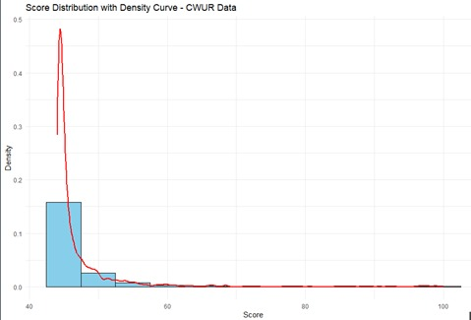
Here is a Histogram showing the frequencies of our dependent variable to include the normal curve overlay.
Our RQ asks about Correlation
For example:
Choose one:
1. The blue normal curve overlay follows the contours of the underlying data, so for our analysis, we will use a parametric test for correlation: Pearson’s r
OR
The example here is borderline, in terms of shape, so choose the non-parametric equivalent when in doubt.
7
Notes:
7

Slide 8
Here is a Histogram showing the frequencies of our dependent variable to include the normal curve overlay (shown in blue).
Our RQ asks about Differences in means/ medians of world university rankings
For example:
Choose one:
1. The normal curve overlay follows the contours of the underlying data, so we use the parametric test: t-test.
OR
2. The normal curve overlay does not follow the shape of the underlying data, so we use the non-parametric test that does not assume normality: Wilcoxon also known as the Mann Whitney U Test.
The example here is borderline, in terms of shape, so when in doubt choose the non-parametric equivalent.
8

Slide 9
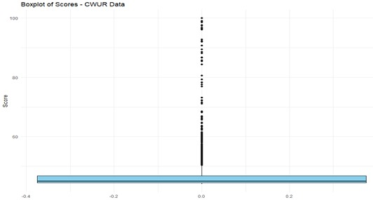
Box plot daigram
Our RQ asks about Differences in means/ medians of world university rankings
For comparison of proportions analysis, we will use a chi-square test to check for the likelihood that there is a relationship between the two nominal variables (reason for absenteeism and age group in example). This non-parametric test makes no assumptions about the shape of the data (which is nominal, not interval) so we do not include a histogram for this test.
9
Notes:
9

Slide 10
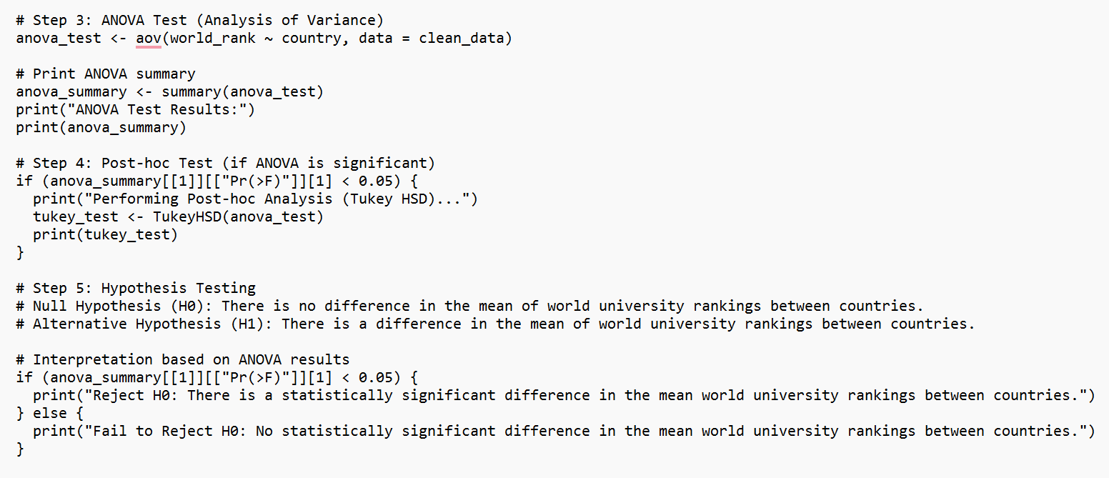
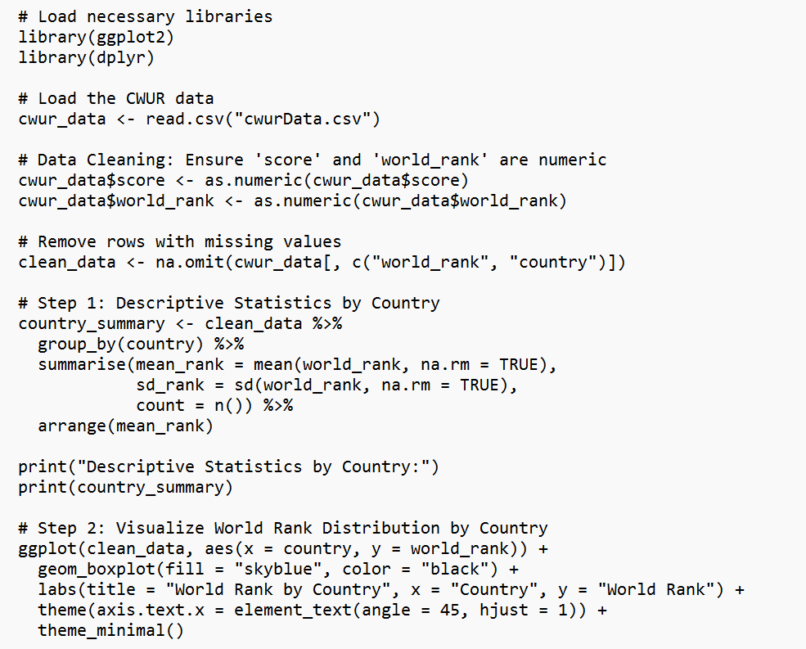
R Script and Results (For ALL types of test) – The Analysis
PRE 7COM1079-2022 Student Group No: ?????
10
Notes:
10

Slide 11
