Slide 1



CSE 299
Cadence
Project Update 2

Slide 2
Main Goal for the Week : Finish Database Models and start connecting frontend with backend
01
02
03
04
Create Chatroom
User Auth and Implementation
Django Channels
Database Models

Slide 3
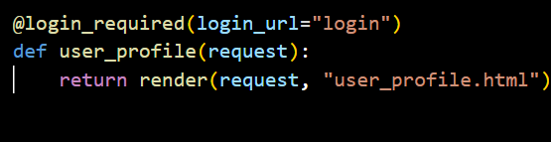
User Authentication:
User Authentication System
Built a dedicated 'accounts' app to handle all auth logic
separately from the main app (core)
Features:
- Login & Signup
- Logout
- Forgot Password
- All pages protected from unauthorized access

Slide 4
App Architecture:
To keep the project clean and maintainable, authentication logic was separated into its own dedicated app called accounts, following Django's separation of concerns principle. The accounts app handles everything auth-related — login, signup, logout, and password reset — while the core app focuses solely on the main features like dashboard, rooms, tasks, and friends. This structure makes it easy to find, maintain, and scale each part of the project independently, and mirrors how real-world Django projects are built.
Why separate?
Clean separation of concerns (by assigning each app to do one job)
Easy to find and maintain auth logic & industry standard practice

Slide 5
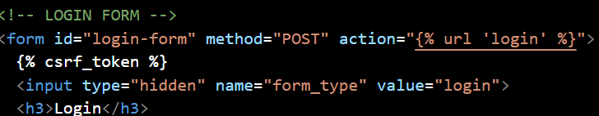
Security Features:
Three layers of security were implemented to protect the application. First, all forms use {% csrf_token %} which prevents “Cross-Site Request Forgery” attacks by ensuring form submissions only come from our site. Second, every protected page uses @login_required which automatically redirects unauthorized users to the login page if they try to access the dashboard, rooms, tasks, or any other feature. Third, Django's built-in create_user() method automatically hashes passwords before storing them in the database, meaning plain text passwords are never saved.

Slide 6
Forgot Password Flow:
How it works:
Django 6's built-in password reset system uses a token-based approach that had compatibility issues during development — tokens were being invalidated immediately due to a session handling change in Django 6. Instead of fighting the framework, a custom session-based solution was built.
User enters email
↓
User found in database → ID stored in session
↓
Redirected to reset page
↓
User enters new password → hashed and saved
↓
Session cleared → redirected to login

Slide 7
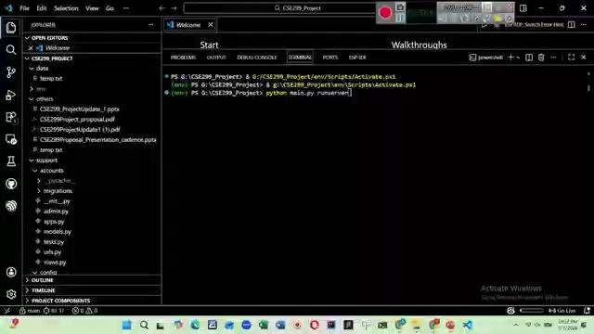

Slide 8
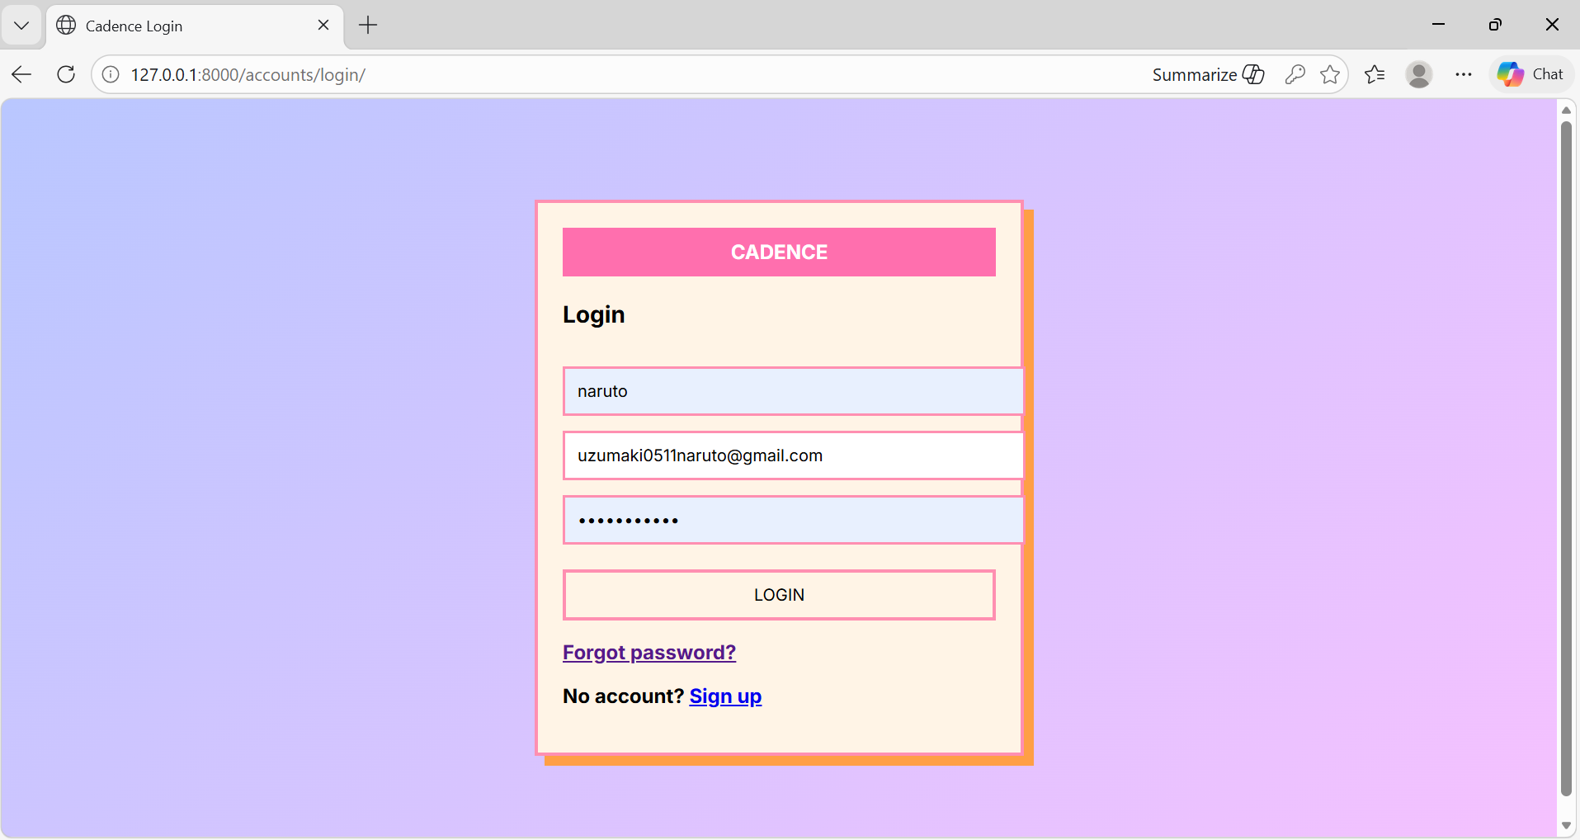

Slide 9
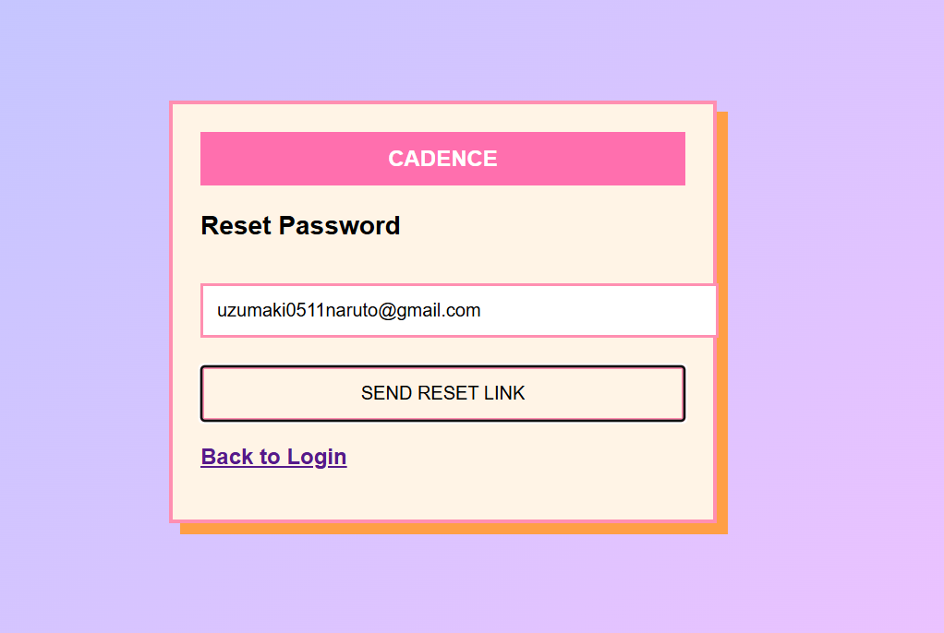

Slide 10
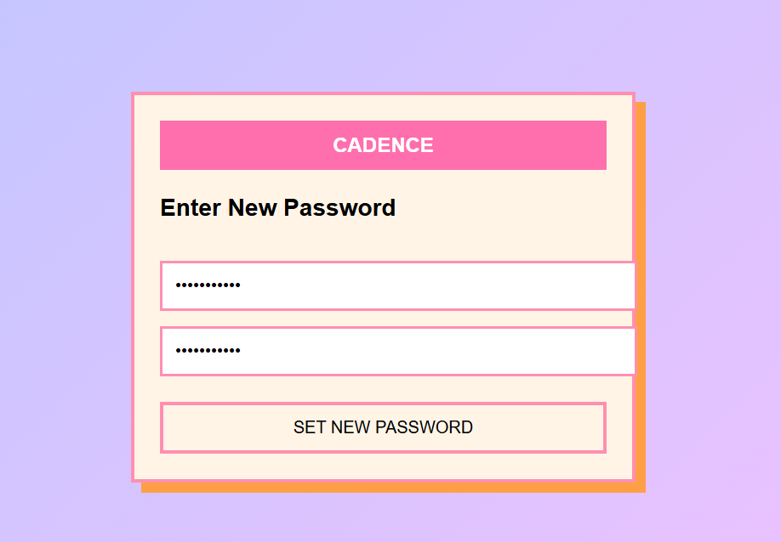

Slide 11
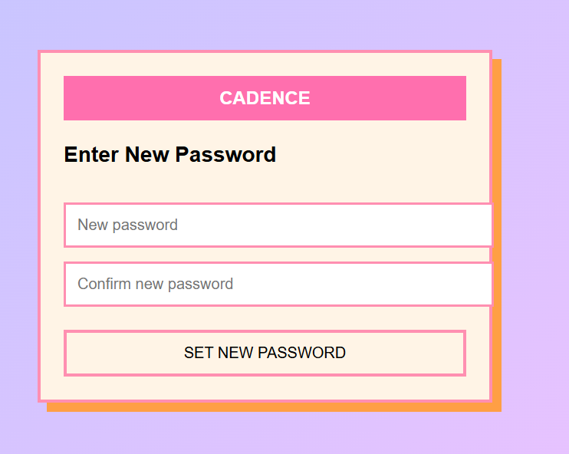


Slide 12
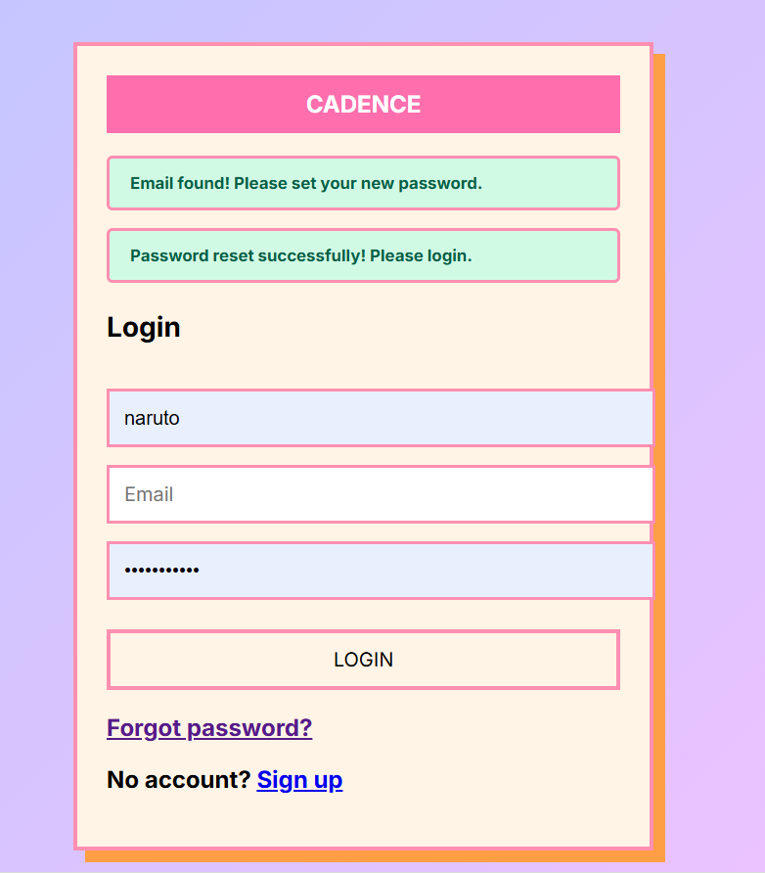

Slide 13
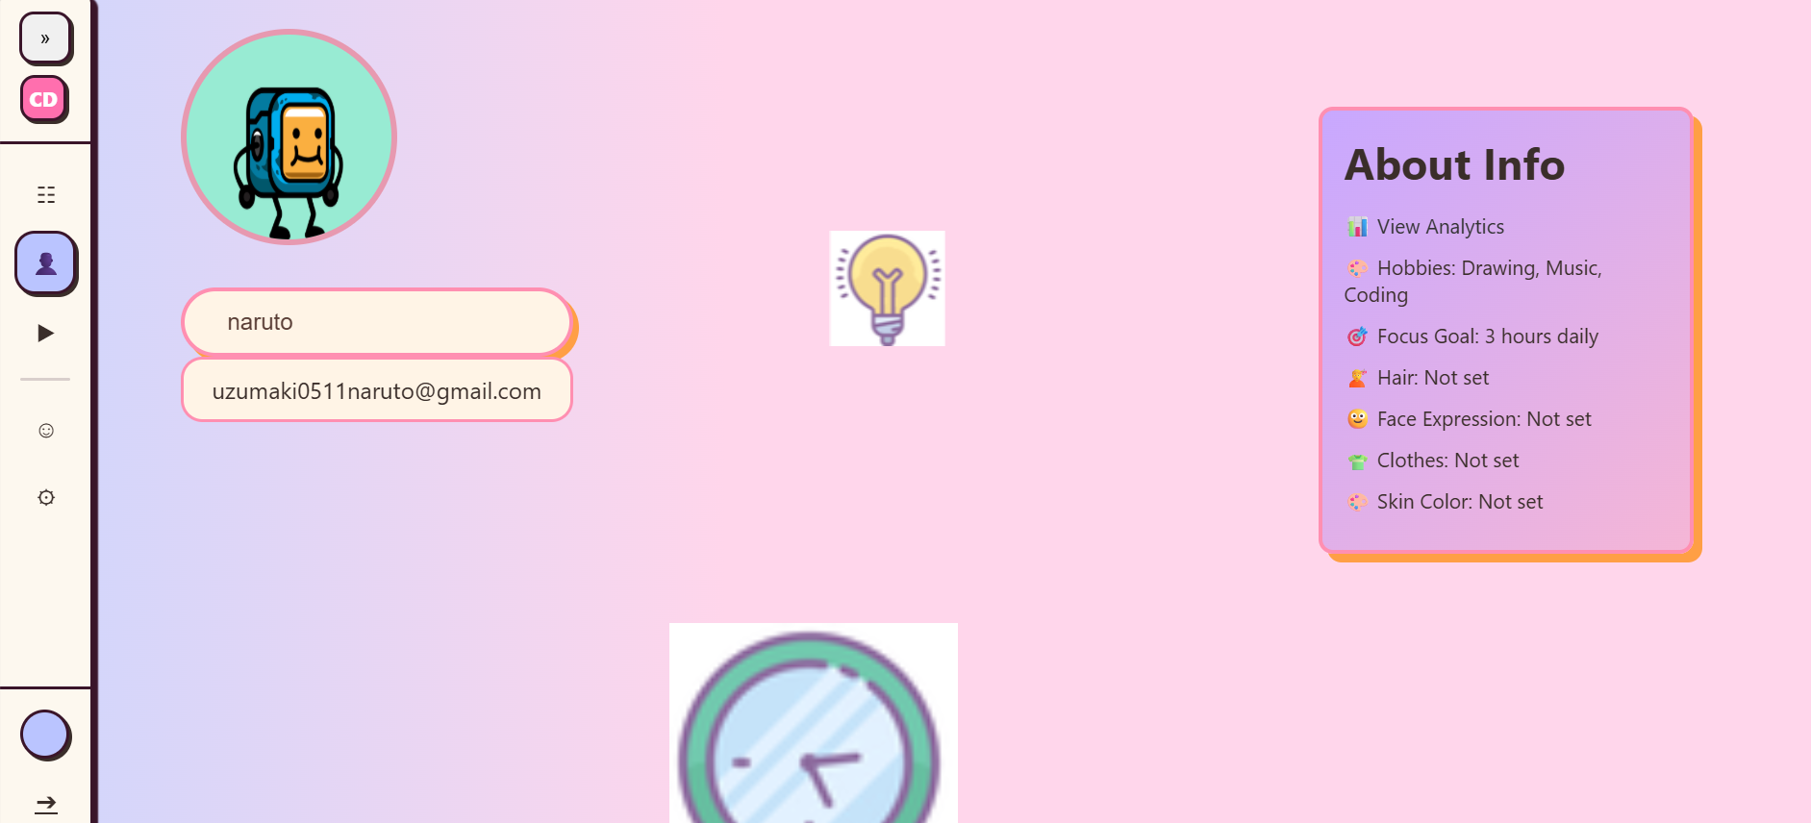

Slide 14
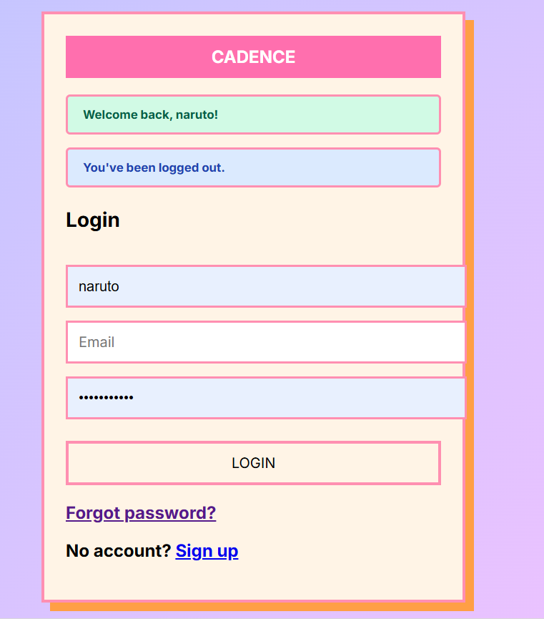

Slide 15
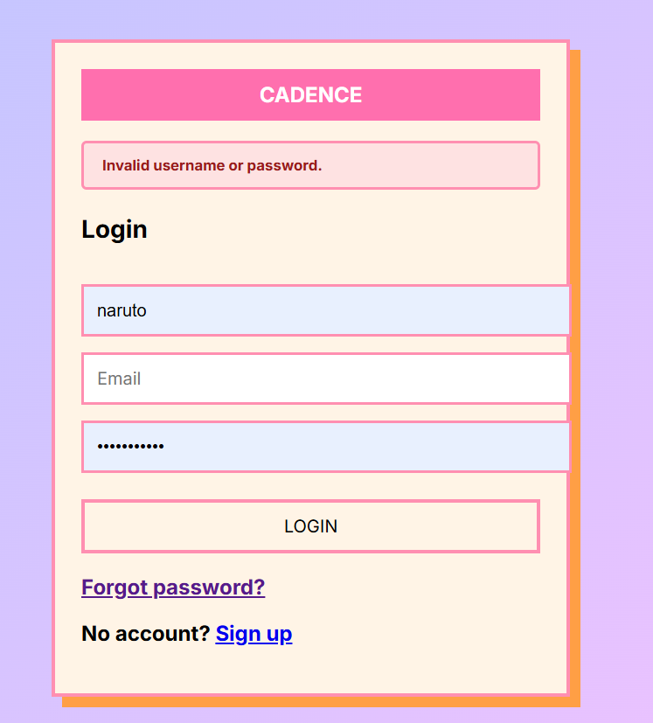
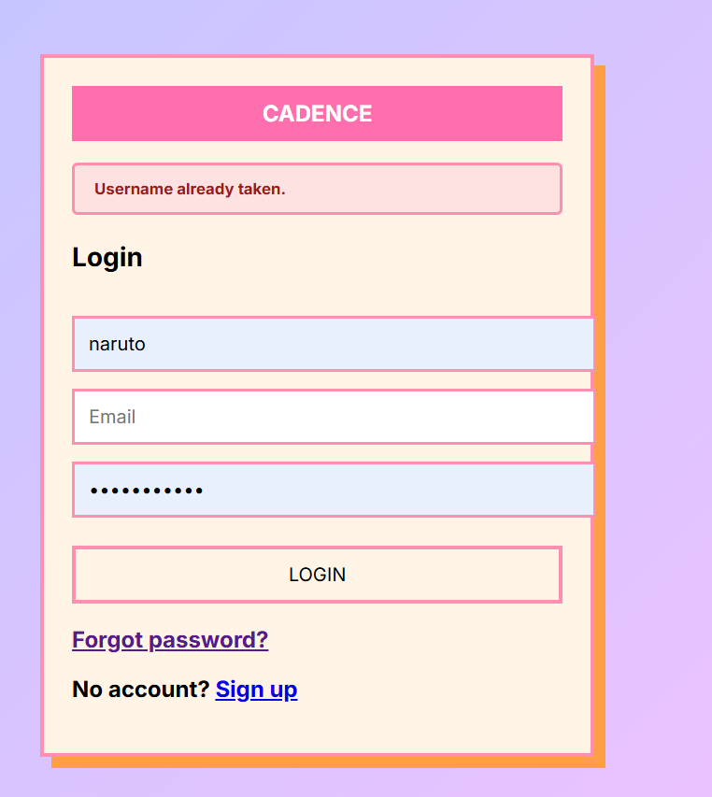

Slide 16
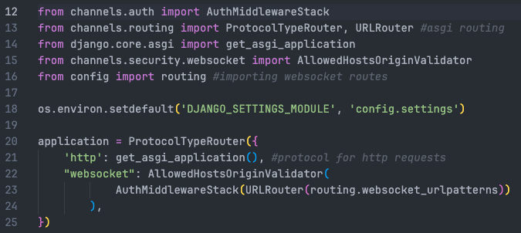
Django Channel Setup
Installed and configured to enable WebSocket support within the application.
Django by default works using request-response cycle (HTTP) -> this is one way
Django channels extends Django to support asynchronous communication and Websockets.
Websockets: communication protocol that creates a persistent, two-way connection between client and server.
How it works in our project:
Needed for : Chatroom texts, timer and state changes
Browser connects to server using Websockets.
When there is an update all users receive it instantly

Slide 17
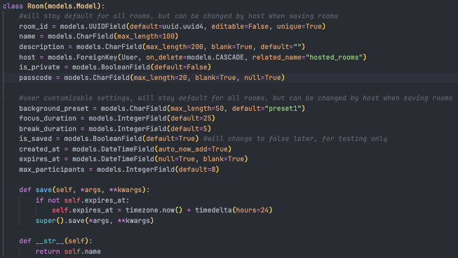
Database Models
To implement the chatrooms, user messages and sessions we created database models
Rooms: Responsible for all room information such as unique id, name, description and customizable settings

Slide 18
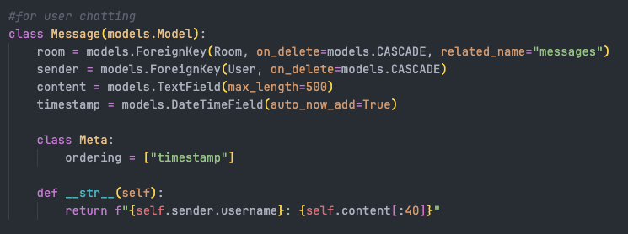
Database Models
To implement the chatrooms, user messages and sessions we created database models
Messages: Contains user texts for a specific chat room instance

Slide 19
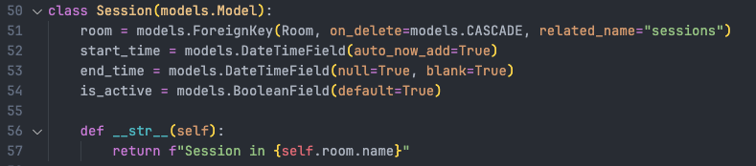
Database Models
To implement the chatrooms, user messages and sessions we created database models
Session: handles the status and activity of the session

Slide 20
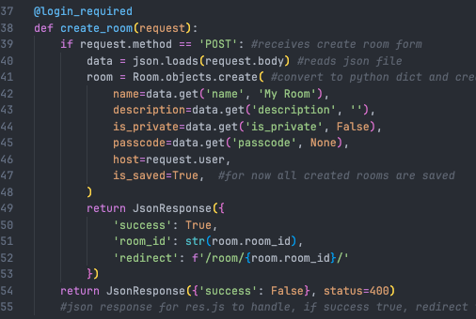
Chatroom Creation
Added chatroom functionality
User create room from Saved Spaced tab
From Open as Overlay
Once user has filled the form they are redirected to the new chatroom
Public Chatrooms will also appear in Community Tabs
Frontend and Backend connections made to show real-time data

Slide 21
