Slide 1



CSE 299
Cadence
Project Update 1

Slide 2
Objectives of 1st Week:
Goals for this development phase:
Set up Django project environment
Configure templates and static file directories
Create core Django application
Develop main frontend interfaces
Implement initial backend components
Connect frontend with Django routing system

Slide 3
Django Environment Setup
Project configuration and environment preparation
Created Django project structure
Configured settings.py
  Added templates directory path, static files directory path
  Updated BASE_DIR to root directory
  Ensured project runs correctly from root
Successfully tested Django development server

Slide 4
Core Application Creation
Backend application initialization
Created core Django application module
Organized project structure for scalability
Established base template structure
Prepared application for frontend and backend integration

Slide 5


Frontend Development
Implemented primary user interface pages
Developed using HTML, CSS, and JavaScript:
Home page interface
Login & Signup page frontend
Profile page frontend
Dashboard interface with sidebar navigation
Settings page frontend
System now supports basic user interface navigation.
Community rooms page
Individual room interface
Chatroom user interface
JavaScript used for dynamic interactions

Slide 6
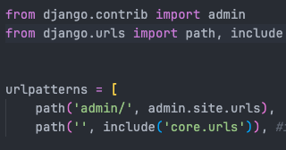
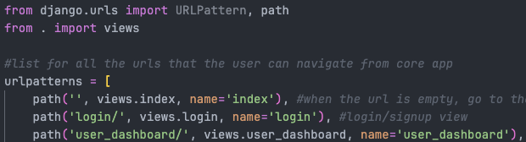
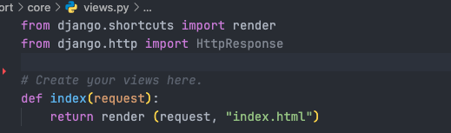
Django Routing Integration
Frontend and backend connectivity
Connected templates with Django routing system:
Configured urls.py
Implemented corresponding views.py
Linked templates with views
Verified successful page navigation
System now supports proper page routing.

Slide 7
Backend Development – User Profile
Database and model implementation
Created initial backend components:
Designed User Profile model
Defined profile attributes and structure
Connected model with Django framework
Prepared system for database integration
This enables user data storage and profile management.

Slide 8
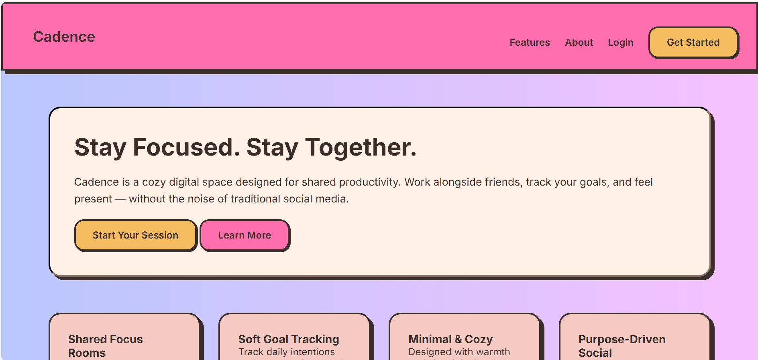
Home Page of our site

Slide 9
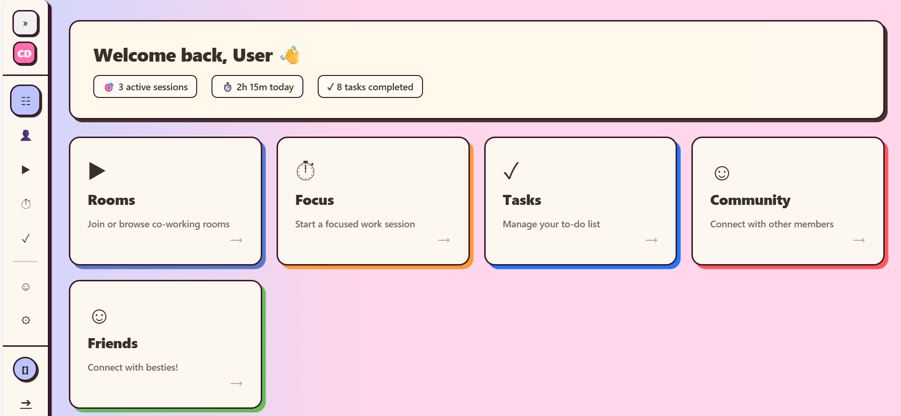
User Dashboard

Slide 10
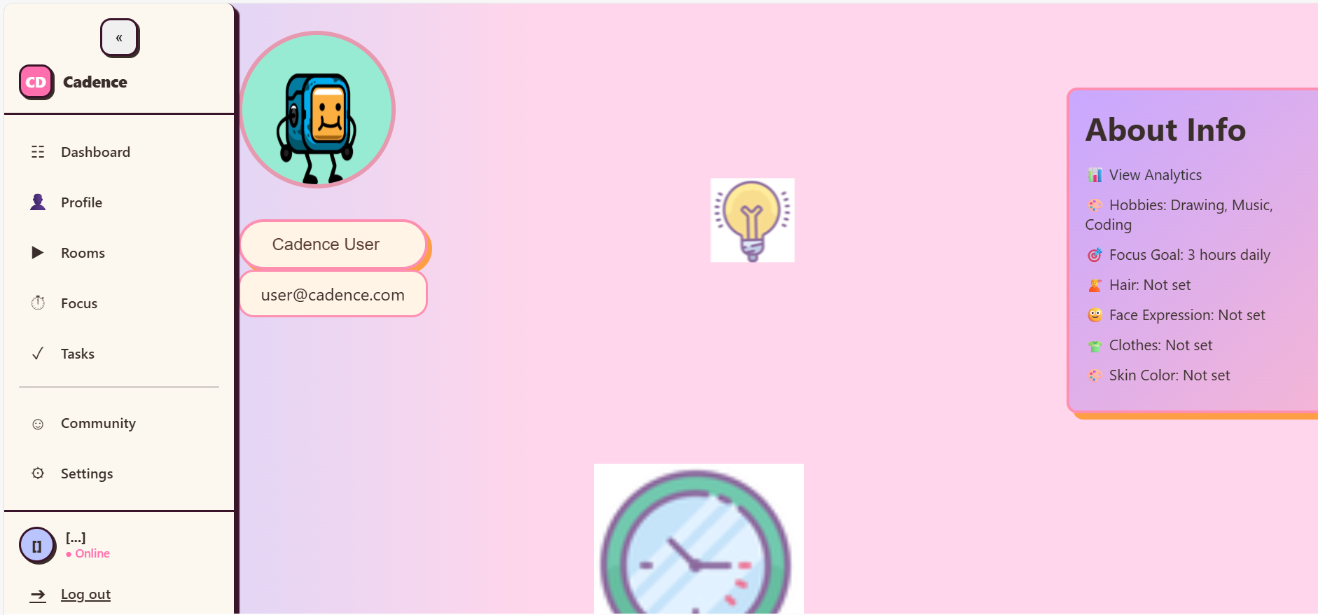
User Profile

Slide 11
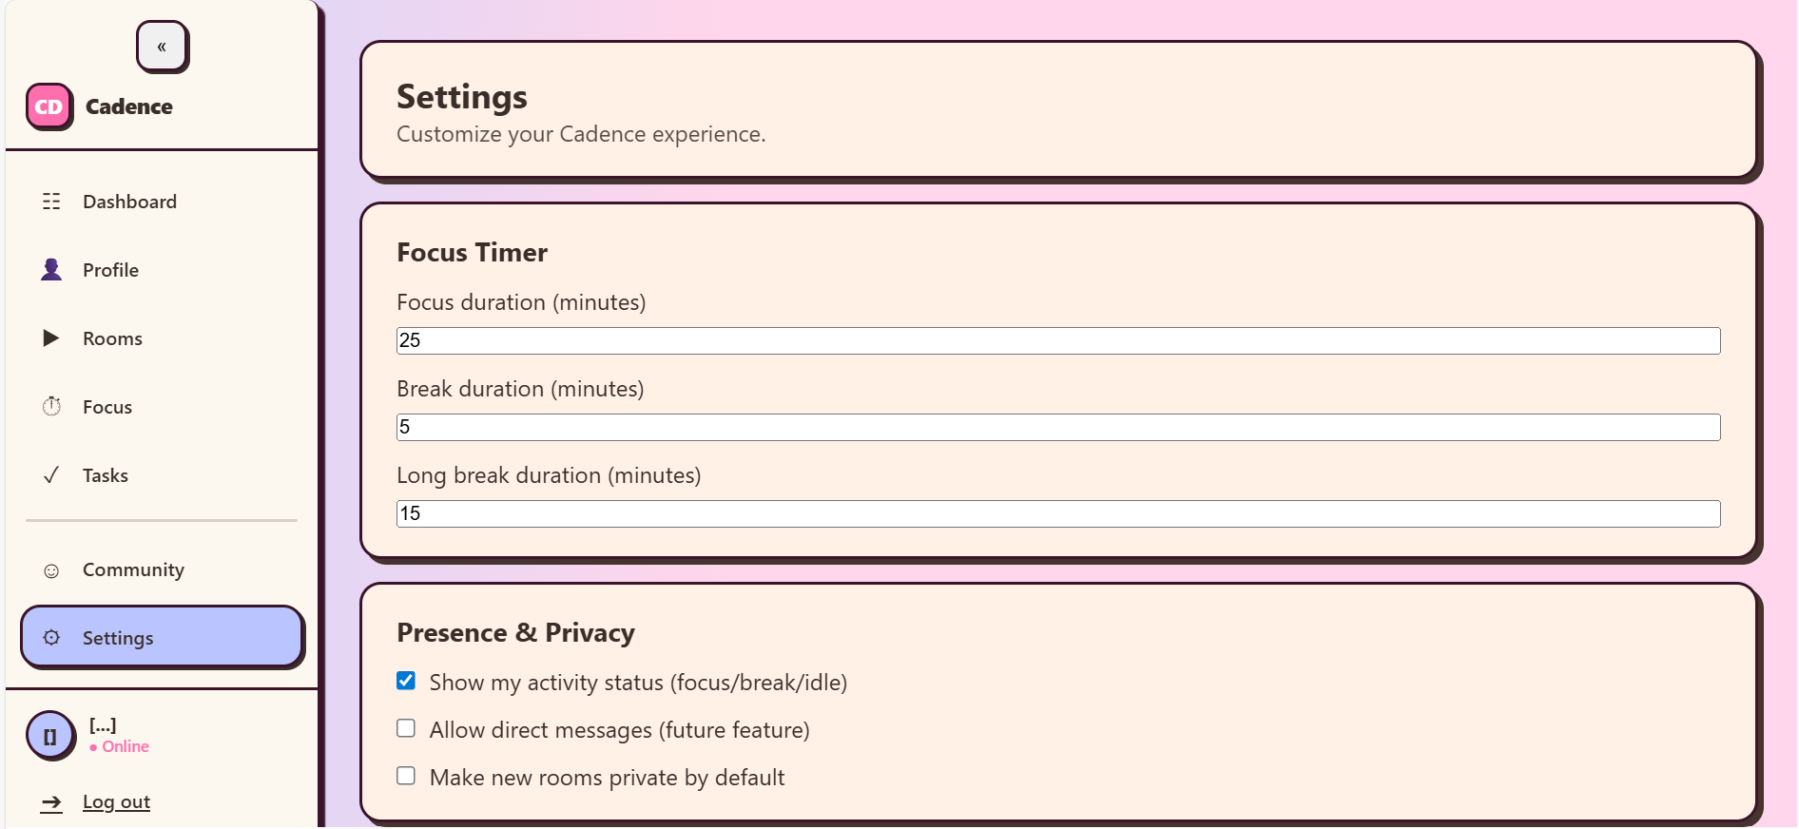
User Settings

Slide 12
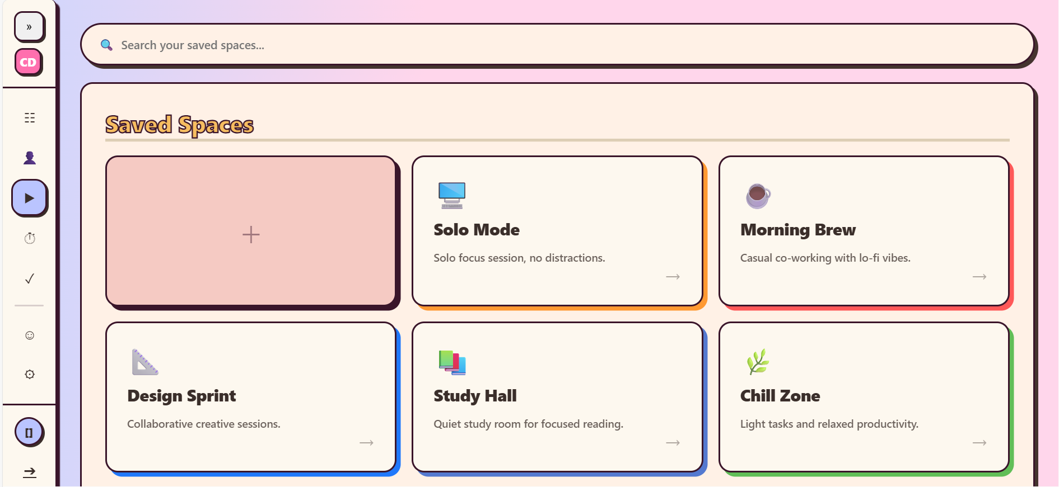
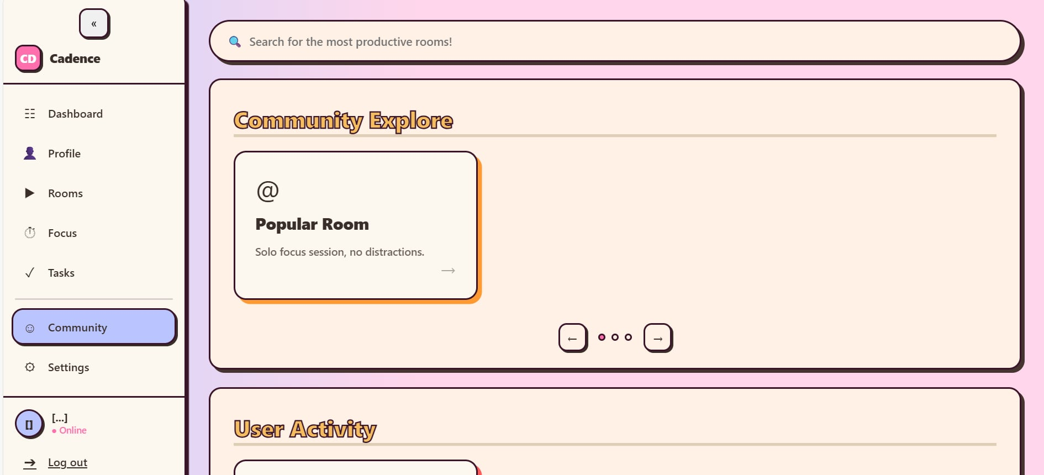
User Room
Plan to keep saved rooms
User can create more rooms
Community Rooms
Plan to store public room access here
Plan to keep community notices

Slide 13
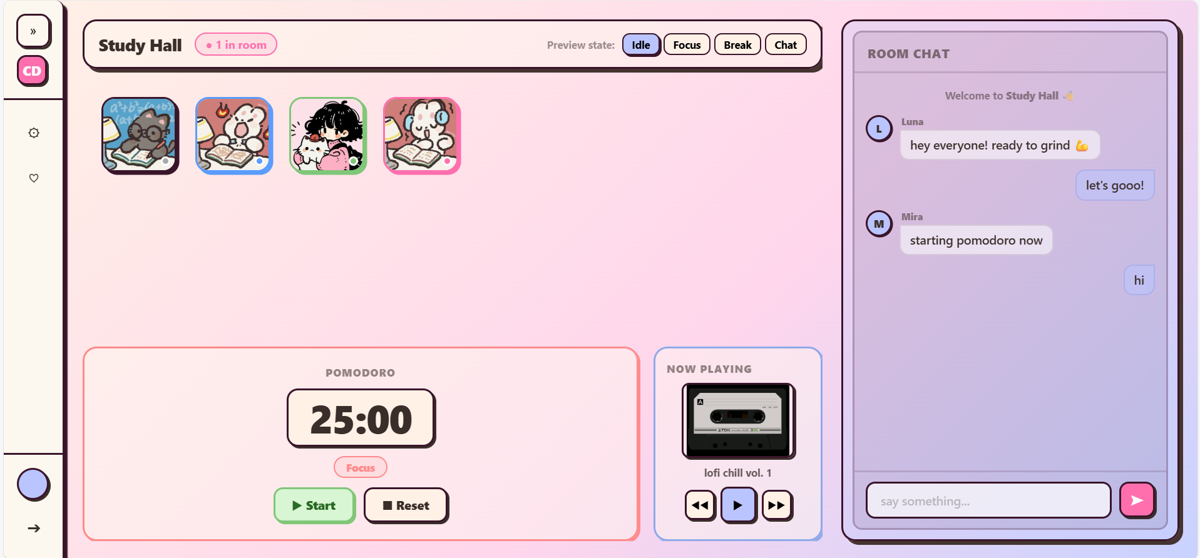
Chatroom UI

Slide 14
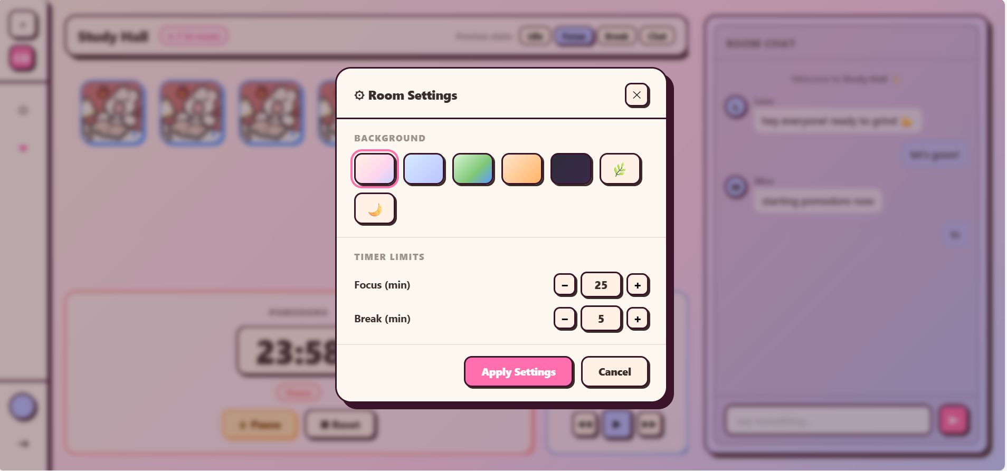

Slide 15
Current Progress Summary
Completed components:
Django environment setup
Core application structure
Multiple frontend pages
Chatroom and rooms interface
Initial backend models
Routing integration
System Status: Functional frontend with partially integrated backend.

