Slide 1
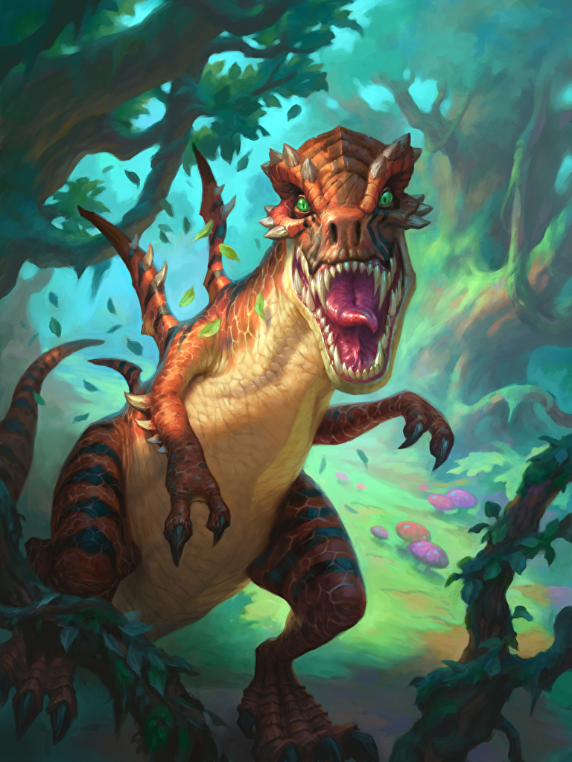
Resource
not found
Click to login

Slide 2

Angry-Dinosaurs

Slide 3
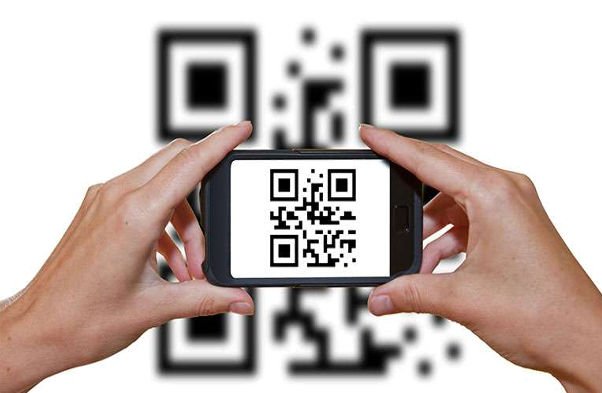
¡You must scan a Dino QR Code!
Resource
not found
Click to login

