Slide 1
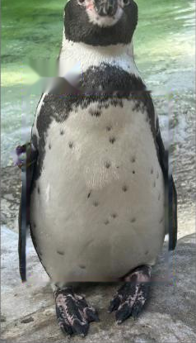
Automatic Identification of
Humboldt Penguins at London Zoo
What a photograph can tell you about which bird it is — and what it cannot
Candidate TDYK3 · MSc Ecology and Data Science · BIOS0057
Supervisor: Robin Freeman · Division of Biosciences, UCL
Notes:
[slide 1 · 20s · ends 0:20 of 10:00 · 40 words ≈ 18s at 130 wpm]
My first result on this project was 0.920 — nine penguins in ten identified correctly from a photograph. It was wrong. The reason it was wrong is most of what I want to tell you in the next ten minutes.

Slide 2
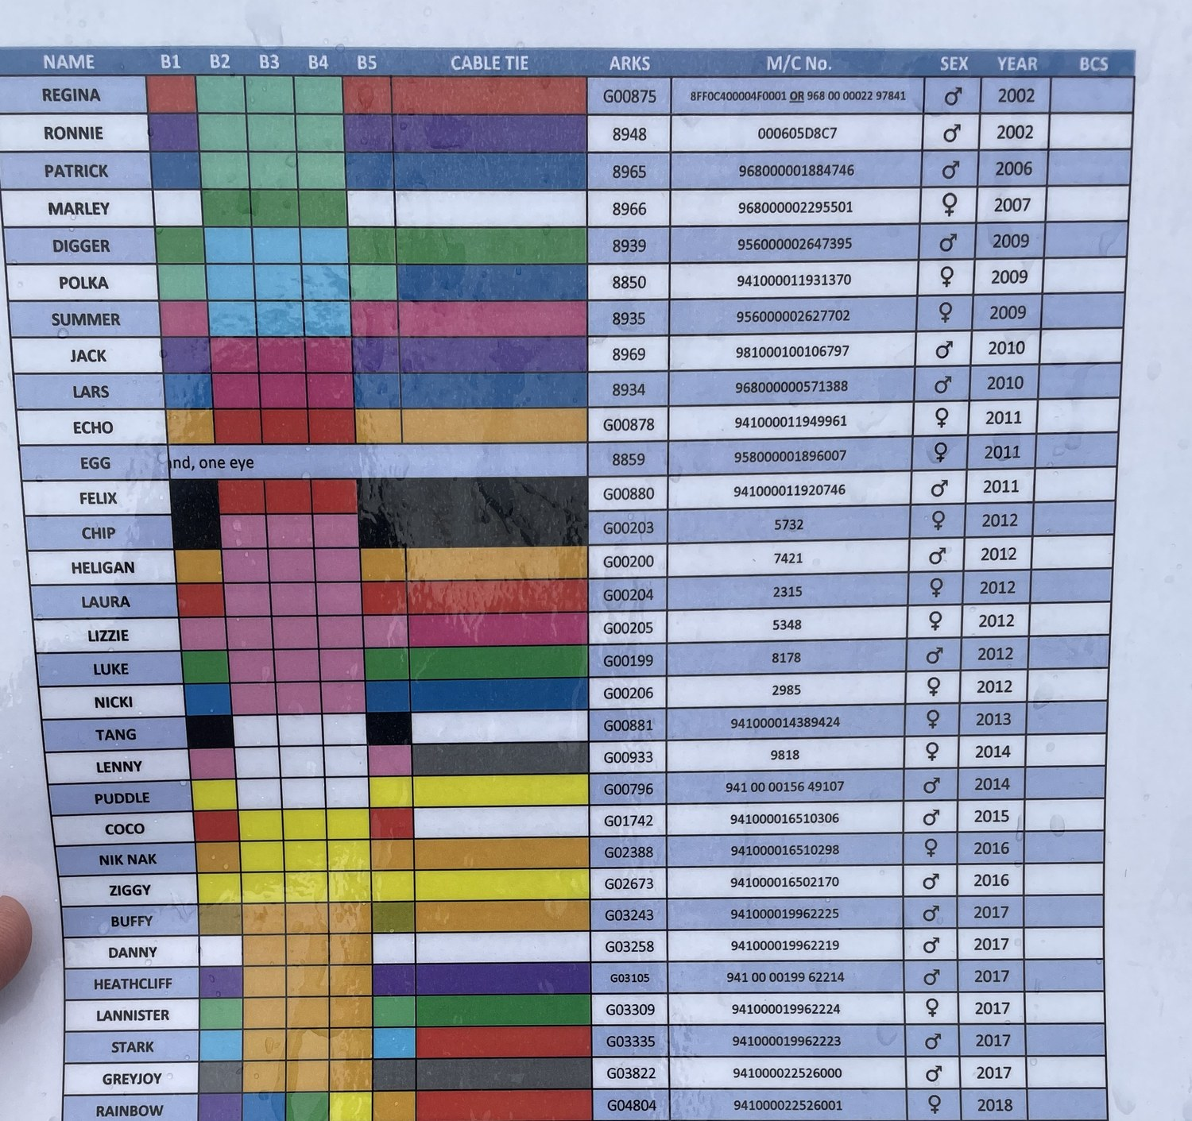
WHY THIS PROBLEM
Identity is currently worn,
not read from the bird
Bands can be hidden by posture, another bird, or the angle
In king penguins, ten years of banding cost survival and breeding success (Saraux et al. 2011) — not directly transferable to captive Humboldts, but a marker is not automatically neutral
Humboldts have been told apart by their breast spots since Scholten (1989)
African penguins use ventral dot patterns to recognise each other (Baciadonna et al. 2024) — the cue is already doing this job
The colony's identification sheet: five band colours per bird.
Nicki and Greyjoy — two birds you will meet again — are on it.
Automatic identification of Humboldt penguins · ZSL London Zoo
2
Notes:
[slide 2 · 44s · ends 1:04 of 10:00 · 92 words ≈ 42s at 130 wpm]
London Zoo tells its 81 Humboldt penguins apart with coloured flipper bands, read off this laminated sheet. Bands work, but they can be hidden by posture or another bird — and in king penguins, ten years of banding cost survival and breeding success. That does not transfer directly to captive Humboldts; it just says a marker is not automatically neutral. The alternative is already on the bird: African penguins use their ventral dot patterns to recognise each other, so I am asking a model to read a cue the species already reads.

Slide 3
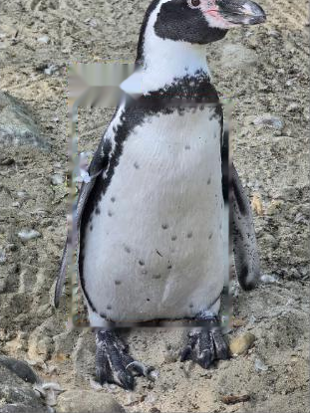
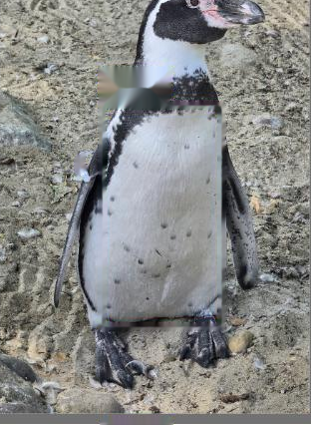
THE DATA
2,307 volunteer photographs — but the unit of evidence
is the encounter, not the file
2,307
81
35
335
photographs
individuals
evaluated
capture sessions
81 birds, 1 to 291 each
the whole colony
≥16 photos and ≥3 sessions
258 across the 35
one capture session — two frames of Ping
A capture session = every photograph of one bird from a single photographic encounter.
Inferred per bird from the camera filename prefix and frame number: a new session starts when the gap to the previous frame exceeds 50. Checked against EXIF timestamps where present. Frames inside one session share light, background, viewpoint and posture — they are correlated observations, not independent evidence of how a bird looks on a new day.
Same light, same ground, same posture. A random split can put one of these in training and the other in test.
Automatic identification of Humboldt penguins · ZSL London Zoo
3
Notes:
[slide 3 · 43s · ends 1:47 of 10:00 · 93 words ≈ 43s at 130 wpm]
2,307 photographs of all 81 birds, taken by volunteers during husbandry, not to a research protocol — counts run from 1 to 291. Thirty-five birds clear both inclusion rules: the better-photographed 43% of the colony. The other 46 are never queries; they are gallery distractors and, later, genuine strangers. The definition at the bottom is what matters. A capture session is one photographic encounter with one bird, inferred from the camera's frame numbering. The two frames on the right are one session: same light, same ground, same posture. They are not independent samples.

Slide 4
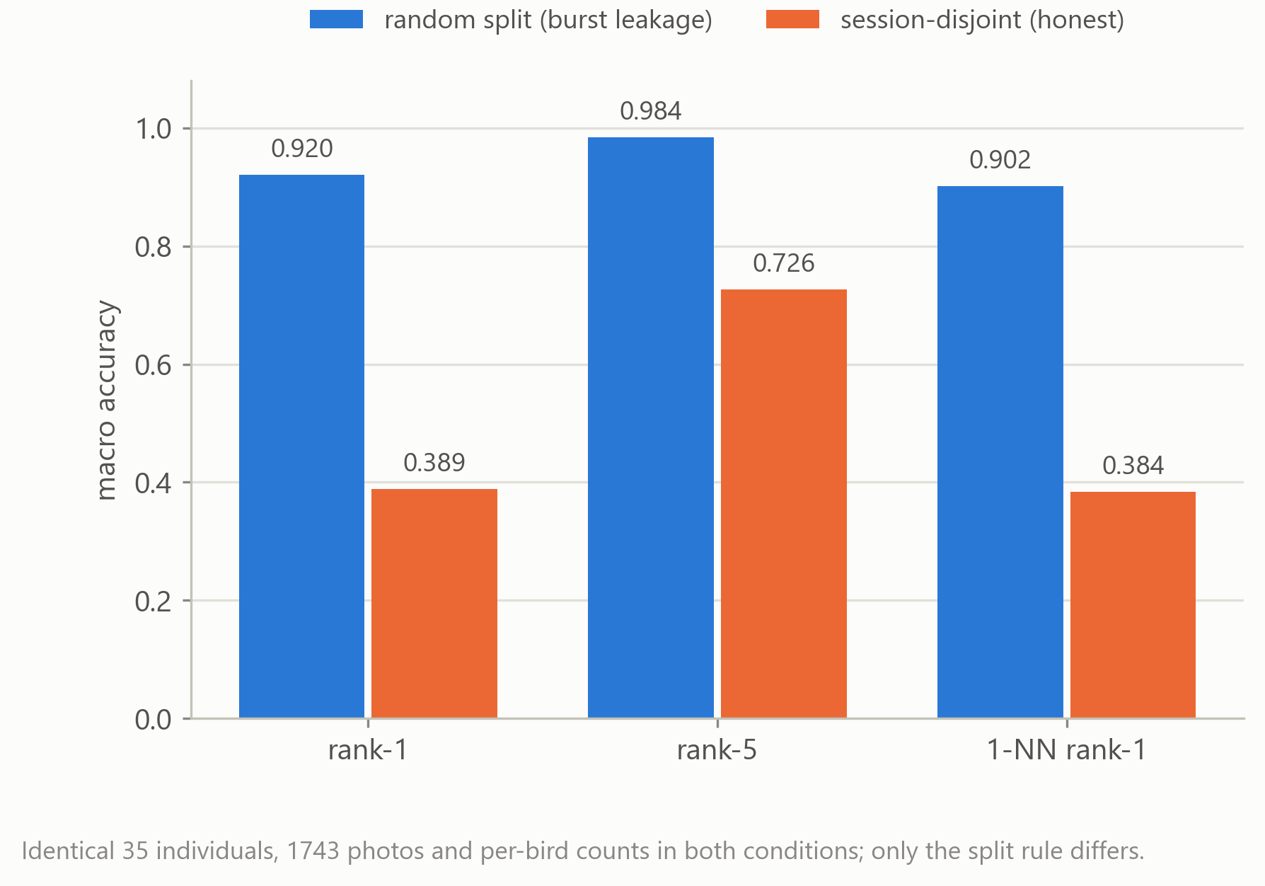
RESULT 1 — THE CONTROLLED EXPERIMENT
Change only the split rule, and 0.920 becomes 0.389
Same 35 birds, same 1,743 photographs, same per-bird partition sizes, same training recipe
Only difference: whole capture sessions may no longer straddle the split
Rank-5 and 1-NN collapse the same way — not a quirk of one metric
Audited before any model ran
97.8% of random-split test photos shared a capture session with a gallery photo; 13.8% had an outright near-duplicate — measured by perceptual hash, pixel correlation and EXIF time, none of which touch the model.
Automatic identification of Humboldt penguins · ZSL London Zoo
4
Notes:
[slide 4 · 60s · ends 2:47 of 10:00 · 125 words ≈ 58s at 130 wpm]
Here is the experiment the whole project turns on. Birds, photographs, per-bird counts and training recipe all held fixed, and exactly one thing changed: whether a test photograph may come from a capture session the gallery has already seen. Under the conventional random split, rank-one accuracy — every bird weighted equally — is 0.920. Under the session-disjoint split, it is 0.389: an inflation of 0.531 attributable to the partitioning rule alone. Rank-five and nearest-neighbour move with it. And I can show the entanglement without reference to any model: 97.8% of the randomly assigned test photographs shared a capture session with a gallery photograph, and 13.8% had a near-duplicate. So the random split was measuring recognition of a familiar encounter, not identification on a new occasion.

Slide 5
WHAT REPLACES IT
An evaluation whose unit is the encounter and whose
weight is the individual
1
Session-wise 5-fold cross-validation
Whole sessions are dealt to folds, largest bird and largest session first. Folds of 349 / 350 / 351 / 347 / 346 photographs. Every one of the 1,743 photographs is tested exactly once by a model that never saw its session — the evaluation script asserts it.
2
Macro metrics
Accuracy is computed per bird and then averaged with equal weight, so Cooper's 127 photographs cannot cover for a bird with 18.
3
Bootstrap that resamples sessions, not photographs
2,000 replicates, capture sessions resampled within each bird, and the same resampled sessions applied to both arms of every comparison — so the reported effects are paired differences, not overlapping independent intervals.
Automatic identification of Humboldt penguins · ZSL London Zoo
5
Notes:
[slide 5 · 47s · ends 3:34 of 10:00 · 97 words ≈ 45s at 130 wpm]
So what replaces it. Three things. First, session-wise five-fold cross-validation: complete sessions are dealt to folds, so no session is ever split, and every one of the 1,743 photographs is tested exactly once by a model that never saw its session. That is not a claim in prose — the evaluation script asserts it and refuses to run without the session map. Second, every number is macro: one bird, one vote. Third, the intervals resample capture sessions rather than photographs, and apply the same resampled sessions to both arms of a comparison, so these are paired differences.

Slide 6
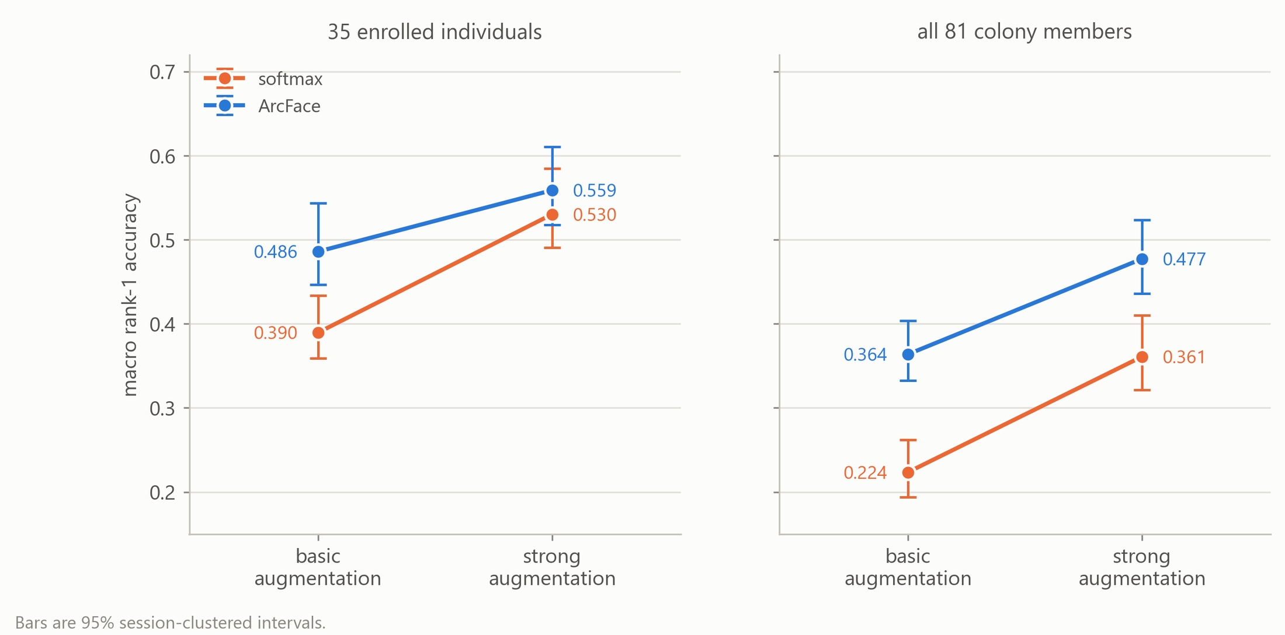
RESULT 2 — WHICH CHANGE DID THE WORK
Augmentation is the larger lever; metric learning
earns its place only as the gallery grows
Paired simple effects, rank-1
Strong augmentation
under softmax
+0.141
[0.105, 0.179]
ArcFace
under basic aug.
+0.096
[0.061, 0.139]
ArcFace given strong,
35 candidates
+0.029
[−0.005, 0.060] n.s.
ArcFace given strong,
81 candidates
+0.116
[0.082, 0.148]
Highest of four configurations: ArcFace + strong, 0.559 [0.517, 0.610].
Automatic identification of Humboldt penguins · ZSL London Zoo
6
Notes:
[slide 6 · 55s · ends 4:29 of 10:00 · 115 words ≈ 53s at 130 wpm]
Under that protocol I ran a full two-by-two: objective crossed with augmentation, five folds each, twenty runs. The baseline scores 0.390, close to the single-split 0.389 — but different recipes, so not a validation. Strong augmentation is worth plus 0.141; ArcFace alone plus 0.096. They are sub-additive: once strong augmentation is there, ArcFace adds only 0.029 and that interval crosses zero, so at 35 candidates I cannot claim the loss is doing significant work. Widen the gallery to all 81 — the right-hand panel — and ArcFace is worth plus 0.116, clear of zero, because metric learning shapes the embedding geometry rather than the top-one call. That is the regime a real colony is in.

Slide 7
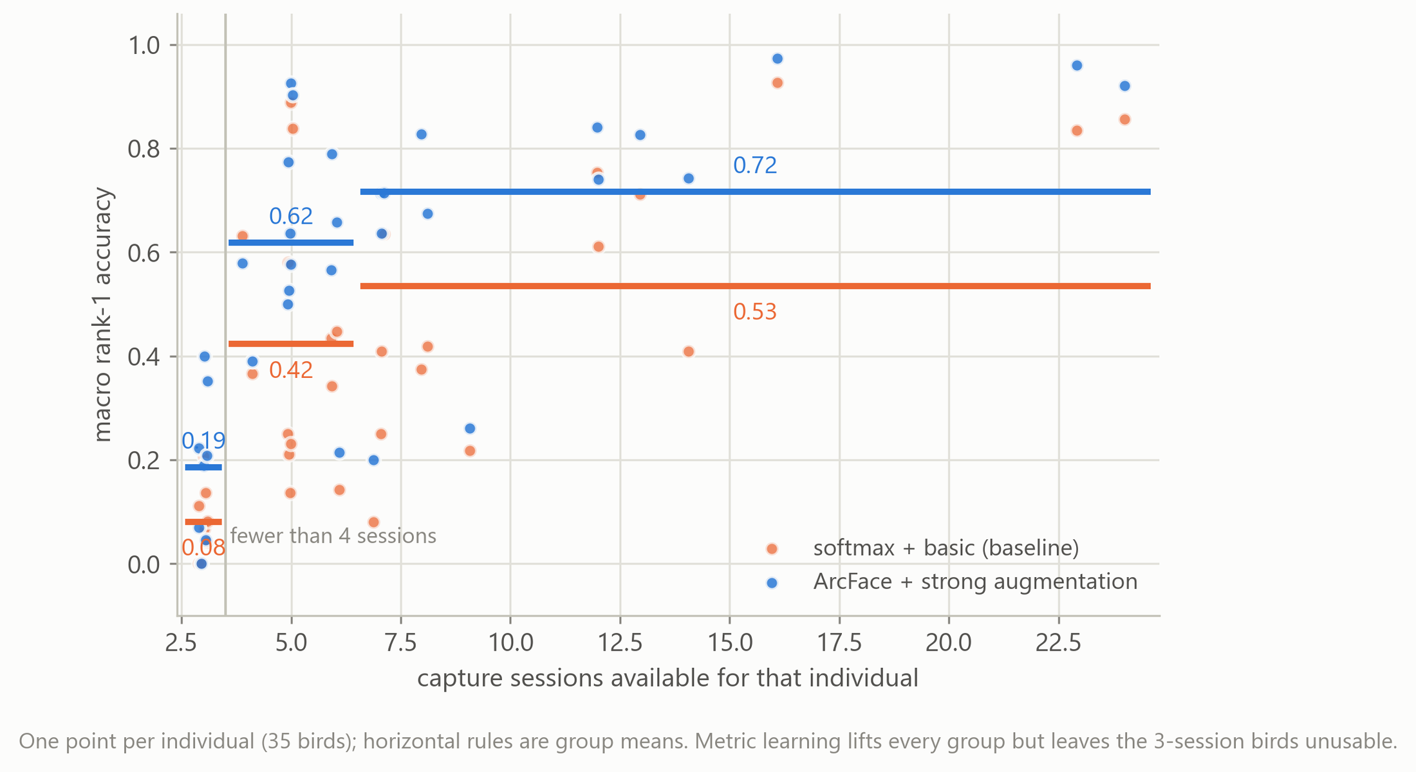
RESULT 3 — THE CENTRAL FINDING
Identifiability tracks how many separate occasions a bird
was photographed on, not how many photographs exist
Nicki
0.189
53 photographs · 3 capture sessions
Gonzo
0.827
52 photographs · 13 capture sessions
Each figure is the fraction of that bird's photographs identified correctly. Illustration, not evidence — the evidence is the partial rank correlation across all 35 birds: holding photograph count constant, sessions still predict accuracy (ρ = 0.518, P = 0.002); holding sessions constant, photograph count does not reach significance (ρ = 0.224, P = 0.203) — which does not exclude a modest effect this study is underpowered to detect.
Automatic identification of Humboldt penguins · ZSL London Zoo
7
Notes:
[slide 7 · 73s · ends 5:42 of 10:00 · 154 words ≈ 71s at 130 wpm]
This is the finding I care most about. Group the 35 birds by how many separate occasions they were photographed on: three sessions, 0.186; four to six, 0.618; seven or more, 0.717. The same ordering holds in all four configurations. Nicki and Gonzo make it concrete: 53 photographs against 52, but three sessions against thirteen, and 19% against 83%. That pair is an illustration, not the evidence. Sessions and photograph count are correlated at rho 0.663, so I partial one out. Sessions survive at 0.518; photograph count falls to 0.224 and does not reach significance — with 35 birds I cannot exclude a modest photograph effect, only say sessions are the stronger one. And one caution I will give you myself: a three-session bird's prototype is built from one or two gallery sessions, so part of this gradient is my design rather than the birds. It points the same way for collection either way.

Slide 8
RESULT 4 — DEPLOYMENT READINESS
One set of models, three questions — and only one of them
describes deployment
0.559
0.477
The shortcut I did not take
Simulating strangers by hiding a bird's own prototype reports 0.230 instead of 0.123 — an overstatement of 87%. Both numbers come out of the same evaluation run, so this is a controlled comparison, not two studies stitched together.
0.123
“The number that describes
deployment readiness
is 0.123, not 0.559.”
35 candidates,
closed set
…now rank against
all 81 colony
candidates
…now strangers must
be refused 99% of
the time
the reference —
highest of the four
configurations
same 1,743 queries;
46 identities added
as distractors
DIR at 1% false-accept,
against 564 photographs
of 46 never-trained birds
The deployed configuration's five-candidate shortlist contains the right bird 78.2% of the time (35 candidates; softmax + strong is better at rank-5, at 0.809).
Each of the two is one change away from the first, not a chain: the gallery grows, or strangers must be refused. All three come from the same five cross-validated models and are macro over the 35 individuals.
Automatic identification of Humboldt penguins · ZSL London Zoo
8
Notes:
[slide 8 · 64s · ends 6:46 of 10:00 · 135 words ≈ 62s at 130 wpm]
I want to be the one who tells you how good this is not. These are the same five models asked three questions. Against 35 candidates, closed set, the best configuration reaches 0.559. Rank the same queries against all 81 colony identities and it falls to 0.477 — how often the right bird outranks eighty alternatives, not accuracy across all 81 birds. Then the real test: it must be able to refuse. Using the 564 photographs of 46 birds the models never trained on, at a one percent false-accept rate only 12.3% of photographs of enrolled birds are both accepted and correctly named. Simulate the strangers instead — the conventional shortcut — and it reports 0.230, an 87% overstatement. Both come from the same run. The number that describes deployment readiness is 0.123, not 0.559.

Slide 9
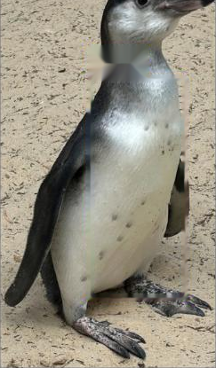
WHAT EXISTS
Retrieval, not classification — so a new bird costs
an enrolment, not a retraining
Photograph
79 trained on 81 enrolled
one uncropped image
Smew and Skunk have one and two photographs. Never trained on, in the gallery, searchable. A softmax head would need a new output layer and a full retrain for each arrival. The deployed model has no held-out partition of its own — the cross-validated 0.559 is its estimate.
ResNet18 embedding
ArcFace-trained · 512-d · L2-normalised
Search 81 enrolled identities
FAISS · cosine vs class prototypes
one photograph,
uncropped, as taken
Open-set threshold 0.938
“not a bird I know”
accept · or refuse
best score below 0.938
It refuses in two ways
Below 0.938 it returns “not a bird I know” and asks for a clearer photograph. Above it, but with a top-two margin under 0.05, it returns a shortlist and asks the keeper to confirm. It never emits a name it is not confident in.
Ranked shortlist for a keeper
identity + alternatives, human confirms
Automatic identification of Humboldt penguins · ZSL London Zoo
9
Notes:
[slide 9 · 55s · ends 7:41 of 10:00 · 115 words ≈ 53s at 130 wpm]
What exists is a retrieval system, not a classifier. A photograph becomes a 512-dimensional vector, compared by cosine similarity against one prototype per enrolled identity. I chose retrieval for two properties a softmax head does not have. First, enrolment without retraining: the deployed model trained on 79 birds, but the gallery holds all 81. Smew and Skunk, with one and two photographs, were never trained on — and they are searchable. Second, a principled way to say I don't know. A softmax head must name something, whatever walks past. Here, below 0.938 — that five-per-cent point — the answer is a refusal, and a narrow top-two margin returns a shortlist for the keeper to confirm.

Slide 10
SCOPE
What this study does not show
No end-to-end test
Identification is measured from the archive as photographed. There is no detector in the deployed path, so every claim is conditional on inputs that resemble the existing archive.
The threshold is transferred, not recalibrated
0.938 was measured at 5% false-accept on the cross-validated models. Once all 81 birds are enrolled the realistic unknown is a blurred, rear-facing or non-penguin image — which it has never been calibrated against.
35 of 81 birds
The evaluated set is the better-photographed 43% of the colony. Given the session gradient, the rest are likely to be harder, and they were not measured.
One backbone, reconstructed sessions
Only ResNet18, so this compares objective and augmentation, not architectures — 0.559 is not a ceiling. And sessions were inferred from filenames and frame gaps, not recorded at capture.
Automatic identification of Humboldt penguins · ZSL London Zoo
10
Notes:
[slide 10 · 41s · ends 8:22 of 10:00 · 84 words ≈ 39s at 130 wpm]
Four things this does not show, quickly. There is no end-to-end test — no detector in the deployed path, so every claim is conditional on inputs like the archive. The operating threshold was transferred from the cross-validated models, not recalibrated, and has never been tested against blurred or rear-facing photographs. The evaluated set is the better-photographed 43% of the colony, and the rest are probably harder. And there is one backbone and one reconstructed session rule — so 0.559 is not an upper limit.

Slide 11
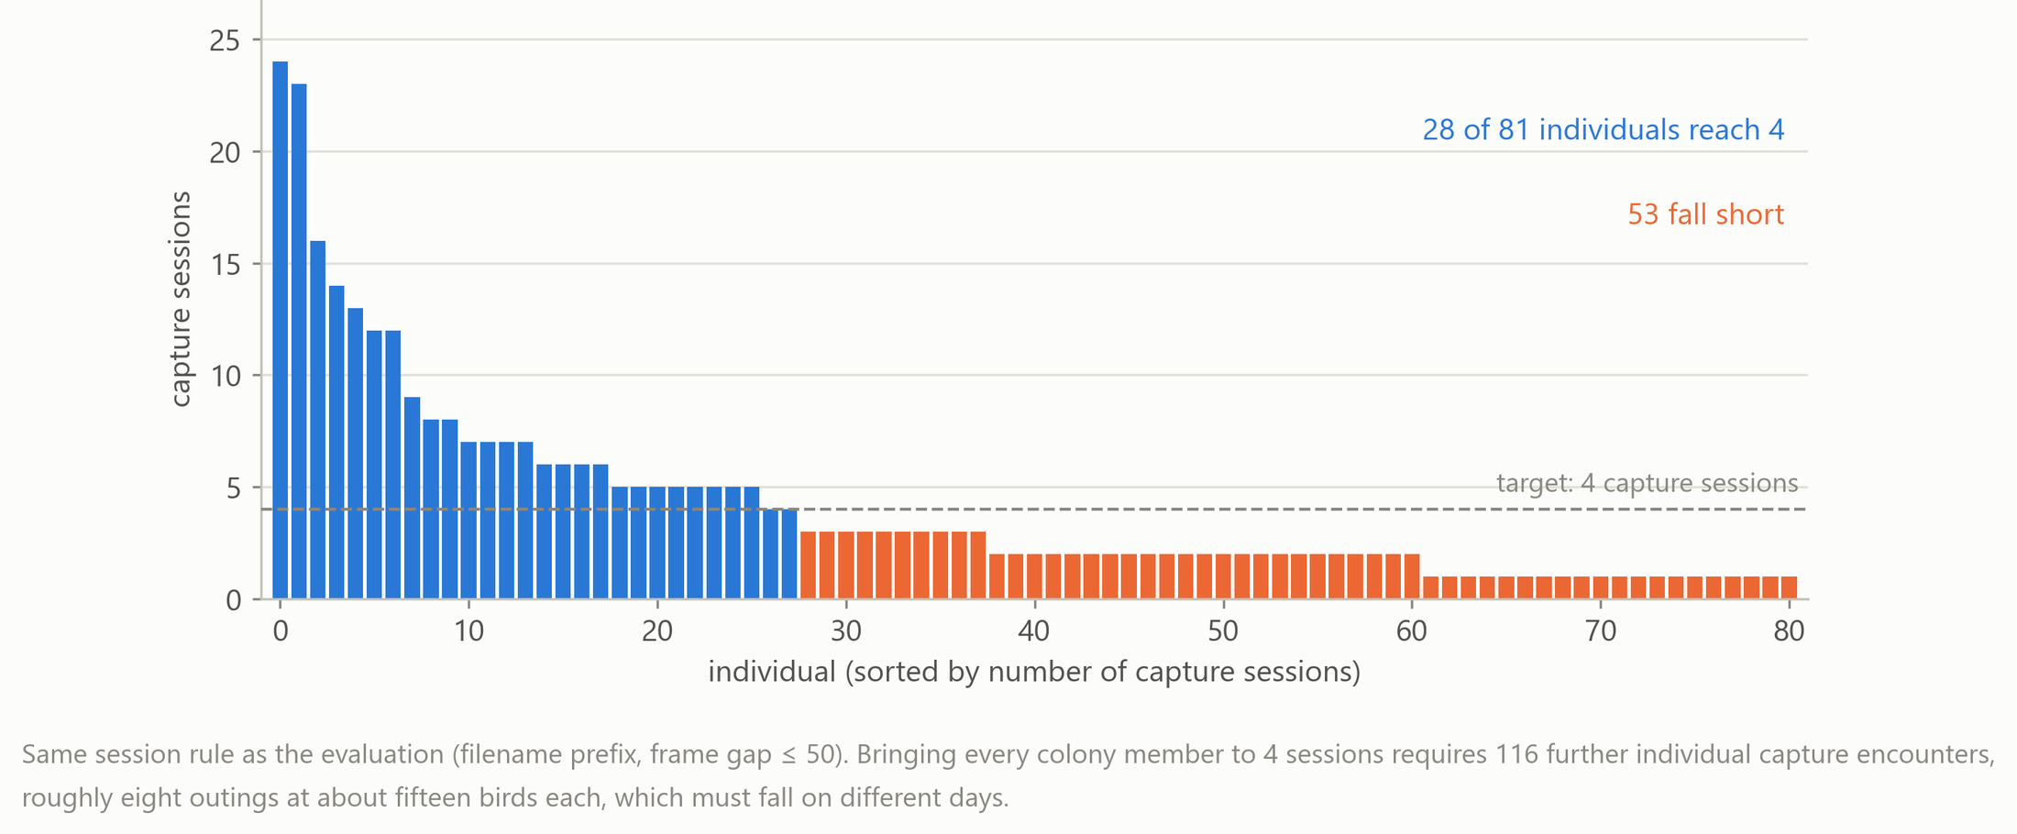
WHAT TO DO ABOUT IT
The next gain is a camera, not a loss function
53 of 81
116
≈ 8
birds below four sessions
further individual encounters
separate outings
only 28 reach the provisional target
to bring the whole colony to four
at ~15 birds each — on different days
Automatic identification of Humboldt penguins · ZSL London Zoo
11
Notes:
[slide 11 · 45s · ends 9:07 of 10:00 · 93 words ≈ 43s at 130 wpm]
So the recommendation is a collection protocol, not an architecture. Applying my session rule to the whole colony: 335 sessions across 81 birds, very unevenly spread. Only 28 reach four separate occasions; 53 fall short. Four is provisional — I grouped four, five and six sessions together and did not assign effort experimentally, so it is a starting point, not a validated threshold. But it is costable: 116 further encounters, about eight outings, on different days, deliberately varying viewpoint, light and distance. Eight mornings with a camera is something a zoo can approve.

Slide 12
The number I would defend is not 0.559.
It is 0.531 — the amount a conventional random split
silently added to a result that already looked finished.
If you can tell me which day a photograph was taken, you can tell me whether it belongs in your test set.
github.com/aoaoguo2003/pgs
12
Notes:
[slide 12 · 34s · ends 9:41 of 10:00 · 70 words ≈ 32s at 130 wpm]
To close. On this evidence, 116 more individual encounters — about eight mornings with a camera — is worth more than any change I could make to the model. Better algorithms cannot substitute for observations that are not in the archive. And the number I would defend is not 0.559. It is 0.531: the amount a conventional random split silently added to a result that already looked finished. Thank you.

Slide 13
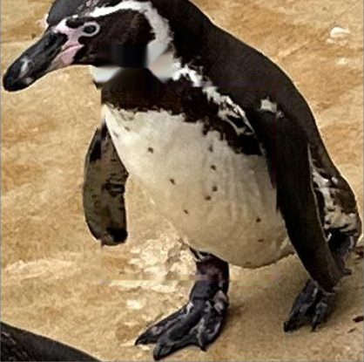
Thank you
Any questions?
0.531
0.559
0.123
inflation from splitting by
file instead of by encounter
macro rank-1, 35 candidates,
closed set
correctly named at a 1%
stranger false-accept rate
With thanks to Robin Freeman for his supervision, and to ZSL London Zoo and the volunteer photographers whose archive made this possible.
Code and analysis: github.com/aoaoguo2003/pgs
Notes:
[slide 13 · 15s · ends 9:56 of 10:00 · 29 words ≈ 13s at 130 wpm]
Thank you. I am happy to take questions — and I have backup slides on the inclusion criteria, the open-set calibration, the training recipe and the full results table.

Slide 14
Backup
Prepared answers

Slide 15
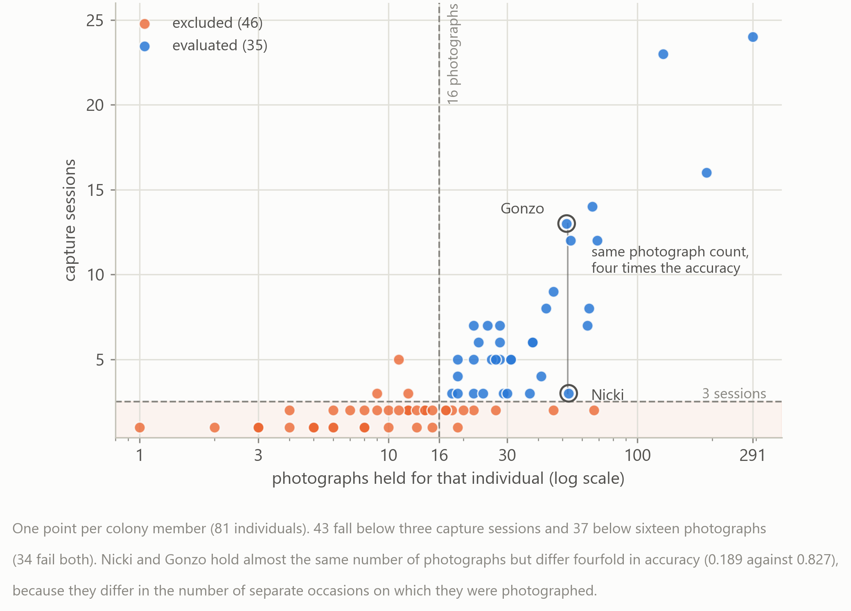
Q — INCLUSION CRITERIA
Why 35 of 81? The session rule binds, not the photo rule
37 of 81 birds fall below 16 photographs; 43 fall below 3 sessions; 34 fail both
The 46 excluded birds are never queries — they are gallery distractors and, in the open-set test, genuine strangers
Nicki and Gonzo sit at almost the same photo count and thirteen sessions apart
Consequence to concede: 0.559 describes the better-photographed 43% of the colony
BACKUP
Notes:
[backup slide — not part of the 10 minutes]
Two criteria: at least 16 photographs, which leaves 44 birds, and at least 3 capture sessions, which leaves 35. The session rule is the binding one — 43 birds fall below three sessions against 37 below sixteen photographs. I concede the consequence: these figures describe the better-photographed 43% of the colony, and the session gradient says the remaining birds are likely to be harder.

Slide 16
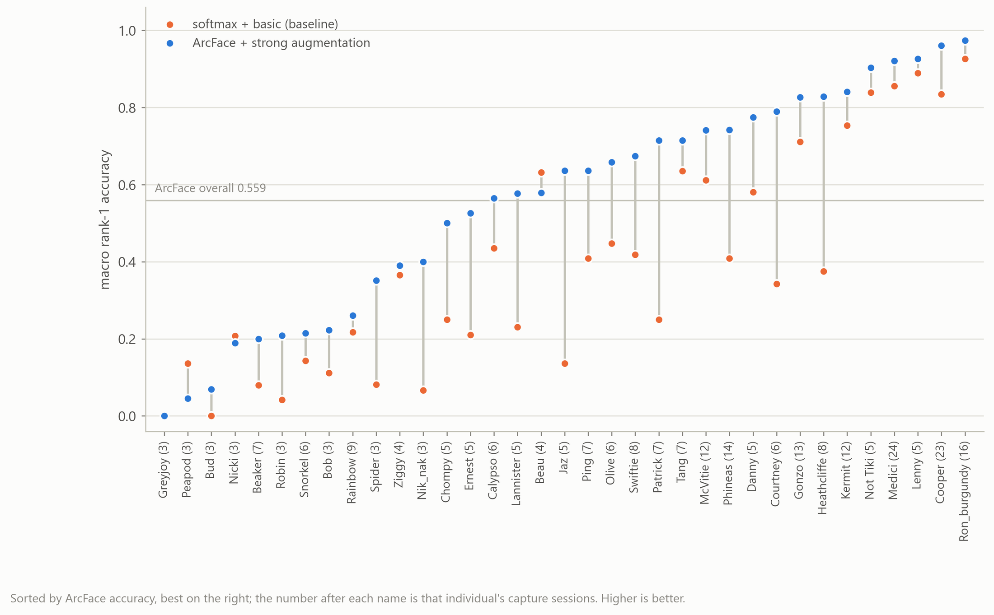
Q — IS THE GAIN BROAD?
Did ArcFace help everyone, or did the macro mean hide it?
31 of 35 birds improve from softmax+basic to ArcFace+strong
Three decline: Beau 0.632→0.579, Nicki 0.207→0.189, Peapod 0.136→0.045
Greyjoy is 0.000 under both — the only bird never identified by the best configuration
The four that do not gain are all 3-to-5-session birds: the same session story
BACKUP
Notes:
[backup slide — not part of the 10 minutes]
Thirty-one of thirty-five birds improve. Three decline slightly and Greyjoy is zero under both. The birds that do not gain are the sparsely sampled ones, which is the session finding again rather than a counterexample.

Slide 17
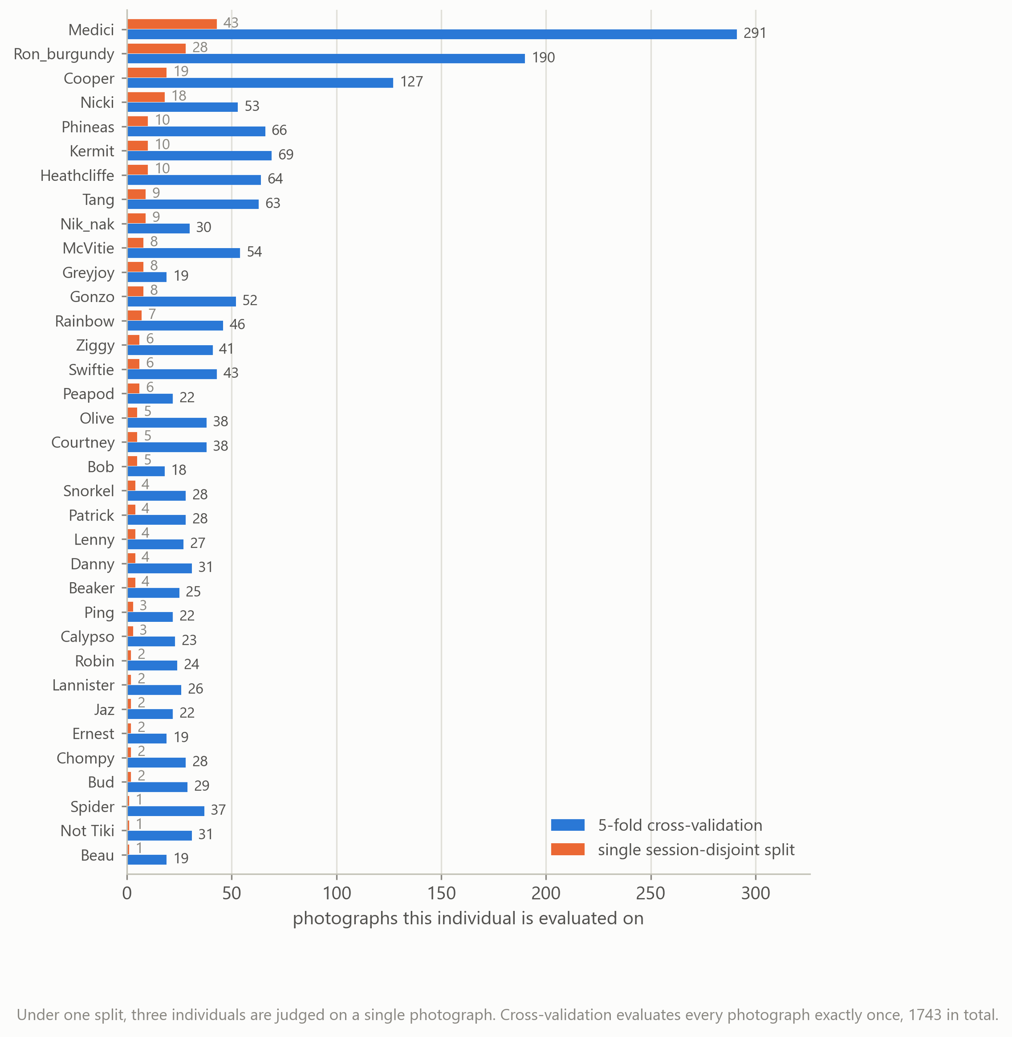
Q — EVALUATION DESIGN
Why cross-validate rather than hold out one split?
A single session-disjoint split tests only 261 of 1,743 photographs
Three birds are judged on a single test photograph
Session-wise 5-fold tests all 1,743 exactly once, still session-disjoint
Every bird's whole record contributes out-of-fold evidence
BACKUP
Notes:
[backup slide — not part of the 10 minutes]
Under one split only 261 of the 1,743 photographs are ever tested, and three birds are judged on a single photograph. Five-fold session-wise cross-validation tests every photograph exactly once while still keeping complete sessions disjoint.

Slide 18
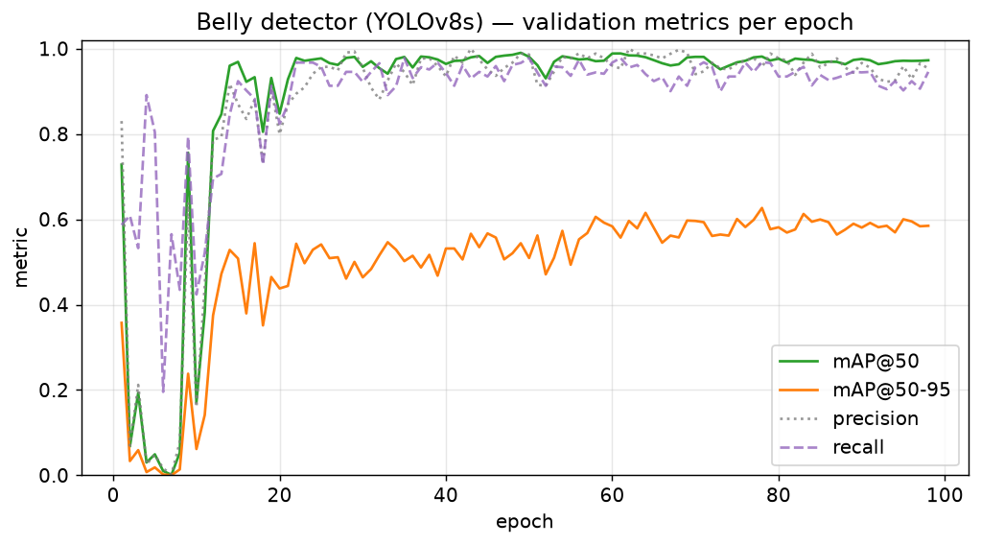
Q — THE OBVIOUS ECOLOGY QUESTION
Why not crop to the breast spots?
I did. A YOLOv8s ventral-region detector reaches mAP@50 ≈ 0.98
The classifier on the cropped bellies still lost: 0.866 against 0.950 on full-body images (both under the leaky random split)
Cropping removes identity information the model was using — face, chest band, proportions, posture
So localisation was not the bottleneck, and every reported identification number uses uncropped photographs
BACKUP
Notes:
[backup slide — not part of the 10 minutes]
I did try it — the literature points straight at the ventral spots. The detector was not the problem: mAP at 50 is about 0.98. But the classifier on cropped bellies scored 0.866 against 0.950 on whole images, both under the random split. Cropping throws away identity cues the model was actually using. So the reported pipeline uses uncropped photographs.

Slide 19
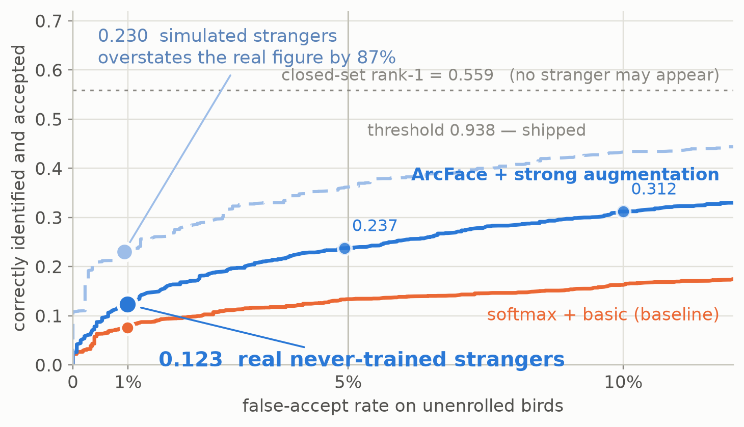
Q — OPEN-SET CALIBRATION
The threshold has a provenance, and it was wrong once
The error I caught
The first shipped threshold was 0.800, tuned on the leaky split with simulated impostors, and documented as rejecting 96.6% of unknown birds. Measured against real never-trained birds it accepts 29.7% of them. That is what replaced it with 0.938.
0.974 → 1% FAR → DIR 0.123
0.938 → 5% FAR → DIR 0.237 (shipped)
0.908 → 10% FAR → DIR 0.312
Transferred from the CV models, not recalibrated after full-data training
BACKUP
Notes:
[backup slide — not part of the 10 minutes]
The operating threshold carries its own calibration table in the deployed code. And it was wrong once: the first version, 0.800, was tuned on the leaky split using simulated impostors and documented as rejecting 96.6% of unknowns. Against real never-trained birds it accepts 29.7% of them. Finding that is what produced 0.938.

Slide 20
Q — OVERFITTING AND THE 1.000 DIAGNOSTIC
Training is fixed-length by design — and memorises perfectly
The recipe, identical in all 20 runs
1.000
0.390
ResNet18, ImageNet init; 512-d penultimate embedding, L2-normalised; head discarded at inference
ArcFace scale 30, margin 0.3, warmed up over the first five epochs — the paper's defaults, never tuned, not exposed as flags
AdamW, lr 3e-4, wd 1e-4, batch 32, AMP, seed 42
80 fixed epochs; 3-epoch warm-up then cosine decay to exactly zero; final epoch kept unconditionally
No validation split, no early stopping, no checkpoint selection — so no configuration can win by being selected more luckily
training photographs
held-out sessions
own session excluded — fold 0, 1,394 photos.
A diagnostic, not a test.
softmax + basic, session-disjoint.
The same fixed recipe.
Those 1,394 photographs had already contributed to optimising the parameters, so high performance was expected and this is not independent evidence of generalisation. Its only job is to locate the failure: the model separates everything it was fitted on, and fails on sessions it was not. The bottleneck is new capture occasions, not the representation. It was run for fold 0 only, and no script was retained to reproduce it across folds.
BACKUP
Notes:
[backup slide — not part of the 10 minutes]
Training is 80 fixed epochs with no early stopping and no checkpoint selection, so no configuration can win by being selected more luckily. Yes, it memorises: query the training photographs against prototypes rebuilt without their own session and it is perfect. That is a diagnostic, not a test — those photographs shaped the parameters. What it tells me is where the failure is: the model separates what it was fitted on and fails on sessions it was not.

Slide 21
Q — THE FULL RESULTS
Every reported number, in one table
configuration | rank-1 (35) | rank-5 (35) | mAP | rank-1 (81) | DIR@FAR 1%
softmax + basic | 0.390 | 0.746 | 0.420 | 0.224 | 0.076
softmax + strong | 0.530 | 0.809 | 0.533 | 0.361 | 0.086
ArcFace + basic | 0.486 | 0.734 | 0.509 | 0.364 | 0.097
ArcFace + strong | 0.559 | 0.782 | 0.581 | 0.477 | 0.123
Session-wise 5-fold cross-validation · 35 individuals · 1,743 photographs · every value macro over individuals
Session gradient (ArcFace + strong): 3 sessions 0.186 (n=8) · 4–6 sessions 0.618 (n=13) · 7+ sessions 0.717 (n=14) · ≥4 combined 0.669 (n=27)
CMC, 35 candidates: rank-2 0.650 · rank-3 0.702 · rank-5 0.782 · rank-10 0.860. Rank-k beyond 1 was never computed at 81 candidates
Softmax + strong is the best rank-5 configuration at 0.809 — ArcFace was selected on rank-1, mAP and colony-scale degradation, not rank-5
Single session-disjoint split, different recipe: rank-1 0.389, rank-5 0.726, 1-NN 0.384; random split 0.920 / 0.984 / 0.902
BACKUP
Notes:
[backup slide — not part of the 10 minutes]
Everything in one place, if you want to check a number.

