Slide 1

MSc Ecology and Data Science · Dissertation defence
Where do bats feed?
Teaching a bird-trained model to find feeding buzzes
in places it has never heard
Time-Expanded Perch Embeddings for Feeding-Buzz Detection, Retrieval and Field Candidate Discovery
Candidate WPNS1
Supervisors: Santiago Martinez Balvanera · Kate Jones · BIOS0057 · University College London · 2025–2026
Notes:
Good morning. Before I say a word about methods, I want to start with the animal. Insectivorous bats are night-shift predators in almost every terrestrial ecosystem on Earth. They eat enormous quantities of insects, including agricultural pests, and that has real consequences for crops and for disease vectors. But we know remarkably little about WHERE they actually do that eating — which patches of habitat are the dinner tables and which are just corridors they pass through. This project is about closing a small part of that gap with sound. Over the next fifteen minutes I will ask three questions in turn, and answer each one before moving on to the next.

Slide 2
THE BIG PICTURE
Bats eat.
We barely know where.
Insectivorous bats hold down insect populations across almost every terrestrial ecosystem — yet their foraging sites are largely unmapped.
Notes:
Here is the puzzle in one line. Bats eat, in quantities that matter ecologically and economically — and we barely know where. The reason is practical. You cannot follow a bat around at night. Radio-tracking is expensive, invasive and gives you a handful of individuals. What you CAN do is leave a microphone in the landscape and let the bats tell you themselves. That is passive acoustic monitoring, and it is now routine in biodiversity work. A recorder sits in the field for weeks with almost no disturbance to the animals. The difficulty is not collecting the sound. The difficulty is what comes next.

Slide 3

WHAT WE LISTEN FOR
Presence is easy. Feeding is the question.
search-phase calls
terminal buzz → a capture attempt
A call
A buzz
Brief · ultrasonic · recorded at 384 kHz
Over 200 calls a second in the terminal phase.
the bat was here
the bat tried to eat here
Why feeding buzzes
3
Notes:
This is the signal the whole project turns on. On the left of the spectrogram you can see the regular, widely spaced search-phase calls of a hunting bat. On the right those calls compress — the interval collapses, the repetition rate climbs past two hundred calls a second in some species — and then it stops. That compression is a feeding buzz, and it is the acoustic signature of a bat closing on prey. This is the important distinction. An ordinary call tells you a bat passed through. A buzz tells you a bat tried to eat. Buzzes are behaviour, not just presence — which is exactly what you need if you want to map foraging. They are also hard to find: brief, ultrasonic, recorded here at 384 kilohertz, and easily confused with other pulse trains.

Slide 4
THE SCALE PROBLEM
Hours of audio, seconds of signal
one 60-second recording
one 0.25 s window
9.4 h
→
270,156
→
69
from one recorder
windows to be scored
a human could review
Something has to rank those windows before anyone listens to them.
564 one-minute recordings · 0.25 s windows with a 0.125 s hop · one AudioMoth, Mara Triangle, Kenya
The workload
4
Notes:
Here is the workload, in the dataset I actually worked with. Nine point four hours of field audio from a single recorder in the Mara Triangle in Kenya. I score it in overlapping quarter-second windows — the bar at the top is one minute of audio, and the amber sliver is one window. That one minute alone is 479 windows. Across 564 recordings it comes to two hundred and seventy thousand windows. A person can carefully review a few dozen of those. Sixty-nine, in my case. So the question is never 'can a human find the buzzes' — it is 'what puts the right sixty-nine in front of the human'. That is a ranking problem, and ranking depends entirely on how you turn sound into numbers.

Slide 5
THE GAP
Detectors are graded where they were born
1.0
0.930
Same detector.
Same clips.
Only the split changed.
0.9
0.8
0.727
−0.203 F1
Built and validated close to home:
Buzzfindr · Ontario, Canada
BatBuddy · the Netherlands
This field test · Mara Triangle, Kenya
0.7
tested the usual way
clips shuffled and split at random
tested on a site it has never heard
its weakest held-out site
Six recording sites. Each one held out in turn, and scored only on the site left out.
Spectral-statistics baseline, this study · F1 on the Ontario clips · random split vs the weakest of six held-out rounds.
The generalisation gap
5
Notes:
This is the gap I want you to see rather than take on trust. On the left is the number you normally get quoted. Take a labelled set of clips, shuffle them, split at random, train and test. My hand-crafted spectral baseline scores 0.930 F1 that way, and that sounds like a solved problem. On the right is the same detector on the same clips, with one change: I held out an entire recording site, so the detector has never heard that place before. I repeat that six times, holding each site out in turn — the squares along the bottom — and its weakest site falls to 0.727. Twenty F1 points vanish, and nothing about the model changed, only the honesty of the test. That matters here because of where these tools come from. Buzzfindr was developed on Ontario recordings, BatBuddy on Dutch ones, and the recordings I care about are from the Mara Triangle in Kenya — different species assemblage, different insects, different background. If twenty points can disappear between two Ontario sites, we should not assume anything survives that jump. So the first question writes itself.

Slide 6
01
Which way of describing
the sound survives a site
it has never heard?
Notes:
Question one. Which way of describing the sound survives a site it has never heard? To answer that I need to say what 'a way of describing the sound' actually means, because it is the thing the whole talk turns on.

Slide 7
METHOD · QUESTION 1
A detector never hears the sound
→
→
THE RECORDING
THE REPRESENTATION
THE DETECTOR
buzz
not a buzz
what a bat actually did
a list of numbers
one decision per window
Whatever the representation leaves out, the detector can never learn.
The classifier is the same in every experiment. Only the middle box changes.
What a representation is
7
Notes:
One idea, and everything else in the talk depends on it. A detector never hears anything. What actually reaches it is the middle box: a fixed-length list of numbers describing a quarter of a second of sound. That list is what we call an acoustic representation. Whatever the representation leaves out is gone. If your numbers throw away the fine timing of a pulse train, no classifier downstream can recover it, however clever the classifier is. So in every experiment I keep the right-hand box fixed — the same simple logistic regression, the same settings, the same threshold — and change only the middle box. Any difference you see is a difference between representations.

Slide 8
METHOD · QUESTION 1
Three ways to describe the same sound
Baseline
Compact
Perch v2
→
pretrained
network
513 narrow frequency bands
64 wide frequency bands
learned, not chosen by me
1,543
199
1,536
numbers per 0.25 s window
numbers per 0.25 s window
numbers per 0.25 s window
Mean, SD and max in every narrow band
The same summary, over wider bands
A pretrained network's own description
Two are built by hand. One is learned — and used frozen, with no fine-tuning.
Perch v2 was pretrained on a very large multi-taxa sound collection. It needs one adaptation before it can hear a bat.
Acoustic representations
8
Notes:
Three representations, and then a deliberately boring classifier. The baseline is what a bioacoustician would build by hand: temporal mean, standard deviation and maximum for each of 513 frequency bins, plus four global statistics. Fifteen hundred and forty-three numbers, every one of them interpretable. The compact version is the same idea with the frequency axis coarsened into 64 bands instead of 513 bins — 199 numbers. I included it to ask whether the fine frequency detail is doing any work. Perch v2 is different in kind. It is a pretrained network trained on a very large multi-taxa sound collection, and I use it frozen — no fine-tuning at all. I just take its 1,536-dimensional embedding. Downstream everything is identical: a standard scaler fitted on training data only, L2 logistic regression, C of one, balanced class weights, threshold 0.5. So any difference I show you is a difference between representations, not between classifiers. One catch: Perch cannot listen to a bat.

Slide 9
METHOD · THE KEY ADAPTATION
Perch hears up to 16 kHz. Bats call at 20–120.
AS RECORDED
AS PERCH READS IT
×10
0.25 s · 0 – 192 kHz
2.5 s · 0 – 19.2 kHz
every call is above the model's ceiling
the same pattern, now inside the ceiling
Resample 384 → 320 kHz, then let a 32 kHz model read it: time ×10, frequency ÷10, pattern intact.
Only Perch carries this conversion — the comparison is between whole pipelines, not architectures.
Tenfold time expansion
9
Notes:
This is the one piece of engineering I want to spend a slide on, because it is what makes the rest possible. Perch was built for birds, and it expects 32 kilohertz audio. A 32 kilohertz frontend can only represent frequencies up to 16 kilohertz. Bat echolocation in this dataset sits between roughly 20 and 120 kilohertz. So if I simply downsample the recordings, I delete the entire signal and hand the model silence. Instead I resample from 384 to 320 kilohertz, and then let Perch read those samples as though they were 32 kilohertz. That is a tenfold time expansion. A quarter of a second of real audio becomes two and a half seconds for the model, and every frequency drops by a factor of ten — so a 100 kilohertz call arrives at 10 kilohertz, comfortably inside what the model can see. The two panels are the same spectrogram. Nothing about the pattern changes; only the axes move. That is the point — the relative structure of the pulse train, which is what identifies a buzz, is preserved exactly. I should be straight about the cost: only the Perch route carries this step. So what I compare is three complete pipelines, not three architectures under identical preprocessing. I come back to that in the limitations.

Slide 10
RESULT · QUESTION 1
The gap closes — for one of the three
Perch's worst site beats the baseline's average
0.950 against 0.872 mean F1
And it is steady, not just high
Spread across sites 0.020, vs 0.101 and 0.114
More features bought nothing
199 dimensions matched 1,543 to within 0.002 F1
F1 on 316 balanced Ontario clips. Six rounds, each recording site held out in turn, scaler and detector refitted inside every round. Two of the six groups share a site — see limitations.
Detection performance
10
Notes:
Here is the answer to question one, in the same shape as the gap slide. The pale bars are the flattering random split. The teal bars are the worst site the detector had never heard. For both hand-crafted representations the bar collapses — 0.930 down to 0.727, and 0.905 down to 0.691. For Perch it barely moves: 1.000 down to 0.950. The comparison I would put weight on is this one: Perch's WORST site, 0.950, is better than the baseline's AVERAGE across all six folds, which is 0.872. And the spread tells the same story — a standard deviation of 0.020 across folds against 0.101 and 0.114. It is not only better on average, it is stable, and stability is what you need if you are going to point a detector at a place you have no labels for. One honest aside on the compact representation: 199 dimensions matched 1,543 to within two thousandths of an F1 point. Eight times fewer features, the same answer. More hand-crafted detail was not buying anything. I should also say the grouped-site split did not discriminate: all three reached F1 of exactly 1.000, so that test told me nothing. Classification needs a threshold, though. In a real review workflow, you do not want a yes/no — you want an ordered queue.

Slide 11
02
Can it put the right clips
at the top of a reviewer's list,
with no threshold at all?
Notes:
Question two. Forget the threshold. Give me one labelled buzz, and rank everything else by how similar it looks in the representation. That is query-by-example retrieval, and it is much closer to how a person would actually use this: not 'is this a buzz, yes or no', but 'show me the twenty clips most worth my time'. I used all 158 labelled buzz clips as queries in turn, and — importantly — removed every clip from the query's own site from the candidate pool. So the model is always retrieving across sites, never within one.

Slide 12
RESULT · QUESTION 2
Ten results. How many are real?
the first ten results →
Precision@10
Perch v2
0.984
Baseline
0.831
Random ranking
0.500
Same ordering as detection — and the separation sits right at the top, where a reviewer looks.
158 buzz queries · the query's own site removed from the candidate pool · cosine similarity · averaged over sites. Average Precision 0.879 vs 0.770 and 0.771.
Similarity retrieval
12
Notes:
Read each row as: if a reviewer opened the top ten results, how many would be real feeding buzzes? An unguided reviewer, working through a balanced pool at random, gets five. The hand-crafted baseline gets about eight — Precision at ten of 0.831. Perch gets essentially ten — 0.984. And this holds while retrieving across sites, because I removed everything from the query's own site from the pool every time. Two things worth noticing. First, the ordering is the same as in detection, which is reassuring: it is not an artefact of the classifier or the threshold. Second, the separation is concentrated at the top of the ranking — Perch's Average Precision over the whole list, 0.879, is lower than its precision at ten. For a review workflow that is exactly the right shape of error: the list is at its most trustworthy where people actually look. I want to be honest about difficulty, though. This candidate pool is balanced, which is why random scores 0.5. In continuous field recordings buzzes are far rarer than that, so this is an easier problem than the one I turn to next.

Slide 13
03
Does any of it survive
a real night in the field?
9.4 h · 564 recordings · one AudioMoth · Mara Triangle, Kenya · no ground truth
Notes:
Question three, and the hardest one. Everything so far has been curated clips from Ontario, balanced fifty-fifty, with labels. Now I take the Perch pipeline, unchanged, and point it at nine and a half hours of continuous recording from a single AudioMoth in the Mara Triangle in Kenya. Different continent, different bats, different insects, and — this is the crucial constraint — no exhaustive ground truth. Nobody has listened to all of it, so I cannot compute precision or recall here. What I can do is ask what the detector puts at the top, and then look at it myself.

Slide 14
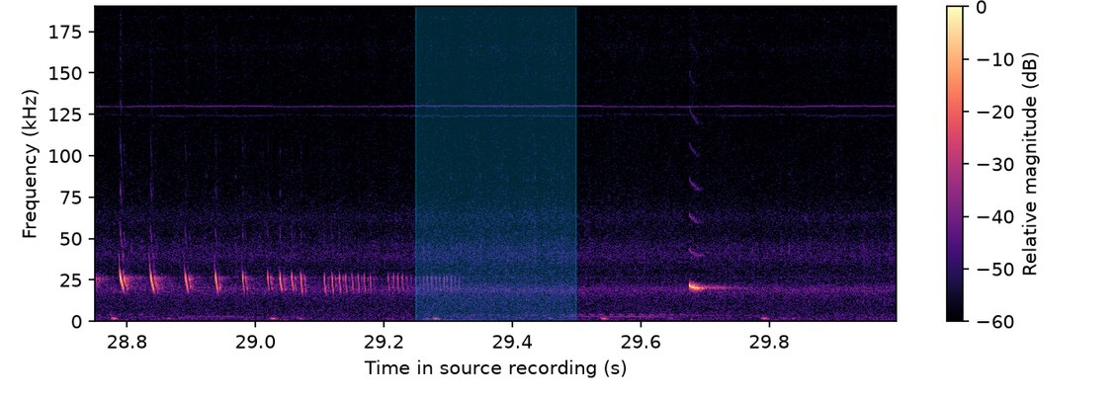
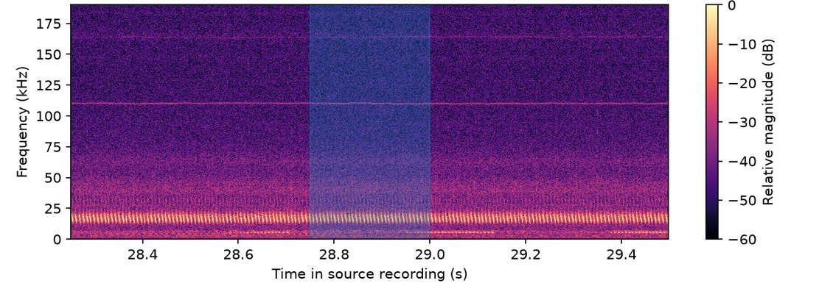
RESULT · QUESTION 3 · MARA TRIANGLE, KENYA
The score ranks. It does not identify.
Buzz-like · score 1.000
Insect-like · score 0.999
1.25 s of context; the cyan band is the scored 0.25 s window.
Insect-like 27
Buzz-like 19
Background 10
Artefact 9
69 top-ranked candidates, one per recording, reviewed by hand
27 of the 69 were insect pulse trains — ranking is not identification.
Reviewed Kenya candidates
14
Notes:
Both of these panels scored essentially 1.0. The one on the left is a feeding buzz. The one on the right is an insect. That is the honest headline of question three. The Perch score is a good ranker — it pulled genuinely pulse-like structure to the top of two hundred and seventy thousand windows — but it is not an identifier. Insects produce pulse trains too, and at the level of a single quarter-second window they look very similar. The strip along the bottom is what the sixty-nine top-ranked candidates actually were when I reviewed each one with 1.25 seconds of surrounding context, its pulse timing and time-expanded audio. Nineteen were buzz-like. Twenty-seven — the largest single category — were insect-like. The rest were background, recording artefacts, single clicks and one I could not call. Two caveats I want to state plainly. These candidates were selected BY the Perch score, so those proportions describe the reviewed set, not the prevalence of buzzes in the recordings. And my category labels are my own descriptive judgements, not verified ground truth. What separated the two panels was context — the wider window showed the insect's pulse train continuing, where a real buzz compresses and stops.

Slide 15
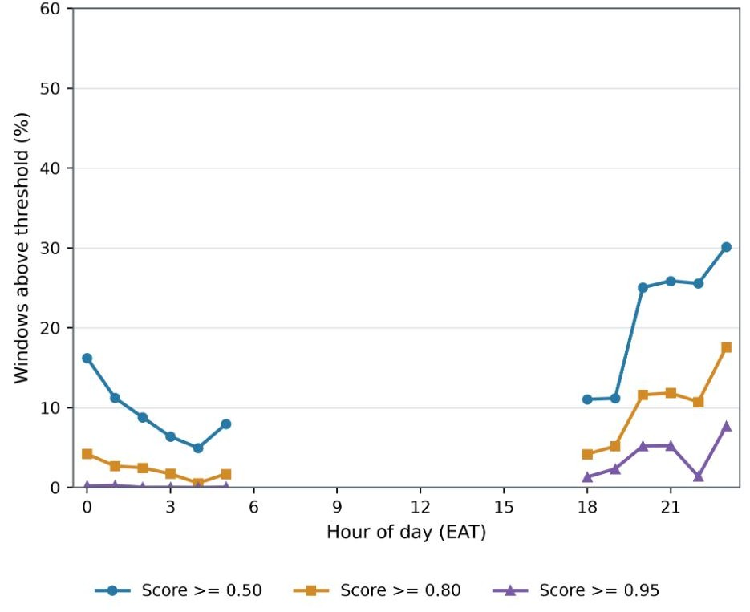
RESULT · QUESTION 3
High scores arrive after sunset
Nothing in daylight
The recorder ran 18:00–23:00 and 00:00–05:00 EAT.
Peak at 23:00 EAT
30.1% of windows ≥ 0.50, against about 5% at 04:00.
Consistent with foraging
What you would expect of foraging bats — but these are candidates, not confirmed buzzes.
Windows above each Perch threshold, by hour of day (EAT, UTC+3). Descriptive — no ground truth exists for this site.
Temporal pattern
15
Notes:
This is the part that takes us back to the opening question — where and when do bats feed. This plots the percentage of scored windows above each threshold against hour of day. There is nothing in daylight, which is partly because the recorder only ran from six in the evening to eleven, and midnight to five. Within the dark hours, though, there is a clear gradient: the rate climbs through the evening and peaks at eleven at night, where thirty percent of windows scored above 0.5, against about five percent at four in the morning. I want to be careful about what I claim. This is a distribution of detector scores, not of confirmed feeding buzzes — and we have just seen that a large share of the high-scoring windows are insects. So I present this as a descriptive pattern that is consistent with nocturnal foraging activity, and as an illustration of the kind of question this pipeline could answer once the candidates are verified. It is not, yet, a measurement of when bats feed.

Slide 16
HONEST LIMITS
Four things this study cannot tell you
1
Two groups, one site
2
A duration shortcut survives
Two of the six recording groups come from the same site, so the held-out test is group-level, not strict five-site isolation.
127 buzz clips padded, every non-buzz clip cropped — duration partly encodes the label.
3
Pipelines, not architectures
4
No Kenya ground truth
Only Perch carries the ×10 expansion, so the gain is not the embedding alone.
Candidates were chosen by score, so no precision or recall can be computed.
Every one of these has a concrete fix — that is the next project.
Limitations
16
Notes:
Four limitations, and I would rather raise them than have you find them. One. The six recording groups I hold out are not six separate places. Two of them, buzzes_sp and buzzes_spmylu, come from the same location — Site 4 — so in those two rounds a companion group from the same place was still in training. My headline test therefore measures group-level robustness, not strict isolation of five locations. The grouped-site test on buzzes_tb is genuinely geographically separated, and Perch held up there too, but I do not want to overstate the main result. Two. A duration shortcut. Buzz clips tend to be shorter than non-buzz clips, so when I pad or crop everything to a fixed window, the padding itself partly encodes the label. At half a second that shortcut is complete — every buzz padded, every non-buzz cropped — which is exactly why the half-second result of 0.994 is not the one I report. At a quarter of a second it is weakened but not gone: 127 buzz clips are still padded. A duration-matched benchmark would quantify it. Three. Only Perch carries the resampling and time expansion, so strictly I have compared three pipelines, not three representations under identical preprocessing. Testing other expansion factors would separate those. Four. Kenya has no exhaustive labels, so nothing I show from it is a precision or recall figure. Each of these has a concrete fix, and that is what I would do next.

Slide 17
SO — WHERE DO BATS FEED?
A little closer than we were
01
Representation decides transfer
Frozen, time-expanded Perch: 0.989 mean F1 across held-out sites, worst site 0.950.
02
It ranks as well as it classifies
Precision@10 of 0.984 against 0.831, with the query's own site removed.
03
The field still needs a human
Insect pulse trains were the largest category among the top-ranked Kenya candidates.
NEXT An independently sampled, exhaustively reviewed Kenya subset — event-level precision and recall, and those insect pulse trains as hard negatives.
Notes:
So, back to where I started. One. How you represent the sound is what decides whether a detector survives a new site. A frozen, time-expanded Perch embedding reached 0.989 mean F1 across held-out sites with a worst site of 0.950, where hand-crafted spectral statistics fell to 0.727. Two. The same representation ranks as well as it classifies — 0.984 precision at ten across sites — which is what you would actually deploy, because it needs no threshold and it puts its best work at the top of the queue. Three. And in the field, none of that removes the human. The largest category among my top-ranked Kenya candidates was insects, not bats. What the pipeline buys you is a shortlist of sixty-nine instead of two hundred and seventy thousand — which is the difference between an impossible job and an afternoon. The next step is the obvious one: an independently sampled, exhaustively reviewed Kenya subset. That would give real event-level precision and recall, let both detectors be compared on the same confirmed events, and turn those insect pulse trains into hard negatives for retraining. Thank you — I am happy to take questions.

Slide 18
Thank you
Questions welcome
With thanks to Santiago Martinez Balvanera and Kate Jones for their supervision, and to the researchers who collected and shared the Kenya recordings.
Backup slides follow →
Notes:
Thank you. I am happy to take questions. I have backup slides on the full metric tables, the preprocessing sensitivity analysis, the Kenya threshold counts and the implementation settings.

Slide 19
BACKUP 1
Detection — full metric set
Representation | Random F1 | Grouped-site F1 | LOFO mean F1 | LOFO SD | Worst folder | LOFO accuracy | LOFO ROC-AUC | LOFO AP
Baseline (1,543-d) | 0.930 | 1.000 | 0.872 | 0.101 | 0.727 | 0.883 | 0.9728 | 0.9744
Compact (199-d) | 0.905 | 1.000 | 0.870 | 0.114 | 0.691 | 0.881 | 0.9716 | 0.9737
Perch v2 (1,536-d) | 1.000 | 1.000 | 0.989 | 0.020 | 0.950 | 0.990 | 0.9997 | 0.9996
LOFO mean precision / recall 0.910 / 0.857 (baseline) · 0.910 / 0.851 (compact) · 0.994 / 0.984 (Perch).
Folder-level range baseline F1 0.727 (buzzes_sp) → 1.000 (buzzes_tb); compact low 0.691 (buzzes_sp); Perch 0.950 (buzzes_o), 0.983 (buzzes_sp), 1.000 in the other four rounds.
Splits Random: 222 train / 48 validation / 46 test, stratified. Grouped-site: buzzes_o (Site 3) validation, buzzes_tb (Site 2) test, 229 train. LOFO: six rounds, scaler and detector refitted inside each round. Representation definitions, detector settings and the 0.5 threshold were fixed independently of the reserved validation set.
B1
Notes:
Backup: full detection metric set, including accuracy, ROC-AUC and Average Precision averaged over the six LOFO rounds.

Slide 20
BACKUP 2
Retrieval — full metric set
Representation | Precision@5 | Precision@10 | Precision@20 | Average Precision
Baseline | 0.834 | 0.831 | 0.822 | 0.770
Compact | 0.839 | 0.830 | 0.821 | 0.771
Perch v2 | 0.988 | 0.984 | 0.968 | 0.879
Random ranking | 0.500 | 0.500 | 0.501 | 0.510
All 158 labelled buzz clips used as queries; every clip from the query's own folder excluded from the candidate pool.
StandardScaler fitted on the cross-folder candidate pool only, then applied to both pool and query; vectors L2-normalised and ranked by cosine similarity.
Folder-level values macro-averaged so folders with more queries do not dominate.
Perch Precision@10 ranged 0.948 (buzzes_o queries) to 1.000 (buzzes_tb); folder-level AP ranged 0.750 to 0.955.
Random baseline: 100 seeded permutations per query (seed 42), generator advancing between repetitions. Roughly balanced pools put random Precision@10 at ≈ 0.500 — easier than naturally rare field events.
B2
Notes:
Backup: full cross-folder similarity retrieval results and the retrieval protocol.

Slide 21
BACKUP 3
Preprocessing sensitivity
Spectrogram resolution
1024 / 512 (used): LOFO mean 0.872, worst 0.727
256 / 128: LOFO mean 0.881, worst 0.714
1024 / 900: LOFO mean 0.864, worst 0.691
Main spectral-statistics settings
Periodic Tukey window (α = 0.25), nfft = 1024; 513 frequency bins × 186 time bins per clip; log10(magnitude + 1e-10) applied first. Crop position gave the same pattern.
0.50 s scores highest — and is exactly where the padding shortcut is total: all 158 buzz clips padded, all 158 non-buzz clips cropped. 0.25 s was retained as the compromise (127 buzz clips padded, 189 clips cropped). At 0.10 s, random-test F1 was 0.979 but worst-folder F1 collapsed to 0.050.
B3
Notes:
Backup: clip-duration and spectrogram-resolution sensitivity, and why the higher-scoring 0.50 s window was not used.

Slide 22
BACKUP 4
Kenya — thresholds, coverage and timing
Detector | ≥ 0.50 windows | ≥ 0.80 windows | ≥ 0.95 windows | Files with ≥ 0.95
Baseline | 59,741 (22.11%) | 36,110 (13.37%) | 11,978 (4.43%) | 161
Perch v2 | 43,130 (15.96%) | 17,692 (6.55%) | 5,774 (2.14%) | 121
Spread across recordings
Temporal pattern (EAT, UTC+3)
At the lower two thresholds Perch windows were spread across more recordings despite being fewer in total — 466 files vs 343 at ≥ 0.50, and 328 vs 254 at ≥ 0.80.
Highest rates at 23:00 EAT — 30.14% / 17.57% / 7.71% at the 0.50, 0.80 and 0.95 thresholds. Highest daily rates on 24 October 2019. Hours without recordings are not treated as zero.
Candidate selection and review Route 1 — top 50 Perch windows, neighbouring high-scoring windows within 1 s grouped into one event, one representative window kept per event. Route 2 — eight windows sampled from each of four score bands (0.95–1.00, 0.80–0.95, 0.50–0.80, 0.20–0.50). De-duplicated to one candidate per one-minute recording: 53 retained plus 16 newly reviewed = 69 candidates from 69 distinct recordings. Each reviewed with its 0.25 s spectrogram, 1.25 s of context, pulse-timing structure and time-expanded audio.
B4
Notes:
Backup: Kenya threshold counts, recording coverage, temporal pattern and the two-route candidate-selection procedure.

Slide 23
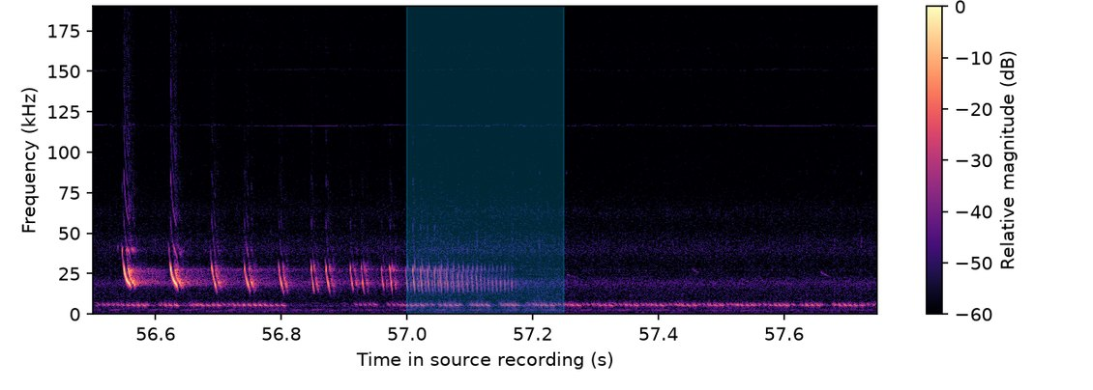
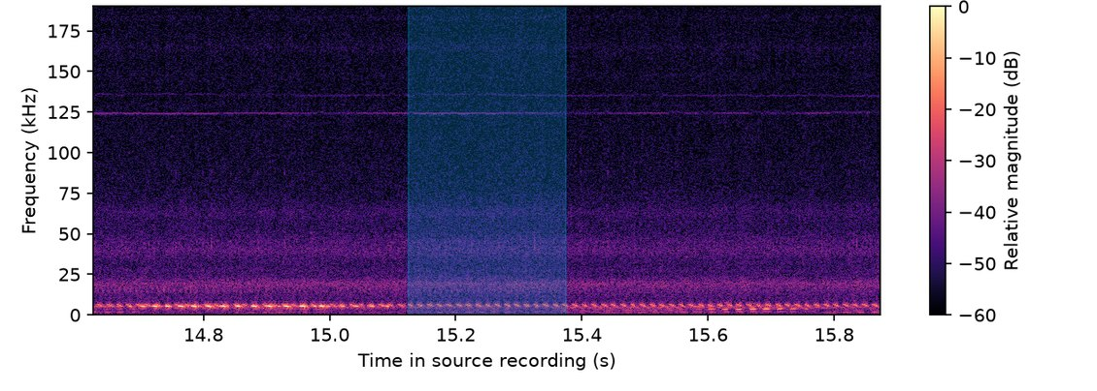
BACKUP 5
More reviewed Kenya candidates
Buzz-like · score 1.000
Recording artefact · score 0.857
Each panel: 1.25 s of context; the cyan band is the 0.25 s window scored by the detector.
Environment
Detector
Field scoring
Python 3.12.13
SciPy 1.18.0
scikit-learn 1.9.0
Perch-Hoplite 1.0.1
perch_v2_cpu (frozen)
StandardScaler, training data only
Logistic regression, L2 penalty
C = 1.0, solver lbfgs
class_weight = balanced
random_state = 42, max_iter = 1000
Decision threshold 0.5
Every 60 s recording peak-normalised
0.25 s windows, 0.125 s hop
479 windows per recording
564 files → 270,156 windows
Perch: 384→320 kHz, 80,000 samples
read as 2.5 s
B5
Notes:
Backup: the two remaining reviewed Kenya candidates, plus fixed model settings and Kenya analysis settings for reproducibility.

