Slide 1







ICAC 2026 · International Conference on Automation and Computing
A Lightweight LLM-Driven Multi-Agent Framework for Virtual Society Simulation with Memory Feedback
Aoao Guo · Xinyi Tao · Huakang Li · Xuewu Dai
University College London | Xi'an Jiaotong-Liverpool University | Northumbria University
Paper 108 · Parallel Session 3: Robotics & Autonomous Systems · Thursday 27 August 2026
Valentown — seven residents who plan, meet, remember and adapt
Notes:
Good afternoon. I'm Aoao Guo from University College London, with Xinyi Tao, Huakang Li and Xuewu Dai. We've built a lightweight multi-agent framework that simulates a virtual society, driven by a large language model. It's a small town called Valentown. Seven residents plan their own days, meet each other, remember what happened, and change what they do next.

Slide 2
MOTIVATION
Two ways to simulate people
R
Rule-based agent models
L
LLM-driven agents
Fixed rules
Action
Prompt
LLM
Action
same input → the same behaviour, every day
fluent — but one step at a time
No context · no planning · no memory
Reactive: answers the prompt in front of it
Macro patterns yes — human-like behaviour no
Interaction ad hoc or random · no day structure
Missing: explicit structure for behaviour, interaction and feedback
ICAC 2026 · Paper 108 · Valentown
2
Notes:
Multi-agent simulation is how we model complex systems: social networks, transport, smart cities. But classical models run on fixed rules. They capture macro patterns well and human behaviour poorly. No context, no planning, no memory. Large language models changed that. An LLM agent writes coherent language, holds context, and imitates parts of human reasoning. But most LLM agents are reactive. They answer the prompt in front of them. There's no structure to the day, and interaction is ad hoc. So behaviour drifts, control is hard, and results don't reproduce. That's our gap.

Slide 3
PROBLEM STATEMENT
One question, three requirements
How can we design a virtual society whose agents are structured, evolving and controllable over time?
1
Temporal structure
2
Behavioural evolution
3
Controllability
A day — not a stream of reactions
Yesterday changes tomorrow
An explicit rule, plus a human override
OUR ANSWER
OUR ANSWER
OUR ANSWER
Schedule-driven agents
Memory feedback loop
Co-location trigger + human-in-the-loop
ICAC 2026 · Paper 108 · Valentown
3
Notes:
So our question is simple: how do we make agents structured, evolving and controllable at the same time? Three requirements, three mechanisms — and those are our contributions. Structure: behaviour has to be organised as a day. Our answer is schedule-driven agents. Evolution: yesterday has to change tomorrow. Our answer is a memory feedback loop. Control: interaction needs an explicit rule, and a person should be able to step in. Our answer is a co-location trigger, plus optional human feedback.

Slide 4
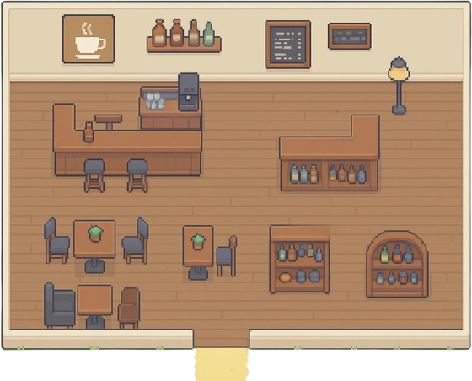


MECHANISM 1 & 2
Plan the day, then let the town decide who meets
1
Schedule-driven day
2
Co-location interaction
identity + goals + memory → one day's plan
07:00 home
12:00 café
15:00 shop
20:00 home
same place + same period → they talk
one generated day, illustrative
Deterministic when · generative what
the framework controls the dynamics — the model supplies the diversity
ICAC 2026 · Paper 108 · Valentown
4
Notes:
The first two mechanisms. Schedule-driven behaviour. The day starts with a plan, not with a reaction. The prompt combines identity, personality and goals with retrieved memories, and the model returns activities and destinations. Routines stay coherent, and we can read them. Interaction. We don't sample conversations at random. Two agents talk when they're in the same place at the same time. The trigger is deterministic, so the dynamics are reproducible; the content still comes from the model. That's our design principle: deterministic when, generative what.

Slide 5
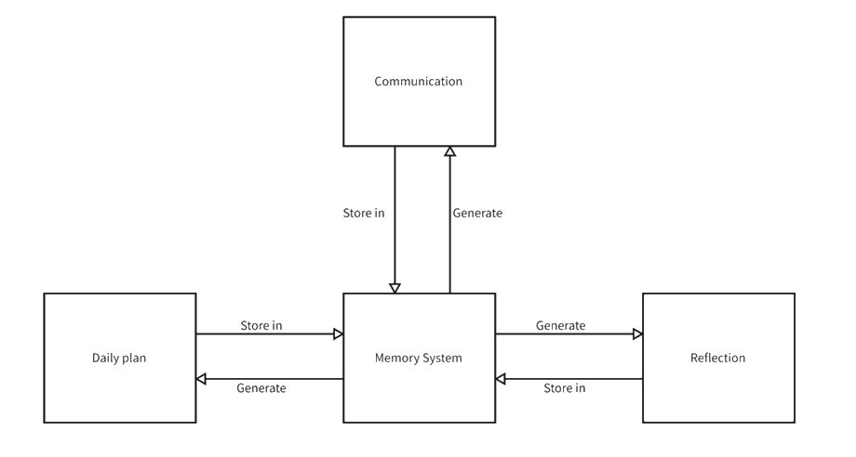
MECHANISM 3
Memory is where the days connect
3
Memory-based feedback loop
WRITTEN IN
Plans
Conversations
Reflections
READ OUT
Planning
Dialogue
Reflection
Every entry: category · timestamp · importance score
Retrieval: recent + important · the store stays bounded
Fig. 3 Memory-centred feedback loop
The LLM stays stateless — all continuity lives in memory
OPTIONAL: HUMAN IN THE LOOP
Feedback written into the same memory channel
ICAC 2026 · Paper 108 · Valentown
5
Notes:
The third mechanism, and the heart of the paper: memory. Everything an agent produces is written to one store: plans, conversations, reflections. Each entry has a category, a timestamp and an importance score. Everything also reads from that store. Planning retrieves relevant memories. Dialogue retrieves recent ones. Reflection compresses the important ones into a short insight and writes it back. That's the loop in the figure. Retrieval prefers recent and important entries, and the store stays bounded. Two notes. A person can write feedback into the same store. And the model is stateless — all continuity lives in memory.

Slide 6
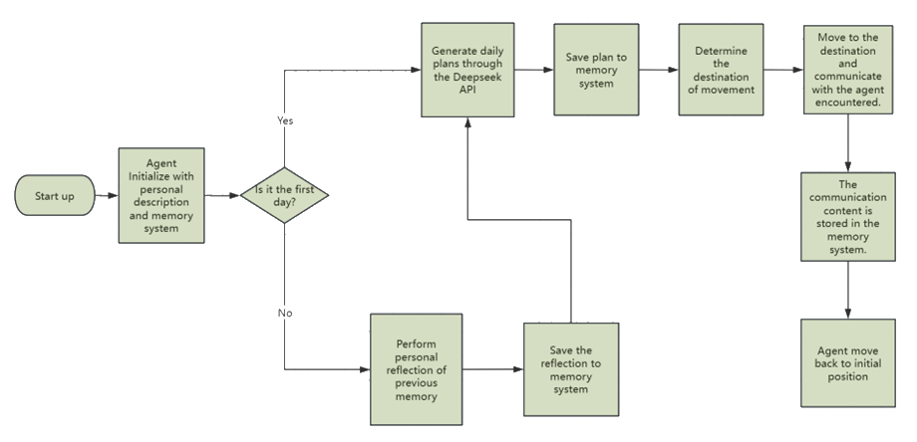
EXECUTION
One simulation day, end to end
Fig. 2 · Day 1 plans from the profile — every later day reflects first, then plans
ICAC 2026 · Paper 108 · Valentown
6
Notes:
Here is that loop as the system runs it. An agent starts from its profile and its memory. On day one there's nothing to reflect on, so it plans from the profile. Later days reflect first, and the reflection feeds the plan. Then: plan, store it, pick a destination, move, talk if someone is there — and the conversation goes back into memory. Let me show you.

Slide 7
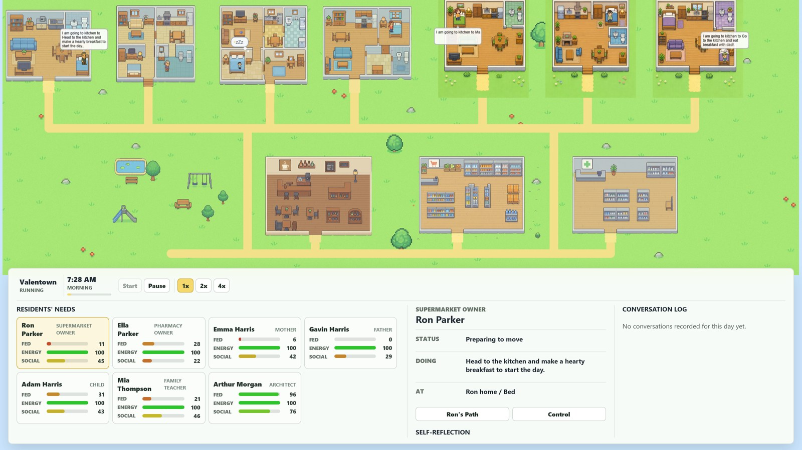
DEMO
Valentown, running
Paper 108 · Valentown
a day planned overnight · two residents meeting at the same place · reflection reshaping tomorrow
Notes:
▶ INSERT THE VIDEO OVER THE FRAME BEFORE THE TALK. Set it to start automatically, and check the sound is muted. About 140 words over two minutes — leave gaps and let the town play. [start] So that's the loop. Here it is running. This is Valentown. Homes along the top, café, supermarket and pharmacy below, a park on the left. Everything you see came from the Python backend — planning, dialogue, reflection, and the only calls to DeepSeek. The client just replays it. [~20 s] Watch one resident. He wakes at home, and his own schedule sends him out. Nobody is steering him. [~50 s] Now two residents reach the same place at the same time. That's the co-location trigger. What they say comes from their context and recent memory, and goes straight back into memory. [~1:30] At the end of the day each agent reflects — the step you saw in the flow chart — and tomorrow's plan is built on it. [end] Schedule, trigger, memory loop. Everything from the last four slides, running.

Slide 8
EXPERIMENTS
What we ran, and what we looked for
Ron Parker
Ella Parker
Emma Harris
Gavin Harris
Adam Harris
Mia Thompson
Arthur Morgan
60 · supermarket owner
58 · pharmacy owner
30 · mother
32 · father
7 · child
28 · family teacher
29 · architect
Environment
Duration
Execution
predefined locations;
co-location enables interaction
multiple consecutive days,
a full cycle each day
deterministic triggers,
stochastic content
WE LOOK AT
interaction → behaviour
memory → adaptation
emergent social structure
ICAC 2026 · Paper 108 · Valentown
8
Notes:
We run seven agents: a supermarket owner, a pharmacist, a couple with a young son, a family teacher, an architect. The simulation runs several consecutive days, each a full cycle. Scheduling is deterministic, generated content is not — a reproducible pipeline with diverse behaviour. We ask three things: what interaction does, what memory does, and whether social structure emerges.

Slide 9
RESULT 1
Turn interaction off, and the town goes quiet
INTERACTION ENABLED
Conversation
Memory
Next day's plan
richer activities · follow-up meetings · lasting pairs
INTERACTION DISABLED
Conversation
Memory
Next day's plan
repetitive · isolated · schedules stay static
✕
Interaction drives behavioural diversity and day-to-day adaptation
ICAC 2026 · Paper 108 · Valentown
9
Notes:
Our first experiment is an ablation on interaction. With interaction on, behaviour is clearly richer. The reason is mechanical: a conversation adds context to memory, and memory feeds the next plan. What someone said to you yesterday shows up in what you do today. Agents schedule follow-ups, revisit places, and specific pairs grow closer. With interaction off, the town goes quiet. No new social information arrives, agents fall back on their initial goals, and schedules stop changing. Interaction drives both diversity and adaptation.

Slide 10
RESULT 2
Memory changes shape as the days pass
What memory is made of
Bonds form on their own
Repeated meetings → persistent pairs → repeated co-location.
Nobody wrote a friendship rule.
Behaviour follows memory
Reflection-derived insight → goal-aligned task selection shifts across days.
Limit memory, and adaptation weakens.
Day 1
Day n
Day N
Plans & observations
Conversations
Reflections
schematic — relative composition, not measured proportions
ICAC 2026 · Paper 108 · Valentown
10
Notes:
The second result is memory over time. Memory changes shape. Early on it's mostly plans and observations. Then conversations and reflections take over. Later, high-importance memories dominate the context for new decisions — a log becomes experience. And that tracks behaviour. Agents with rich memories adapt more and act more coherently. Two agents who meet repeatedly form a lasting bond, visible later as repeated co-location. Nobody wrote a friendship rule; it comes from memory and retrieval.

Slide 11
CONCLUSION
Where this leaves us
Future work
What we showed
1
Planning, interaction and reflection linked by one memory loop
1
Quantitative evaluation
network metrics, plan coherence, user studies
2
Importance-based memory + reflection → next-day behaviour
2
Scale & real time
Consistent routines, lasting bonds, adaptation — no hand-written rules
larger populations, live reaction
3
AND WE OWN THE LIMITS
3
Deeper reasoning
cost
scale
stochasticity
NPCs, education, embodied agents
quantitative evaluation is the first thing we owe this work
ICAC 2026 · Paper 108 · Valentown
11
Notes:
To conclude. We presented a schedule-driven framework where planning, interaction and reflection are linked by one memory loop. Importance-based memory keeps what mattered; reflection turns it into guidance for the next day. The experiments show that simple mechanisms are enough. Agents build routines, form lasting relationships, and adapt from experience — with no hand-written rules. We're open about the limits. Every plan, conversation and reflection is an API call, so cost grows with agents times days. The study is small. Output varies between runs, so our evaluation is qualitative for now. Next: quantitative evaluation, then scale and real time, then deeper reasoning.

Slide 12
Thank you
Questions are very welcome.
Aoao Guo
Paper 108
Faculty of Life Sciences, University College London
aoao.guo.25@ucl.ac.uk
A Lightweight LLM-Driven Multi-Agent Framework for
Virtual Society Simulation with Memory Feedback
Notes:
Thank you. I'm happy to take questions.

Slide 13
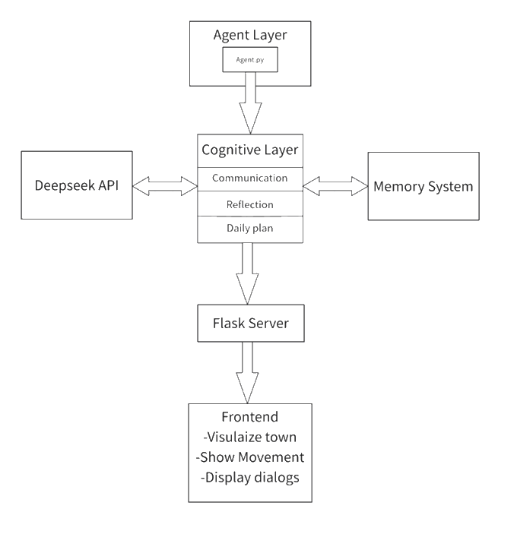
BACKUP · FRAMEWORK
A backend that thinks, a frontend that shows
Backend · Python
Planning, dialogue, reflection, memory —
the only part that calls the LLM
Frontend · Phaser
Town, movement and conversations,
served over a REST API
Five modules
Agent Manager · Scheduler · Interaction
Engine · LLM Interface · Memory Manager
Fig. 1 Overview of the proposed framework
ICAC 2026 · Paper 108 · Valentown
B1
Notes:
BACKUP. Use if someone asks how the system is put together. The backend, in Python, does the planning, the dialogue, the reflection and the memory, and it's the only part that calls the model — through the DeepSeek API. The frontend, in Phaser, renders the town over REST. Five modules underneath — Agent Manager, Scheduler, Interaction Engine, LLM Interface, Memory Manager — each replaceable on its own.

Slide 14
BACKUP · IMPLEMENTATION
Valentown: the framework, running
Valentown
homes · shop · pharmacy · café · park
7 residents
own age, role, personality, goals
DeepSeek API
schedules · dialogue · reflection
Python + Phaser
pre-computed, replayed over REST
ICAC 2026 · Paper 108 · Valentown
B2
Notes:
BACKUP — and the fallback if the video won't play. Same client, as a still image: talk through it exactly as you would have talked over the video.

Slide 15
BACKUP · DISCUSSION
What this buys us, and what it costs
Advantages
Limitations
1
Lightweight & reproducible
1
Cost
explicit pipeline, deterministic triggers
API calls scale with agents × days
2
Controllable
2
Scale
schedules, co-location rules, human feedback
small population, simple town
3
Extendable
3
Stochasticity
every module swaps independently
runs vary — strict metrics are hard
agents
×
days
×
conversations
any module can be swapped without touching the others
every plan, conversation and reflection is an API call
ICAC 2026 · Paper 108 · Valentown
B3
Notes:
BACKUP. The full advantages and limitations, if the discussion goes there. Lightweight and reproducible; controllable; extendable. Against that: cost that grows with agents times days, a small study, and run-to-run variation that makes strict quantitative evaluation hard.

