Slide 1
Summer 2026 Independent Research
Alyssa Obermayer

Slide 2
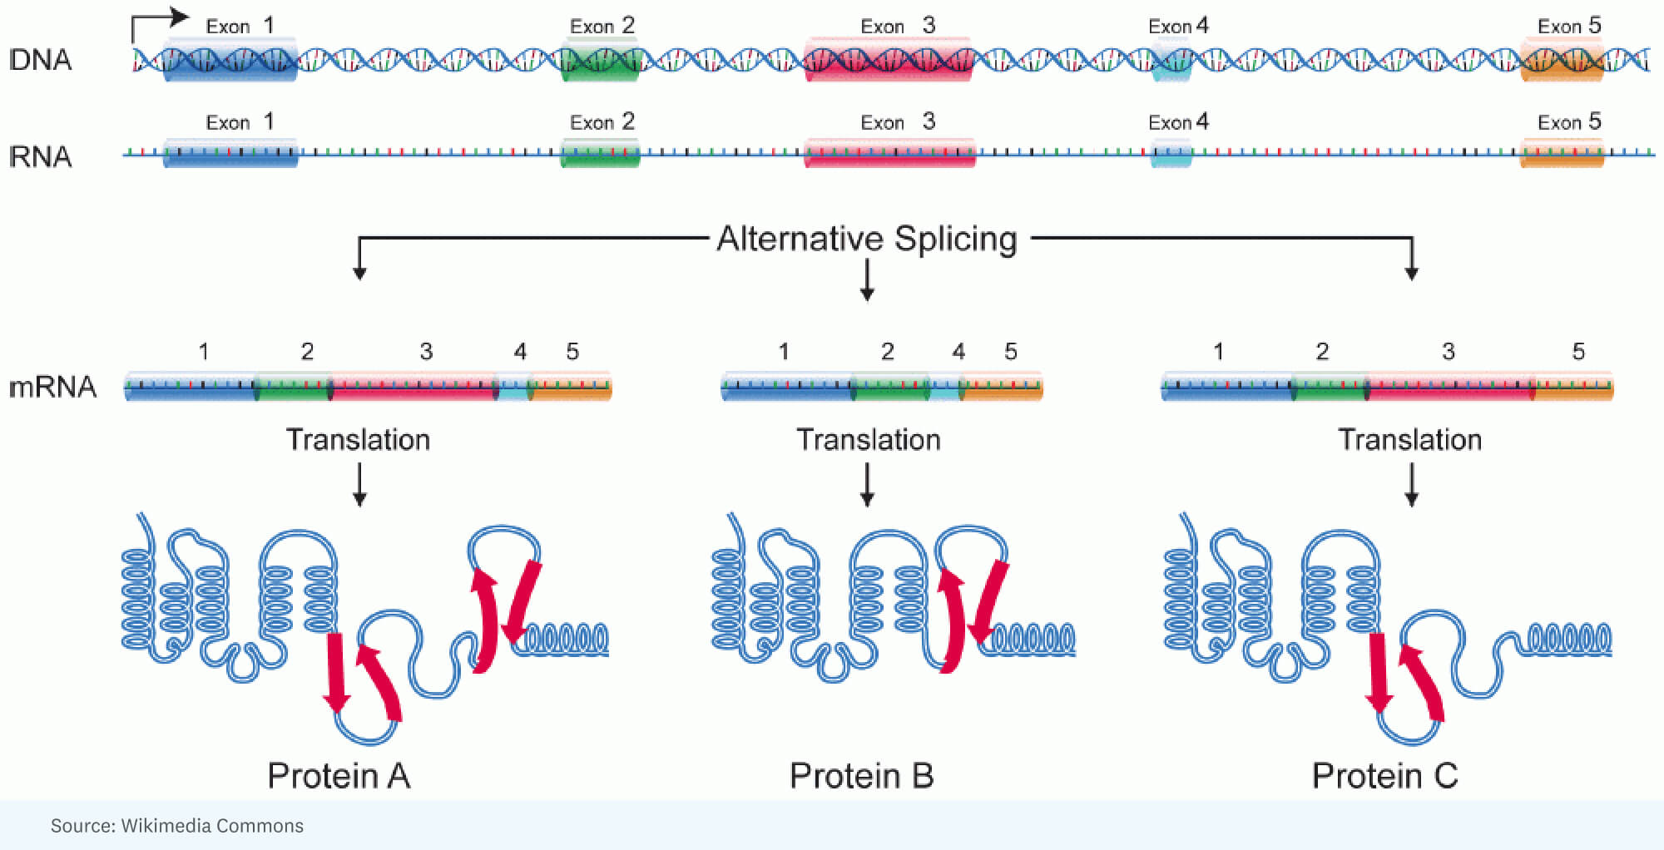
The Central Dogma and Alternative Splicing
DNA stores genetic information
RNA carries and/or regulates that information
Proteins are the synthesized functional products
Alternative splicing allow for flexibility and diversity within our genome
Notes:
“Biology often starts with the central dogma: DNA is copied into RNA, and RNA can be used to make protein. But this is not just a simple one-way assembly line. Cells regulate each step, especially RNA processing, to control what proteins are made, when they are made, and how much is made.”
DNA stores genetic information
RNA carries or regulates that information
Proteins perform many cellular functions
Gene expression is the process of using DNA instructions
Only some DNA contains protein-coding genes
Some DNA produces functional non-coding RNAs
Some regions regulate when genes are turned on or off
Other regions may have no clearly defined function
Genes contain exons and introns
Exons are usually retained in mature RNA
Introns are removed during RNA processing
This editing step is called splicing
Pre-mRNA is the first RNA copy
The spliceosome removes introns
Exons are joined together
Mature mRNA can then be translated into protein
Spliceosome recognizes splice sites
The intron forms a loop-like structure
The intron is cut out as a lariat
Neighboring exons are ligated together
Splicing is not always the same every time
Exons can be included or skipped
Different RNA isoforms can come from one gene
This increases protein and regulatory diversity

Slide 3
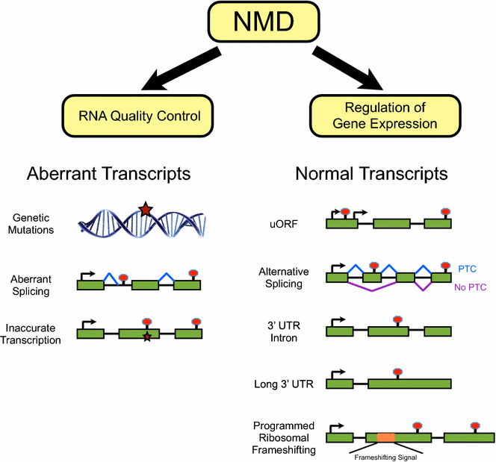
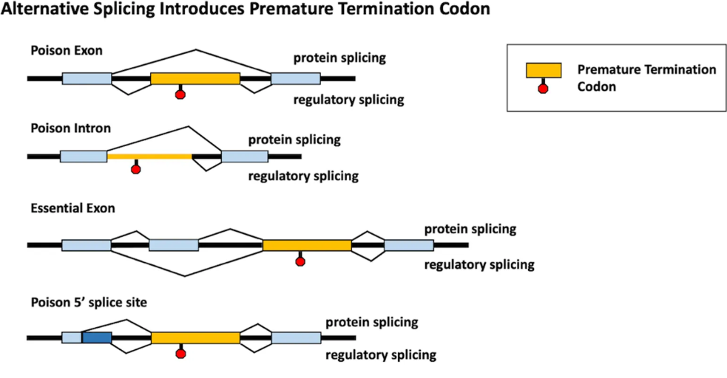
Nonsense Mediated mRNA Decay (NMD)
Alternative splicing can result from an error during gene regulation, or it can be the gene regulatory mechanism itself.
Premature termination codons (PTCs) can lead to isoform susceptibility to NMD.
NMD
RNA quality-control pathway
Regulator of normal transcript abundance.
Notes:
Nonsense-mediated mRNA decay, or NMD, is both an RNA quality-control pathway and a regulator of normal transcript abundance.
Alternative splicing can produce premature termination codons that make individual transcript isoforms susceptible to NMD.
Public perturbation datasets provide an opportunity to study NMD-responsive transcripts without generating every dataset from scratch.
Reuse is difficult because experimental treatments, controls, sample identities, and protocols are described inconsistently across repositories.
Gene-level expression alone may obscure transcript- and splice-event-specific responses to NMD perturbation.
Alternative splicing can change protein domains
It can alter protein location or function
It can affect RNA stability
Some splice forms may trigger RNA decay pathways
Quality control + regulatory mechanism
Some RNA isoforms contain early stop signals
These can be recognized as abnormal or regulated targets
NMD removes many premature-stop-containing RNAs
Splicing patterns can influence NMD sensitivity
NMD plays a role in:
Biological development
Cellular stress adaptation
Pro-tumorigenic
Tumor suppressor functions
More directly
NMD resistant isoforms may result in more immunogenic neoantigens resulting in stronger immune response (positive)
NMD resistant isoforms may result in gene variants may have a negative impact on patient response to therapies (negative)
Soluble PDL1 decoy
ARv7 drug resistance
Future Impact
Identify NMD sensitive or resistance transcripts via NMD burden calculation to highlight clinically relevant transcripts and mechanism of treatment response

Slide 4
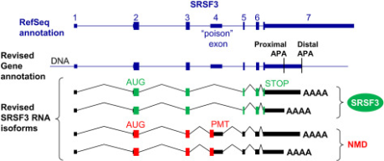
Summer Research Objective
Current heading:
Determine how splicing-derived transcript features influence observed NMD sensitivity
Gain a better understanding of how to derive these features
Look at nmd perturbation vs control
Curate public RNA-seq genomic datasets that measure NMD perturbation versus control
Quality
Compatibility
Reproducibility
Open-Source
Notes:
Public perturbation datasets provide an opportunity to study NMD-responsive transcripts without generating every dataset from scratch.
Reuse is difficult because experimental treatments, controls, sample identities, and protocols are described inconsistently across repositories.
Gene-level expression alone may obscure transcript- and splice-event-specific responses to NMD perturbation.
Current heading:
Determine how splicing-derived transcript features influence observed NMD sensitivity
Gain a better understanding of how to derive these features
Look at nmd perturbation vs control
Curate public RNA-seq genomic datasets that measure NMD perturbation versus control
Quality
Compatibility
Reproducibility
Open-Source
Develop a systematic framework to identify and curate public RNA-seq studies involving NMD perturbation.
Determine how NMD was perturbed, which samples represent the perturbation, and which samples are appropriate matched controls.
Harmonize heterogeneous study- and sample-level metadata from GEO and ArrayExpress/BioStudies.
Prioritize studies that are sufficiently clear, replicated, and comparable for downstream transcript and splicing analysis.
Create a reusable and searchable resource rather than a one-time accession list.

Slide 5
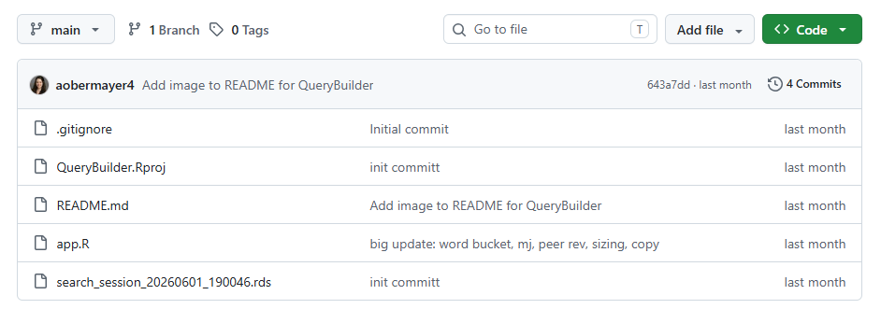
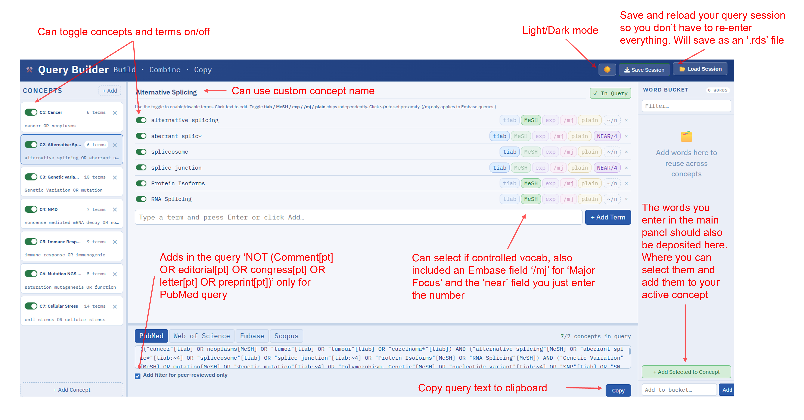
Directed Literature Search and Review
(("cancer"[tiab] OR neoplasms[MeSH] OR "tumor"[tiab] OR "tumour"[tiab] OR "carcinoma*"[tiab]) AND ("nonsense mediated mRNA decay"[MeSH] OR "nonsense mediated decay"[tiab:~3] OR "NMD"[tiab] OR "nonsense mediated RNA decay"[tiab:~3] OR "premature termination codon"[tiab:~4] OR "truncated transcript"[tiab:~4] OR "nonsense mediated degradation"[tiab:~4]) AND ("UPF1 knockdown"[tiab:~4] OR "UPF1 knockout"[tiab:~4] OR "UPF1 depletion"[tiab:~4] OR "UPF1 inhibition"[tiab:~4] OR "UPF1 perturbation"[tiab:~4] OR "UPF2 knockdown"[tiab:~4] OR "UPF2 knockout"[tiab:~4] OR "UPF2 depletion"[tiab:~4] OR "UPF2 inhibition"[tiab:~4] OR "UPF2 perturbation"[tiab:~4] OR "NMD knockdown"[tiab:~4] OR "NMD knockout"[tiab:~4] OR "NMD depletion"[tiab:~4] OR "NMD inhibition"[tiab:~4] OR "NMD perturbation"[tiab:~4] OR "SMG1 knockdown"[tiab:~4] OR "SMG1 knockout"[tiab:~4] OR "SMG1 depletion"[tiab:~4] OR "SMG1 inhibition"[tiab:~4] OR "SMG1 perturbation"[tiab:~4] OR "SMG6 knockdown"[tiab:~4] OR "SMG6 knockout"[tiab:~4] OR "SMG6 depletion"[tiab:~4] OR "SMG6 inhibition"[tiab:~4] OR "SMG6 perturbation"[tiab:~4])) NOT (Comment[pt] OR editorial[pt] OR congress[pt] OR letter[pt] OR preprint[pt] OR review[pt])
Build and format specific literature search queries
Formatted for 4 major databases
Save and reload your search session
Notes:
Candidate studies were identified through literature searches and repository searches.
Study accessions were collected across GEO, SRA, BioProject, ArrayExpress/BioStudies, and related repositories.
Initial inclusion focused on studies with raw sequencing data and a plausible genetic or pharmacologic NMD perturbation.
Perturbations included:
siRNA or knockdown
knockout
inducible degradation or degron systems
NMD inhibitors
overexpression
translation-inhibiting treatments
Automated metadata retrieval was performed using GEOquery and ArrayExpress-based workflows.
GEO and ArrayExpress were retained as separate sources because their metadata structures differ substantially.

Slide 6
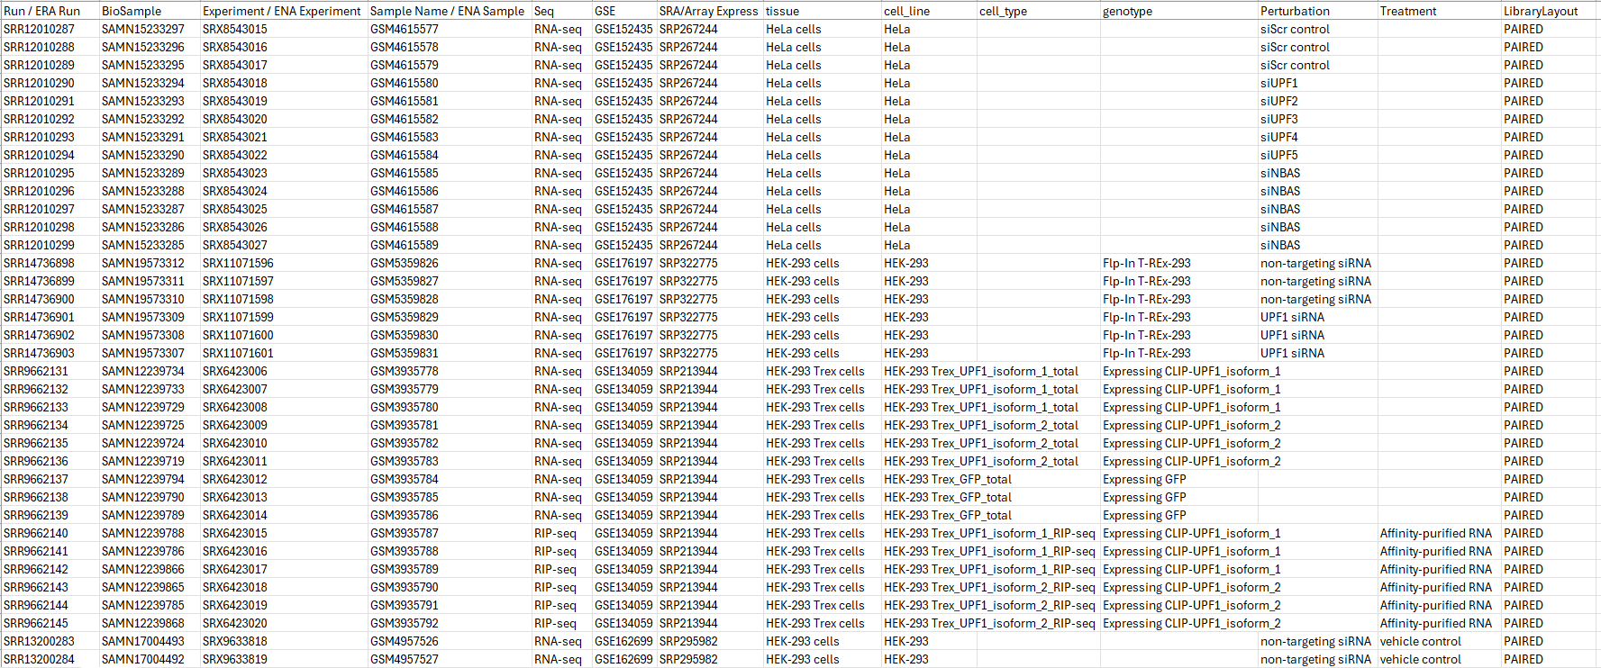
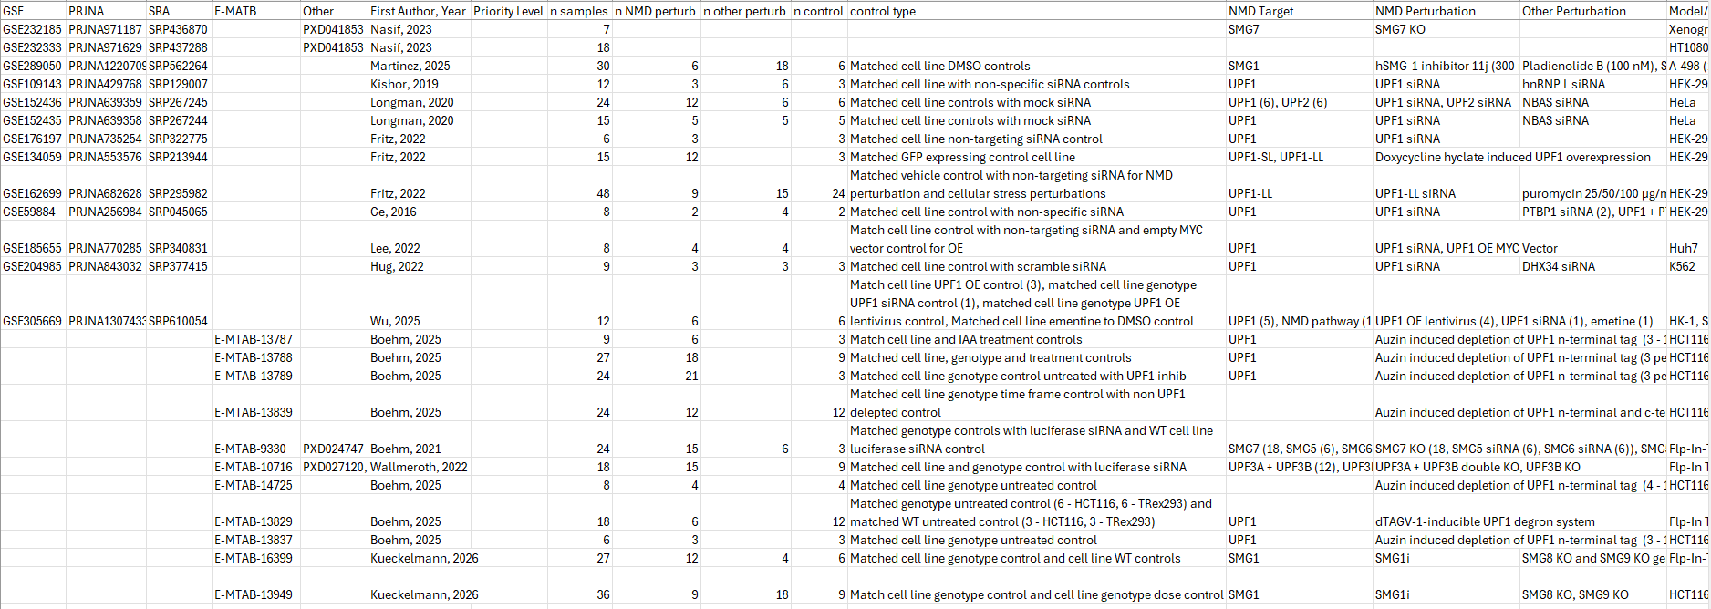
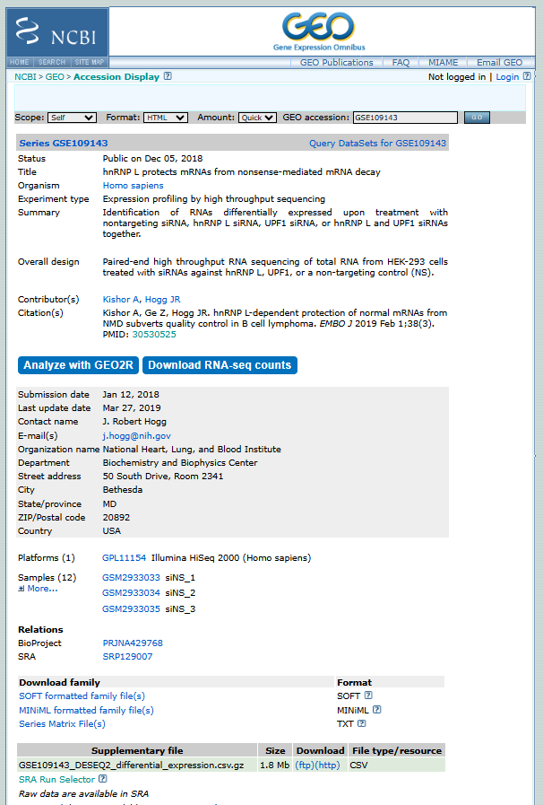
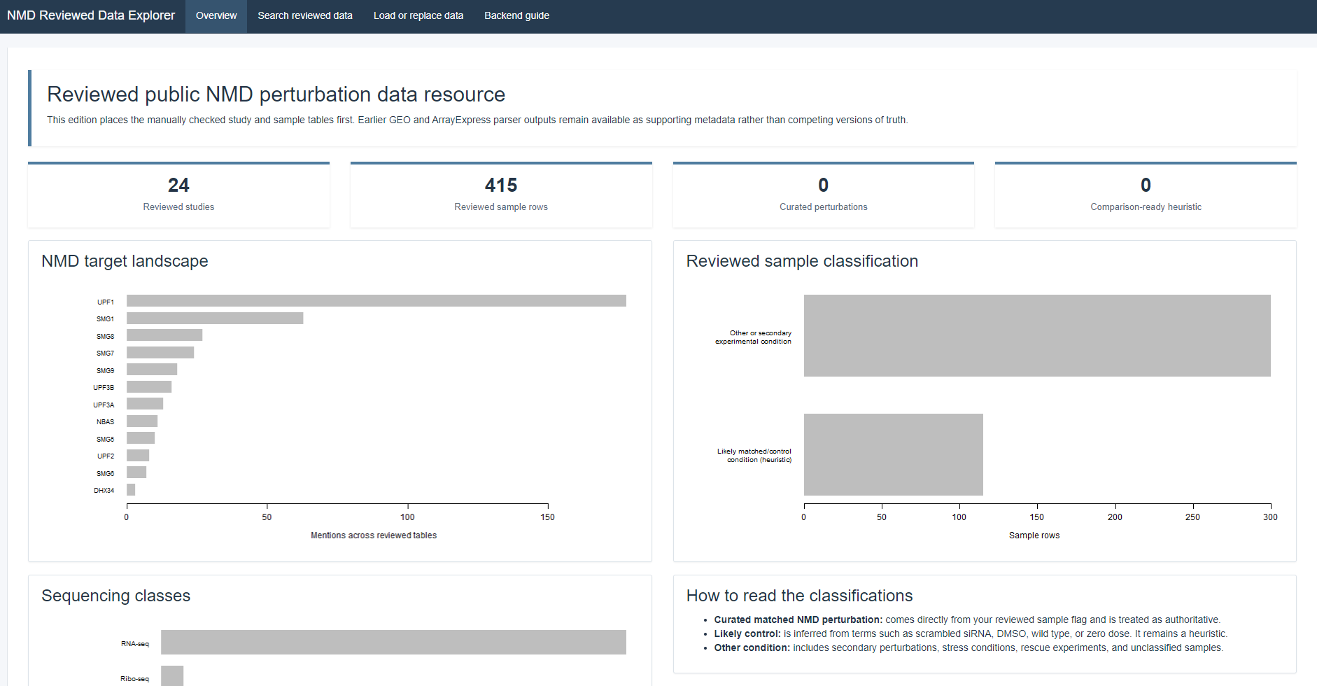
Dataset Discovery

Slide 7
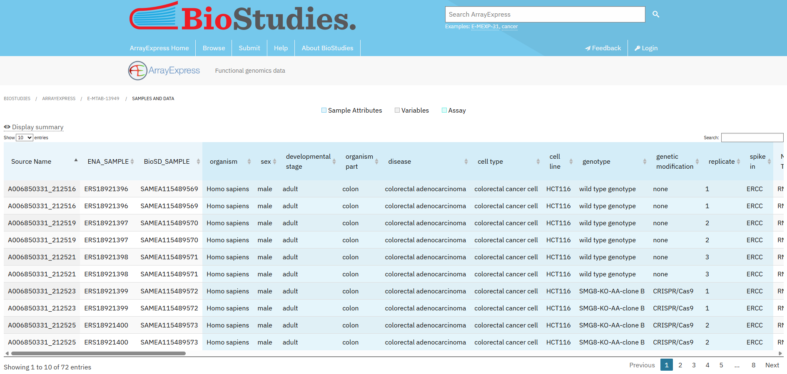
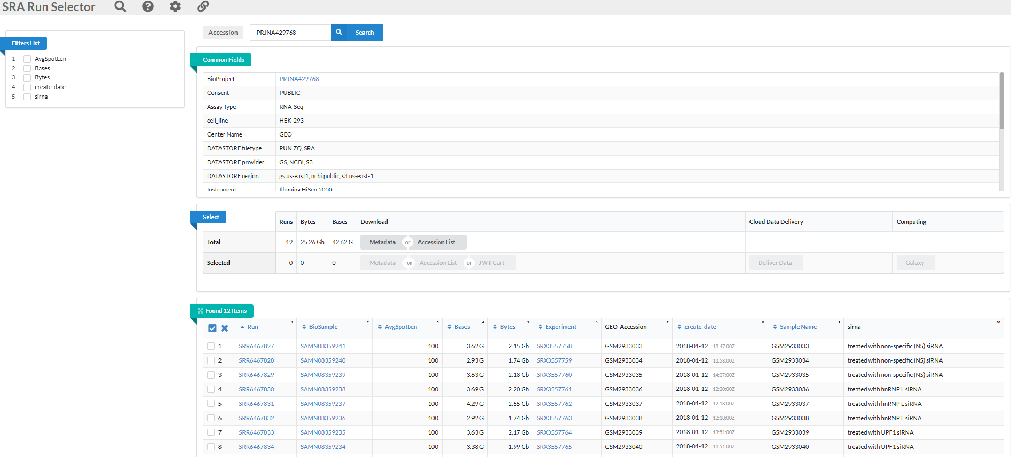
Dataset Review
Manually verified study designs, perturbations, controls, and sample assignments
Standardized metadata across GEO and ArrayExpress/BioStudies
Separated clear NMD perturbations from secondary or mixed conditions
Linked reviewed samples to sequencing and repository accessions
Notes:
Repository metadata were converted into standardized study-level and sample-level tables.
Each study was manually checked for:
NMD factor or pathway target
perturbation mechanism
biological model or cell line
sample counts and replicate structure
matched control design
sequencing assay and library preparation
Samples were classified as:
clear NMD perturbation
matched control
secondary or unrelated perturbation
combination treatment
rescue or overexpression condition
other assay type, such as RIP-seq or Ribo-seq
Manual review was necessary because repository labels were often incomplete, inconsistent, or biologically ambiguous.
Exact sample accessions were linked to reviewed treatment and control assignments.
Paired-end or multi-run ArrayExpress records were collapsed to one row per sequenced sample where appropriate

Slide 8
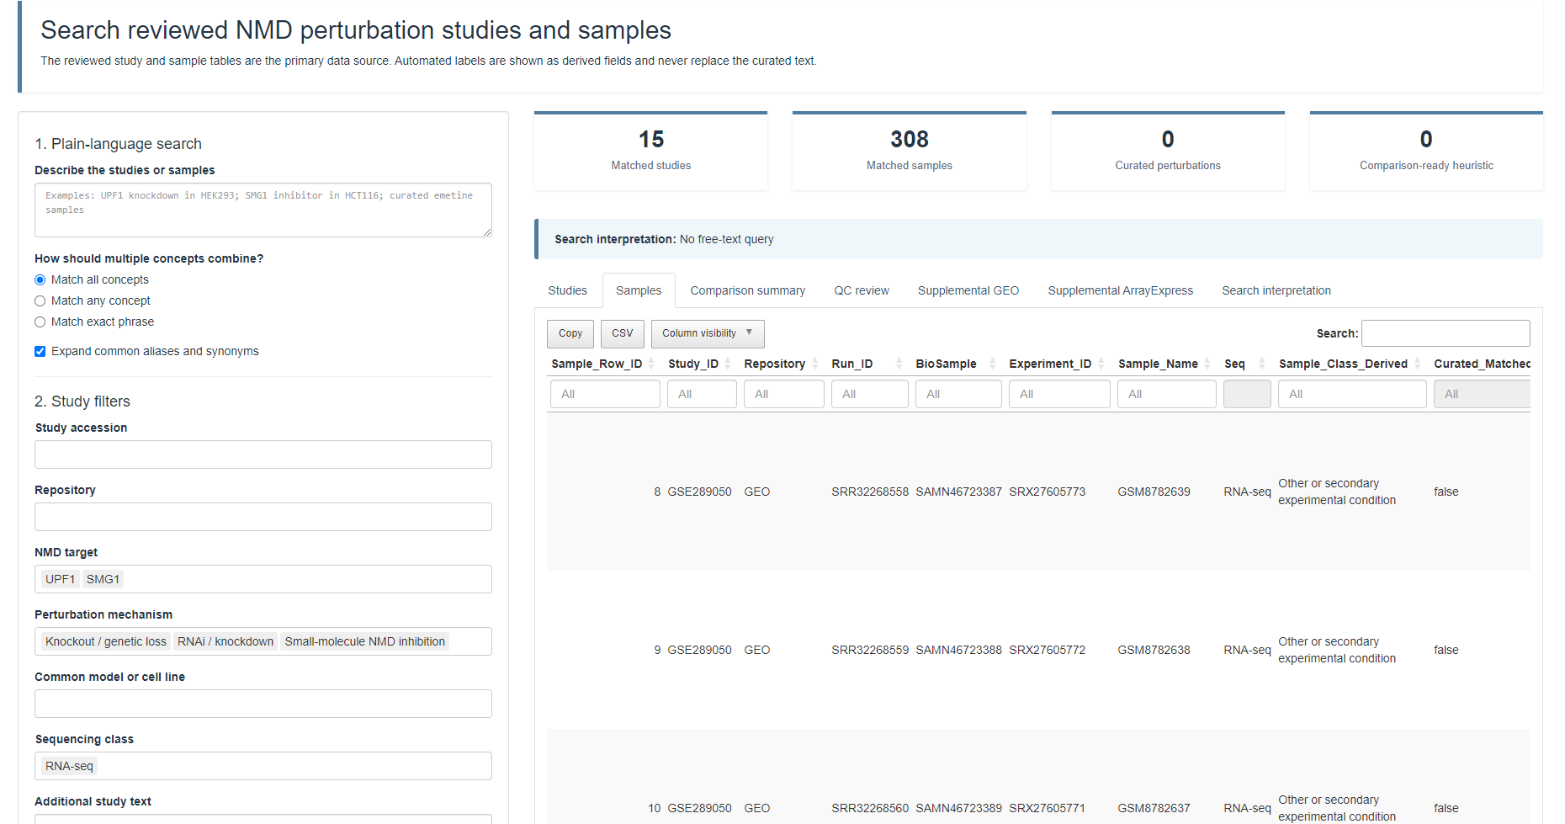
Searchable Resource
Built an interactive Shiny application for exploring curated studies and samples
Search and filter by target, treatment, model, and accession
Displays and export reviewed annotations with supplemental repository metadata
Notes:
A Shiny application was developed around the manually reviewed study and sample tables.
Users can search using plain-language terms rather than repository-specific column names or regular expressions.
Searchable fields include:
NMD target
perturbation type
inhibitor or treatment
cell line or tissue
sequencing type
repository accession
sample classification
Common aliases and synonyms are expanded in the backend.
Reviewed annotations are treated as the primary source, while automated GEO and ArrayExpress metadata are retained as supplemental evidence.
Results are displayed in separate tabbed tables for studies, samples, QC, and supporting repository metadata.
Filtered results can be exported as TSV files in a ZIP archive.
The application was adapted for an older Shiny Server environment without relying on bslib or Bootstrap 5.

Slide 9
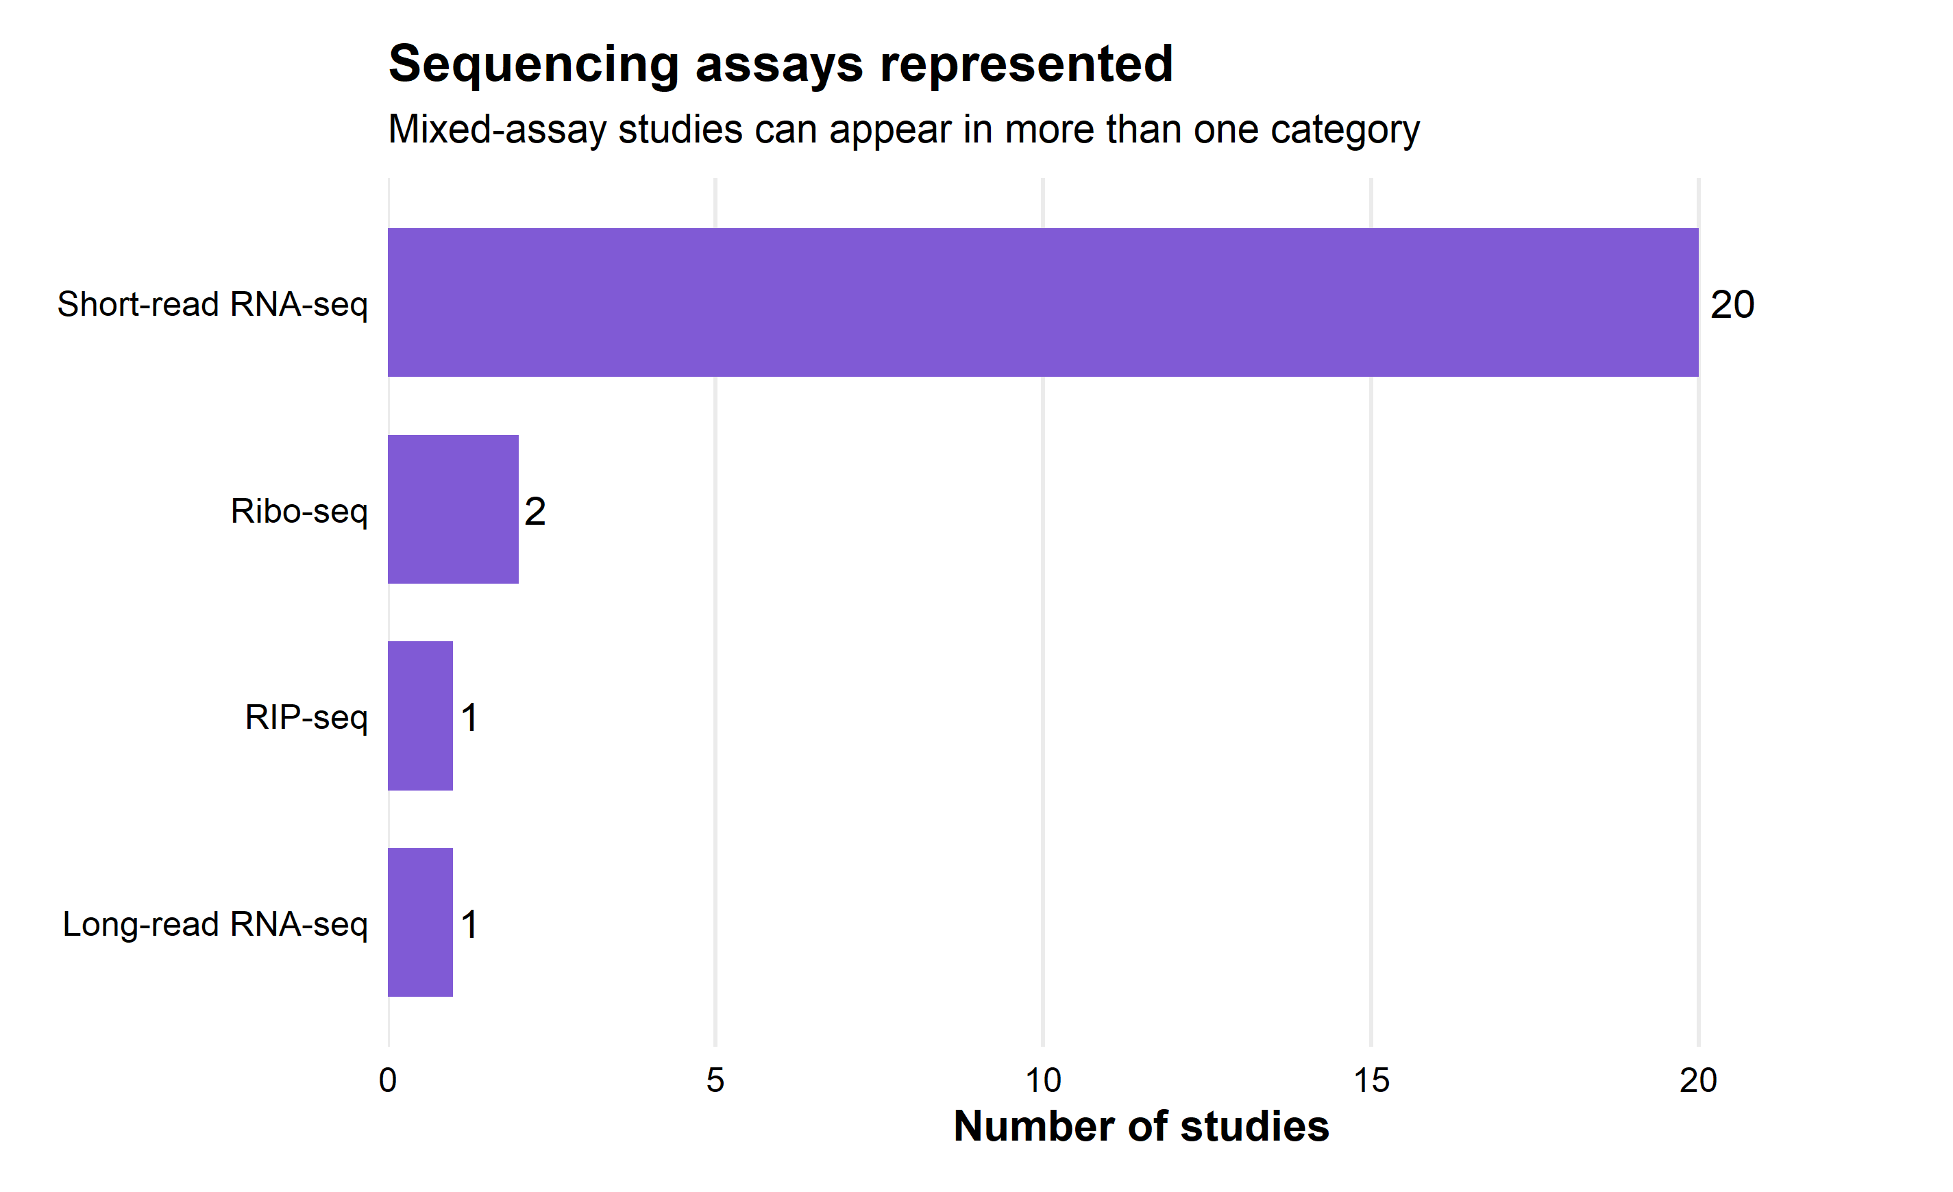
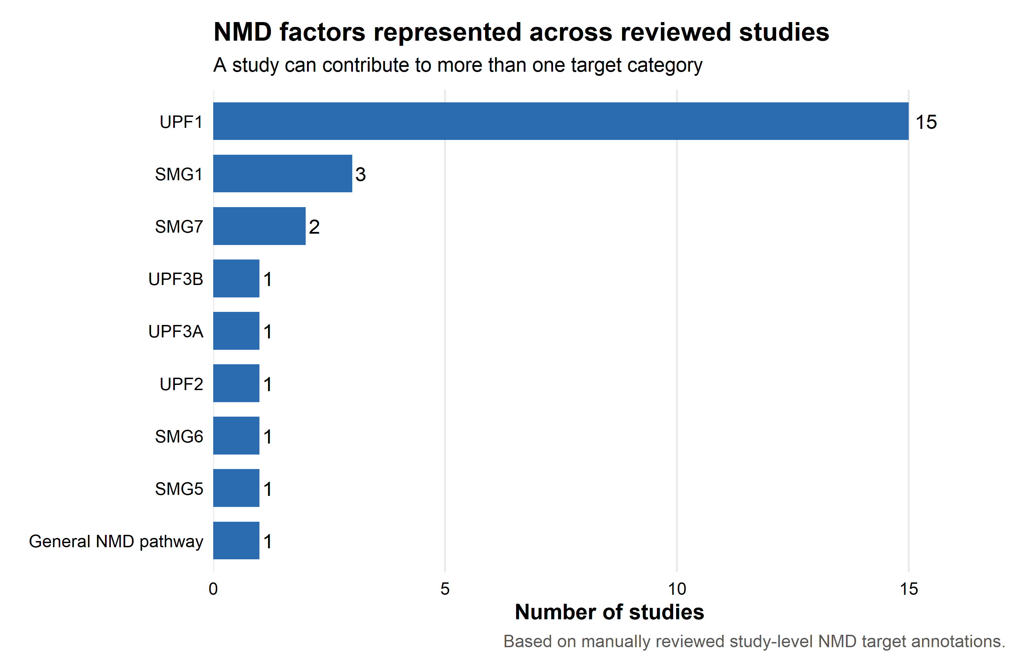
Study-readiness confidence
Assessed perturbation clarity, controls, replication, and sequencing design
Distinguished manually reviewed annotations from automated classifications
Prioritized studies with clear matched comparisons and sufficient sample size
Flagged ambiguous or exploratory studies for additional review
Notes:
Not every dataset containing an NMD-related term is suitable for comparative analysis.
Confidence was assessed using practical criteria:
clearly defined NMD perturbation
identifiable matched control
adequate biological replication
raw sequencing data availability
clear sample-to-treatment assignments
documented sequencing and library design
similarity to another study or experimental model
Manually reviewed perturbation flags were kept separate from software-derived classifications.
High-confidence samples represent straightforward NMD perturbations with a reasonable matched control.
Lower-confidence cases include:
mixed perturbations
rescue experiments
unclear controls
multiple assay types
incomplete metadata
A study-level QC table compares declared sample counts with observed curated sample records.
Differences are flagged for review rather than automatically treated as errors, since one sample may have multiple sequencing runs.

Slide 10
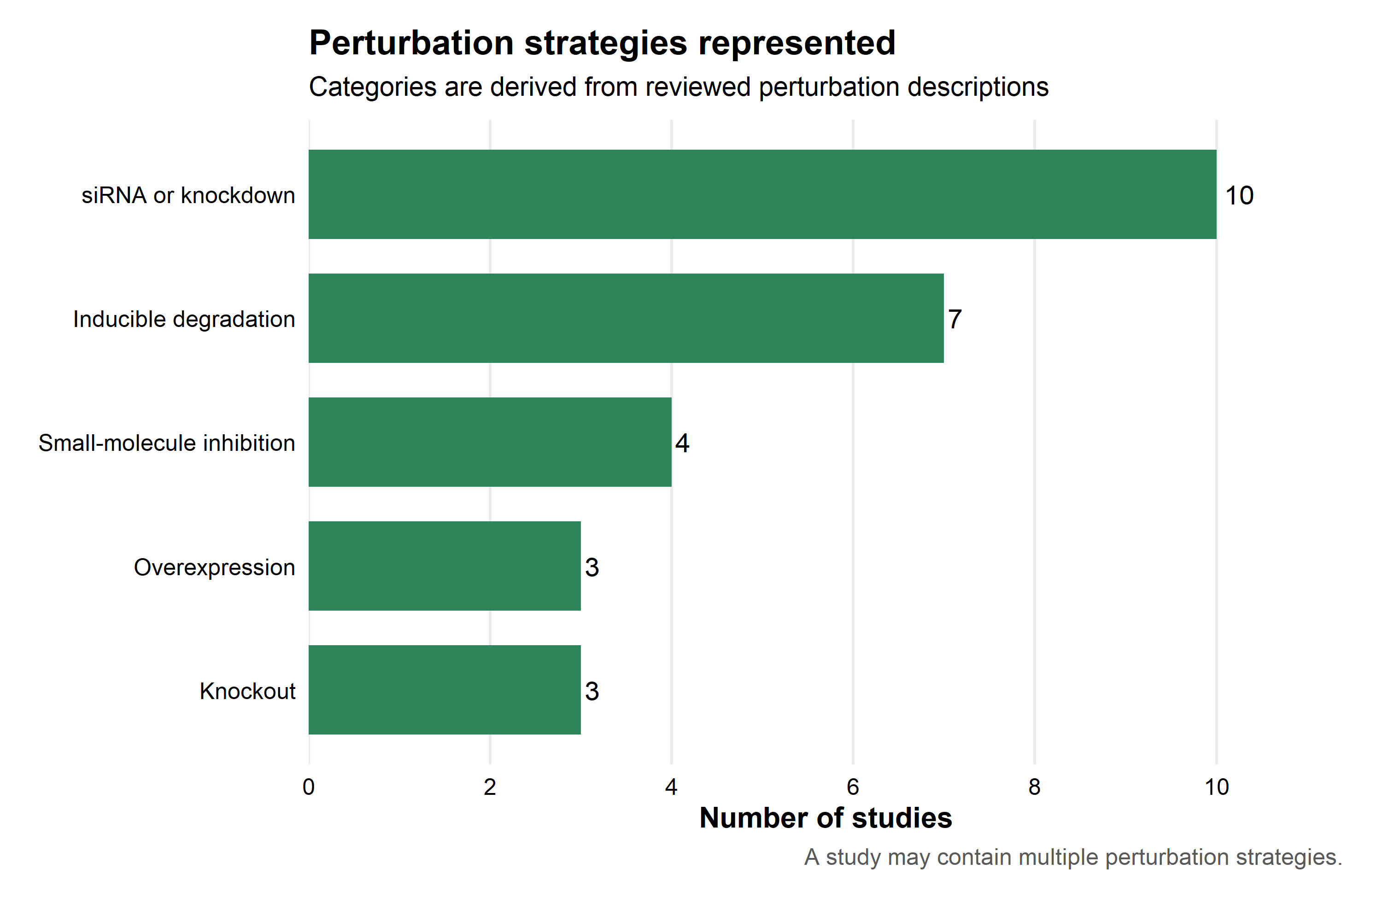
Next Steps
Complete manual validation
Standardize terminology
Assign explicit comparison groups
Download and process the strongest candidate RNA-seq datasets.
Perform initial analyses
Integrate tools such as JunctionScope for targeted splice-junction assessment.
Notes:
Complete manual validation of the remaining ArrayExpress/BioStudies samples.
Standardize remaining terminology for treatments, doses, time points, and control types.
Assign explicit comparison groups, for example:
UPF1 siRNA versus non-targeting siRNA
SMG1 inhibitor versus DMSO
degron-treated versus untreated genotype-matched control
Finalize a study-readiness matrix and prioritized shortlist.
Identify groups of studies with compatible:
NMD target
perturbation method
biological model
sequencing type
replicate structure
Download and process the strongest candidate RNA-seq datasets.
Perform initial analyses of:
differential gene expression
transcript-level changes
splice-junction usage
poison exon inclusion
candidate NMD burden metrics
Integrate tools such as JunctionScope for targeted splice-junction assessment.
Continue refining the Shiny resource as study annotations and analysis results are added.

Slide 11
Thank you ☺

