Slide 1
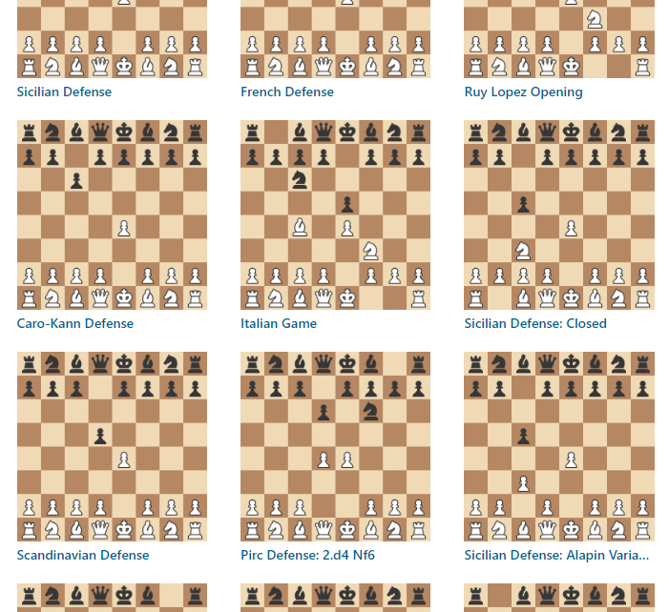
Chess Opening Analyzer
Adrian Obermühlner, Freja Rasmussen

Slide 2
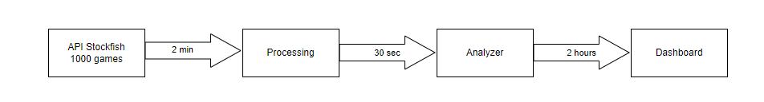
Simple Approach

Slide 3
API Optimization
Parallel download
Chunking download into smaller files
Personalized access token

Slide 4
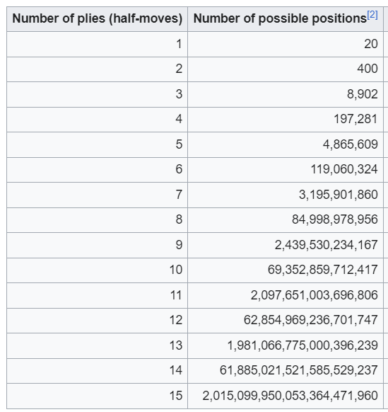
Analyzer – Indexing

Slide 5
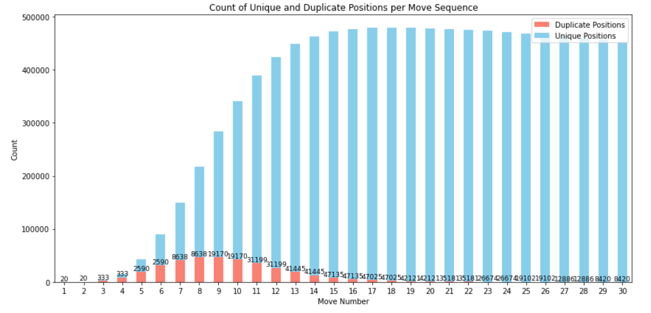
Analyzer – Indexing 500’000 games example

Slide 6
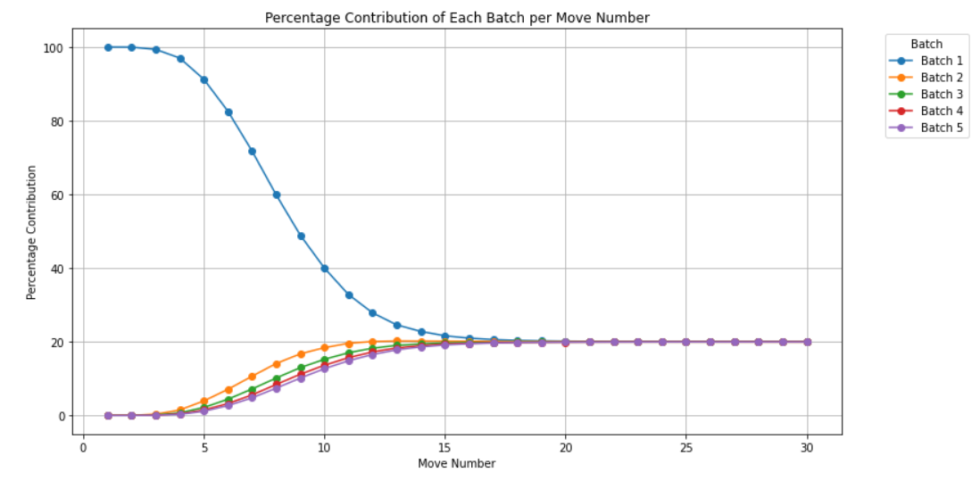
Analyzer – Indexing 500’000 games example

Slide 7
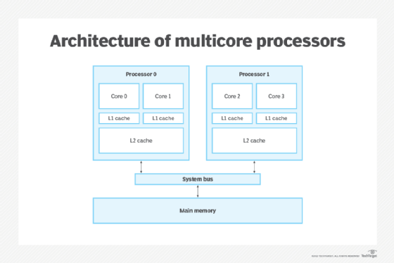
Analyzer – Parallel Processing
Distributed Computing
Multi-Core Processing
  4 oder 8 Cores
Source: https://www.techtarget.com/searchdatacenter/definition/multi-core-processor, 08.04.24

