Slide 1
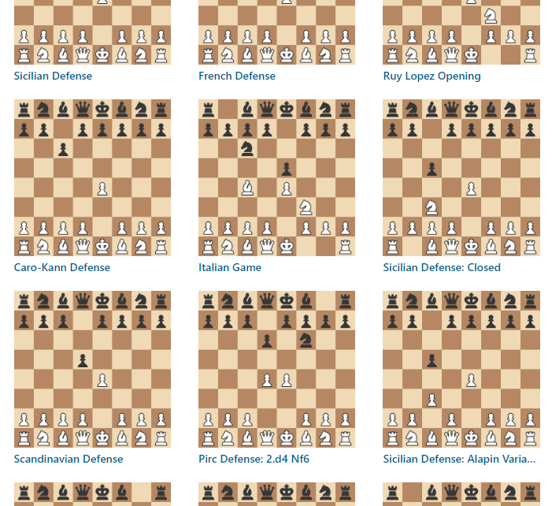
Chess Opening Analyzer
Adrian Obermühlner, Freja Rasmussen

Slide 2
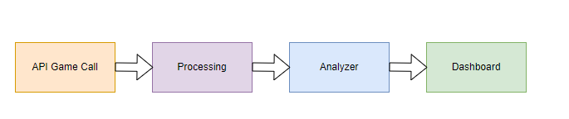
Simple Approach
~ 1.20 min
~ 0.2min
~ 4h 28 min
~ 0.1 min
= Total time ~ 4h 30 min

Slide 3
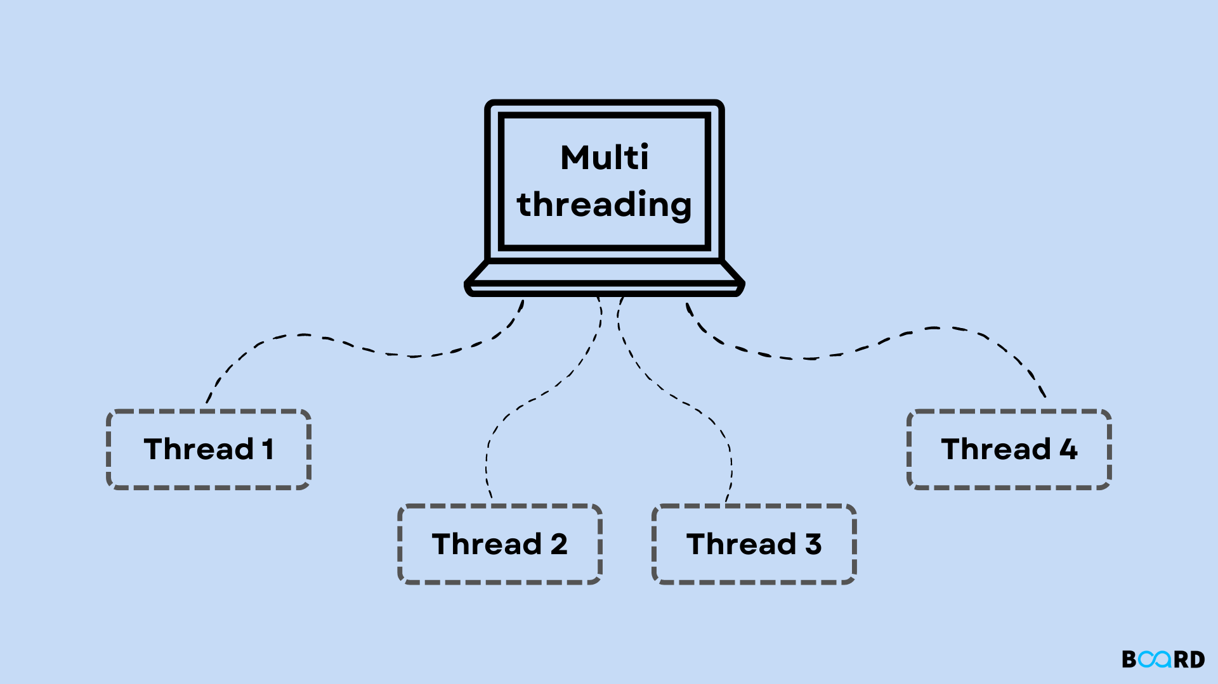
API Optimization
Current state: 2000 games = ~ 80.2 sec
With multithreading: 2000 games = ~ 30.4 sec

Slide 4
Processing Optimization – Opening shortening
Current state: 2000 games = 4h 28min
2000 games * 30 * 15 depth = 900’000 positions
Transition from opening to midgame = 20 + 4
2000 games * 24 * 15 depth = 720’000 positions

Slide 5
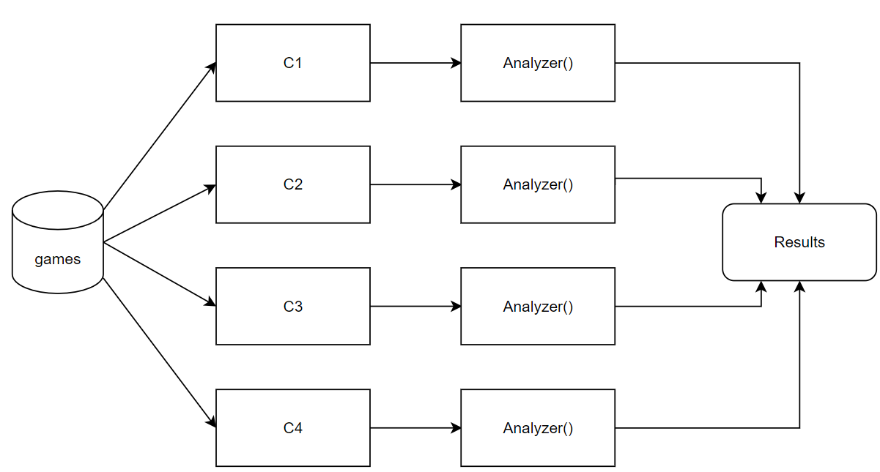

Processing Optimization – Parallel Processing
Usage of 8 cores = ~ 5 times faster

Slide 6
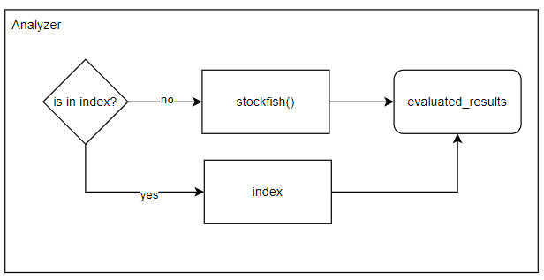
Processing Optimization – Indexing

Slide 7
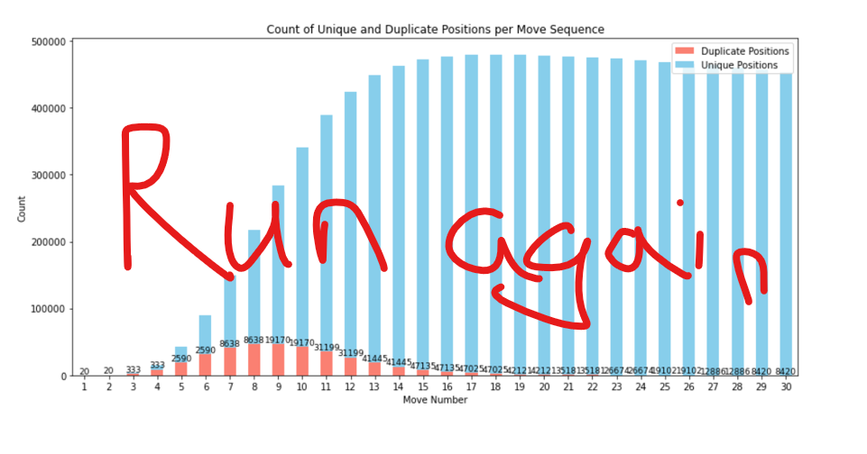
Processing Optimization – Indexing
40 % of positions in index

Slide 8
Results
Api fetch reduced from 80.2 sec to ~30.4 sec
Total analysing time from 4h 28 min reduced to ~18min
Total time = ~19min

Slide 9
Dashboard Presentation

