Slide 1
Compilers 101
Debuggers

Slide 2
Previously…
Preprocessing
Lexical analysis
Frontend
Syntax analysis
Semantic analysis
IR Generation
IR Optimization
Middle-end
Code generation
Backend
Optimization

Slide 3
Why debugging?
Static analysis does not discover many kinds of errors (especially, logic errors)
Retrieve runtime information
Need some insight into running programs
Allow to change execution flow without recompilation

Slide 4
Debuggers in a nutshell
Ability to control execution
Resume after signal/trap
Ability to read/write memory
Registers and RAM
Mapping from binary code to source

Slide 5
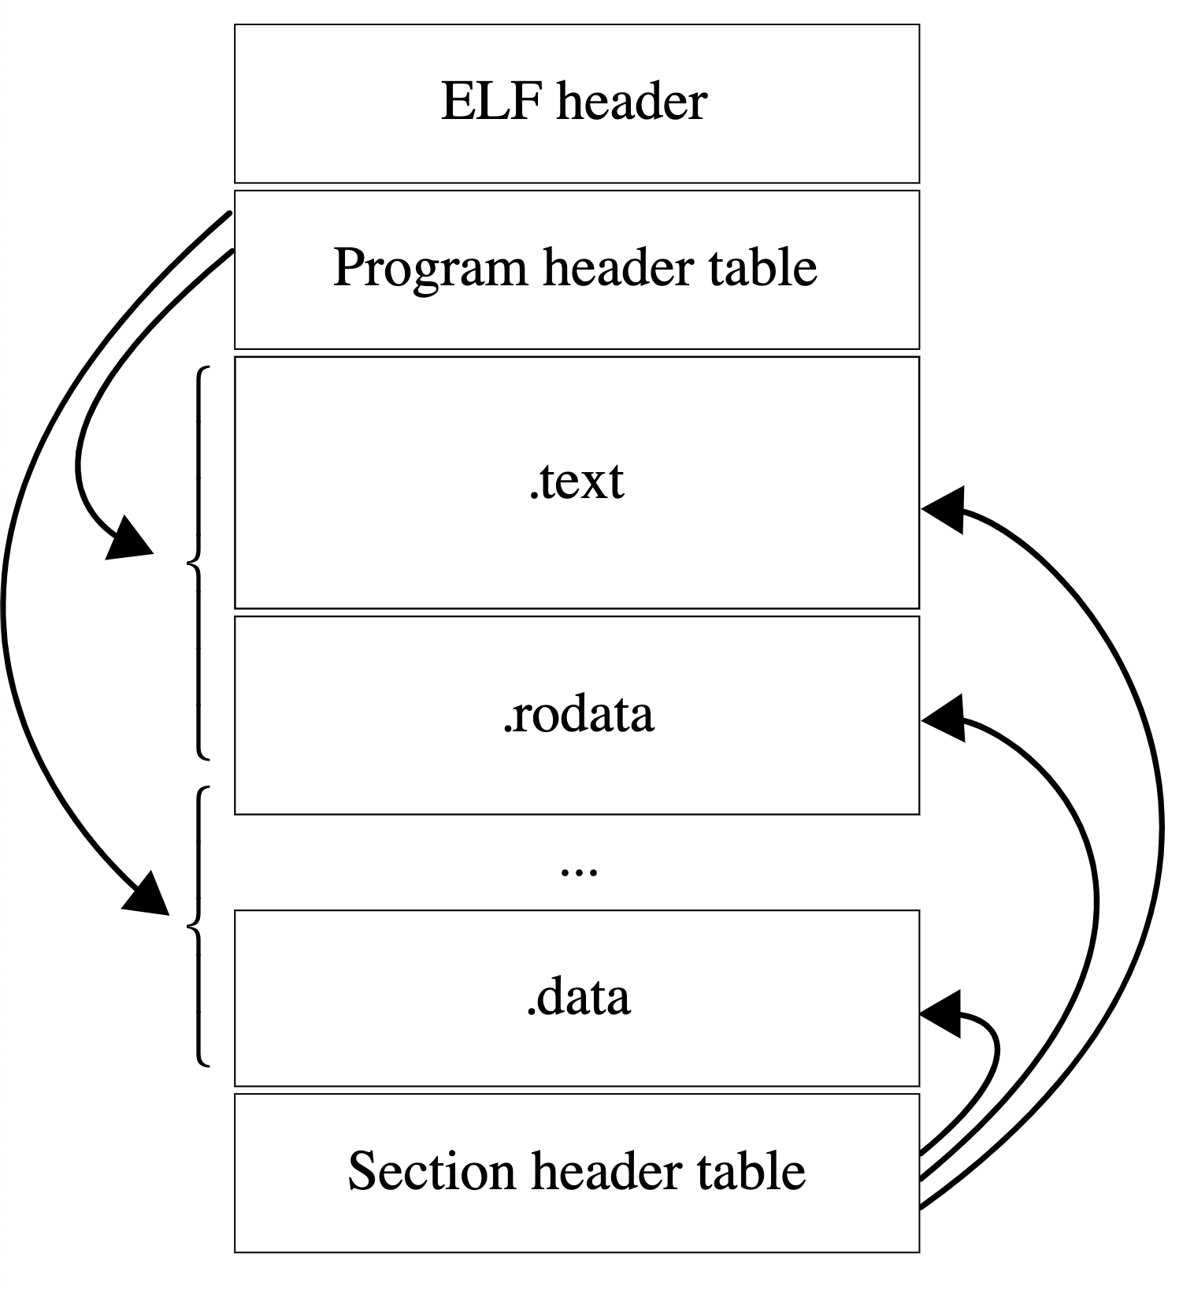
Executable and linkable format (ELF)
ELF is a common executable file format for Unix-like systems
File is divided in multiple sections
Sections can be read-only and executable
https://en.wikipedia.org/wiki/Executable_and_Linkable_Format

Slide 6

DWARF
DWARF is a widely used debugging information format
DWARF uses Debugging Information Entry (DIE) data structure
A DIE has a tag (DW_TAG_variable, DW_TAG_pointer_type, DW_TAG_subprogram)
And attributes (key-value pairs)
DIE attributes can reference other DIEs
https://dwarfstd.org/
The name is a medieval fantasy complement to "ELF" that had no official meaning, although the name "Debugging With Arbitrary Record Formats" has since been proposed as a backronym

Slide 7
Working with DWARF
Use -g flag to enable DWARF in the compiler
GDB and LLDB are the most used debuggers on Unix-like platforms
libdwarf – C library for working with DWARF (http://www.prevanders.net/dwarf.html)
dwex – GUI for visualizing DWARF (https://github.com/sevaa/dwex)

Slide 8
PE and PDB
Portable Executable (PE) is an executable file format on Windows
Program database (PDB) is a debug info file format on Windows
PE plays a similar role to ELF on Windows, but the structure and loader model differ
Unlike DWARF*, PDB is typically stored as an external file
* -gsplit-dwarf gcc/clang option can place DWARF debug info into a separate .dwo file, but it is not default behavior

Slide 9
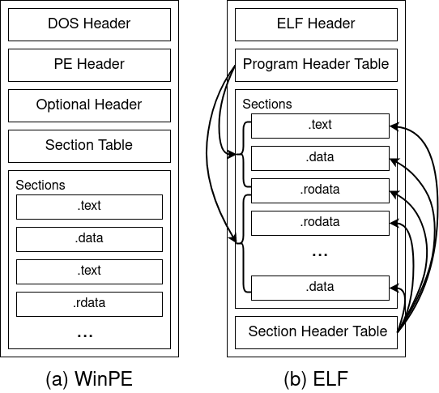
ELF and PE
Comparison of different executable formats:
PE (Portable Exectuable) - Windows
ELF (Executable and Linkable Format) - Unix

Slide 10

Debug info path
The whole compilation flow is involved in debug information processing:
Preprocessing
Preprocessor:
Lexer:
AST:
LLVM IR:
Assembly/Object:
https://godbolt.org/z/f9n1n8dK3
Lexical analysis
Syntax analysis
https://godbolt.org/z/17snPja5v
Semantic analysis
https://godbolt.org/z/v41qPPGEf
IR Generation
IR Optimization
https://godbolt.org/z/ecn15d566
Optimization
Code generation
https://godbolt.org/z/oW19bY35E

Slide 11
Debug info in AST
https://godbolt.org/z/v41qPPGEf
// ...
int square(int num) {
return num * num;
}
AST preserves code locations from the original file
`-FunctionDecl 0x4bd603b8 <<source>:2:1, line:4:1> line:2:5 square 'int (int)'
|-ParmVarDecl 0x4bd602e8 <col:12, col:16> col:16 used num 'int'
`-CompoundStmt 0x4bd60550 <col:21, line:4:1>
`-ReturnStmt 0x4bd60540 <line:3:5, col:18>
`-BinaryOperator 0x4bd60520 <col:12, col:18> 'int' '*'
|-ImplicitCastExpr 0x4bd604f0 <col:12> 'int' <LValueToRValue>
| `-DeclRefExpr 0x4bd604b0 <col:12> 'int' lvalue ParmVar 0x4bd602e8 'num' 'int'
`-ImplicitCastExpr 0x4bd60508 <col:18> 'int' <LValueToRValue>
`-DeclRefExpr 0x4bd604d0 <col:18> 'int' lvalue ParmVar 0x4bd602e8 'num' 'int'

Slide 12
From LLVM IR to DWARF
https://godbolt.org/z/ecn15d566
LLVM IR debug metadata used to emit DWARF
// ...
int square(int num) {
return num * num;
}
!0 = distinct !DICompileUnit(language: DW_LANG_C_plus_plus_14, file: !1, producer: "clang version 23.0.0git (https://github.com/llvm/llvm-project.git 652700b4cb3c87294f2d78cb87df5e394e589984)", isOptimized: false, runtimeVersion: 0, emissionKind: FullDebug, splitDebugInlining: false, nameTableKind: None)
!1 = !DIFile(filename: "/app/example.cpp", directory: "/app", checksumkind: CSK_MD5, checksum: "10b91831677796a5c7dc72e7bd216467")
!2 = !{i32 7, !"Dwarf Version", i32 5}
!3 = !{i32 2, !"Debug Info Version", i32 3}
!4 = !{i32 8, !"PIC Level", i32 2}
!5 = !{i32 7, !"PIE Level", i32 2}
!6 = !{i32 7, !"uwtable", i32 2}
!7 = !{i32 7, !"frame-pointer", i32 2}
!8 = !{!"clang version 23.0.0git (https://github.com/llvm/llvm-project.git 652700b4cb3c87294f2d78cb87df5e394e589984)"}
!9 = distinct !DISubprogram(name: "square", linkageName: "square(int)", scope: !10, file: !10, line: 2, type: !11, scopeLine: 2, flags: DIFlagPrototyped, spFlags: DISPFlagDefinition, unit: !0, retainedNodes: !14)
!10 = !DIFile(filename: "example.cpp", directory: "/app", checksumkind: CSK_MD5, checksum: "10b91831677796a5c7dc72e7bd216467")
!11 = !DISubroutineType(types: !12)
!12 = !{!13, !13}
!13 = !DIBasicType(name: "int", size: 32, encoding: DW_ATE_signed)
!14 = !{}
!15 = !DILocalVariable(name: "num", arg: 1, scope: !9, file: !10, line: 2, type: !13)
!16 = !DILocation(line: 2, column: 16, scope: !9)
!17 = !DILocation(line: 3, column: 12, scope: !9)
!18 = !DILocation(line: 3, column: 18, scope: !9)
!19 = !DILocation(line: 3, column: 16, scope: !9)
!20 = !DILocation(line: 3, column: 5, scope: !9)

Slide 13
Debug info in LLVM IR
https://godbolt.org/z/ecn15d566
!DISubprogram - function information
!DILocalVariable - local variable information
!DILocation - source location attached to IR instruction
!DICompositeType - struct/class/array type information
!DIBasicType - int, float, char, ...
!9 = distinct !DISubprogram(name: "square", linkageName: "square(int)", scope: !10, file: !10, line: 2, type: !11, scopeLine: 2, flags: DIFlagPrototyped, spFlags: DISPFlagDefinition, unit: !0, retainedNodes: !14)
!10 = !DIFile(filename: "example.cpp", directory: "/app", checksumkind: CSK_MD5, checksum: "10b91831677796a5c7dc72e7bd216467")
!11 = !DISubroutineType(types: !12)
!12 = !{!13, !13}
!13 = !DIBasicType(name: "int", size: 32, encoding: DW_ATE_signed)
!14 = !{}
!15 = !DILocalVariable(name: "num", arg: 1, scope: !9, file: !10, line: 2, type: !13)
!16 = !DILocation(line: 2, column: 16, scope: !9)
!17 = !DILocation(line: 3, column: 12, scope: !9)
!18 = !DILocation(line: 3, column: 18, scope: !9)
!19 = !DILocation(line: 3, column: 16, scope: !9)
!20 = !DILocation(line: 3, column: 5, scope: !9)

Slide 14
Debug info in object file
https://godbolt.org/z/oW19bY35E
Debug information is stored to the corresponding sections in binary format
Tools responsible for working with DWARF are able to parse it and map back to the original source code
.section .debug_abbrev,"",@progbits
.byte 1 # Abbreviation Code
.byte 17 # DW_TAG_compile_unit
.byte 1 # DW_CHILDREN_yes
.byte 37 # DW_AT_producer
.byte 37 # DW_FORM_strx1
.byte 19 # DW_AT_language
.byte 5 # DW_FORM_data2
.byte 3 # DW_AT_name
.byte 37 # DW_FORM_strx1
.byte 114 # DW_AT_str_offsets_base
.byte 23 # DW_FORM_sec_offset
.byte 16 # DW_AT_stmt_list
.byte 23 # DW_FORM_sec_offset
.byte 27 # DW_AT_comp_dir
.byte 37 # DW_FORM_strx1
.byte 17 # DW_AT_low_pc
.byte 27 # DW_FORM_addrx
.byte 18 # DW_AT_high_pc
.byte 6 # DW_FORM_data4
.byte 115 # DW_AT_addr_base
.byte 23 # DW_FORM_sec_offset
.byte 0 # EOM(1)
.byte 0 # EOM(2)
...

Slide 15
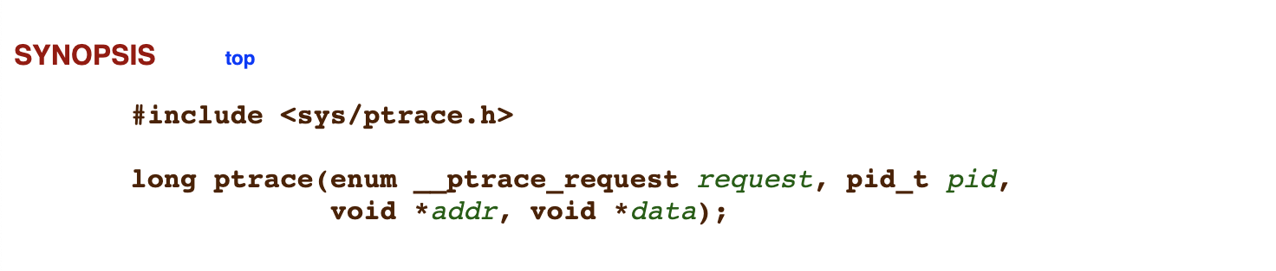
ptrace
Attach to process
Read/write registers
Read/write memory
Signal on traps
Trace syscalls (emulated capability)
https://man7.org/linux/man-pages/man2/ptrace.2.html

Slide 16
Debugger Engine
Debugger Engine provides an interface for examining and manipulating running processes
Debugger Engine can be used to both write debugger extensions (e.g., for WinDbg) and full-featured debuggers
Debugger Markup Language is similar to HTML, but for debug info
Full docs: https://docs.microsoft.com/en-us/windows-hardware/drivers/debugger/debugger-engine-and-extension-apis

Slide 17
Debugger features
Breakpoints
Step-by-step execution
Local variables overview
and many others…

Slide 18
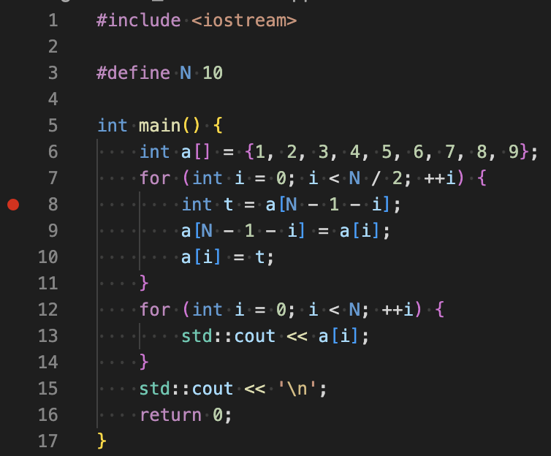
Breakpoints
Essential debugging tool
Two very different kind of breakpoints
Hardware – supported by CPU, limited number of BPs
Software – replace instruction at address with halt/trap/interrupt and then replace back with original instruction
GDB: break <file>:<line>
LLDB: breakpoint set -l <line>

Slide 19
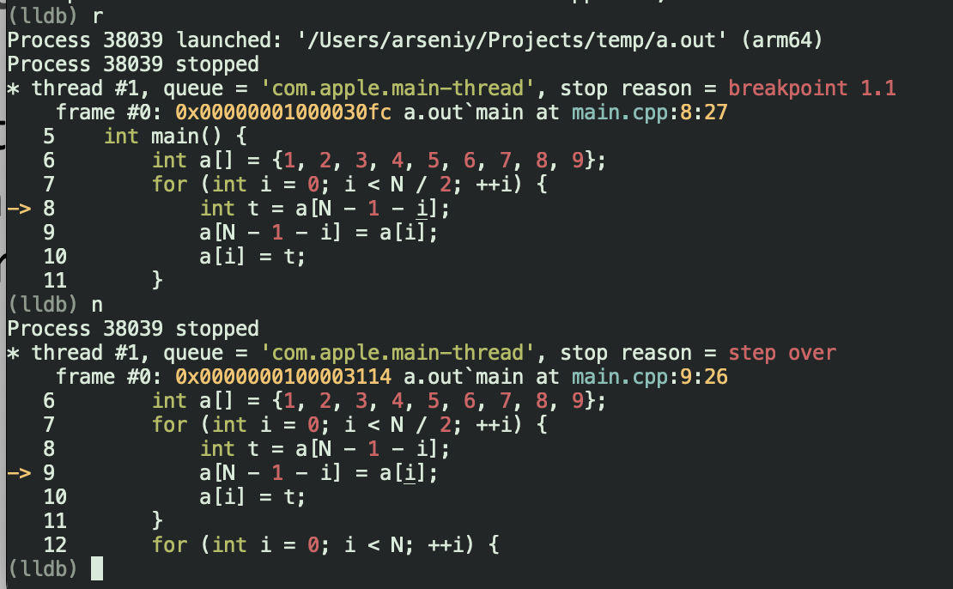
Step-by-step execution
Stepping commands let developers execute their program one line or instruction at a time. This helps in closely monitoring the changes in program state and variable values
Source level (line by line): GDB/LLDB:
step
next
Instruction level (instr by instr): GDB/LLDB:
stepi
nexti

Slide 20
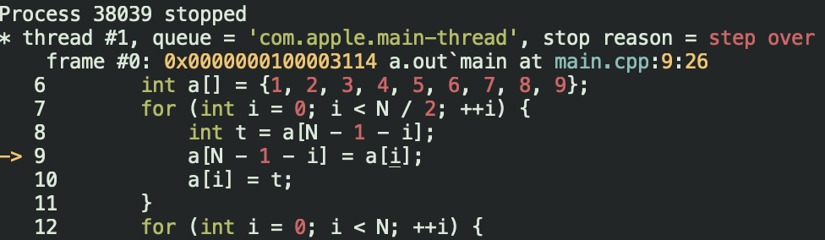
Inspect local variables and stack
See current values of the variables
GDB:
print <variable>
LLDB:
frame variable [variable]

Slide 21
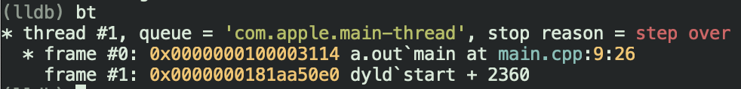
Stack trace
Stack tracing provides a look at the function call stack at any point in a program's execution. This is useful for understanding the sequence of function calls leading to the current point.
GDB/LLDB:
backtrace
bt

Slide 22
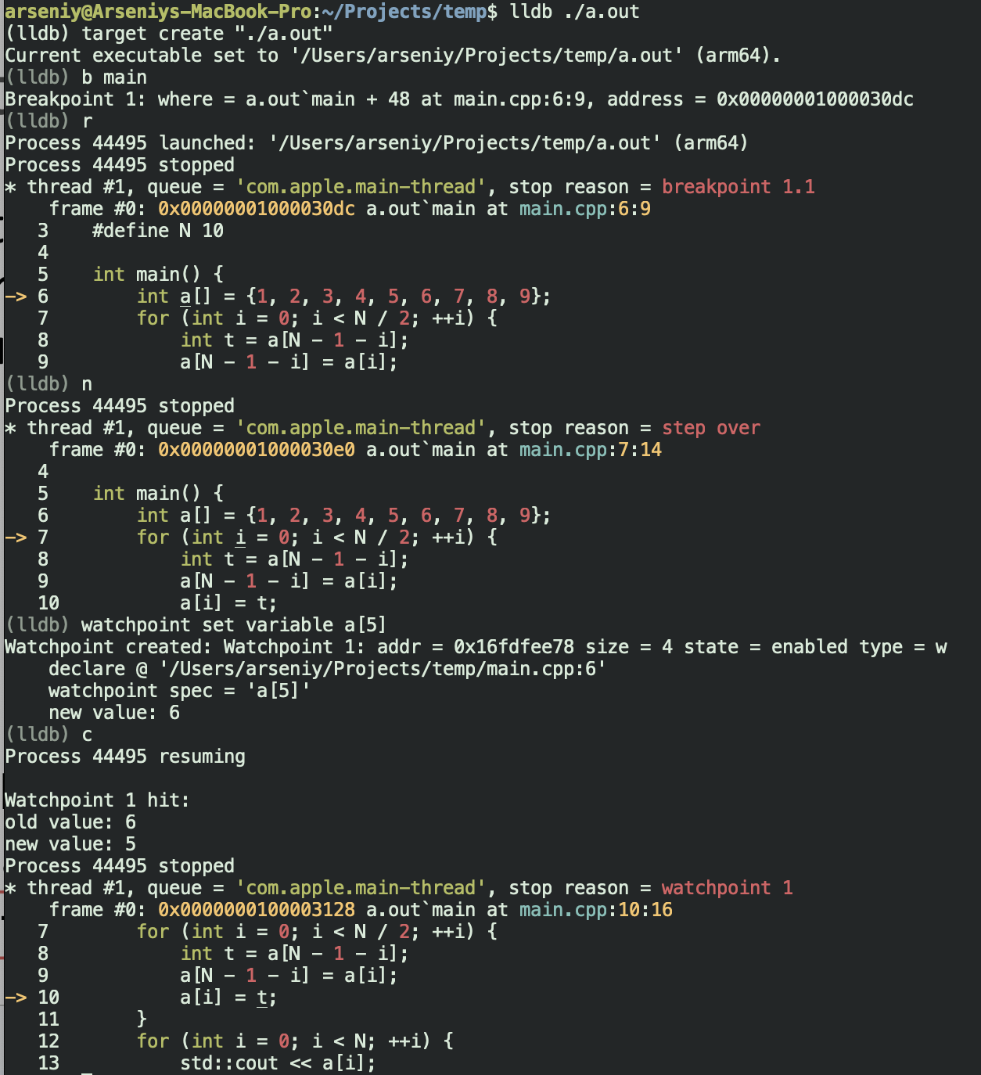
Watchpoints
Watchpoints are similar to breakpoints but are triggered by changes in the value of a variable rather than the execution of a specific line of code.
GDB:
watch <variable>
LLDB:
watchpoint set variable <variable>

Slide 23
Conditional breakpoints
These are breakpoints that are triggered only if a specified condition is true
Condition is checked every time when program reaches particular line of code
GDB:
break [location] if [condition]
LLDB:
breakpoint set --name [function] --condition '[condition]'

Slide 24
Other debugger capabilities
LLDB documentation: https://lldb.llvm.org/
LLDB tutorial: https://lldb.llvm.org/use/tutorial.html
GDB documentation: https://sourceware.org/gdb/documentation/
MSVC debugger documentation: https://learn.microsoft.com/en-us/visualstudio/debugger/getting-started-with-the-debugger-cpp?view=visualstudio

Slide 25
Modifying Program State
Debuggers often allow altering the state of the program, such as changing variable values or jumping to different points in the code.
GDB:
set var <variable>=<value>
LLDB:
expression <variable> = <value>

Slide 26
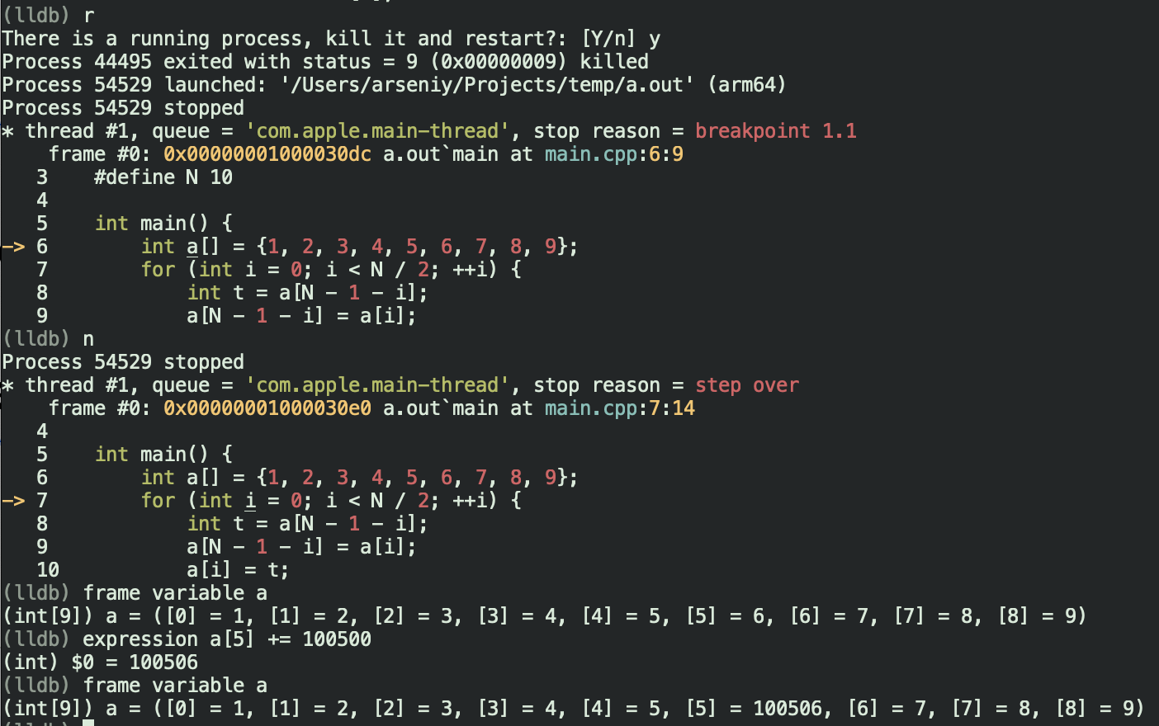
Modifying Program State

Slide 27
Expression evaluation
Parsing programming languages is still a challenge for debuggers
Hard to keep up with all new features
For C++ LLDB uses a full Clang instance:
parses C/C++ expressions using Clang
maps debug info to Clang types
can JIT compile or evaluate expression IR

Slide 28
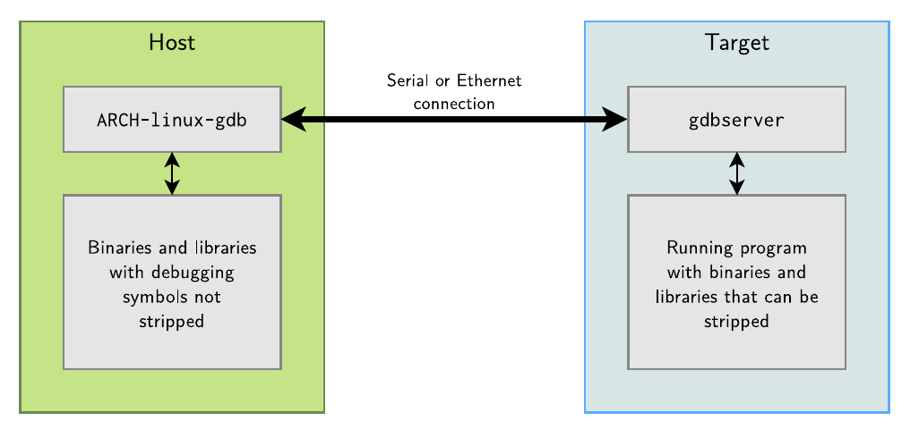
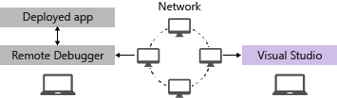
Remote debugging
This feature enables the debugging of a program running on a different machine than the debugger, which is useful for testing in different environments or on different hardware.
Debugger and debuggee communicate over a protocol
gdb/lldb network debugging
MSVC network debugging

Slide 29
LLDB network debugging architecture
Server
Linux
client
GDB remote protocol
macOS
CLI
Windows
…

Slide 30
GDB remote protocol
Exchange textual messages in the format
Checksum is modulo 256 sum of all characters between $ and #
Most common packets
? – query reason for halt
b addr,mode – set breakpoint
c addr – continue at addr
g – read general registers
g XX... – write general registers
m addr,length - read memory
m addr,length:XX… - write memory
-> $packet-data#checksum
<- +
https://sourceware.org/gdb/onlinedocs/gdb/Remote-Protocol.html

Slide 31
Python interface
LLDB has flexible scripting facilities
Interfaces to control entire debugging session
Custom debugger commands
Pretty printers
Customize debugger to support your data structures
LLDB Python API: https://lldb.llvm.org/python_api.html
LLDB Python example: https://lldb.llvm.org/use/tutorials/implementing-standalone-scripts.html

Slide 32
Time travel
Time travel debugging is the ability to step back one or more instructions
Basic principle: save state in particular points of program execution and restore it
Typical implementation ideas:
Virtual machine, that saves the whole processor state
Save state on perf counters change only
Use hardware assistance: Intel Processor Trace (PT), ARM CoreSight
Limitations:
Networking, GPUs, other peripherals
Multithreading
rr (Record and Replay Framework): https://rr-project.org/, https://github.com/rr-debugger/rr

Slide 33
More useful materials on LLDB
LLDB tutorial: https://lldb.llvm.org/use/tutorial.html
GDB to LLDB commands mapping: https://lldb.llvm.org/use/map.html

Slide 34

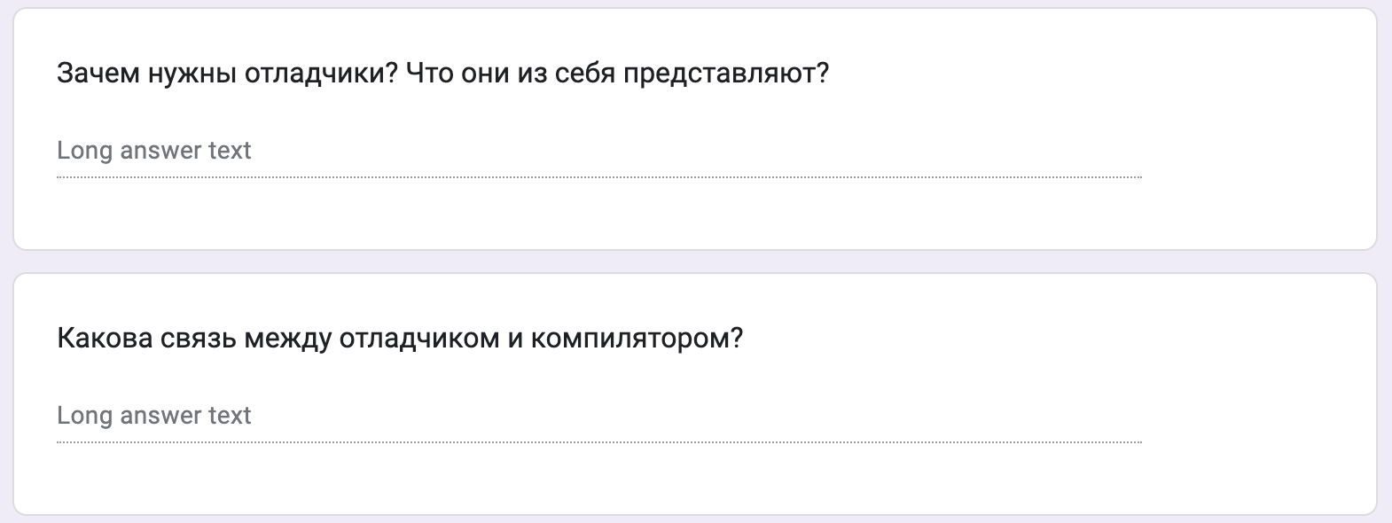
Test
https://forms.gle/VGhg53cKmkHoVtPw9
Submission time: 10 minutes
Backup: me@gooddoog.ru

Slide 35

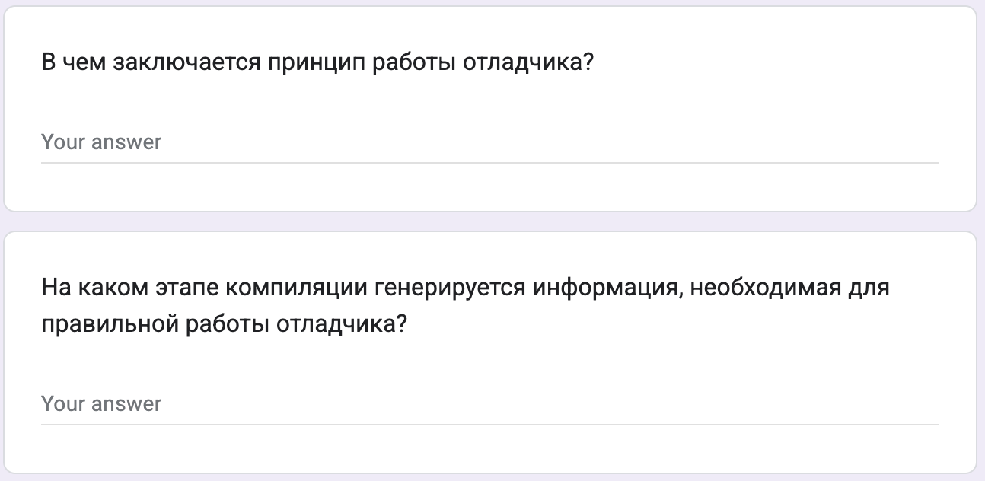
Test
https://forms.gle/ESvwo5dfw9drBFvk7
Submission time: 10 minutes
Backup: me@gooddoog.ru

Slide 36

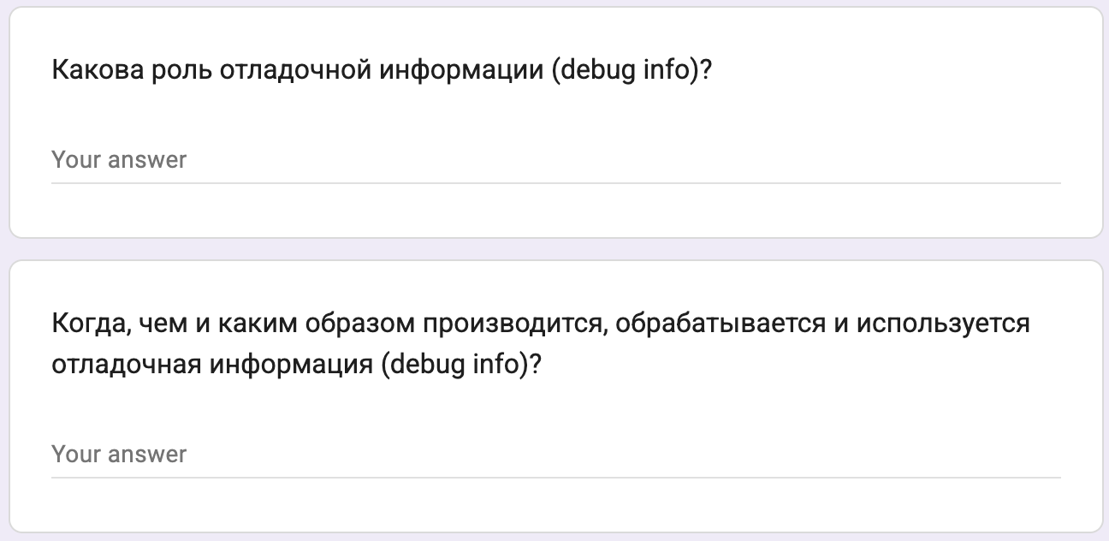
Test
https://forms.gle/8JntK294hophUPVX6
Submission time: 10 minutes
Backup: me@gooddoog.ru

Slide 37
Extra materials
Source Level Debugging with LLVM: https://llvm.org/docs/SourceLevelDebugging.html
Greg Law "Give me 15 minutes & I'll change your view of GDB”: https://www.youtube.com/watch?v=PorfLSr3DDI
LLVM Developers’ Meeting: R. Isemann “Better C++ debugging using Clang Modules in LLDB”: https://www.youtube.com/watch?v=vuNZLlHhy0k
2015 EuroLLVM Developers’ Meeting: “Why should I use LLDB?”: https://www.youtube.com/watch?v=JtpQZw9NpIU

