Slide 1
Compilers 101
LLVM IR

Slide 2
Previously…
Preprocessing
Lexical analysis
Frontend
Syntax analysis
Semantic analysis
IR Generation
Middle-end
IR Optimization
Optimization
Backend
Code generation

Slide 3
Today
Three address code
Intermediate representations
LLVM IR

Slide 4
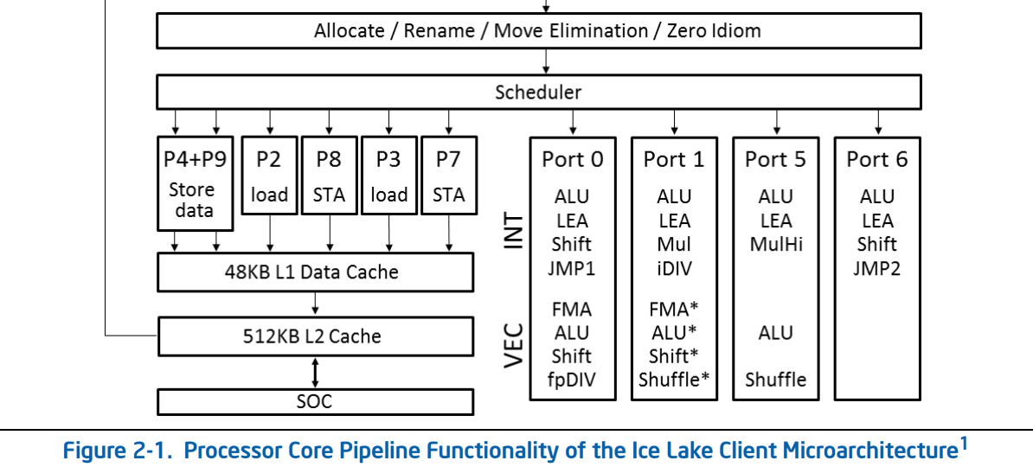
How to represent computation?
https://www.intel.com/content/www/us/en/developer/articles/technical/intel-sdm.html

Slide 5
Two-address code (2AC)
Two-address code is a representation of the computation in the form of a sequence of expressions A := A op B
Example:
A := B + C + D
A := B
A += C
A += D

Slide 6
Three-address code (TAC, 3AC)
Three-address code is a representation of the computation in the form of a sequence of expressions A := B op C
Example:
A := B + C + D
t1 := B + C
t2 := t1 + D
A := t2
Key point here: we have a separate return value, not a single operand is being modified

Slide 7
Three-address code (TAC) instructions
The following forms are allowed
A := constant
A := B
A := B op C
A := constant op B
A := B op constant
A := constant op constant

Slide 8
TAC control flow
int x, y;
while (x < y) {
x = x * 2;
}
y = x;
L0:
t0 := x >= y;
if t0 goto L1;
x := x * 2;
goto L0;
L1:
y := x;

Slide 9
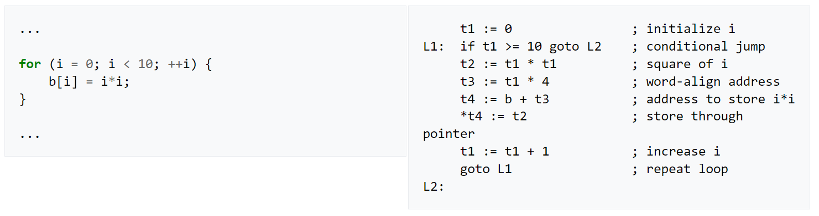
Three-address code example
https://en.wikipedia.org/wiki/Three-address_code

Slide 10
Function calls
bar:
B = pop;
A = pop;
…
foo:
push 10;
push 42;
goto bar;
…
void bar(int A, int B) {
…
}
void foo() {
bar(10, 42);
}

Slide 11
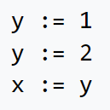
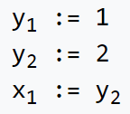
Single static assignment
SSA is a property of intermediate representation, which requires that each variable to be assigned exactly once
Benefits
https://en.wikipedia.org/wiki/Static_single_assignment_form

Slide 12
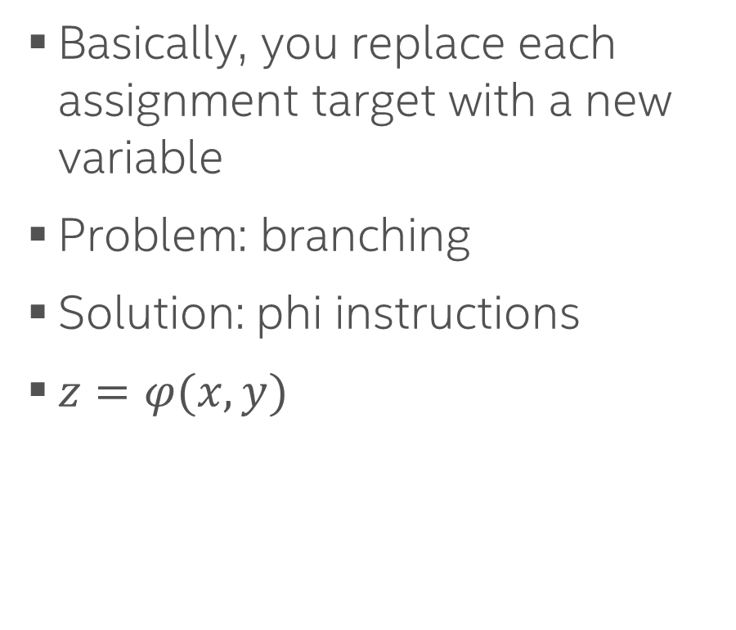
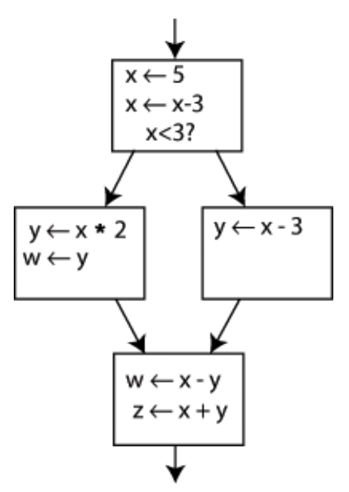
Converting to SSA

Slide 13
Computing minimal SSA
Dominance frontier: a node B is in the dominance frontier of a node A if A does not strictly dominate B, but does dominate some immediate predecessor of B, or if node A is an immediate predecessor of B.
If the node A defines a certain variable, then that definition will reach every node A dominates. When we leave those nodes and enter a dominance frontier, we must account for other flows.

Slide 14
Def-use analysis
Def-use analysis is a technique used in compilers to determine the points in the program where variables are defined (def) and used (use).
Definition (Def): A point in the program where a variable is assigned a value.
Use (Use): A point in the program where the value of a variable is read.
This analysis helps in:
Identifying dead code (code that is defined but never used).
Optimizing away redundant computations.
Facilitating more complex analyses like reaching definitions, live variable analysis, and more.

Slide 15
Intermediate representations (IRs)
LLVM
MLIR
LLVM IR
(g)MIR
GCC
GENERIC
GIMPLE
RTL

Slide 16
Intermediate representations of LLVM infrastructure
MLIR
LLVM IR
(g)MIR
Other IRs will be covered later as a part of this course as well

Slide 17
LLVM IR
SSA, infinite registers
Functions
Metadata
Textual and binary representation
Full reference: https://llvm.org/docs/LangRef.html

Slide 18
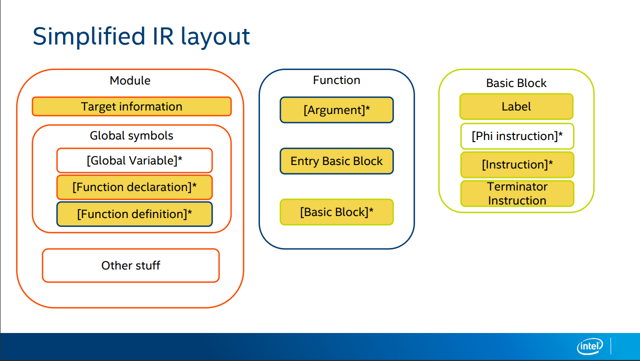
https://llvm.org/devmtg/2019-04/slides/Tutorial-Bridgers-LLVM_IR_tutorial.pdf

Slide 19
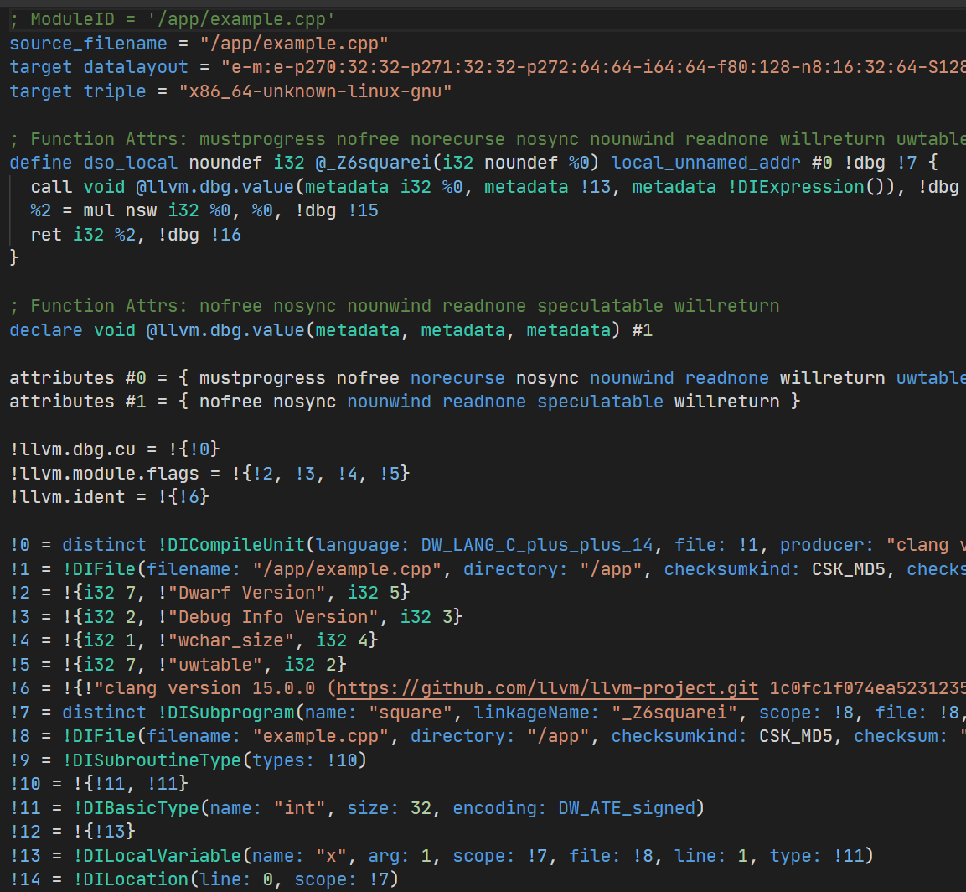
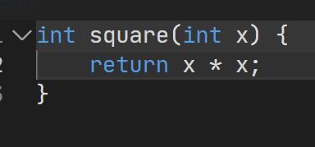

LLVM IR Example
https://godbolt.org/z/sqo4aG7Gd

Slide 20

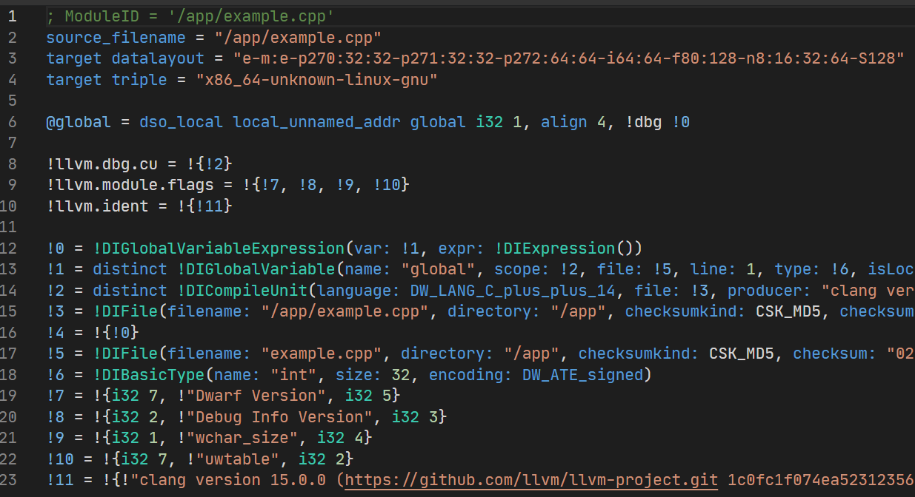
Global variables
https://godbolt.org/z/4hebzfe6s

Slide 21
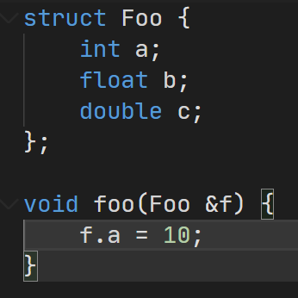
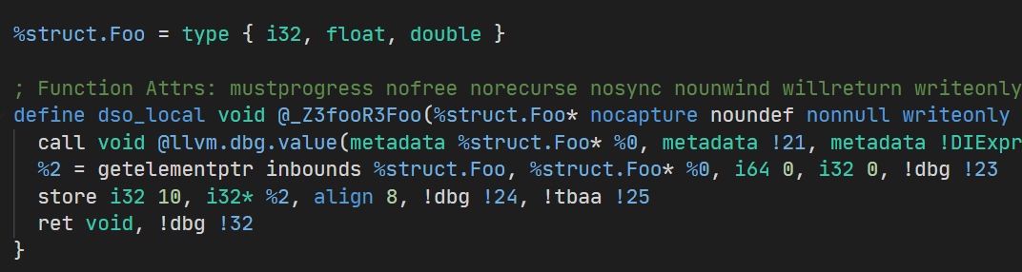
Structures
https://godbolt.org/z/898E47xGf

Slide 22
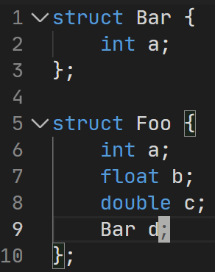
Nested structures
https://godbolt.org/z/jxcvxM57f

Slide 23
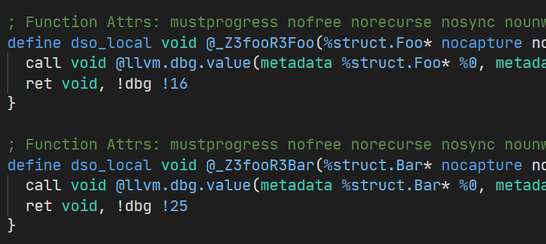
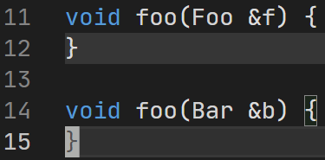
Functions
https://godbolt.org/z/jxcvxM57f

Slide 24
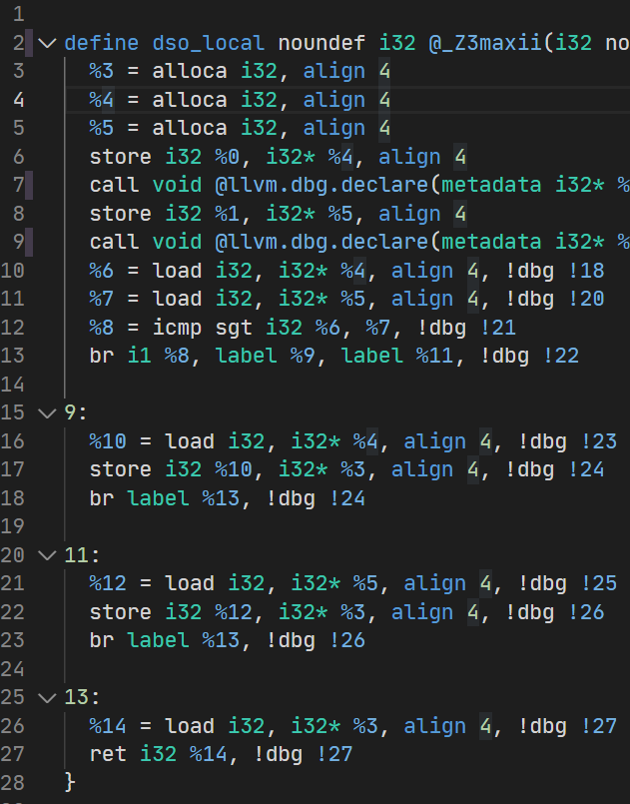
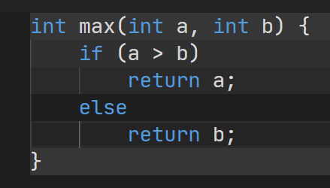
Branches
https://godbolt.org/z/GbqhabvM8

Slide 25
Basic blocks
A basic block is a sequence of consecutive statements in a program.
Execution in a basic block flows linearly (no jumps, branches, or labels except at the start and the end).
Basic block has a single entry and a single exit.

Slide 26
Basic blocks
Basic blocks
Terminators

Slide 27
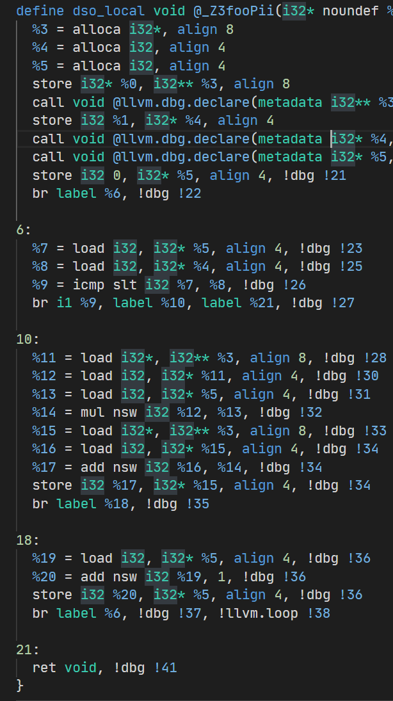
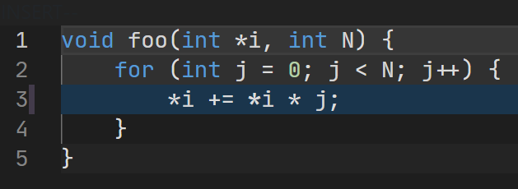
Loops

Slide 28
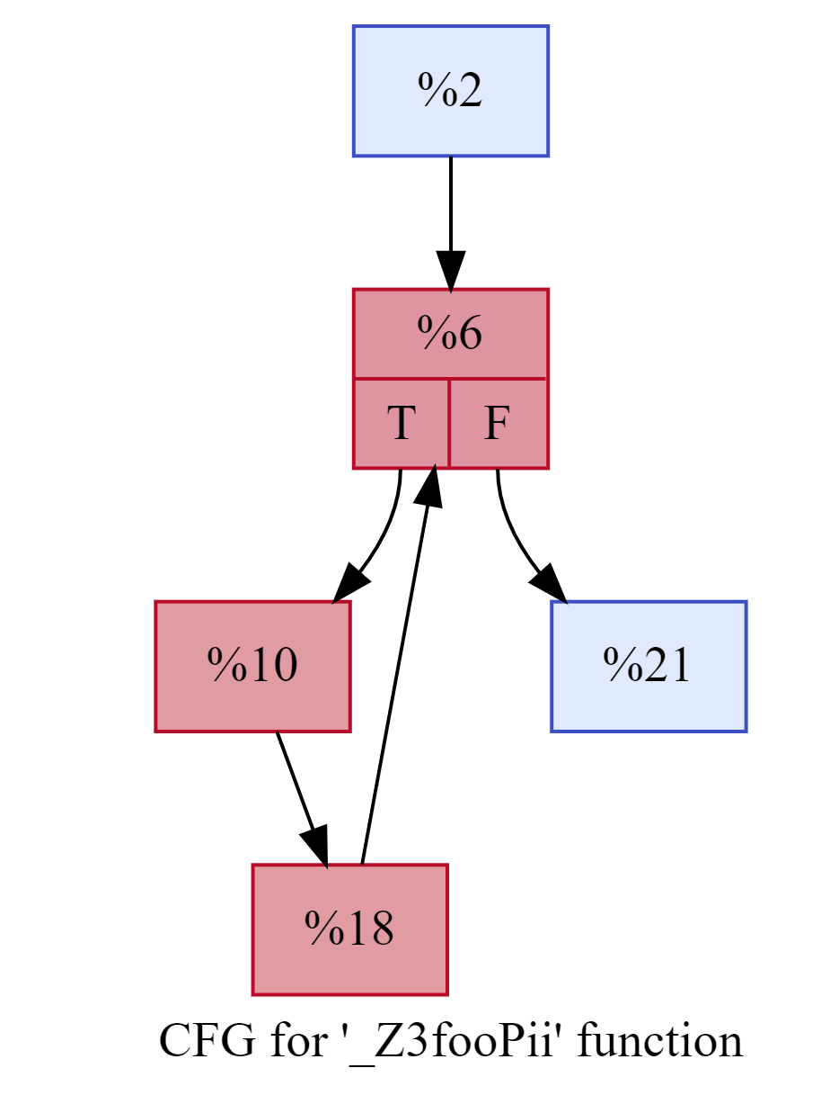
Loops. Control flow graph (CFG)

Slide 29
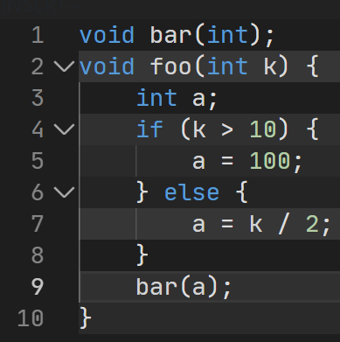
Single assignment
https://godbolt.org/z/x6bf1fxxv

Slide 30
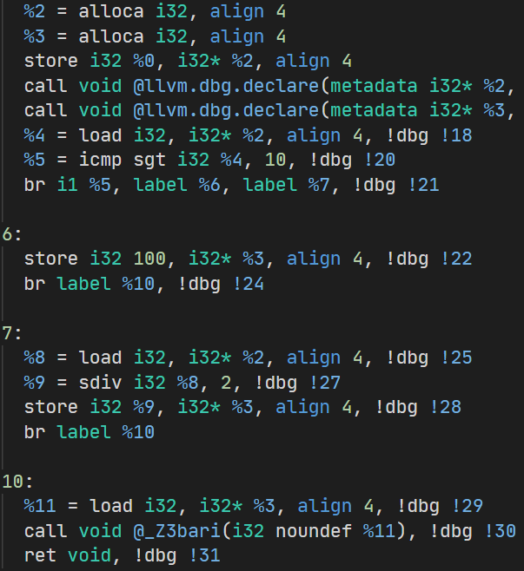
Memory SSA
https://godbolt.org/z/x6bf1fxxv

Slide 31
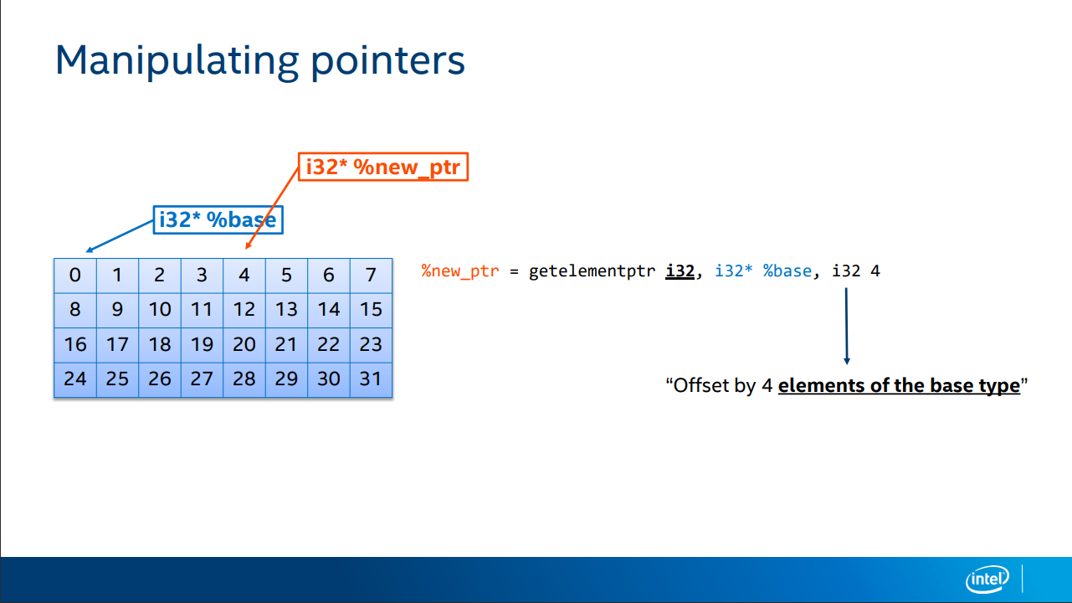
aka GEP

Slide 32
LLVM IR Target Information: triple
Target triple:
Describes the target:
architecture-vendor-operating_system-environment
Example:
x86_64-unknown-linux-gnu
aarch64-apple-darwin
riscv64-unknown-linux-gnu
x86_64 | CPU architecture
unknown | Hardware vendor
linux | Operating system
gnu | ABI/runtime environment
source_filename = "example.c"
target triple = "x86_64-pc-linux-gnu"
target datalayout = "e-m:e-p270:32:32-p271:32:32-p272:64:64-i64:64-f80:128-n8:16:32:64-S128"
define i32 @add(i32 %a, i32 %b) {
entry:
%sum = add i32 %a, %b
ret i32 %sum
}

Slide 33
LLVM IR Target Information: datalayout
The target data layout describes how data is represented in memory for the target platform. It specifies properties such as:
Endianness (big or little endian)
Pointer sizes and alignments
Integer, floating-point, and vector alignments
Native integer widths
Stack alignment
Object-file mangling convention
e-m:e-i64:64-n8:16:32:64-S128
e | Little-endian
E | Big-endian
m:e | ELF symbol mangling
i64:64 | i64 has 64-bit ABI alignment
n8:16:32:64 | Native integer widths
S128 | Natural stack alignment is 128 bits
p:64:64 | 64-bit pointers with 64-bit alignment
source_filename = "example.c"
target triple = "x86_64-pc-linux-gnu"
target datalayout = "e-m:e-p270:32:32-p271:32:32-p272:64:64-i64:64-f80:128-n8:16:32:64-S128"
define i32 @add(i32 %a, i32 %b) {
entry:
%sum = add i32 %a, %b
ret i32 %sum
}

Slide 34
LLVM IR bitcode
Binary Representation of LLVM IR
Use Cases:
distribution (for usage or inspection by other LLVM based tools).
intermediate step in a build process that involves further optimization or cross-compilation.
Just-In-Time (JIT) compilation scenarios.

Slide 35
LLVM IR bitcode: tooling
Emit bitcode:
clang -emit-llvm -c source.c -o source.bc
Converting LLVM IR Bitcode to Human-Readable Format
llvm-dis source.bc -o source.ll
Converting Human-Readable LLVM IR to Bitcode
llvm-as source.ll -o source.bc
Linking Multiple LLVM Bitcode Files
llvm-link file1.bc file2.bc -o combined.bc
Execute LLVM IR bitcode
lli source.bc

Slide 36
Inspecting LLVM IR
Inspecting LLVM IR bitcode from clang
clang++ -emit-llvm -o file.bc file.cpp
Inspecting LLVM IR from clang
clang++ -emit-llvm -o file.ll file.cpp -S
Displaying CFG
opt -analyze -dot-cfg-only

Slide 37
Processing LLVM IR
Run optimizations
opt -O2 source.bc -o optimized.bc
opt -passes=’<pass-pipeline>’ source.bc -o optimized.bc
Compile down to assembler
llc -filetype=obj source.bc -o source.s -S
Compile down to binary (object file)
llc -filetype=obj source.bc -o source.o
Note: both .bc (binary) and .ll (text) are accepted here

Slide 38
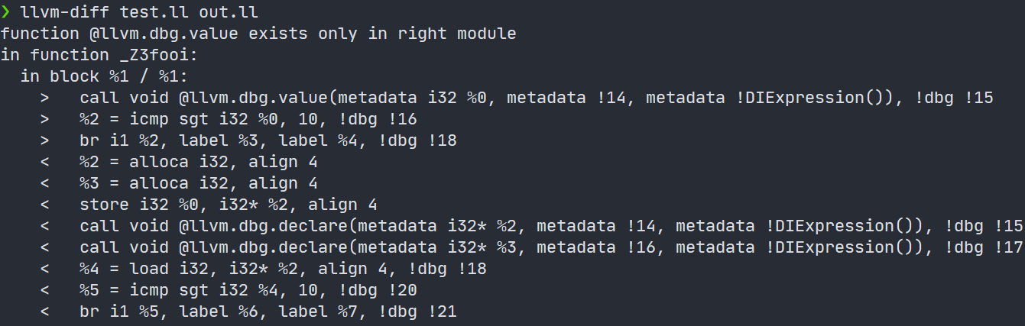
Comparing LLVM modules

Slide 39
Debugging LLVM IR
bugpoint
https://www.llvm.org/docs/CommandGuide/bugpoint.html
llvm-reduce
https://llvm.org/docs/CommandGuide/llvm-reduce.html
https://www.youtube.com/watch?v=n1jDj7J9N8c

Slide 40
Next time…
LLVM Passes
IR Optimizations

Slide 41


Test
https://forms.gle/JbjBRMFNXym6tBQG6
Backup: me@gooddoog.ru

Slide 42

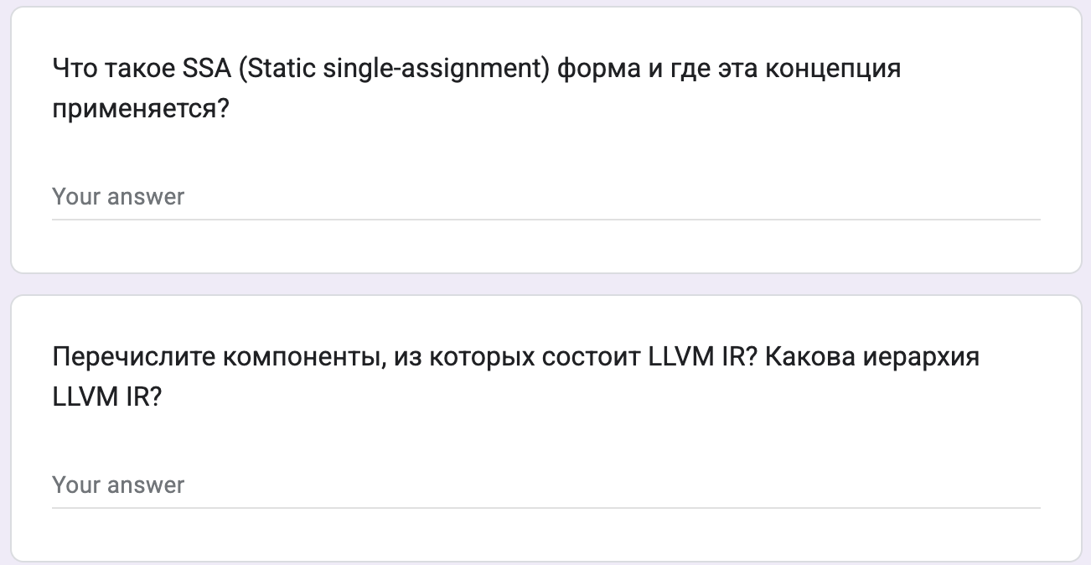
Test
https://forms.gle/KNKvREkPhq3QNHj18
Backup: me@gooddoog.ru

Slide 43

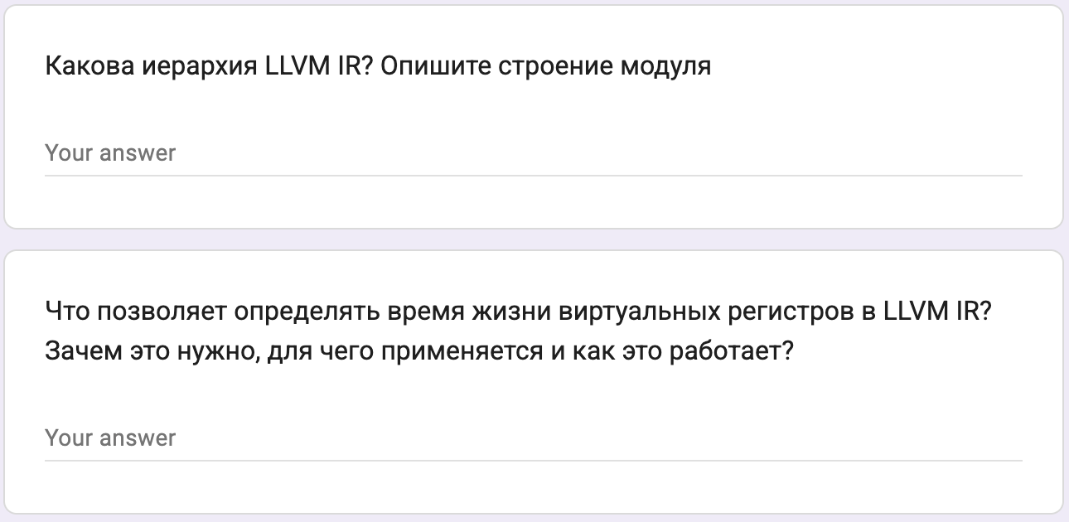
Test
https://forms.gle/6621mVXjavHiQxWB6
Backup: me@gooddoog.ru

Slide 44
Extra materials
Mapping high-level constructs to LLVM IR - https://github.com/f0rki/mapping-high-level-constructs-to-llvm-ir
The often misunderstood GEP (GetElementPtr) instruction - https://www.llvm.org/docs/GetElementPtr.html
LLVM IR Tutorial - Phis, GEPs and other things, oh my! - Vince Bridgers (Intel Corporation), Felipe de Azevedo Piovezan (Intel Corporation) - https://www.youtube.com/watch?v=m8G_S5LwlTo

