Slide 1

Database Administration: The Complete Guide to Practices and Procedures
Chapter 1
Introduction: What is a DBA?

Slide 2
Database 101
Una base de datos es un almacén organizado de datos en el que los datos son accesibles por elementos de datos con nombre. Un DBMS es un software que permite a los usuarios finales o programadores de aplicaciones compartir datos. Proporciona un método sistemático para crear, actualizar, recuperar y almacenar información en una base de datos. Los DBMS también son generalmente responsables de la integridad de los datos, la seguridad de los datos, el control y la optimización del acceso a los datos, la reversión automatizada, el reinicio y la recuperación. En términos simples, puede pensar en una base de datos como una carpeta de archivos. Puede pensar en el archivador que contiene los archivos junto con las etiquetas de archivo como DBMS.
Appendix 1, “Database Concepts and Fundamentals.”
Notes:
This course assumes the student has basic knowledge of relational database technology and DBMS fundamentals. For students needing to review these concepts, please refer to Appendix 1, “Database Concepts and Fundamentals.” This is not a trivial matter. And sometimes the problem is that people think they know more than they actually do.
For example, “What is a database?” I bet most people reading this believe they know the answer to that question. But some (perhaps many) of you would be wrong. SQL Server is not a database, it is a DBMS, or Database Management System. You can use SQL Server to create a database, but SQL Server, in and of itself, is not a database. Same goes for MySQL, Oracle, DB2, and so on.

Slide 3
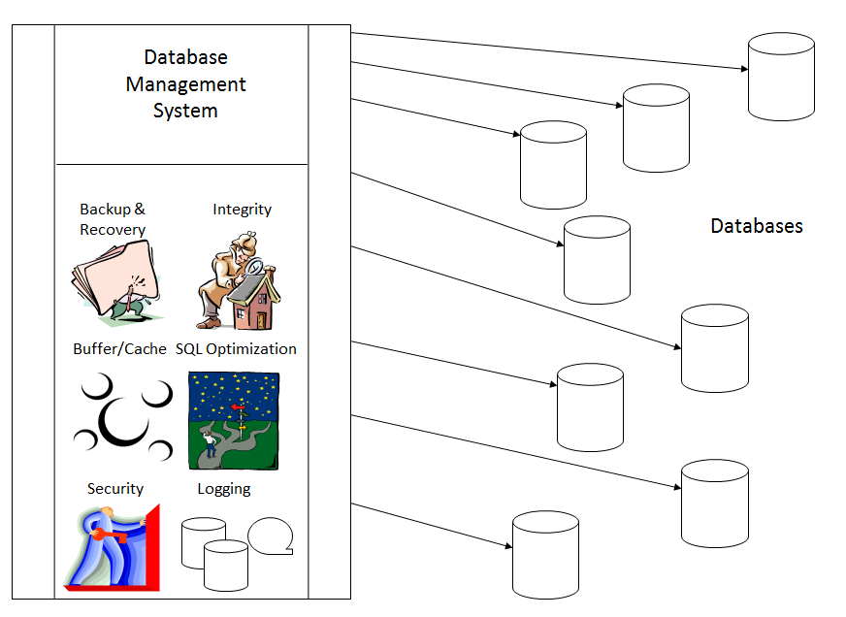
DBMS vs. Database
http://thedatabasesite.com/page100.html

Slide 4
Why Learn Database Administration?
El DBA es responsable de diseñar y mantener las bases de datos de una empresa. Esto coloca al DBA en el centro del negocio. El DBA tiene la oportunidad de aprender sobre muchas facetas de los negocios y cómo las empresas utilizan los datos. Desde un punto de vista tecnológico, el DBA tiene muchas oportunidades para aprender sobre tecnologías nuevas e interesantes a medida que son adoptadas por la organización.

Slide 5
What Makes a Good DBA?
Solucionador de problemas Disfruta de los desafíos Le gusta la tecnología Aprendizaje constante Puede trabajar solo o como parte de un grupo Experiencia como programador

Slide 6
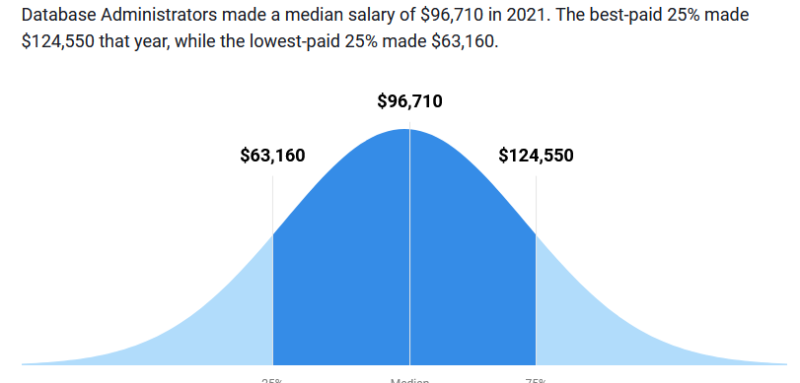
Earn a Good Salary as a DBA
According to a salary study conducted by Global Knowledge and TechRepublic the average DBA salary is $78,468, while their managers average $87,261.
For full-time employees functioning as a DBA, the mean salary ranges in the high $80 thousands
According to the Dice 2010-11 Tech Salary Survey, Oracle experience is requested in more than 15,000 job postings on any given day.
Demand for Oracle skills is up 57% year over year, and the national average salary for technology professionals with experience in Oracle Database is $90,914.
The BLS (May 2010) reports that the median annual wage of database administrators was $73,490 and the mean annual wage was $75,730.
Notes:
The U.S. Bureau of Labor Statistics (BLS) provides additional information about DBA employment and compensation. As of May 2010, the BLS reports that median annual wages of database administrators were $73,490 and the mean annual wage was $75,730. The lowest 10 percent earned less than $41,570, and the highest 10 percent earned more than $115,660. The BLS also breaks down earnings statistics by geographical region so you can use their data to determine expected salary ranges for your specific location of interest.
Keep in mind that the salary figures quoted here are for illustrative purposes only and will vary based on numerous factors. As might be expected, as the years of experience and number of people managed increases, so does the salary. Of course, DBA salaries, as with all salaries, vary by region of the country, as well. In the USA, DBA salaries are likely to be higher in the Northeast and on the West Coast than in other regions. Type of industry is also a factor, with pharmaceuticals paying higher than government entities (for example). When all of these factors are considered the salary figures for DBAs are quite stable and on the higher end of IT individual contributors.

Slide 7
So What’s Not to Like?
Los DBA están bien pagados, son altamente empleables, poseen trabajos desafiantes y es probable que participen en los proyectos más visibles e importantes. ¿Qué es lo que no te gusta? Se espera que los administradores de bases de datos sepan todo, no solo sobre la tecnología de bases de datos, sino sobre cualquier cosa conectada remotamente a ella. Los DBA casi nunca trabajan días simples de 8 horas, sino que trabajan largas jornadas con muchas horas extras, especialmente cuando el rendimiento está sufriendo o los proyectos de desarrollo están retrasados. Según los analistas de la industria, el DBA promedio trabaja más de 50 horas por semana, incluido un promedio de seis horas los fines de semana. Los administradores de bases de datos con frecuencia tienen que trabajar los fines de semana y días festivos para mantener las bases de datos durante las horas de menor actividad.
Notes:
So, DBAs are well-paid, highly employable, possess challenging jobs, and are likely to be engaged in the most visible and important projects. What’s not to like? Well, DBAs are expected to know everything, not just about database technology, but anything remotely connected to it. DBAs almost never work simple 8 hour days, instead working long days with a lot of overtime, especially when performance is suffering or development projects are behind schedule. According to industry analysts, the average DBA works more than 50 hours per week, including an average of six hours on weekends. DBAs frequently have to work on weekends and holidays to maintain databases during off-peak hours.
So, the job of DBA is technically challenging and rewarding, but also potentially one that will exhaust and frustrate you. But don’t let that scare you. The postive aspects of the job far outweigh the negative.

Slide 8
The Management Discipline of Database Administration
Un DBA es el técnico de información responsable de garantizar la funcionalidad operativa continua y la eficiencia de las bases de datos de una organización y las aplicaciones que acceden a esas bases de datos.
http://datatechnologytoday.wordpress.com/2011/02/27/dba-as-a-management-discipline/
Notes:
A DBA is the information technician responsible for ensuring the ongoing operational functionality and efficiency of an organization’s databases and the applications that access those databases. But there is more to it and this class (and the accompanying book) will teach you how to tackle database administration as a management discipline: not art, not magic, but a craft that ensures the ongoing operational functionality and efficiency of an organization’s databases and applications.
Database administration is rarely approached as a management discipline. The term discipline implies a plan, and implementation according to that plan. When database administration is treated as a management discipline, the treatment of data within your organization will improve. It is the difference between being reactive and proactive.

Slide 9

Database, Data, and System Administration
Notes:
Some organizations define separate roles for the business aspects of data and the technical aspects of data. The business aspects of data are aligned with a discipline known as data administration, whereas the more technical aspects are handled by database administration. Not every organization has a data administration function. Indeed, many organizations combine data administration into the database administration role.
Sometimes organizations also split up the technical aspects of data management, with the DBA being responsible for using the DBMS and another role, known as system administration or sysytems programming, being responsible for installing and upgrading the DBMS.
In this section we will differentiate between these three roles.

Slide 10
Database, Data, and System Administration
Algunas organizaciones definen roles separados para los aspectos empresariales de los datos y los aspectos técnicos de los datos.
Los aspectos de negocio de los datos están alineados con una disciplina conocida como administración de datos, mientras que los aspectos más técnicos son manejados por la administración de bases de datos.
No todas las organizaciones tienen una función de administración de datos. De hecho, muchas organizaciones combinan la administración de datos en el rol de administración de bases de datos.
A veces, las organizaciones también dividen los aspectos técnicos de la gestión de datos, con el DBA siendo responsable de usar el DBMS y otro rol, conocido como administración del sistema o programación de sistemas, siendo responsable de instalar y actualizar el DBMS.
Notes:
Some organizations define separate roles for the business aspects of data and the technical aspects of data. The business aspects of data are aligned with a discipline known as data administration, whereas the more technical aspects are handled by database administration. Not every organization has a data administration function. Indeed, many organizations combine data administration into the database administration role.
Sometimes organizations also split up the technical aspects of data management, with the DBA being responsible for using the DBMS and another role, known as system administration or sysytems programming, being responsible for installing and upgrading the DBMS.
In this section we will differentiate between these three roles.

Slide 11
Data Administrator
La AD es responsable de cuestiones tales como: -Identificación y catalogación de los datos requeridos por los usuarios empresariales -Producción de modelos de datos conceptuales y lógicos para representar con precisión la relación entre los elementos de datos para los procesos de negocio -Producción de un modelo de datos empresariales que incorpora todos los datos utilizados por todos los procesos de negocio de la organización -Configuración de directivas de datos para la organización -Identificación de propietarios y administradores de datos -Establecer estándares para el control y uso de datos
Notes:
Data administration (DA) separates the business aspects of data resource management from the technology used to manage data. When the DA function exists in an organization it is more closely aligned with the actual business users of data. The DA group is responsible for understanding the business lexicon and translating it into a logical data model. Referring back to the Application Development Life Cycle, DA would be involved more in the requirements gathering, analysis, and design phases; DBA in the design, development, testing, and operational phases.

Slide 12
Metadata vs. Data
Data
Metadata
Data
Administrator
Database
Administrator
Conceptual
Data
Model
Logical
Data
Model
Physical
Database
http://www.craigsmullins.com/dbta_083.htm
Notes:
At a high level, the DBA manages data and the DA manages metadata. But let’s dig a little deeper.

Slide 13
Data Administrator = Chief Data Officer
No sobre tecnología, sobre datos y su significado en la organización Responsable de reunir a la organización para tratar los datos como el activo corporativo que realmente es Tratar con metadatos y datos Las organizaciones realmente preocupadas por la calidad, integridad y reutilización de los datos invariablemente implementarán y dotarán de personal la función de DA.
Chapter 22 “Metadata Management”
Notes:
The DA can be thought of as the Chief Data Officer of the corporation. The DA position has nothing specifically to do with technology, though. However, in my experience, the DA is never given an executive position. That is actually too bad. Many IT organizations state that they treat data as a corporate asset, but the falsehood of that statement is revealed when you review their actions. Responsibility for data policy is often relegated to technicians who fail to concentrate on the non-technical, business aspects of data management. Technicians do a good job of ensuring availability, performance and recoverability, but are not usually capable of ensuring data quality and setting corporate policies.
In fact, data is rarely treated as a true corporate asset. Think about the assets that every company has in common: capital, human resources, facilities, and materials. Each of these assets is modeled: chart of accounts, organization charts and reporting hierarchies, building blueprints and office layouts, and bills of material. Each is tracked and protected. Professional auditors are employed to ensure that no discrepancies exist in our accounting of the assets. Can we say the same thing about data in most organizations?

Slide 14
System Administrator
Instalación y configuración de recursos informáticos Tecnólogo puro Sin responsabilidad por el diseño y soporte de la base de datos Soporte de infraestructura A veces llamado programador de sistemas
Notes:
Some organizations, once again the larger ones, also have a system administration (SA) or systems programming role that impacts DBMS implementation and operations. When the SA role exists separately from the DBA role, it is responsible for the installation and setup of the DBMS. The SA typically has no responsibility for database design and support. Instead, the DBA is responsible for the databases and the SA is responsible for DBMS installation, modification, and support.
Furthermore, the SA role ensures that the IT infrastructure is implemented such that the DBMS is configured to work with other enabling system software. The SA may need to work with other technicians to configure transaction processors, message queueing software, networking protocols, and operating system parameters to enable the DBMS to operate effectively. The SA ensures that the IT infrastructure is operational for database development by setting up the DBMS appropriately, applying on-going maintenance from the DBMS vendor, and coordinating migration to new DBMS releases and versions.

Slide 15
Database Administrator
Funciona con DA y SA Acepta modelos lógicos de DA para implementarlos como bases de datos físicas Trabaja con SA para programar e implementar software del sistema (por ejemplo, DBMS) y para ajustar el entorno adecuadamente
Notes:
The DBA is the conduit for communication between the DA team and the technicians and application programming staff. Of course, the bulk of the DBA’s job is the on-going support of the databases created from the physical design and the management of the applications that access those databases.

Slide 16
IT Infrastructure
System
Administrator
DBA
(if no SA)
Data & Metadata Policy
Data
Administrator
Database
Administrator
(if no DA)
Analysis
Design
Database
Administrator
Development
Testing
Implementation (Databases, applications)
Maintenance and Tuning

Slide 17
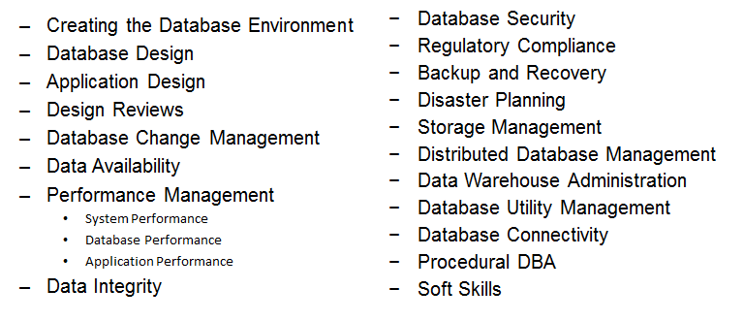
DBA Tasks
Estas son las tareas de DBA necesarias para garantizar un entorno de base de datos óptimo para aplicaciones y usuarios
Notes:
We will not go over these tasks in any detail today as the remainder of the course will cover each of them in-depth.

