Slide 1
Parallel DCEL Construction for map overlay operations support

Slide 2
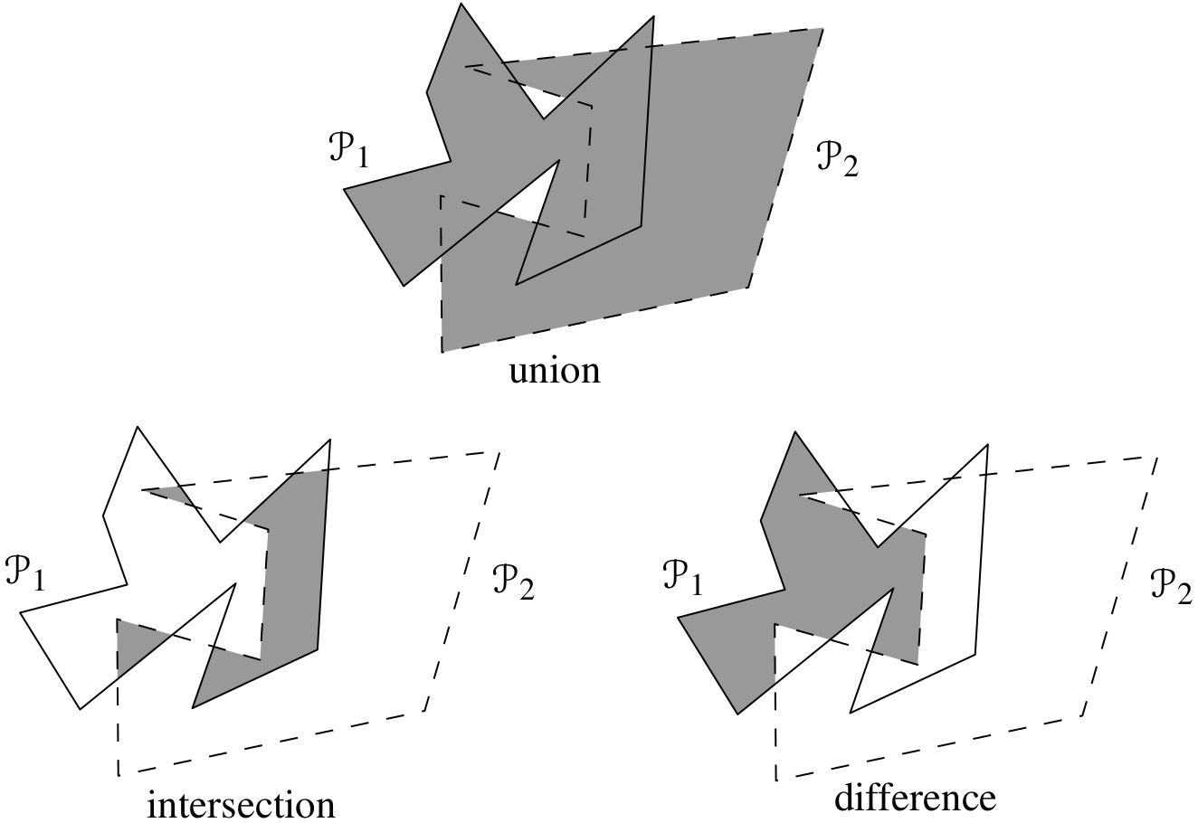
Problem definition
Map overlay operations such as intersection, union or symmetric difference is a well-know problem with diverse applications in Cartography, GIS and Computer Graphics.
The input are two independent polygon layers and the result is a new polygon layer which carries new information not possible to infer from the original layers.
(de Berg et al, 2007)

Slide 3
Motivation
The rise of Big (spatial) data brings us access to a huge amount of spatio-temporal data.
Several applications (i.e. emergency response) demand real-time response.
Current solutions do not scale appropriately and/or evaluate different overlay operations from scratch.
Intermediate spatial data structures, like DCEL (Double Connected Edge List), allow linear execution time of overlay operations once they are constructed.
It is expected that a distributed version of the DCEL could speed up the execution of overlay operations over large spatial datasets.

Slide 4
Challenges
Traditional DCEL definitions expect it fits in main memory. With the increasing amount of data we need to distribute the execution.
The partition strategy must preserve the topological properties of the DCEL along all the partitions.
It has to deal with particularities such as polygons with holes and multi-polygons.
The overlay operations can be run at local level but the results from different partitions must be merged back accordingly.

Slide 5
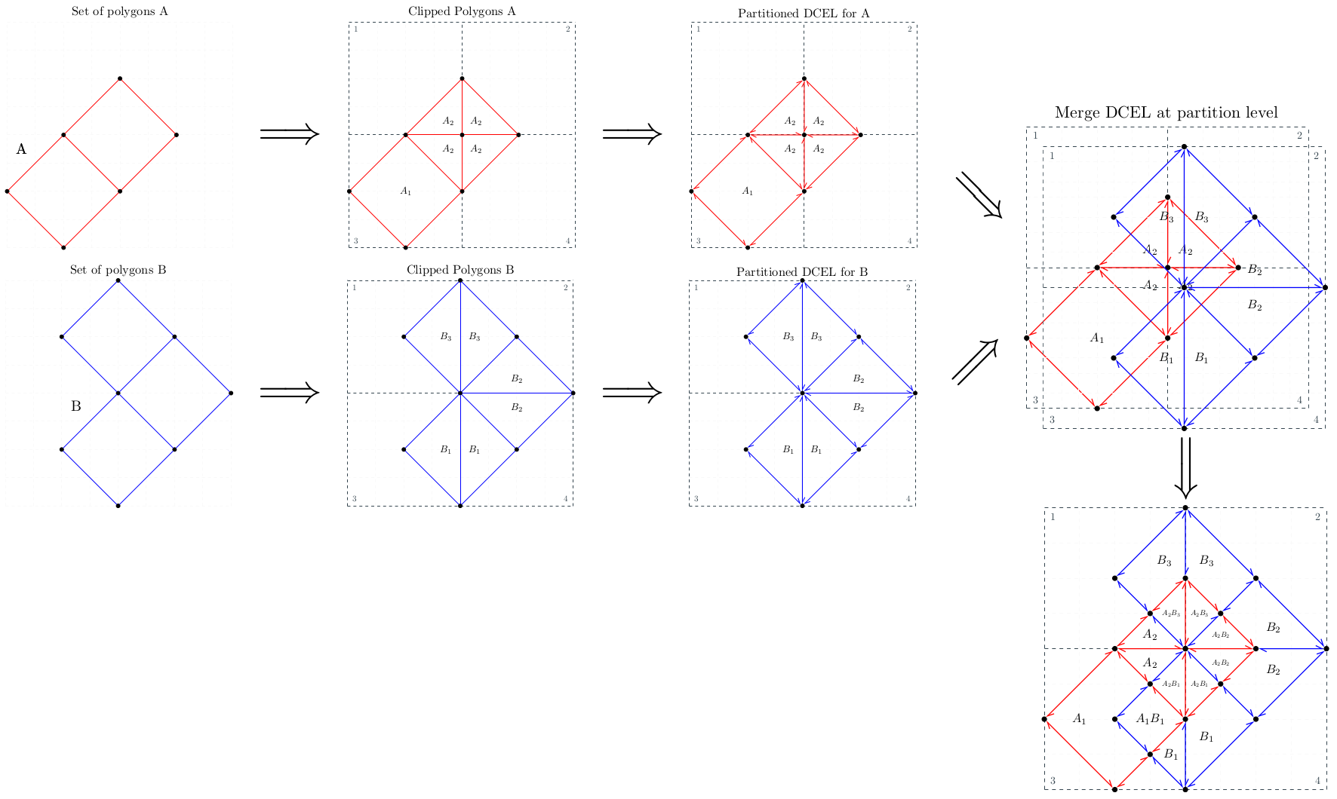
Our technique

Slide 6
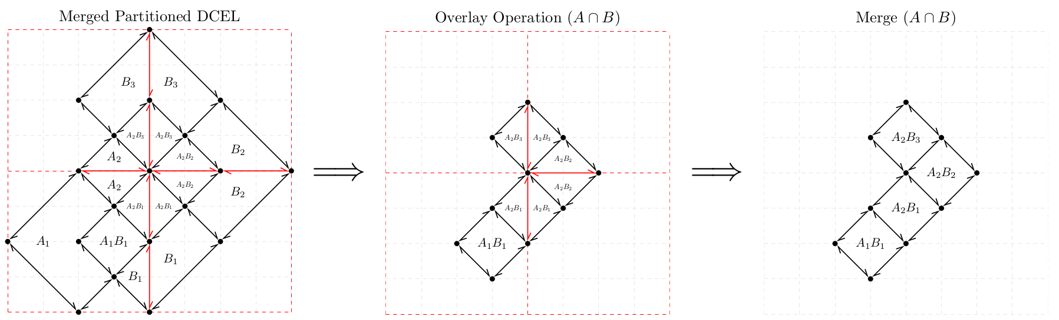
Our technique

Slide 7
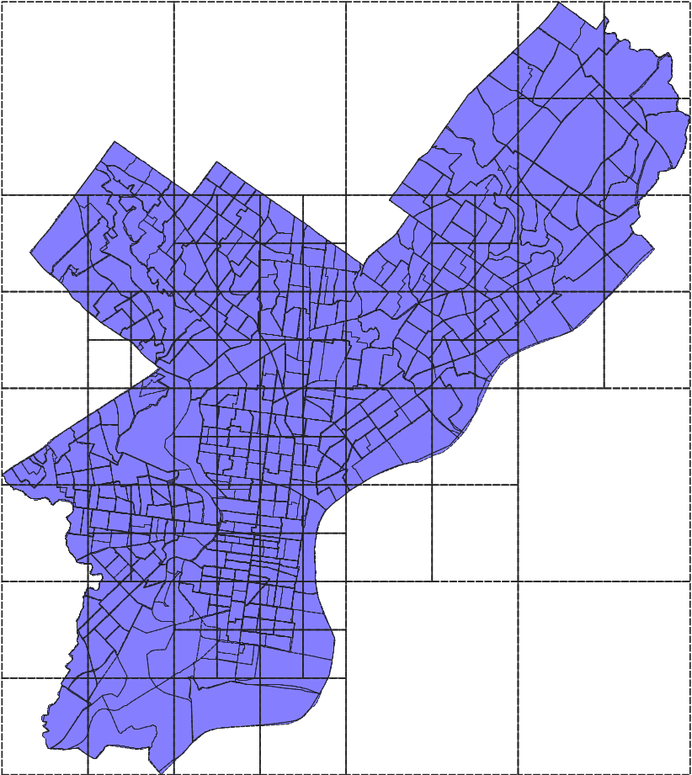
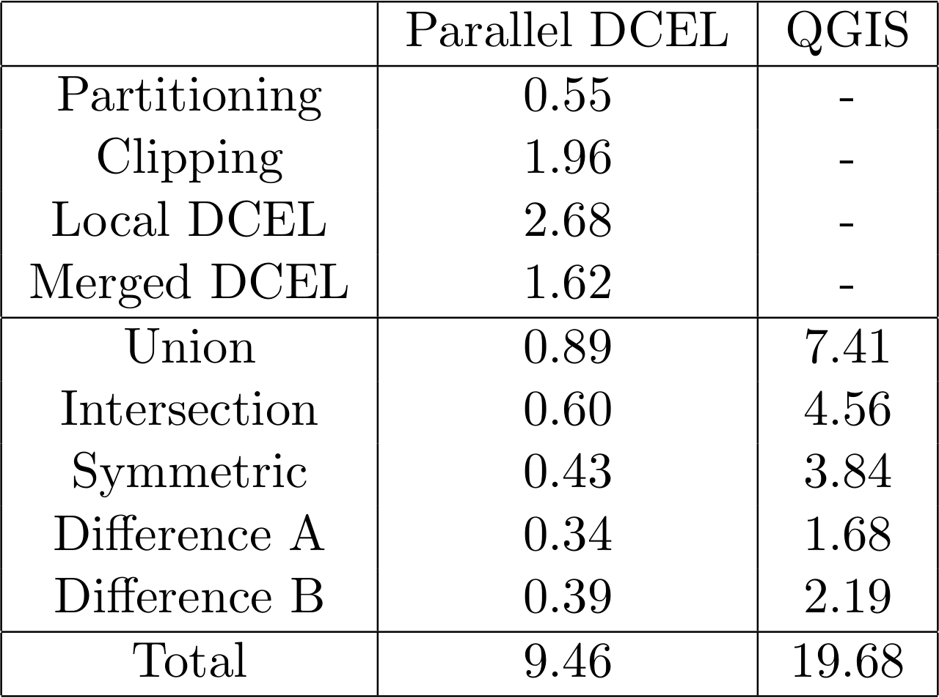
Initial results

