Slide 1


Medusa3D: The Watchful Eye Freezing Illegitimate Users in Virtual Reality Interactions
Aochen Jiao*, Di Duan*, and Weitao Xu City University of Hong Kong
MobileHCI 2024 | Melbourne

Slide 2
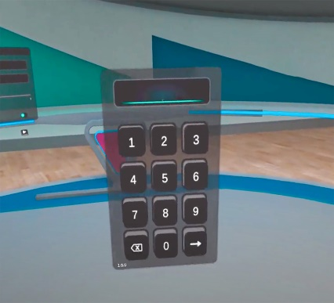
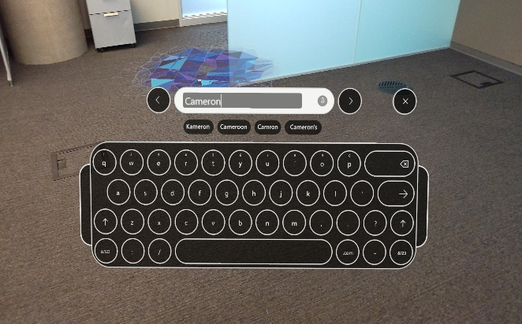
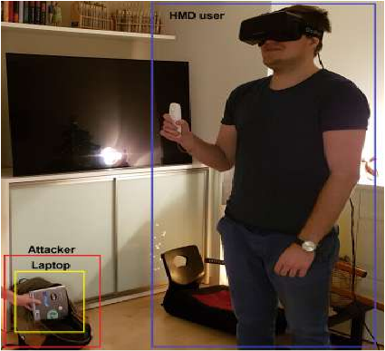

Background
PIN / Password in VR
Shoulder-surfing
Attack

Slide 3
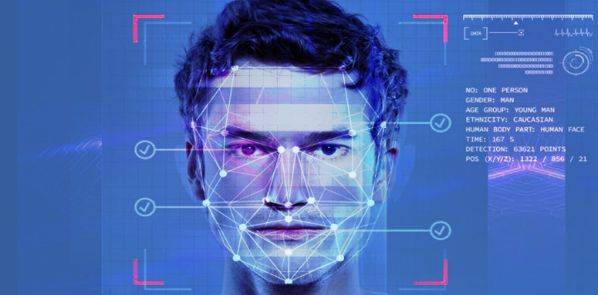

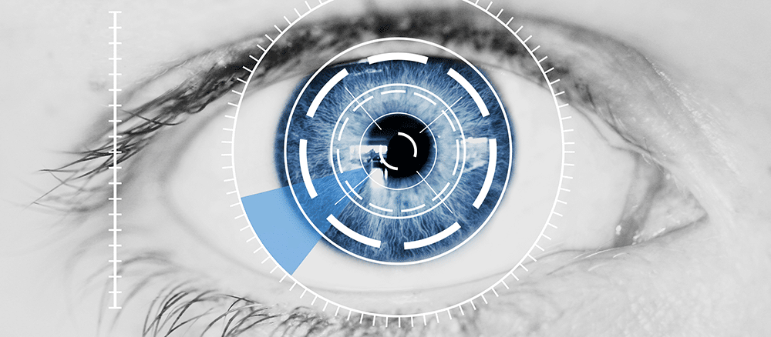
Background
Static Biometric
Vulnerable to data leakage and replay attack
Once stolen -> unrecoverable

Slide 4

Background
Active Biometric
Challenge A
Response A
Challenge B
Response B
Response = H (Challenge)
Challenge-Response Method
Biometric is human’s response pattern to challenge,
but not specific challenge or response.

Slide 5
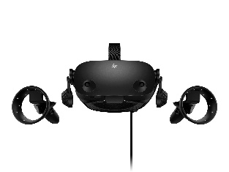
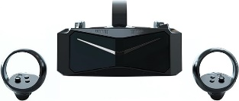
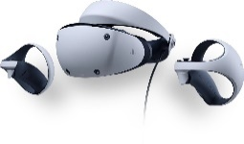
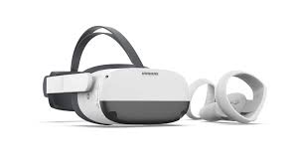
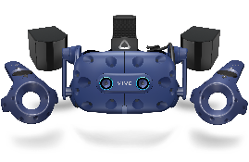
Motivation
Reflexive eye movement is an activity that is driven by visual stimulation but does not require volitional control.
- R John Leigh and David S Zee. The neurology of eye movements. Contemporary Neurology
VR headsets that already include integrated eye tracker
Can we use reflexive eye responses as biometric?
Primax Crystal
PlayStation VR2
HP Reverb G2
Pico Neo 3 Pro Eye
HTC Vive Pro Eye

Slide 6
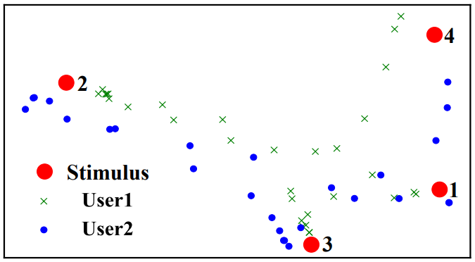
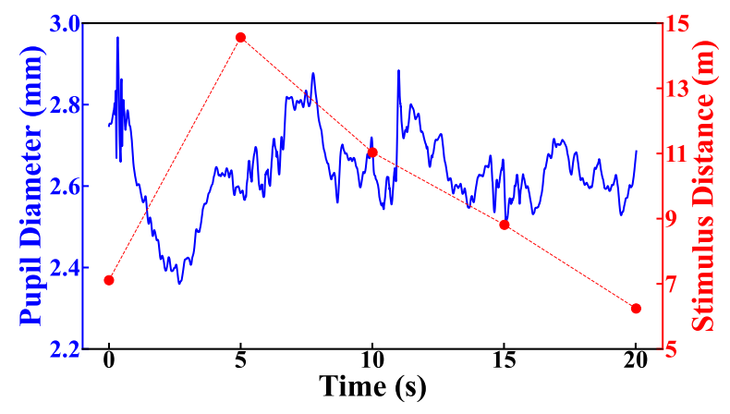
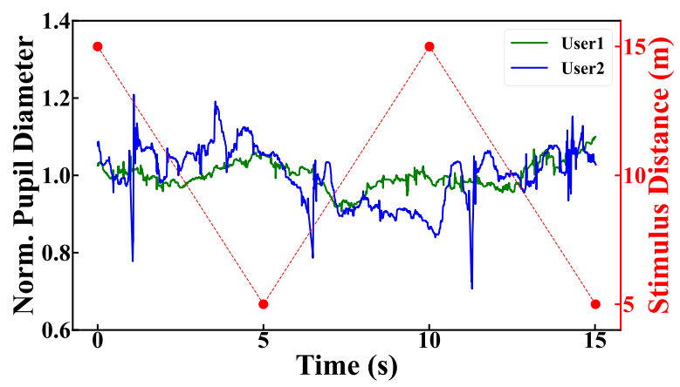
Preliminary Study
What eye responses are reflexive?
Reflexive saccade
Pupil diameter change
How to elicit the reflexive responses?
When a noticeable change occurs in the field of view
When focused object changes its depth

Slide 7
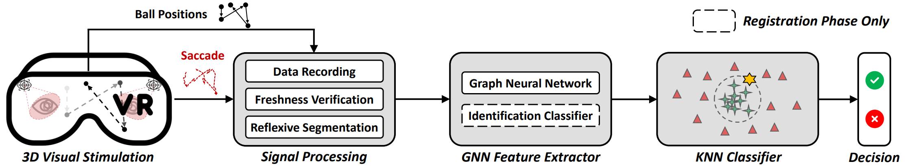
System Design
Overview
Visual stimulation
Signal processing
Feature extraction & Authentication

Slide 8
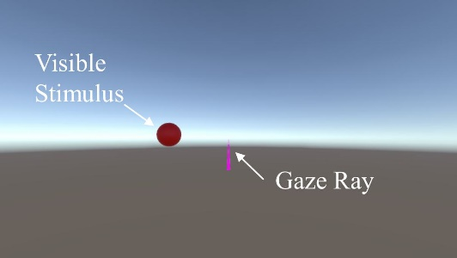
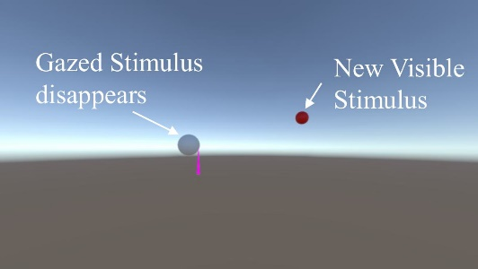
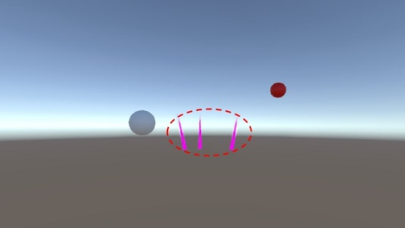
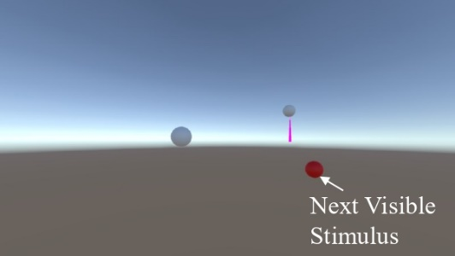
System Design
Visual Stimulation Design
Salient change: elicit reflexive saccades.
Variable depth: elicit pupil diameter changes.
Unpredictability: exclude the interference from memory.
(a) Stim. appears in FOV
(b) Gaze intersects stim.
(c) Saccades catch stim.
(d) New stim. is gazed.

Slide 9
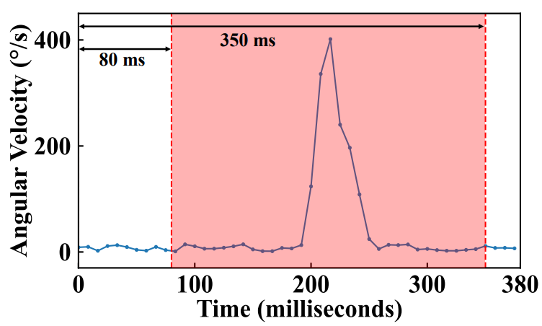
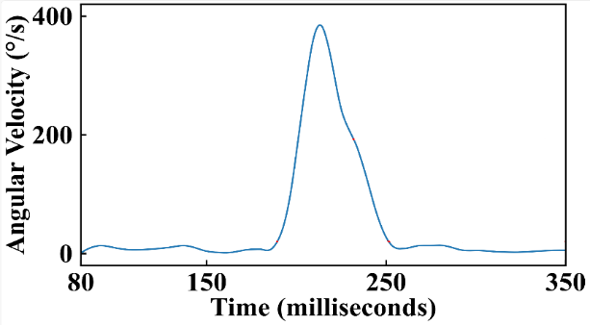
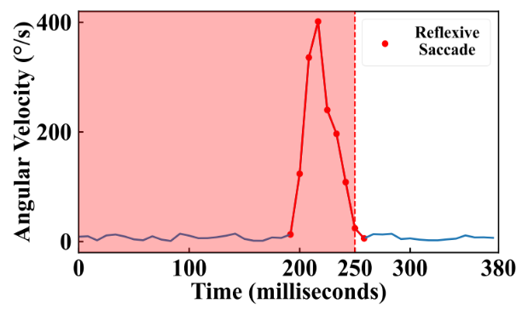
System Design
Signal Processing
Reflexive saccades segmentation
Determine the time interval reflexive saccades may occur.
Employ iteration method to adaptively search the threshold.
Verify the reflexivity of saccades extracted.

Slide 10
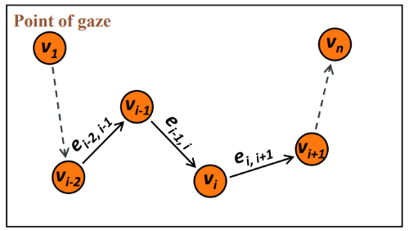
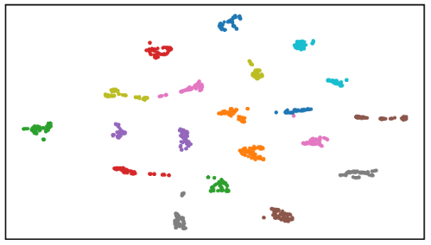
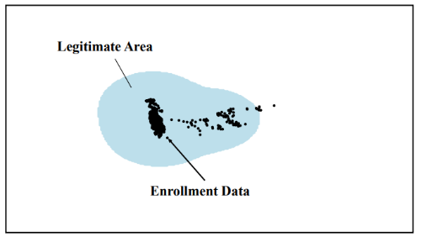
System Design
Feature Extraction & Authentication
Graph design
We embed the spatial information of reflexive saccades into a graph.
GNN network design
We design a graph-oriented network that can classify the users’ feature
KNN classifier
With the feature extracted, a user-specific KNN model is selected that can package legitimate user samples.

Slide 11
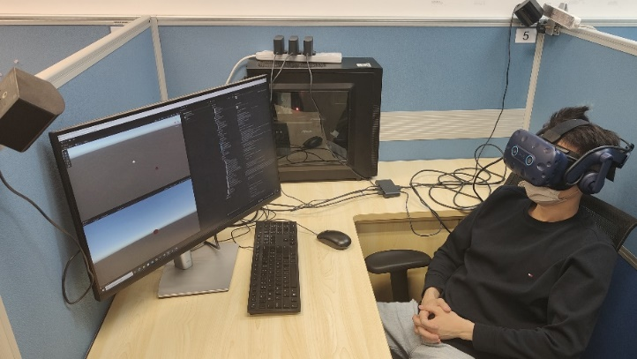
Evaluation
Set-up
Device:
HTC VIVE Pro Eye
Threat model:
Zero-effort attack
Replay attack
Mimicry attack
Participants:
25 (20 users + 5 attackers)
Various in demography and background
Evaluation metrics:
FAR: False Acceptance Rate
FRR: False Reject Rate

Slide 12
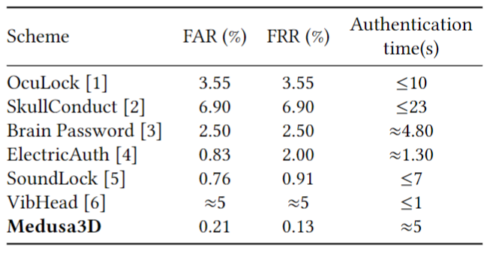
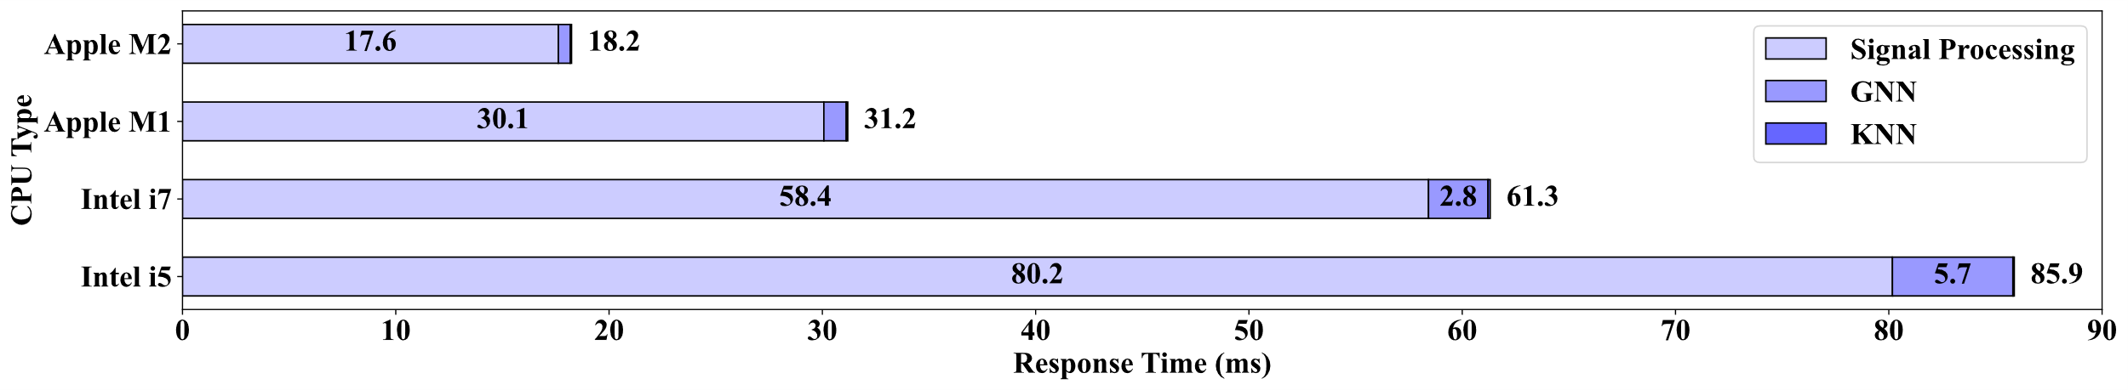
Evaluation
Overall Performance
Overall 0.21% FAR and 0.13% FRR
Time required for authentication is about 5 s.
[1] Luo et al. 2020. OcuLock. NDSS 2020.
[2] Schneegass et al. 2016. SkullConduct. CHI 2016.
[3] Lin et al. 2018. Brain Password. MobiSys 2018.
[4] Chen et al. 2021. ElectricAuth. CHI 2021.
[5] Zhu et al. 2023. SoundLock. NDSS 2023.
[6] Li et al. 2024. Vibhead. TOSN 2024.

Slide 13
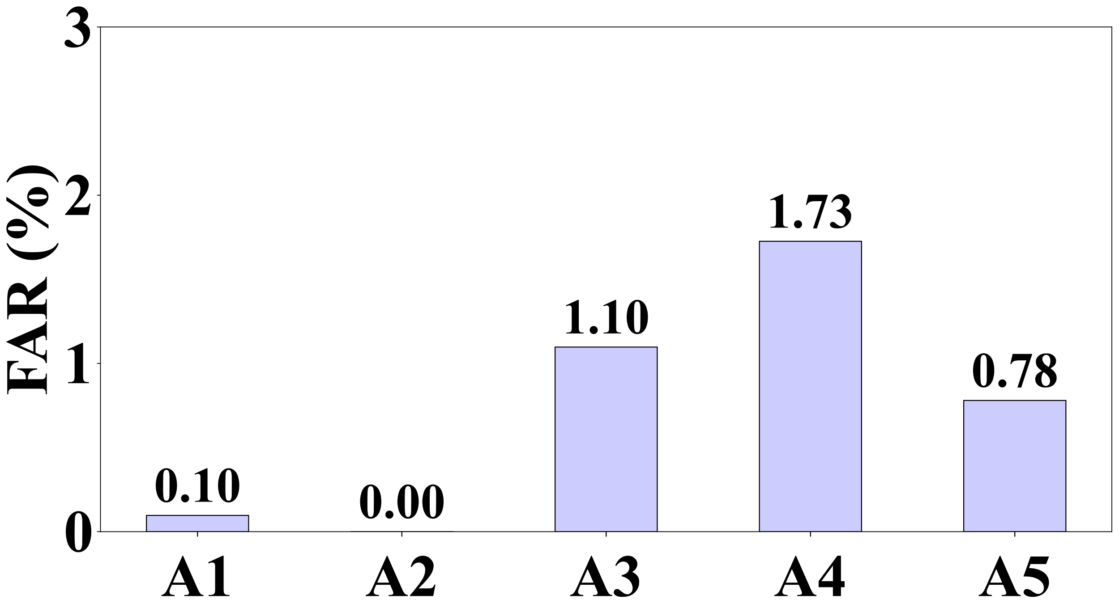
Evaluation
Zero-effort attack
Attackers attempt to unlock the device with their own biometrics as credentials
FAR ~ 1%
Replay attack
Attackers replay a pre-recorded eye movement response.
Challenge is always new. Pre-recorded one cannot match the new challenge.
Mimicry attack
Attackers acquire and imitate the eye movement patterns
Visual stimuli are random and new every time.
Imitation is voluntary and will be excluded from the reflexive part.

Slide 14
Conclusion
We propose Medusa3D, a challenge-response authentication system for VR based on reflexive eye responses.
Medusa3D can utilize active biometric for authentication on users while keep safe against attackers.
Future work will primarily focus on enhancing the system's robustness for long-term use.

Slide 15

Thanks for your attention!
Q&A
I am actively looking for Ph.D. position starting 2025. Feel free to contact me if you have any relevant information.
Email: aochen.jiao@cityu.edu.hk
Personal Website

