Slide 1

Data Mining
Presentation
TERM Project 2 : Applying Association Rules and Comparing them
2020. 07. 02. THU. 09:00~ in KISTI
Data Mining, Prof. Min ho, Lee
02021016 UST-ETRI ICT, Joon Gyu, Maeng

Slide 2
INDEX
Data Analysis
&
preparing
Explanation
FP-Growth
Algorithm
Comparison
Apriori
FP Growth
Problem
Definition
Conclusion

Slide 3
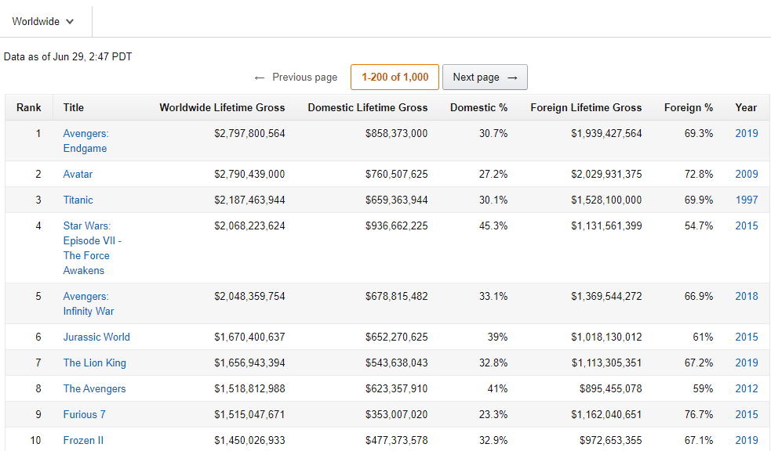
Problem Def.
World Wide Box office TOP 10

Slide 4

Problem Def.
My Task : What genre of movies are successful on average?

Slide 5
Problem Def.
Assumptions for this task
According to the world wide box office, provocative movies are more successful than non-provocative movies.
User ratings are good measure of box office success.
Users are not film critic so that they rated the movies subjectively.

Slide 6
Data Analysis & Preparing
MovieLens?
Rating data sets from the MovieLens website.
It contains 25,000,095 ratings and 1,093,360 tags across 62,423 movies.
These data were created by 162,541 users between 1995. 1. 9. ~ 2019. 11. 21.
All selected users had rated at least 20 movies
Columns
UserId : User Id of rating users
MovieId : movie Id
Rating : Users rate movies between 0.5 ~ 5.0
Tag : Tags left by User
Genome-scores : relevance between tags(1,128) and movie

Slide 7
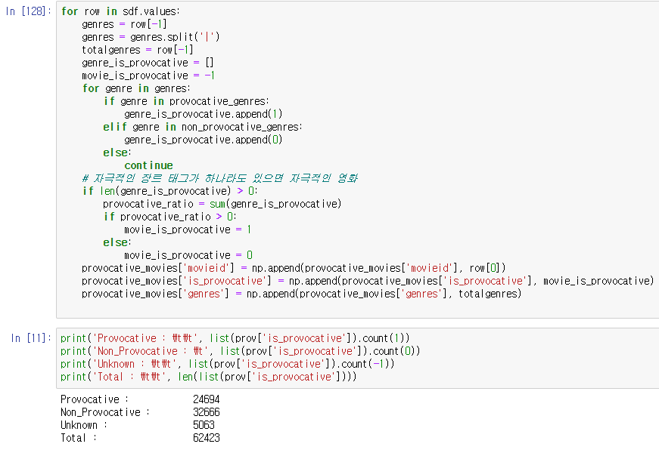
Data Analysis & Preparing
My Task : What genre of movies are successful on average?
According to the World Wide Box office TOP 10, provocative movies achieves great success.
So, ratings are separated by provocative genres and non-provocative genres
Provocative genres : 'Action', 'Adventure', 'Crime', 'Film-Noir', 'Horror', 'Mystery', 'Thriller', 'War', 'Western’
Non-provocative genres : 'Animation', 'Children', 'Comedy', 'Documentary', 'Drama', 'Fantasy', 'Musical', 'Romance', 'Sci-Fi’
which columns I need for solving task?
UserId, MovieId, Genres, Ratings
Merging ‘ratings.csv’ and ‘movies.csv’
Then, classify the movies provocative and non-provocative

Slide 8
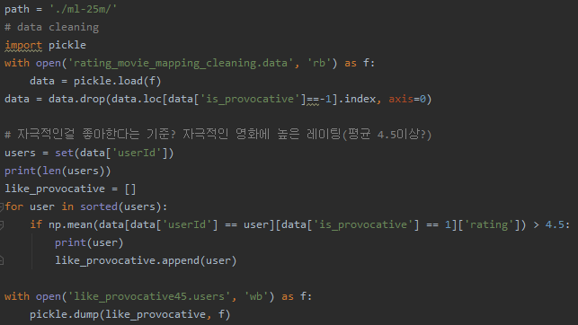
Data Analysis & Preparing
My Task : What genre of movies are successful on average?
If the provocative movies maniacs rate a movie rating highly, the movie might earn the success.
First, extracting the users who like provocative movies.(maniacs)
→ Check the Average of provocative movies rating more than 4.5
419,069 rows X 5 columns were obtained from 25,000,095 rows.
These mean provocative movies maniac’s ratings table.
The number of provocative movies maniac is 5,657.

Slide 9
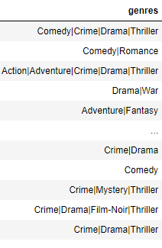
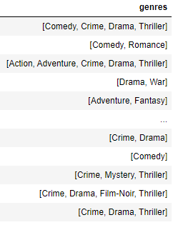
Data Analysis & Preparing
My Task : What genre of movies are successful on average?
Then, the values of ‘Genres’ Column are ‘string’ type values.
It is not suitable for conditioning so that, convert them to the list values.

Slide 10
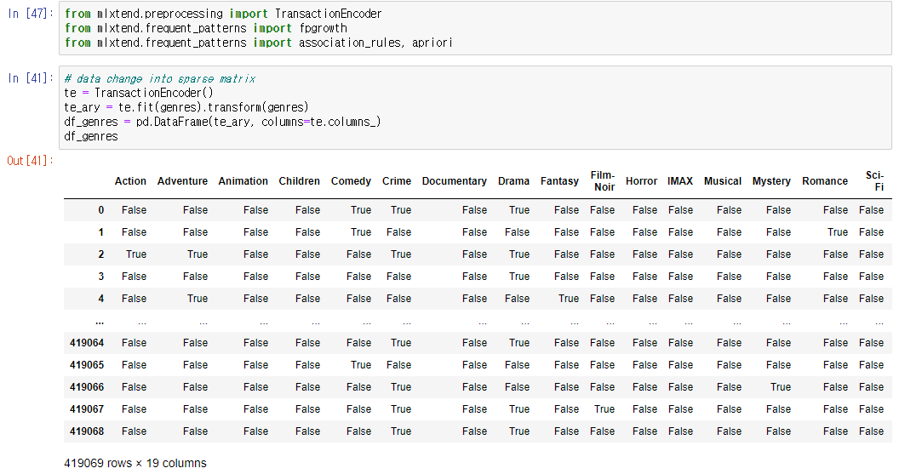
Data Analysis & Preparing
My Task : What genre of movies are successful on average?
Finally, get the sparse matrix of ‘genres’ column for applying to apriori and fp-growth

Slide 11

Explanation FP-Growth Algorithm
The library that I used is in ‘mlxtend’.
This is open source library for machine learning.
Apriori algorithm and FP-growth algorithm are implemented in this package and easy to use.
Source code : https://github.com/rasbt/mlxtend

Slide 12
Explanation FP-Growth Algorithm
Apriori algorithm and FP-growth algorithm are implemented in this package and easy to use.
Implementation of these algorithms are based on the papers [1] Han et al, [2] Agrawal et al.
In [1], the FP-Growth algorithm’s efficiency is achieved with three techniques:
A large dataset is compressed into a condensed, smaller data structure, to avoid costly, repeated dataset scans.
Avoid the costly generation of a large number of candidate sets.
Decompose the mining task into a set of smaller tasks for dramatically reducing the search space.
The implementation of this FP-growth algorithm is the same as the one in our class.
- The developer of ‘mlxtend’ package said that FP-Growth algorithm is about 5 times faster than apriori on toy dataset.
And, robust especially in dense datasets
- When support is very low, FP-Tree becomes bushy, the overhead of links makes the size of FP-Tree large.
it can be resulted in poor performance. To avoid that, we should construct projected databases.
then, we could handle very large and/or sparse database.
Source code : https://github.com/rasbt/mlxtend

Slide 13

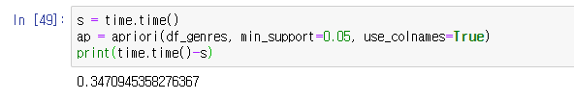
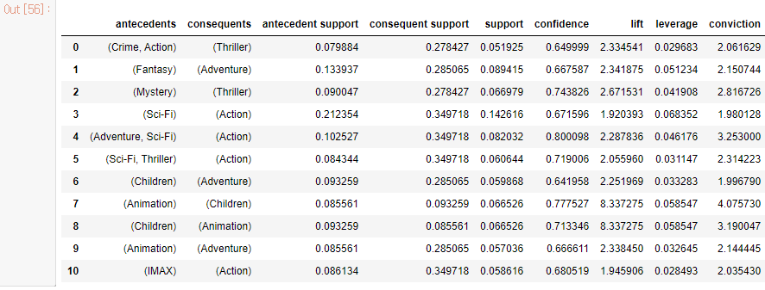
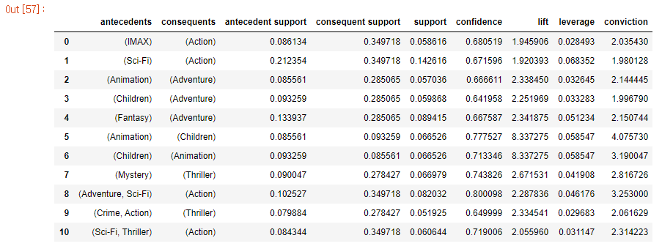
Comparison Apriori & FP Growth
FP-Growth
Apriori

Slide 14
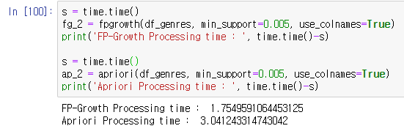
Comparison Apriori & FP Growth
Why Apriori algorithm is faster than FP-Growth?
FP-Growth is usually faster than apriori. But there is no guarantee that either is always better than the other.
if there didn’t had enough data conditioned to min_support, it is possible that apriori be faster than FP-growth
(ref : https://stackoverflow.com/questions/56651242/why-does-apriori-run-faster-than-fp-growth-in-this-implementation)
If the value of min_support is lower than previous pattern discovery…

Slide 15
Conclusion
Association rules analysis
According to the Blue box, the measure ‘lift’ is highest on the table.
→ it means that most of children movies are animation genres and also in the reverse. Depending on each other..
According to the Red box, the measure ‘conviction’ is highest on the table except for children & animation
and ‘confidence’ is highest.
→ a high conviction value means that consequent is highly depending on the antecedent.
3) According to the Green box, the support is highest on the table.

Slide 16
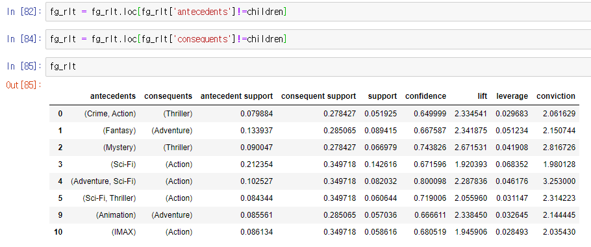
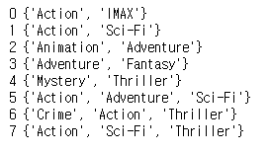
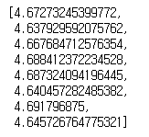
Conclusion
My Task : What genre of movies are successful on average?
First of all, remove the ‘children’ genre movies on the table, because it must be not provocative movie.
Second, get the average ratings about each genre on the table

Slide 17
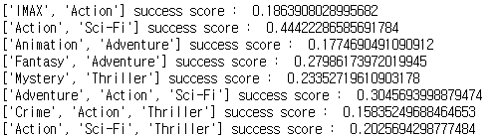
Conclusion
My Task : What genre of movies are successful on average?
Finally, calculate success score. Simply, average rating * support * confidence
The first place is ‘Action’, ‘Sci-Fi’ movies → highest support
Most of Successful Action movies also have ‘Sci-Fi’ genre !!
When making an Action movie, it is recommended to add ‘Sci-Fi’ genre.
The second place is ‘Adventure’, ‘Action’, ‘Sci-Fi’ movies → highest confidence
Most of Successful Adventure movies also have ‘Action’, ‘Sci-Fi’ genres !!
When making an Adventure movie, it is recommended to add ‘Action’, ‘Sci-Fi’ genres.
These rules have higher probability for success than other genres.

Slide 18
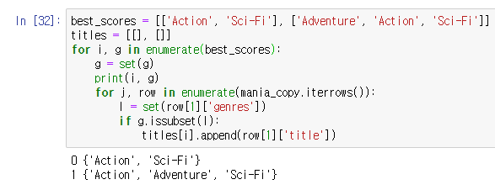
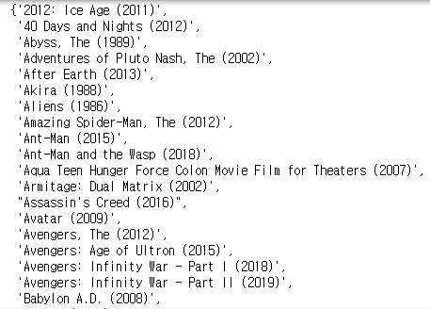
Conclusion
My Task : What genre of movies are successful on average?
What is example of these genres?
→ 607 movies
→ 239 movies

Slide 19





Conclusion
My Task : What genre of movies are successful on average?
What is example of these genres?

Slide 20
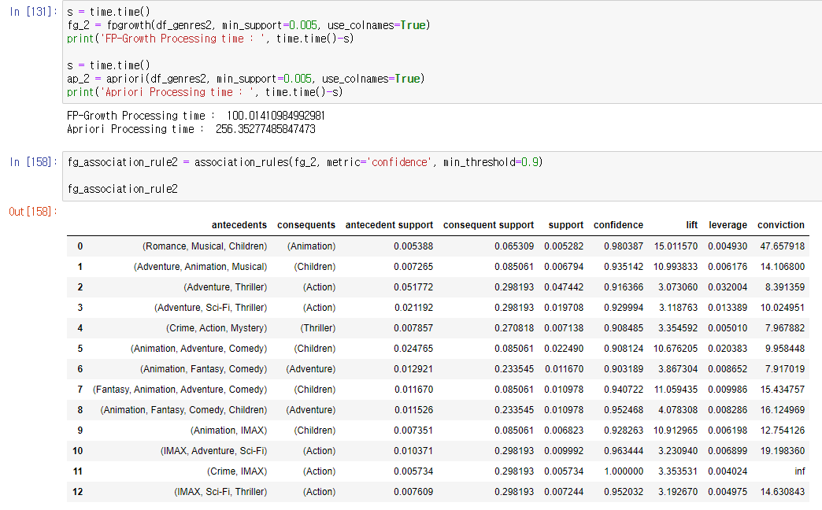
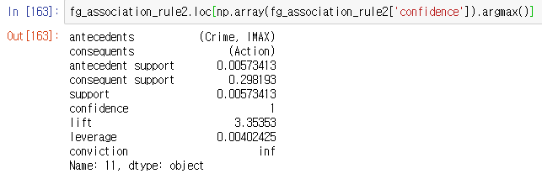
Conclusion
Bonus : pattern discovery on whole dataset(rows:24,973,468)

Slide 21
Q&A

