Slide 1



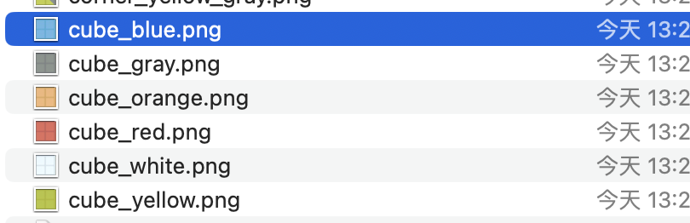




规则块的定义：砖块、旋转、对称
<tile name="cube_gray" symmetry="X" weight="1.0"/>
<tile name="cube_blue" symmetry="X" weight="1.0"/>
<tile name="cube_yellow" symmetry="X" weight="0.5"/>
0 1 2 3
权重比例
X
X
砖块对应的对称性
砖块对应图片的名称
对称性的字母和他们的图案对应
比如对于一个L对称的砖块来说，这两种组合是等价的，所以只需要写一种邻居规则来表示
X
L
L
T
T
T
T
T
T
<neighbor left="corner_blue_gray 1" right="cube_blue "/>
旋转序号 0到3分别对应逆时针0度、90度、180度、270度

Slide 2
<neighbor left="cube_gray" right="cube_gray"/> <neighbor left="cube_gray" right="cube_blue"/> <neighbor left="cube_blue" right="cube_blue"/>
<neighbor left="corner_blue_gray 1" right="corner_blue_gray "/>
<neighbor left="corner_blue_gray" right="cube_gray”weight=0.4/>
<neighbor left="ramp_blue 3" right="cube_blue "/>
T
T
T
T
<neighbor left="ramp_blue" right="cube_gray "/>
T
T
T
T
<neighbor left="corner_blue_gray 1" right="cube_blue "/>
T
T
T
T
<neighbor left="ramp_blue 1" right="cube_gray "/>
<neighbor left="ramp_blue" right="cube_blue "/>
T
T
T
T
T
T
T
T
<neighbor left="ramp_blue" right="ramp_blue "/>
T
T
T
T
T
T
T
T
T
T
T
T
<neighbor left="corner_blue_gray 2" right="cube_blue "/>
<neighbor left= "corner_blue" right="ramp_blue "/>
T
T

Slide 3
<neighbor left=" ramp_yellow 2 right= cube_gray” weight=1/>
3层规则
<neighbor left="cube_yellow " right="cube_gray” weight=1/>
<neighbor left="cube_yellow " right="cube_blue” weight=1/>
<neighbor left="cube_yellow" right="cube_yellow” weight=1/>
<neighbor left=ramp_yellow 1 right=cube_blue weight=1/>
<neighbor left="corner_yellow 3 " right= ="cube_blue” weight=1/>
<neighbor left="cube_yellow" right=corner_yellow” weight=1/>
<neighbor left=" ramp_yellow 2" right="cube_blue” weight=1/>
<neighbor left="cube_yellow" right=ramp_blue” weight=1/>
T
T
T
T
T
T
T
T

Slide 4
