Slide 1
UKGovLD Registry Initial Look (in pictures) Dominic Lowe, BoM, May 2014

Slide 2
Intro
This is just a quick visual overview of the UK Gov Linked Data Registry (LDRegistry) to capture some first impressions.
Using the registry, vocabularies can be managed according to 19135 using SKOS Colllections and SKOS Concepts
Vocabularies and vocabularies are published with persistent HTTP URIs as identifiers.
The functionality is aligned with the ISO 19135 standard 'Procedures for Item Registration'
The LDRegistry uses the same 'elda' technology as SiSSVoc, with additional administrative interfaces for managing content.
https://github.com/UKGovLD/registry-core

Slide 3
Existing deployments
For an understanding of what the registry front end looks like when deployed and populated:
http://codes.wmo.int/
http://environment.data.gov.uk/registry/

Slide 4
Pictorial overview
The following slides are a quick run through of notable back-end functionality.

Slide 5
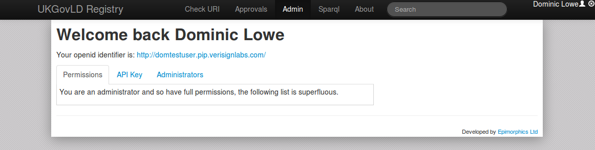
Log in is with OpenID

Slide 6
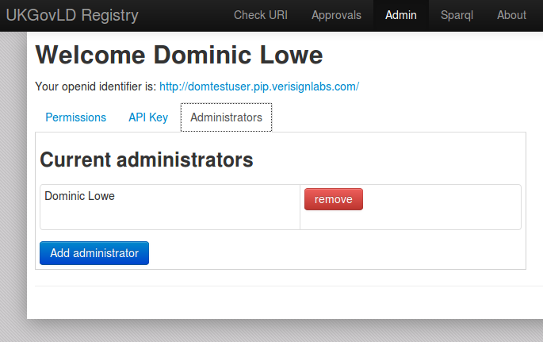
Permissions for different users

Slide 7
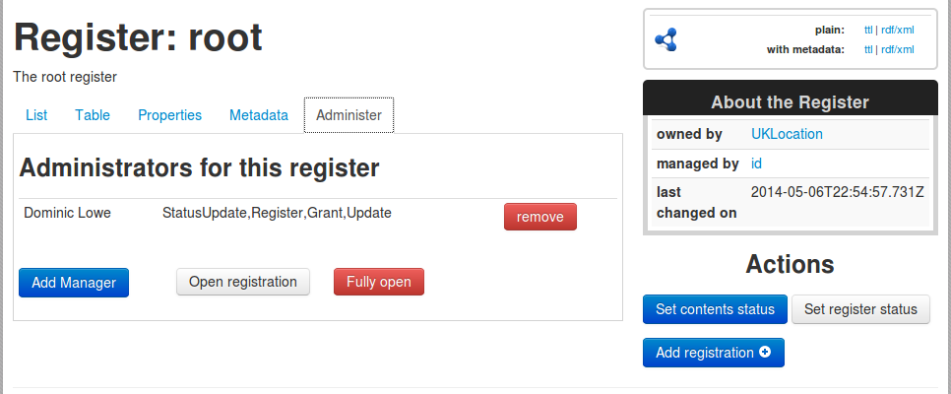
Permissions on a per-registry (vocabulary) basis

Slide 8
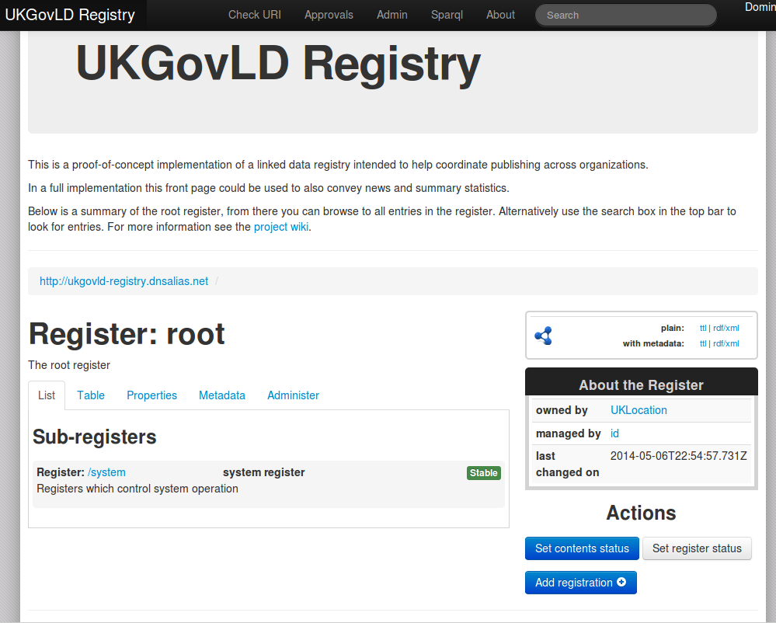
The default empty registry

Slide 9
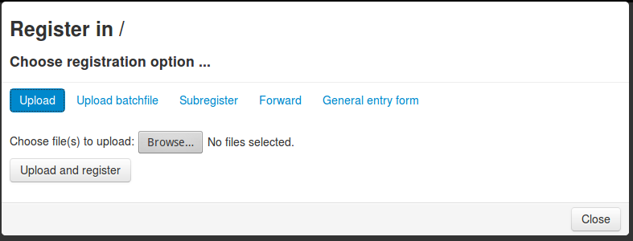
Upload new registry items (vocabularies or vocabulary terms) using RDF

Slide 10
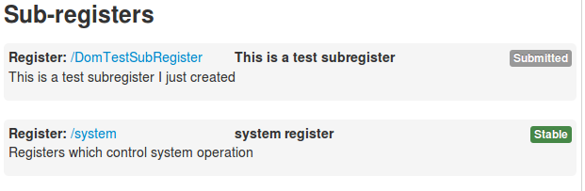
Status of items (as per 19135)

Slide 11
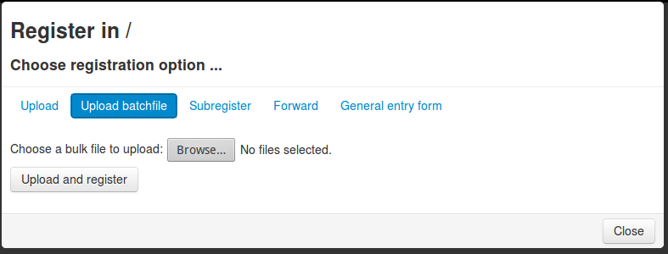
Function: Upload batchfile (??)

Slide 12
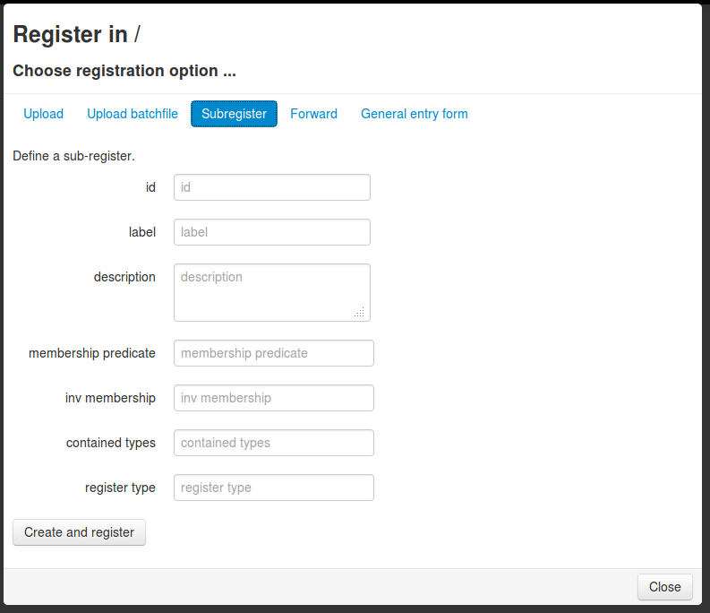
Function: Create a new (sub) register – I.e. a new vocabulary

Slide 13
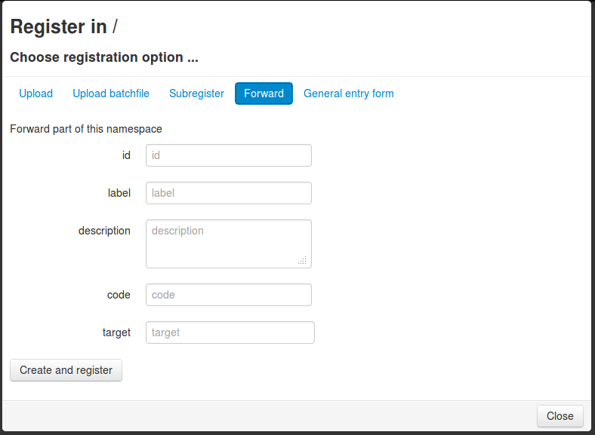
Function: URI forwarding (for managing vocabs from other domains)

Slide 14
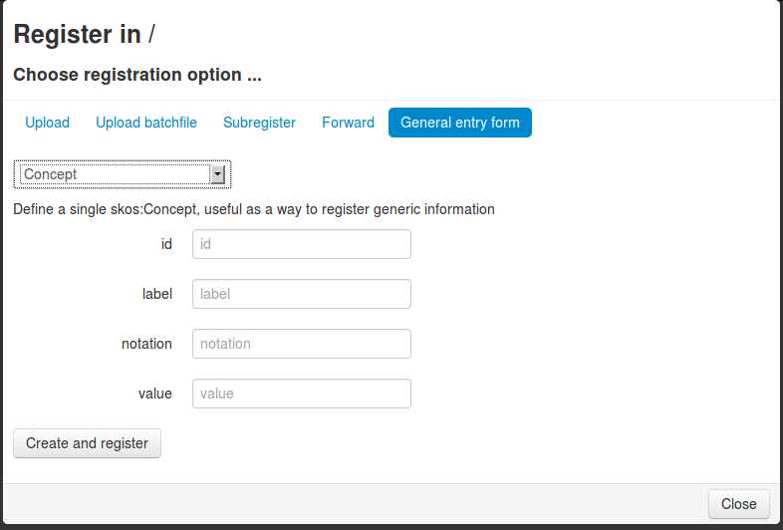
Function: Add a new vocabulary term (SKOS:Concept)

Slide 15
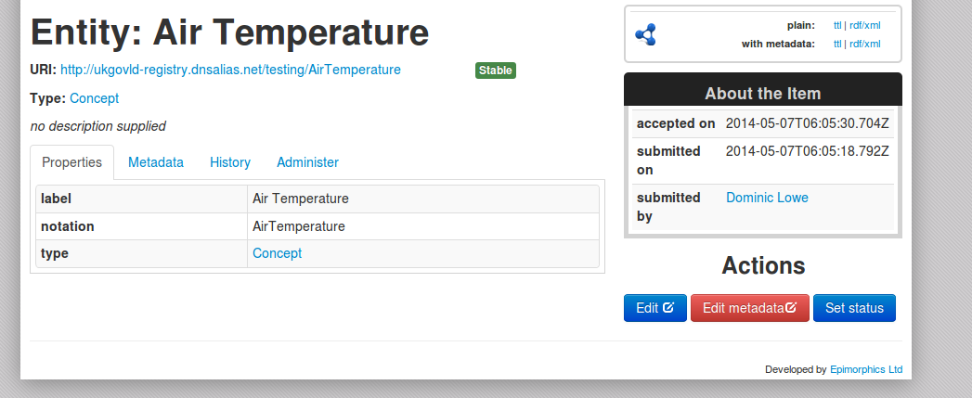
A single vocabulary term (SKOS Concept) with a defined URI.

Slide 16
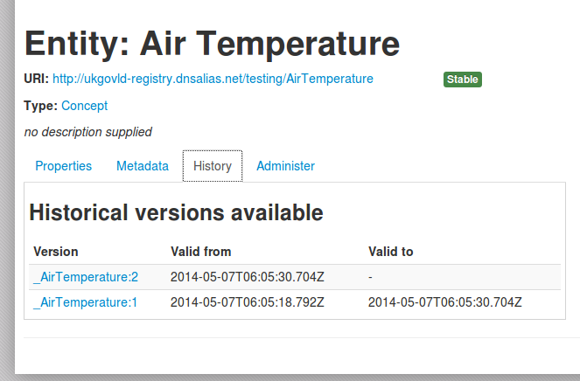
Historical versions of a definition

Slide 17
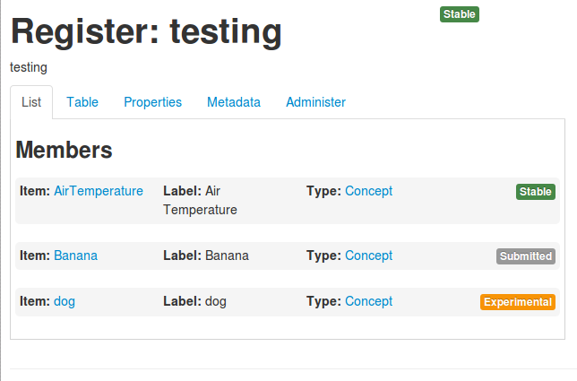
When logged in as admin: Can see all terms and status

Slide 18
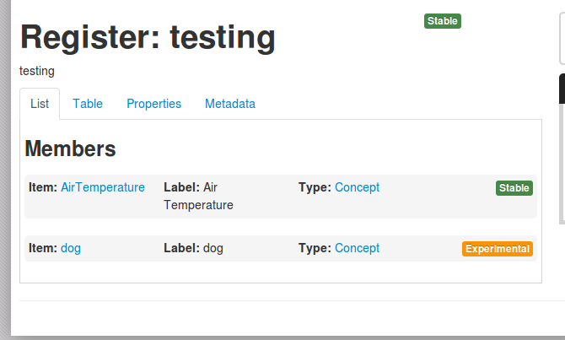
When logged out, only see published terms (no 'submitted')

Slide 19
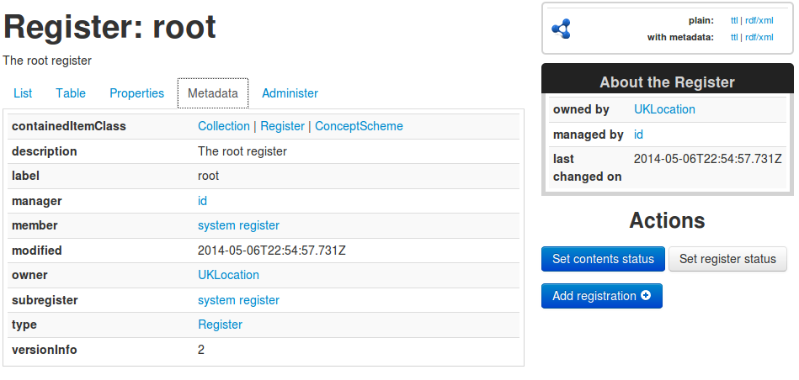
View metadata about vocbaulary

Slide 20
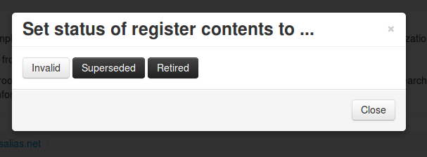
Deprecation/supersession (as per 19135)

Slide 21
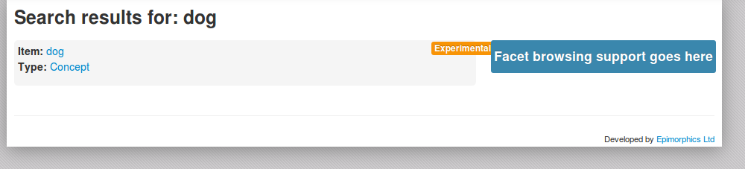
Free text search for terms

Slide 22
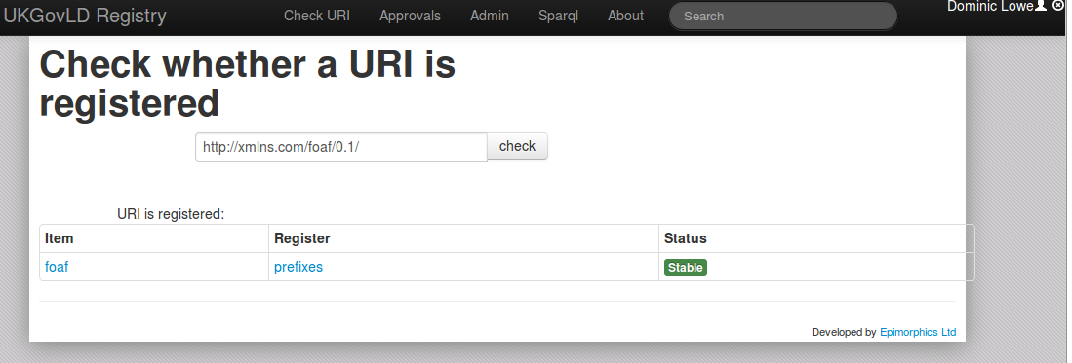
Check for URI

Slide 23
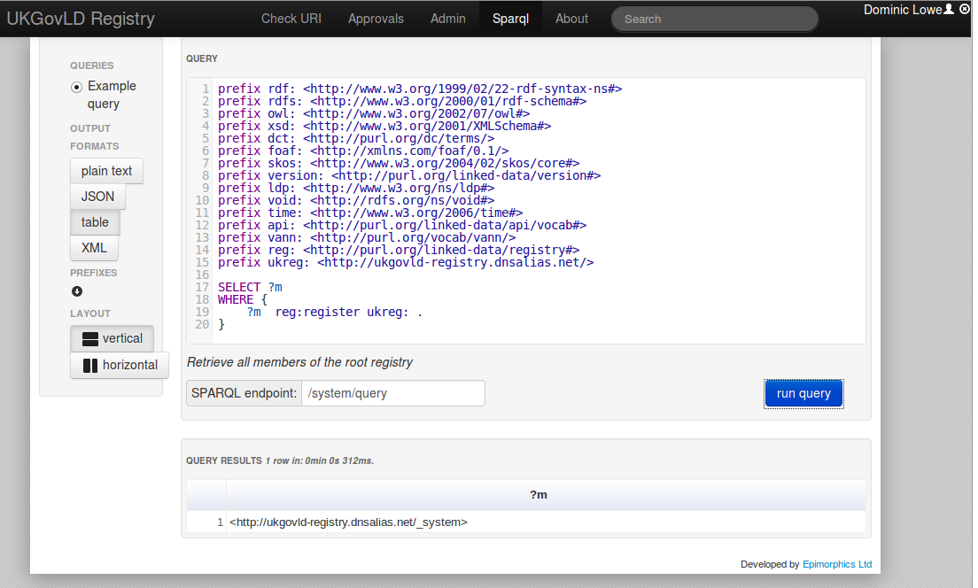
SPARQL query endpoint

Slide 24
Summary
Has potential. Probably on a par with SissVoc in terms of general maturity but more ambitious in terms of functionality.
Still 'prototype' but some key functionality is there
http://codes.wmo.int/
http://environment.data.gov.uk/registry
Is well tailored to publishing/managing vocabularies (19135 Register/Register items).
Has some benefits over SissVoc in terms of permissions and ease of use as well as being constructed around 19135 fundamentals.
Also namespace forwarding may be useful (don't know how it works yet)
Does not do full 19135 governance lifecycle yet (e.g. proposing terms etc) - we would have to do this out of band (e.g. Jira) or implement it.
Still some issues to investigate about best way to load and update bulk content.

