Slide 1
Resolution of Identity
Tianyuan Zhang
6/26/2020

Slide 2
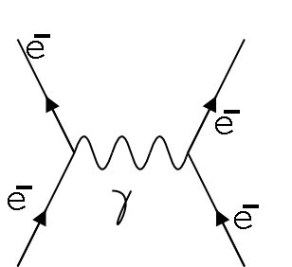
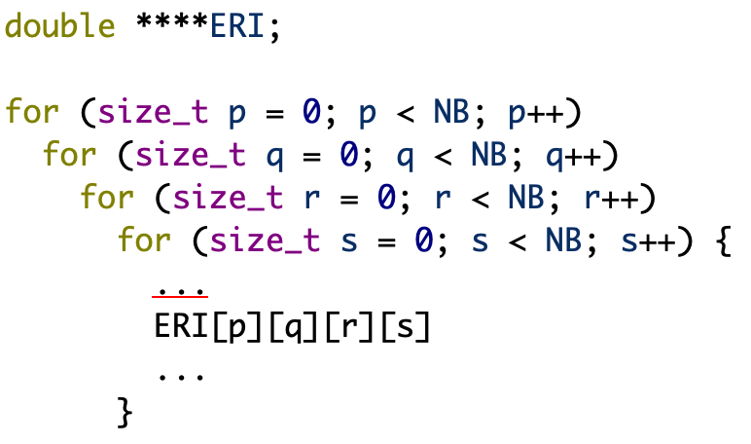
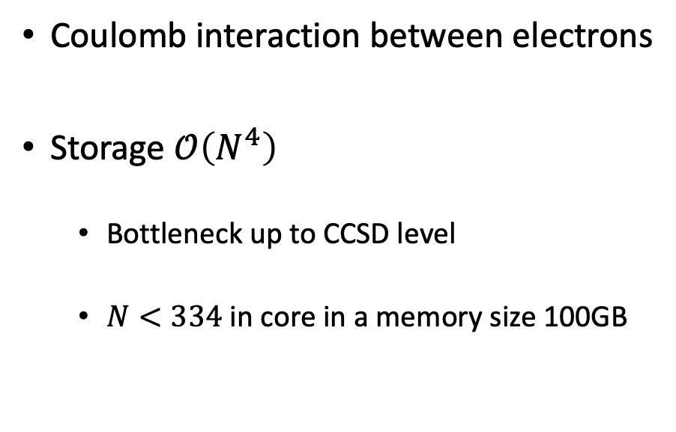
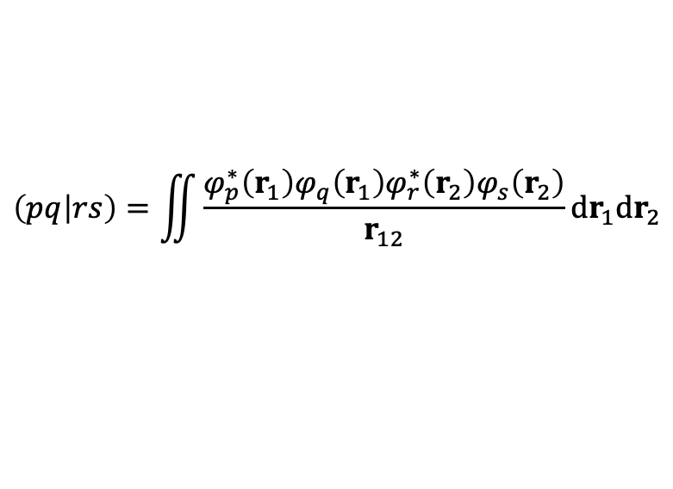
Electron repulsion integrals
$$\left(pq | rs\right)=\iint{\frac{φ_{p}^{∗}\left(r_{1}\right)φ_{q}\left(r_{1}\right)φ_{r}^{∗}\left(r_{2}\right)φ_{s}\left(r_{2}\right)}{r_{12}}dr_{1}dr_{2}}$$
Coulomb interaction between electrons
Storage $𝒪\left(N^{4}\right)$
Bottleneck up to CCSD level
$N<334$ in core in a memory size 100GB

Slide 3
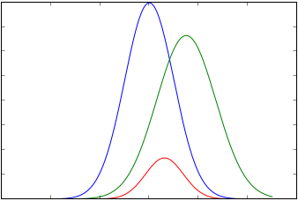
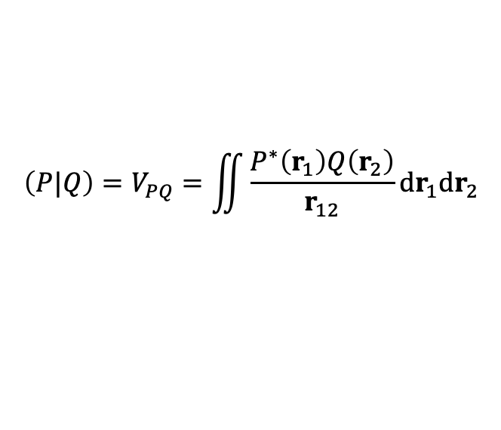
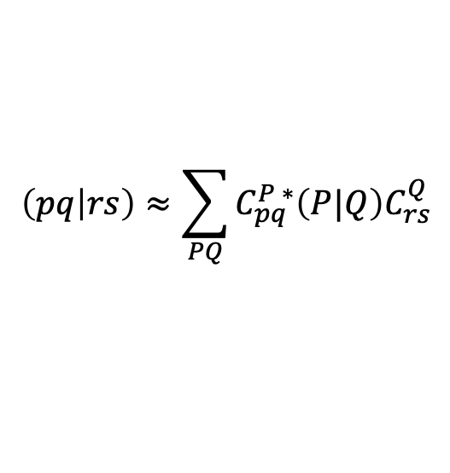

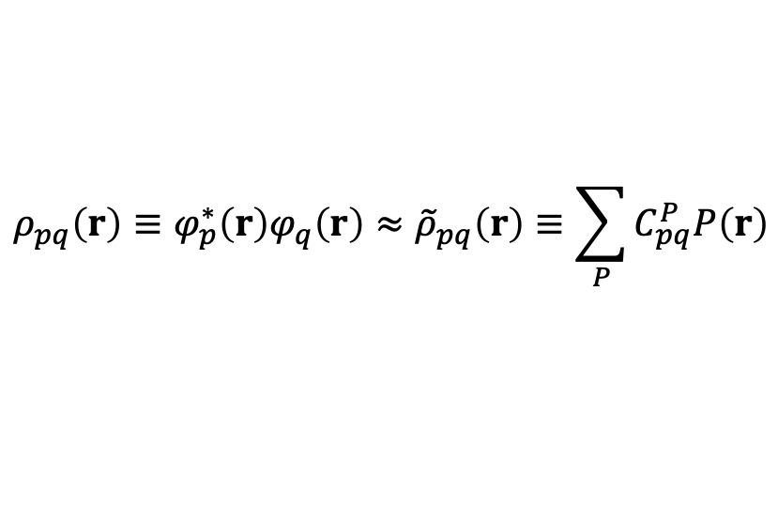
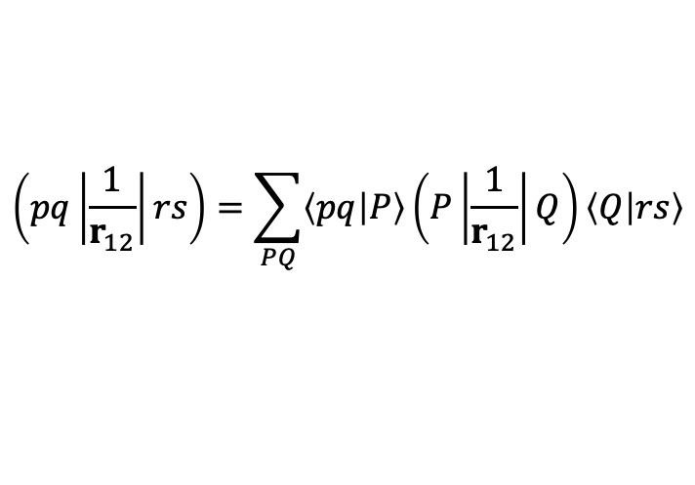

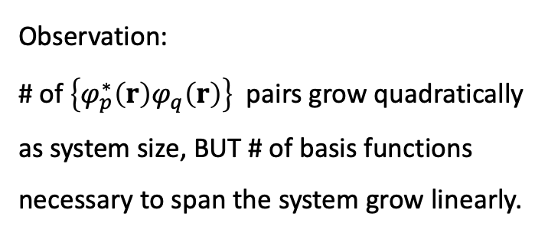
Resolution of identity $\sum_{P}{\left.|P\right\rangle \left\langle P|\right.}$
$$e^{−α{\left(r−R_{1}\right)}^{2}}e^{−β{\left(r−R_{2}\right)}^{2}}=c e^{−γ{\left(r−R_{3}\right)}^{2}}$$
$$\left(pq\left|\frac{1}{r_{12}}\right|rs\right)=\sum_{PQ}{\left\langle pq | P\right\rangle \left(P\left|\frac{1}{r_{12}}\right|Q\right)\left\langle Q | rs\right\rangle }$$
Represents
So
where
$$ρ_{pq}\left(r\right)≡φ_{p}^{∗}\left(r\right)φ_{q}\left(r\right)≈{\tilde{ρ}}_{pq}\left(r\right)≡\sum_{P}{C_{pq}^{P}P\left(r\right)}$$
$$\left(pq | rs\right)≈\sum_{PQ}{C_{pq}^{P ∗}\left(P|Q\right)C_{rs}^{Q}}$$
Observation:
# of $\left\{φ_{p}^{∗}\left(r\right)φ_{q}\left(r\right)\right\}$ pairs grow quadratically as system size, BUT # of basis functions necessary to span the system grow linearly.
$$\left(P|Q\right)=V_{PQ}=\iint{\frac{P^{∗}\left(r_{1}\right)Q\left(r_{2}\right)}{r_{12}}dr_{1}dr_{2}}$$
X. Ren et al 2012 New J. Phys. 14 053020

Slide 4
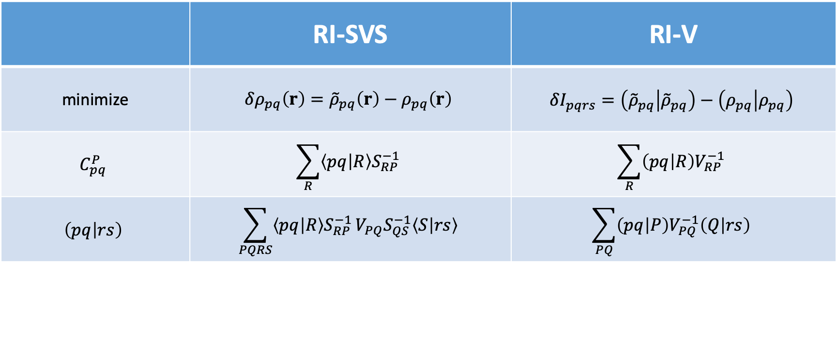

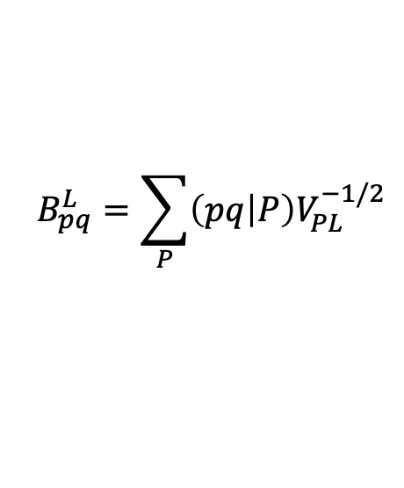
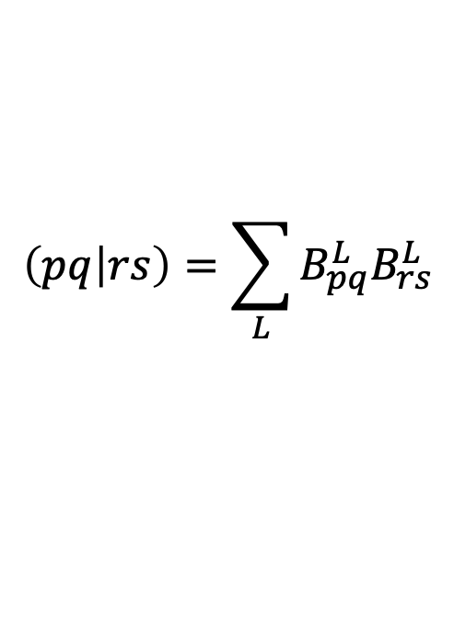
Determine $C_{pq}^{P}$ in $ρ_{pq}\left(r\right)≡φ_{p}^{∗}\left(r\right)φ_{q}\left(r\right)≈{\tilde{ρ}}_{pq}\left(r\right)≡\sum_{P}{C_{pq}^{P}P\left(r\right)}$
 | RI-SVS | RI-V
minimize | $$δρ_{pq}\left(r\right)={\tilde{ρ}}_{pq}\left(r\right)−ρ_{pq}\left(r\right)$$ | $$δI_{pqrs}=\left({\tilde{ρ}}_{pq} | {\tilde{ρ}}_{pq}\right)−\left(ρ_{pq} | ρ_{pq}\right)$$
$$C_{pq}^{P}$$ | $$\sum_{R}{\left\langle pq | R\right\rangle S_{RP}^{−1}}$$ | $$\sum_{R}{\left(pq | R\right)V_{RP}^{−1}}$$
$$\left(pq | rs\right)$$ | $$\sum_{PQRS}{\left\langle pq | R\right\rangle S_{RP}^{−1}}V_{PQ}S_{QS}^{−1}\left\langle S | rs\right\rangle$$ | $$\sum_{PQ}{\left(pq | P\right)V_{PQ}^{−1}\left(Q | rs\right)}$$
$$\left(pq | rs\right)=\sum_{L}{B_{pq}^{L}B_{rs}^{L}}$$
$$B_{pq}^{L}=\sum_{P}{\left(pq | P\right)V_{PL}^{−1/2}}$$
In de facto standard RI-V: , where
X. Ren et al 2012 New J. Phys. 14 053020

Slide 5
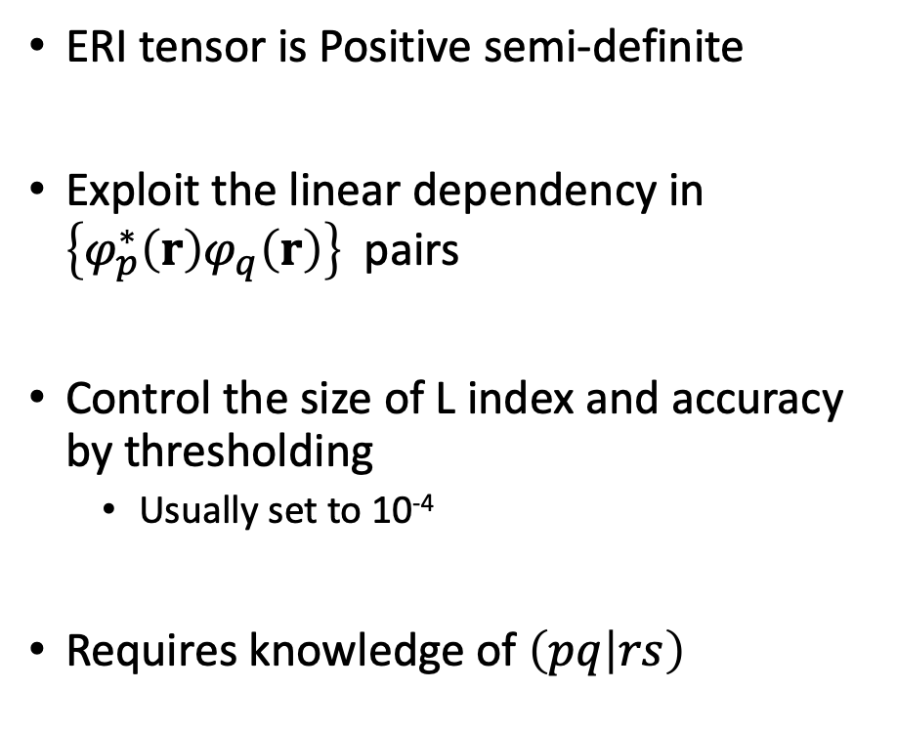

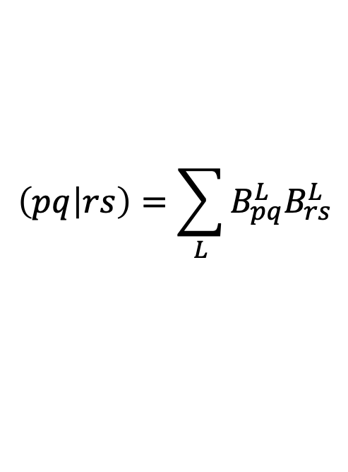
Cholesky decomposition $A=LL^{†}$
$$\left(pq | rs\right)=\sum_{L}{B_{pq}^{L}B_{rs}^{L}}$$
ERI tensor is Positive semi-definite
Exploit the linear dependency in $\left\{φ_{p}^{∗}\left(r\right)φ_{q}\left(r\right)\right\}$ pairs
Control the size of L index and accuracy by thresholding
Usually set to 10⁻⁴
Requires knowledge of $\left(pq | rs\right)$
rs
L
rs
L
$$≈$$
pq
pq
Pros
Does not require aux basis
Tunable accuracy
Cons
Less efficient in building B tensor
PES not contiguous

Slide 6
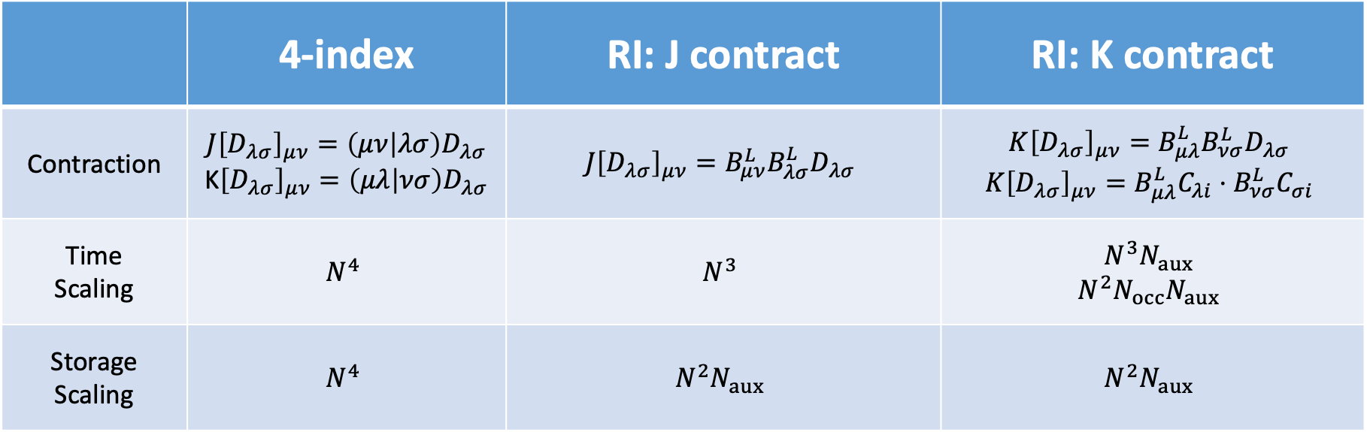
SingleSlater SCF: Comparable time, scaling reduced storage
 | 4-index | RI: J contract | RI: K contract
Contraction | $$J{\left[D_{λσ}\right]}_{μν}=\left(μν | λσ\right)D_{λσ}$$ K${\left[D_{λσ}\right]}_{μν}=\left(μλ | νσ\right)D_{λσ}$ | $$J{\left[D_{λσ}\right]}_{μν}=B_{μν}^{L}B_{λσ}^{L}D_{λσ}$$ | $$K{\left[D_{λσ}\right]}_{μν}=B_{μλ}^{L}B_{νσ}^{L}D_{λσ}$$ $$K{\left[D_{λσ}\right]}_{μν}=B_{μλ}^{L}C_{λi}⋅B_{νσ}^{L}C_{σi}$$
Time Scaling | $$N^{4}$$ | $$N^{3}$$ | $$N^{3}N_{aux}$$ $$N^{2}N_{occ}N_{aux}$$
Storage Scaling | $$N^{4}$$ | $$N^{2}N_{aux}$$ | $$N^{2}N_{aux}$$

Slide 7
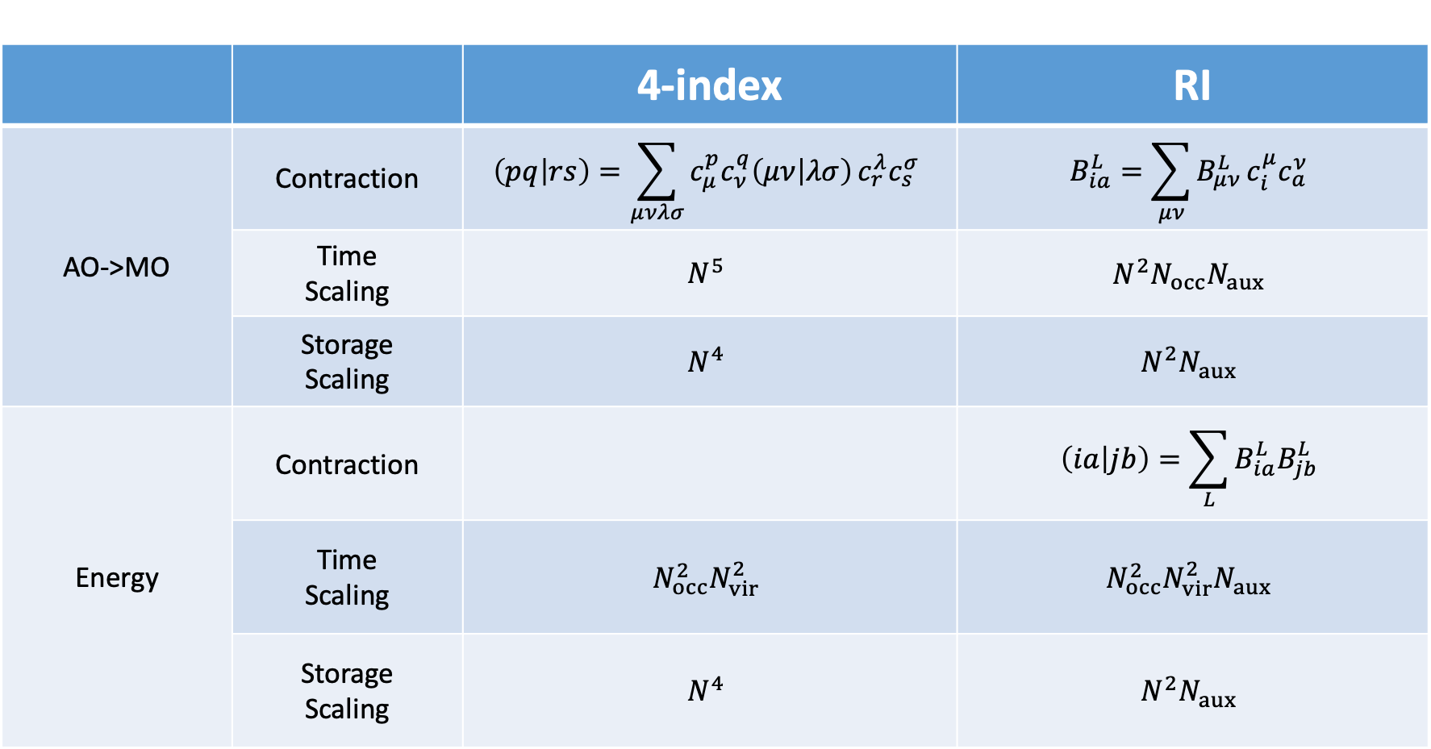
MP2: Prefactor reduced time, scaling reduced storage
 |  | 4-index | RI
AO->MO | Contraction | $$\left(pq | rs\right)=\sum_{μνλσ}{c_{μ}^{p}c_{ν}^{q}\left(μν | λσ\right)}c_{r}^{λ}c_{s}^{σ}$$ | $$B_{ia}^{L}=\sum_{μν}{B_{μν}^{L}}c_{i}^{μ}c_{a}^{ν}$$
 | Time Scaling | $$N^{5}$$ | $$N^{2}N_{occ}N_{aux}$$
 | Storage Scaling | $$N^{4}$$ | $$N^{2}N_{aux}$$
Energy | Contraction |  | $$\left(ia | jb\right)=\sum_{L}{B_{ia}^{L}B_{jb}^{L}}$$
 | Time Scaling | $$N_{occ}^{2}N_{vir}^{2}$$ | $$N_{occ}^{2}N_{vir}^{2}N_{aux}$$
 | Storage Scaling | $$N^{4}$$ | $$N^{2}N_{aux}$$

Slide 8
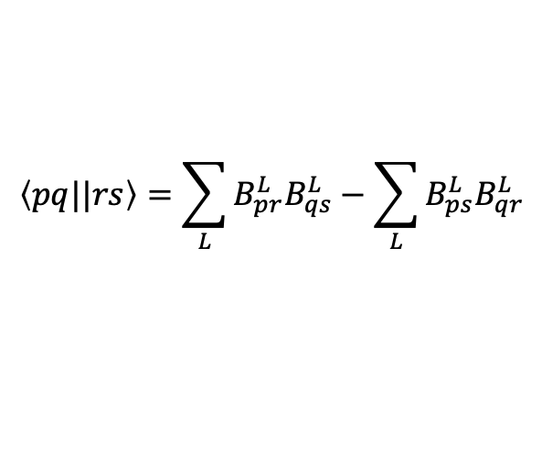
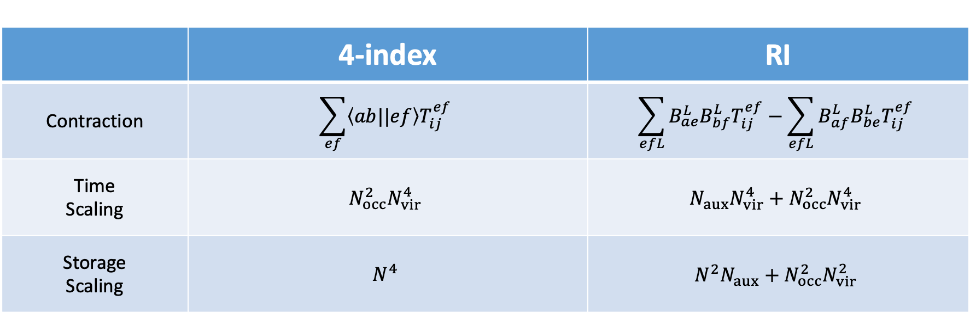
CCSD: Prefactor increased time, prefactor reduced storage
$$\left\langle pq||rs\right\rangle =\sum_{L}{B_{pr}^{L}B_{qs}^{L}}−\sum_{L}{B_{ps}^{L}B_{qr}^{L}}$$
 | 4-index | RI
Contraction | $$\sum_{ef}{\left\langle ab||ef\right\rangle T_{ij}^{ef}}$$ | $$\sum_{efL}{B_{ae}^{L}B_{bf}^{L}T_{ij}^{ef}}−\sum_{efL}{B_{af}^{L}B_{be}^{L}T_{ij}^{ef}}$$
Time Scaling | $$N_{occ}^{2}N_{vir}^{4}$$ | $$N_{aux}N_{vir}^{4}+N_{occ}^{2}N_{vir}^{4}$$
Storage Scaling | $$N^{4}$$ | $$N^{2}N_{aux}+N_{occ}^{2}N_{vir}^{2}$$

Slide 9

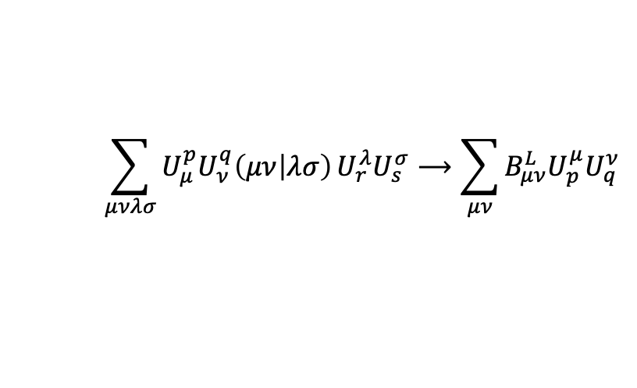
Conclusion
RI is ideal to reduce storage.
Reduced scaling orbital transformation
X2C RI-ERI
Usually does not save time in the presence of exchange and antisymmetrized ERI.
$$\sum_{μνλσ}{U_{μ}^{p}U_{ν}^{q}\left(μν | λσ\right)}U_{r}^{λ}U_{s}^{σ}⟶\sum_{μν}{B_{μν}^{L}U_{p}^{μ}U_{q}^{ν}}$$
rs
L
rs
L
$$≈$$
pq
pq

Slide 10
Thanks!

