Slide 1
CD
07/27/2021

Slide 2
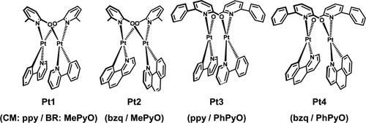
Alexis/Valentine Paper

Slide 3
TASKS
Compile CQ on klone
UF4 NIST
Alexis/Valentine Pt dimer structure
Run jobs (libcint vs. libint seg contracted)
Team Viewer

