Slide 1







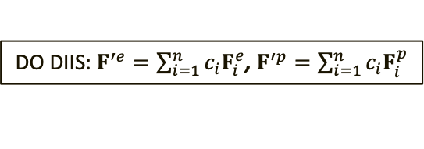









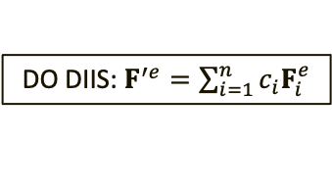
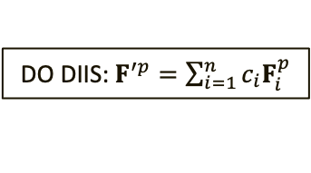
(A)
GENERATE INITIAL GUESS $P^{e}$and $P^{p}$
(B)
GENERATE INITIAL GUESS $P^{e}$and $P^{p}$
FORM $F^{e}$ from $P^{e}$and $P^{p}$
DO DIIS:$F^{′e}=\sum_{i=1}^{n}{c_{i}F_{i}^{e}}$
FORM $F^{e}$ and $F^{p}$ from $P^{e}$and $P^{p}$
ELECTRONIC SCF
DIAGONALIZE $F^{′e}$
No
FORM NEW $P^{e}$
DO DIIS:$F^{′e}=\sum_{i=1}^{n}{c_{i}F_{i}^{e}}$, $F^{′p}=\sum_{i=1}^{n}{c_{i}F_{i}^{p}}$
CHECK if $P^{e}$ is CONVERGED
DIAGONALIZE $F^{′e}$
DIAGONALIZE $F^{′p}$
Yes
No
FORM $F^{p}$from $P^{p}$ and $P^{e}$
No
FORM NEW $P^{e}$
FORM NEW $P^{p}$
DO DIIS: $F^{′p}=\sum_{i=1}^{n}{c_{i}F_{i}^{p}}$
No
PROTONIC
SCF
No
DIAGONALIZE $F^{′p}$
FORM NEW $P^{p}$
CHECK if both $P^{e}$ and $P^{p}$ are CONVERGED
CHECK if $P^{p}$ is CONVERGED
Yes
CHECK if the TOTAL ENERGY is CONVERGED
CHECK if TOTAL ENERGY is CONVERGED
Yes
Yes
END
END

Slide 2


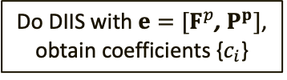






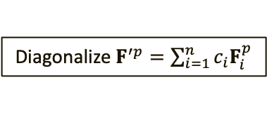

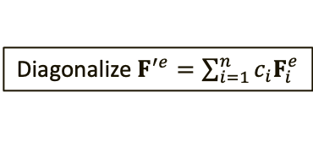
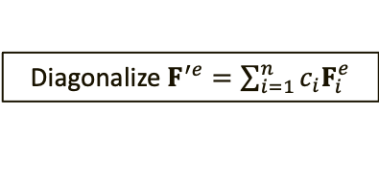
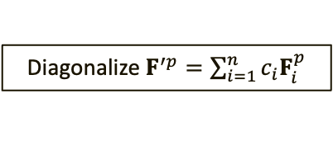

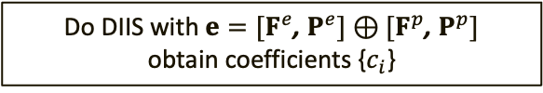

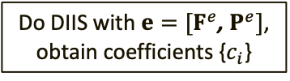

(A)
Generate initial guess $P^{e}$and $P^{p}$
(B)
Generate initial guess $P^{e}$and $P^{p}$
Form $F^{e}$ from $P^{e}$and $P^{p}$
Do DIIS with $e=[F^{e}$, $P^{e}]$, obtain coefficients {$c_{i}$}
Form $F^{e}$ and $F^{p}$ from $P^{e}$and $P^{p}$
Electronic SCF
Diagonalize $F^{′e}=\sum_{i=1}^{n}{c_{i}F_{i}^{e}}$
NO
Do DIIS with $e=[F^{e}$, $P^{e}]⊕[F^{p}\text{,} P^{p}]$
obtain coefficients {$c_{i}$}
Form new$P^{e}$
Check if $P^{e}$ is converged
NO
YES
NO
Diagonalize $F^{′e}=\sum_{i=1}^{n}{c_{i}F_{i}^{e}}$
Diagonalize $F^{′p}=\sum_{i=1}^{n}{c_{i}F_{i}^{p}}$
Form $F^{p}$ from $P^{p}$and $P^{e}$
NO
Do DIIS with $e=[F^{p}$, $P^{p}]$, obtain coefficients {$c_{i}$}
Form new $P^{e}$
Form new $P^{p}$
Protonic
SCF
NO
Diagonalize $F^{′p}=\sum_{i=1}^{n}{c_{i}F_{i}^{p}}$
Form new $P^{p}$
Check if both $P^{e}$ and $P^{p}$ are converged
Check if $P^{p}$ is converged
YES
Check if total energy is converged
Check if total energy is converged
YES
YES
END
END

Slide 3


(A)
Generate Initial Guess P^{e} and P^{p}
(B)
Generate Initial Guess P^{e} and P^{p}
Form F^{e} from P^{e} and P^{p}
Do DIIS:
Electronic
SCF
Form F^{e}$⊕$F^{p} from P^{e} and P^{p}
No
Form new P^{e}
Check if P^{e} is Converged
Diagonalize F^{e}$⊕$F^{p}
Diagonalize F^{e}
Yes
No
No
No
Form F^{p} from P^{e} and P^{p}
Form new P^{e}
Form new P^{p}
Protonic
SCF
Diagonalize F^{p}
No
Form new P^{p}
Check if both P^{e} and P^{p} are Converged
Check if P^{p} is Converged
Yes
Check if the total Energy is Converged
Check if total Energy is Converged
Yes
Yes
End
End

