Slide 1
Update on NEO-DIIS
11/03/2021

Slide 2
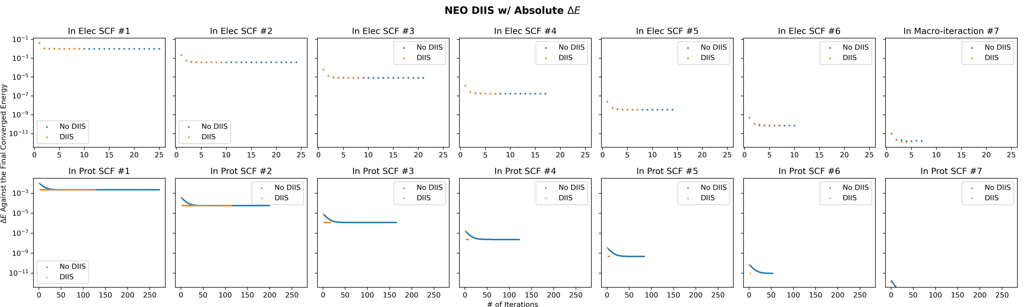
Stepwise DIIS Has Been Implemented

Slide 3
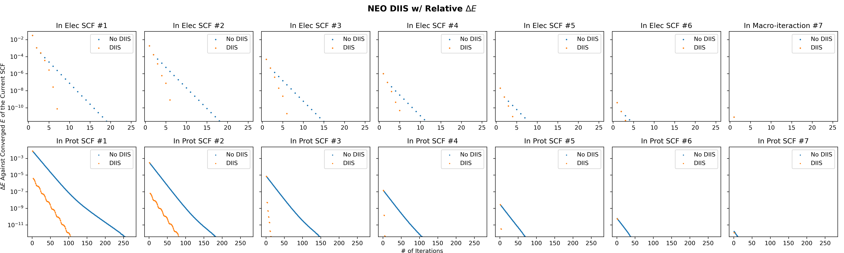
Stepwise DIIS Has Been Implemented

Slide 4
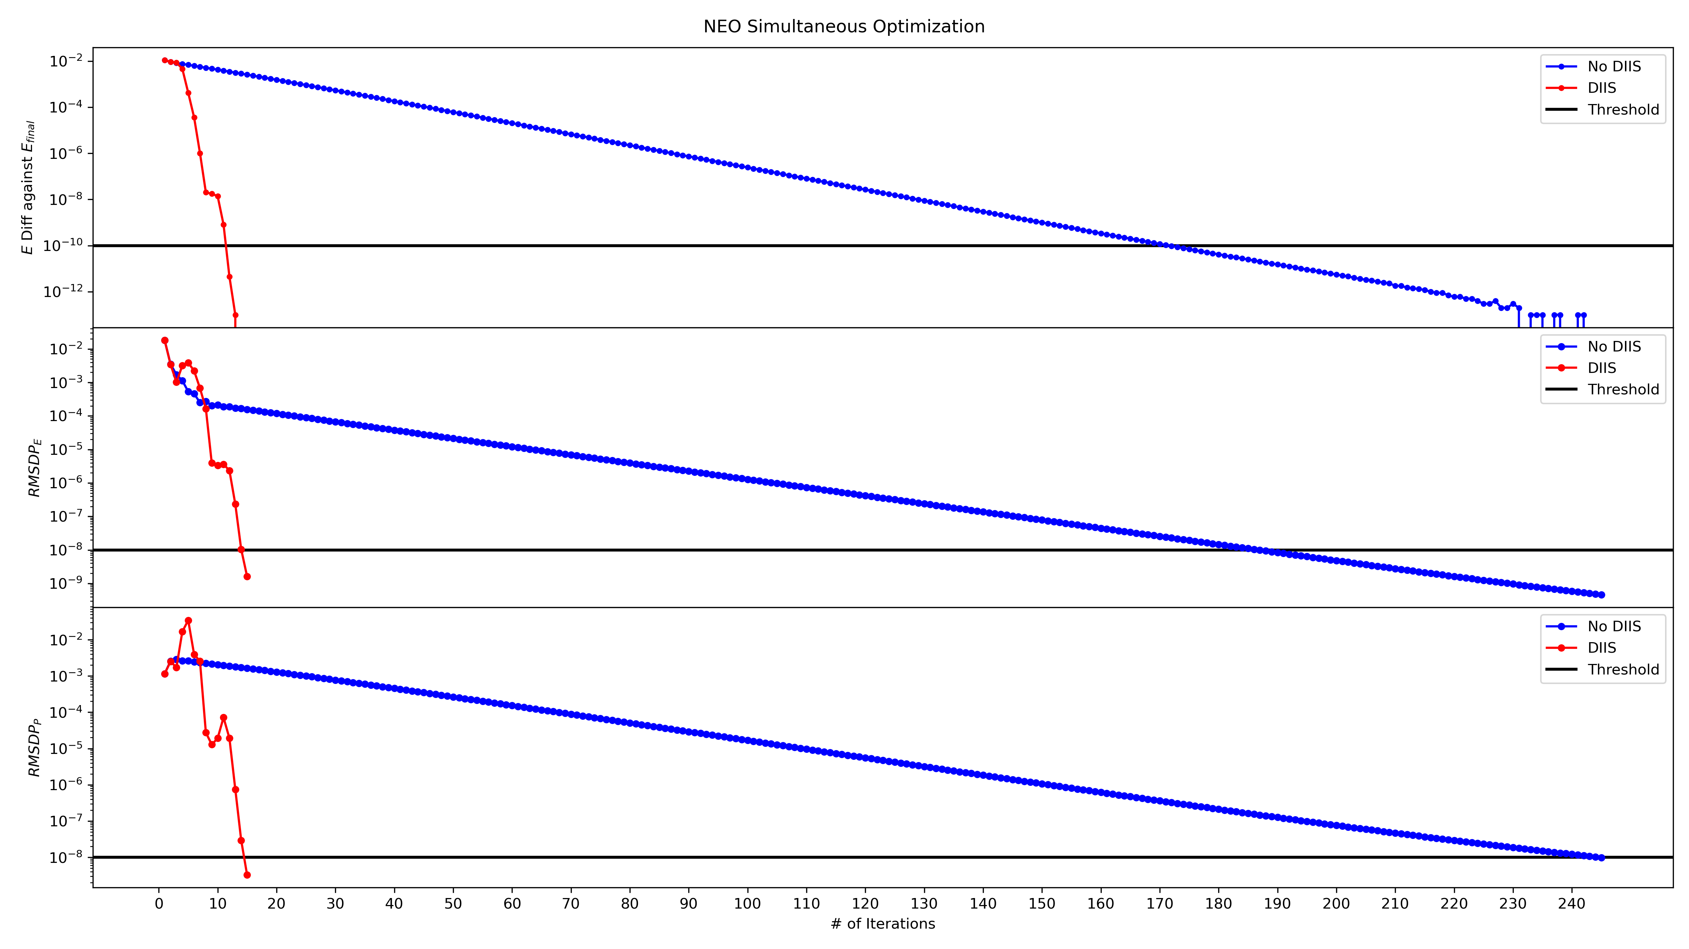
Simultaneous DIIS Has Been Implemented

Slide 5
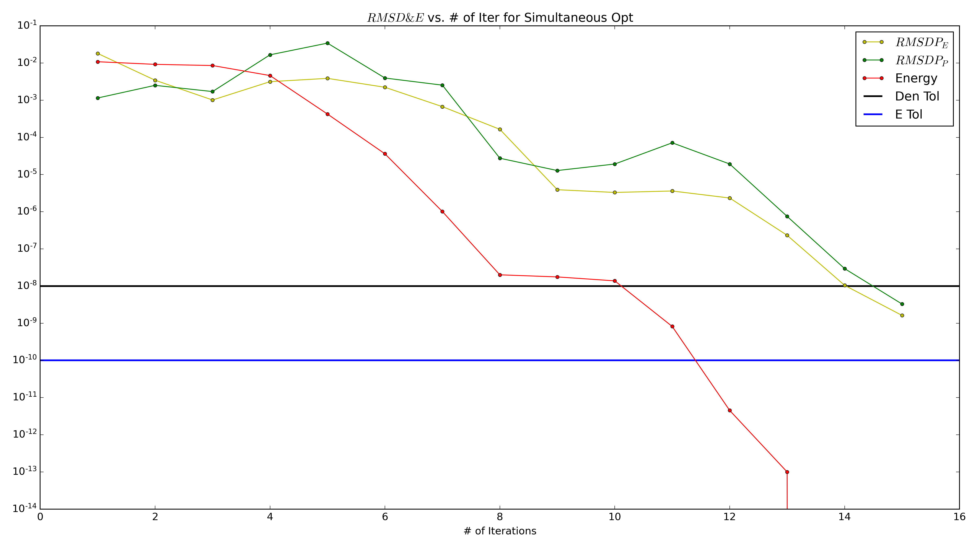
Simultaneous DIIS Has Been Implemented

Slide 6
Quick Summary
Stepwise, No DIIS: 1051 Fock Formations
Stepwise, DIIS: 340 Fock Formations
Simultaneous, No DIIS: 254 Fock Formations
Simultaneous, DIIS: 16 Fock Formations

