Slide 1
Updates on Simulteneous NEO-SCF
06/22/2022

Slide 2
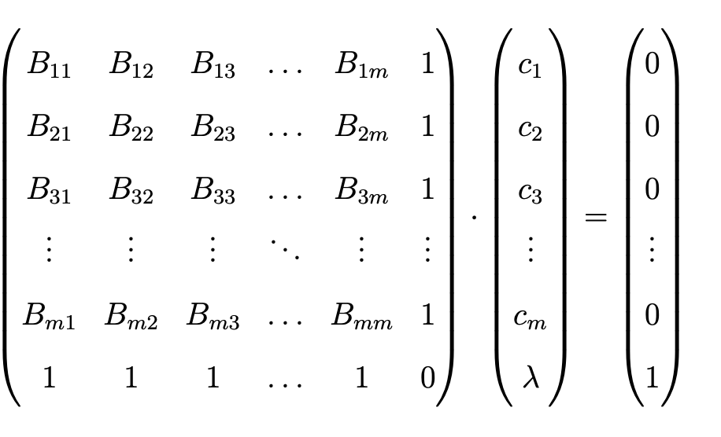
Strange behavior in STW algorithm has been fixed
The oscillation behavior was caused by gaussian’s threshold of extrapolation coefficient (obtained from B-matrix inversion). Once we increase the threshold, the SCF profile looks normal.

Slide 3
SCF Profile for COH2:
Comparison against Q-chem:
Started with the same guess
Two codes can match up very well

Slide 5
Strange behavior in STW algorithm has been fixed
The oscillation behavior was caused by gaussian’s threshold of extrapolation coefficient (obtained from B-matrix inversion). Once we increase the threshold, the SCF profile looks normal.
Started doing benchmarking calculations to show the results
Recreated figure 4 and 5 of the paper (bar plots comparing two algorithm)
Figure 4 is for small test systems
Figure 5 is for 4H2O+ (all protons quantum)

Slide 6
Now the acceleration is less obvious
Figure 4 Before fixing the bug:
Figure 4 After fixing the bug:

Slide 7
Now the acceleration is less obvious
Figure 5 Before fixing the bug:
Figure 5 After fixing the bug:

Slide 8
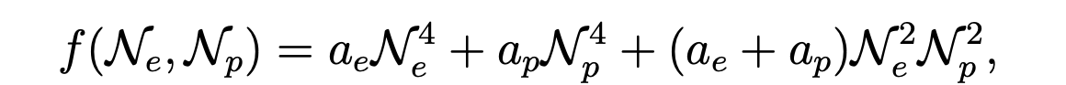
Observation:
Previously, we report an average saving of ~80%. Now it’s 20-30%.
However, the way we define savings is by the ratio of theoretical computational cost, which is calculated as:
N_{e}/N_{p} is # of elec/prot basis functions,
a_{e} /a_{p} is # of elec/prot fock builds
Simultaneous algorithm converges protonic system faster, and reduces the total number of SCF iterations by ~80%. However, with our current test cases, the electronic basis size is a lot bigger, so the Ne^4 term is very predominant, which causes the saving to be small.

Slide 9
So we test more basis set combinations
In order to truly capture the saving of simultaneous algorithm, we tested our different basis set combinations to see if basis size plays a factor
We ran calculations on protonated water tetramer 4H2O+
We tested the following structures and basis set:
structures = ['eigen','ring','zundel','tzundel’]
elec_basis_pool = ['3-21g','6-31g','4-31g','6-311g','6-311g(d,p)','cc-pvdz','cc-pvtz','cc-pvqz','def2svp','def2tzvp','def2qzvp’]
prot_basis_pool = ['protsp','pb4d','pb4f1','pb4f2','pb5d']

Slide 10
Result:
We know from experience that the protonic system is generally harder to converge. And simultaneous optimization can help converge protonic faster.
Therefore, as one would expect, when protonic basis gets larger, and the protonic basis size gets more comparable to electronic basis size, we see a better saving vs the traditional stepwise optimization

Slide 11
Zoom in on lower left:
The lower left part of the last slide was strange, so we zoom in to see what’s going on
I labeled ‘first letter of the structure | electronic basis | protonic basis’ on the graph
It seems like the random trend on the lower left was caused by prot-sp basis, combining with very large electronic basis set. I suggest we remove prot-sp data to see the trend clearer.

Slide 12
Result (removing prot-sp basis)

Slide 13
Other ways to present data
Figure 4 After fixing the bug:
As we saw from the benchmarking results, Figure 4&5 can not properly show the acceleration.
They only show the savings for certain chosen basis sets, and cannot paint the whole picture
We can generate 2D plots to clearly show that the computational cost saving depends on basis set size
Figure 5 After fixing the bug:

Slide 14
COH2 2D Plot
Previously we were only showing the circle data.

Slide 15
HCN 2D Plot

Slide 16
4H2O+ 2D plot
Eigen
Ring
cis-Zundel
trans-Zundel

