Slide 1
Literature Review: The potential for machine learning in hybrid QM/MM calculations

Slide 2
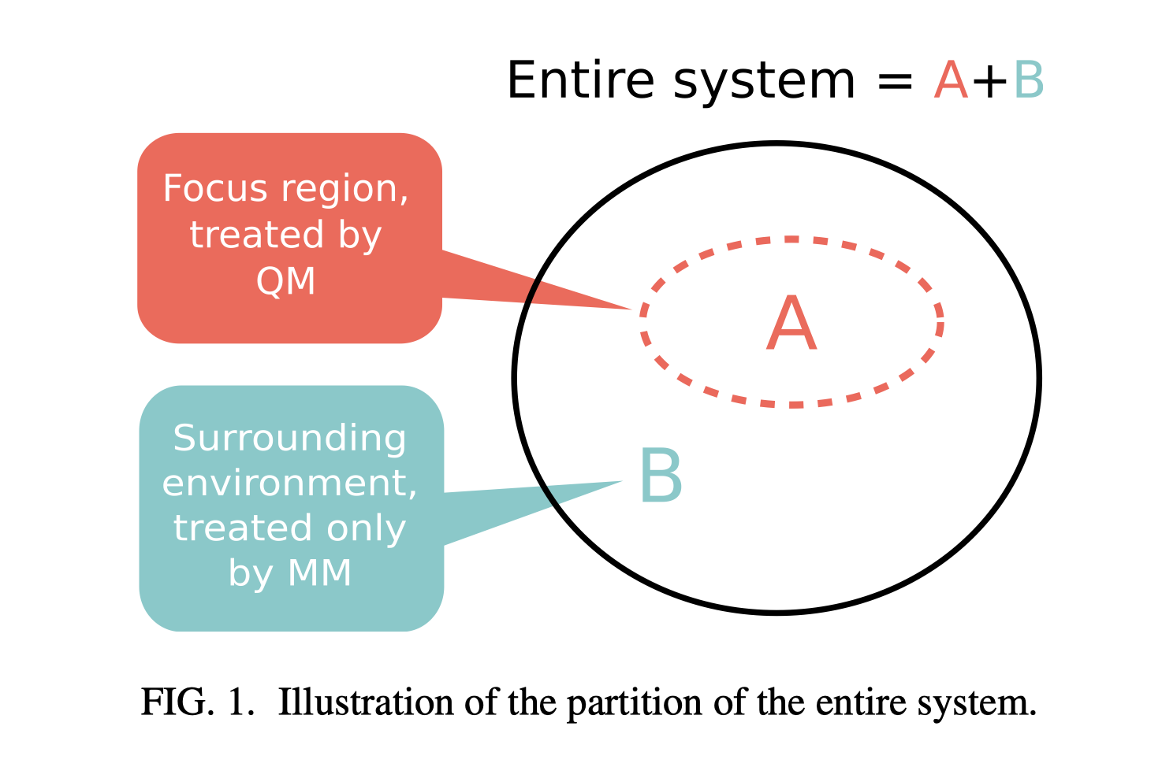
Brief Intro to QM/MM
Two Schemes For QM/MM:
Additive Scheme:
Let MM do the work of coupling
Subtractive Scheme:

Slide 3
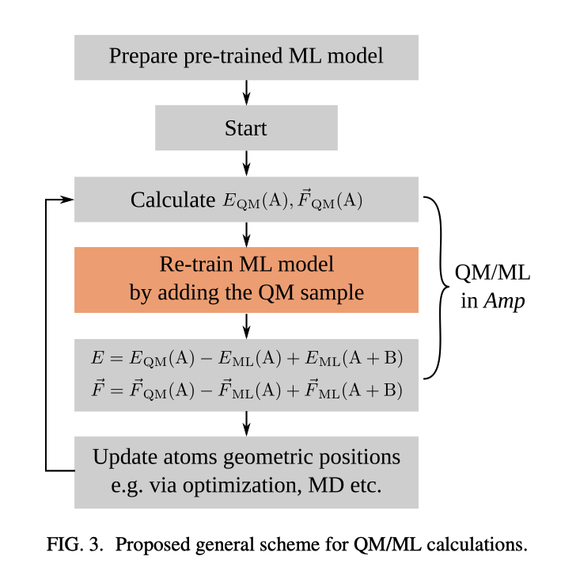
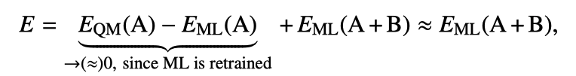
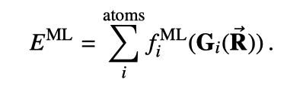
Proposed Scheme for QM/ML Calculations
Subtractive Scheme:
Replace MM with ML
atom-centered feature vectors
Gaussian descriptors
Learn the form of f via ML
Neural network is used
Perturb the geometry in QM region, then perform structure optimization
Notes:
provide a “ﬁngerprint” of each atom i’s local environment. Importantly, these feature vectors are designed to be rotationally, translationally, and permutationally invariant.
Threshold: the energy RMSE was less than 0.001 eV/atom
(Behler–Parrinello scheme): Radial symmetry functions are constructed as a sum of Gaussians with the parameters 􏰃 and Rs
Angular terms are constructed for all triplets of atoms by summing the cosine values of the angles

Slide 4
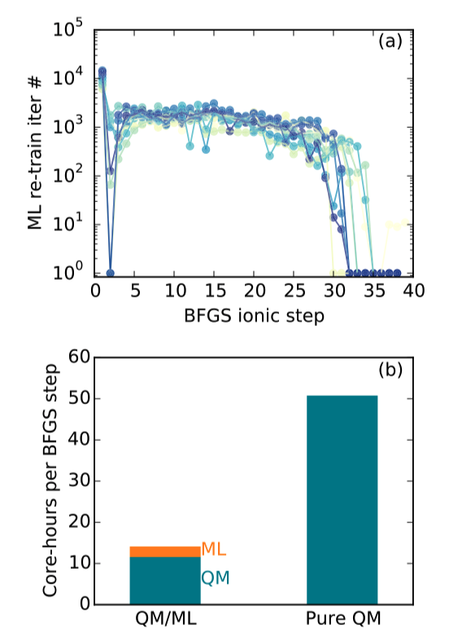
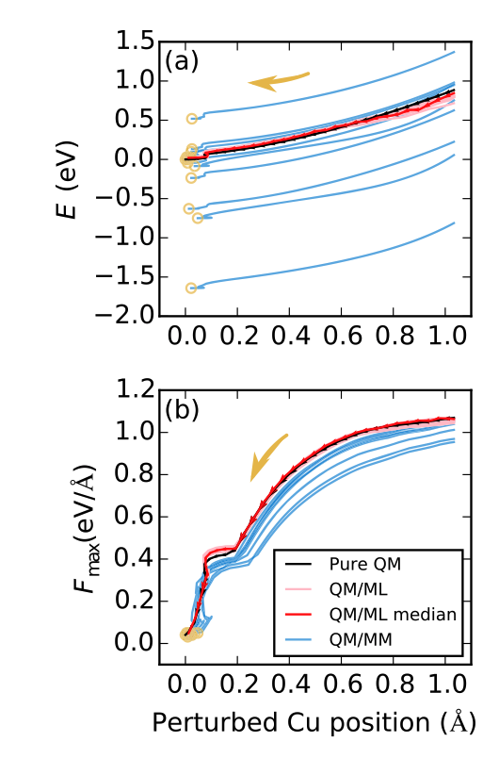
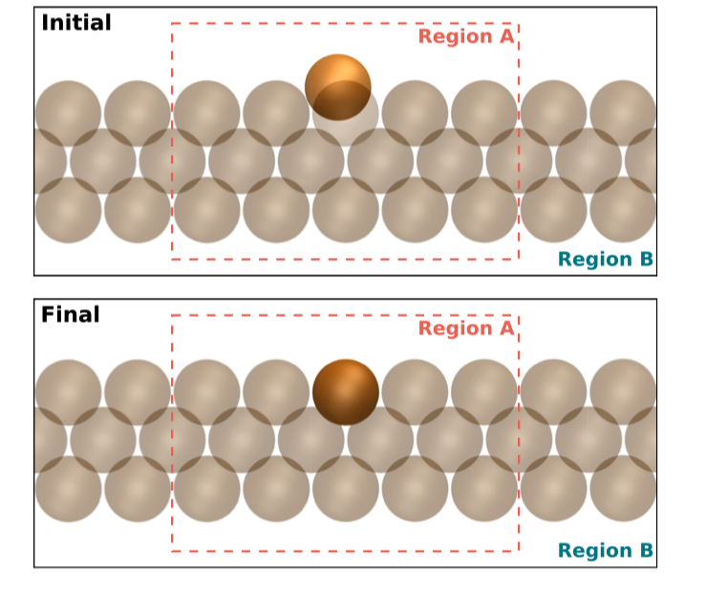
Results from The Illustrative Example
Computational cost of re-Training
QM/ML: with retraining scheme
Structure of the Cu(100) surface with one top layer atoms pulled up:
QM/MM: without retraining scheme
Notes:
provide a “ﬁngerprint” of each atom i’s local environment. Importantly, these feature vectors are designed to be rotationally, translationally, and permutationally invariant.
Threshold: the energy RMSE was less than 0.001 eV/atom
(Behler–Parrinello scheme)

Slide 5
Critical Evaluations
Advantages:
Avoid finding MM potentials
Avoid mismatch between QM and MM descriptors
Allows for adaptive QM/MM
No need for substantial amount of training data
However:
How to ensure region A contains all the geometry in region B?
Long-range correction not being added
Examples shown are rather simple

Slide 6
Future Directions
Use other ways to sample the geometries in the QM region (transition state search, MD)
Change the descriptor so that they can describe other properties other than just energy (for example: Löwdin population analysis)
Notes:
provide a “ﬁngerprint” of each atom i’s local environment. Importantly, these feature vectors are designed to be rotationally, translationally, and permutationally invariant.
Threshold: the energy RMSE was less than 0.001 eV/atom
(Behler–Parrinello scheme)

Slide 7
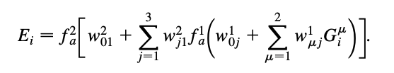

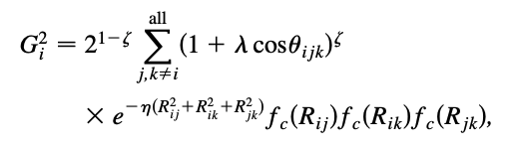
Behler-Parrinello Scheme
Notes:
(Behler–Parrinello scheme): Radial symmetry functions are constructed as a sum of Gaussians with the parameters 􏰃 and Rs
Angular terms are constructed for all triplets of atoms by summing the cosine values of the angles

