Slide 1
NEO-SubGroup
08/19/2022

Slide 2
Changes to the code:
Changed the order of SCF steps, so that we trace current Fock matrix with the density that gives rise to the Fock
Added orthogonalization code that can produce the same transformation matrix as gaussian (X = C s^-1/2 ), not used

Slide 3
Small basis, water, exact same guess, no DIIS
Energy Comparison Step by Step
Energy Difference Step by Step

Slide 4
Still have issues:
For systems with large protonic basis, CQ still converges to a wrong energy
for example, COH2 with 321g (22 basis fxns) and pb4d (46 basis fxns) basis set)
But systems with larger electronic basis than protonic basis converge just fine
So I changed the initial protonic guess to match gaussian
Previously CQ uses COREGUESS for protons
Now it uses TIGHTGUESS

Slide 5
321g/pb4d, coh2, CDIIS comparison

Slide 6
Then I ran more tests to benchmark
Previously
Current

Slide 7
Testing all DIIS algorithms in CQ
CDIIS
EDIIS
CEDIIS

Slide 8
# of SCF Iterations
Colorbar represents # of CQ iterations - # of Gaussian iterations
CDIIS
EDIIS
CEDIIS

Slide 9
Benchmarking RT and DFT

Slide 10
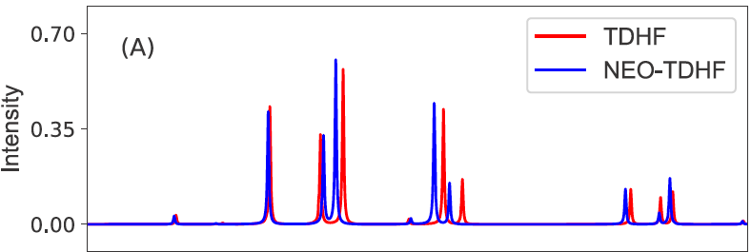
HCN, cc-pVDZ, 8s8p8d, HF

